Slide 1









人 教 PEP 版 英 语 五 年 级 下 册
Unit 2
My favourite season
Part B & Part C
Read and write—Story time

Slide 2

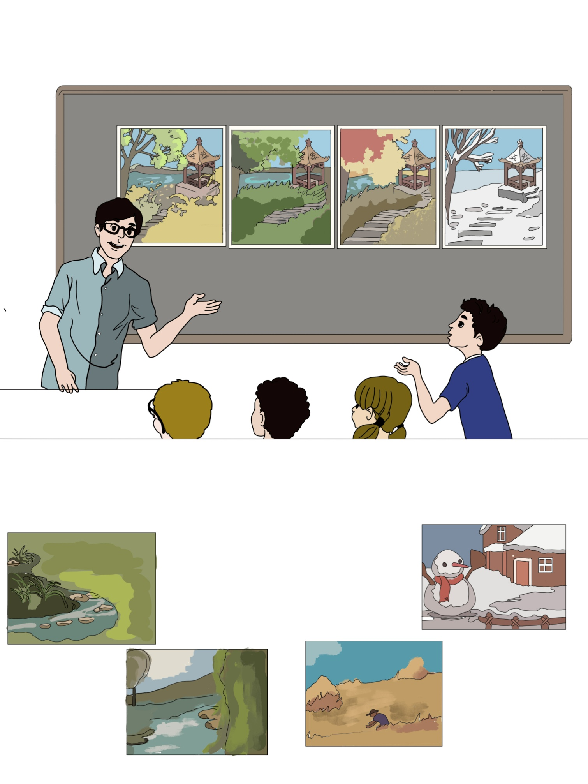
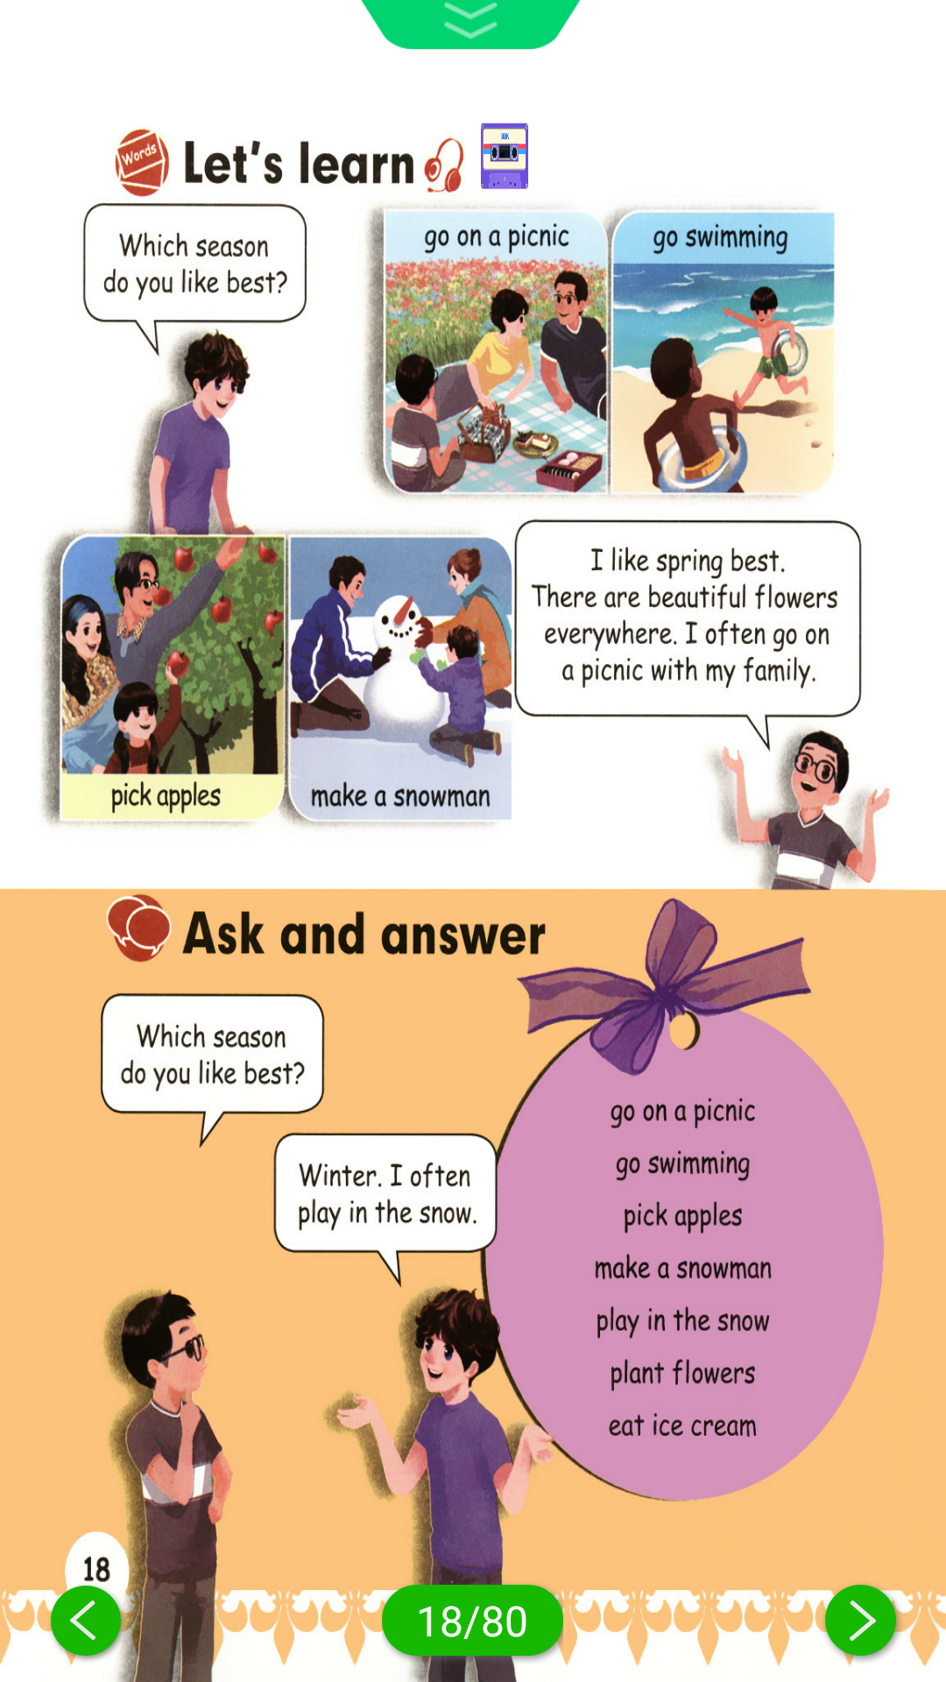
Warm up
Speak the English words according to the picture.

Slide 3

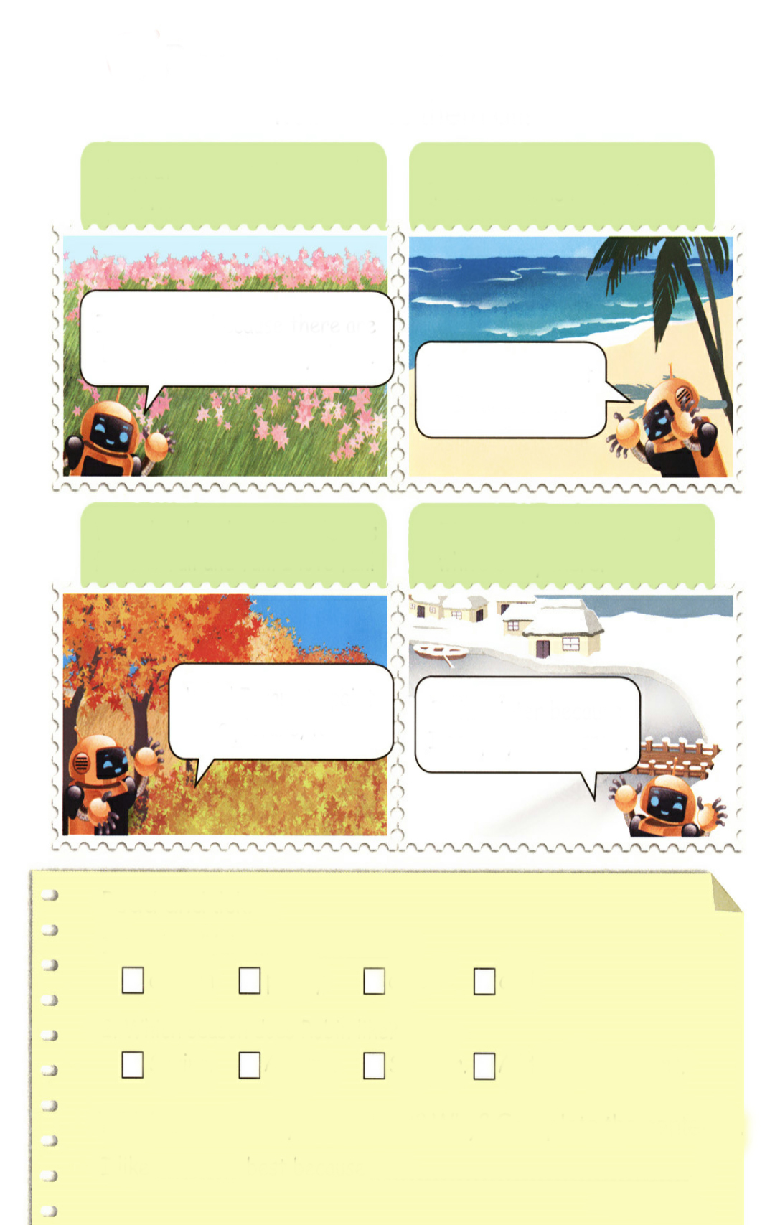
Lead in
Do you want to know Robin’s favourite season?
Now let’s listen.

Slide 4

Presentation
Read and write
Listen and answer the question.
Which season does Robin like?
Robin likes spring. Robin likes summer. Robin likes fall and winter.
Robin likes all the four seasons.

Slide 5

Find why Robin likes spring and winter.
Robin likes them all!
Look at the green trees and pink flowers.
The weather is hot, hot, hot!
I like spring because there are beautiful flowers everywhere.
I like summer, but I can’t swim.
What lovely colours! The leaves fall and fall and fall. I love fall!
There is lots of snow. It is white everywhere.
Wow! I want to paint a picture, too!
I like winter because I can play in the snow.

Slide 6
Read after the tape.
Robin likes them all!
Look at the green trees and pink flowers.
The weather is hot, hot, hot!
I like spring because there are beautiful flowers everywhere.
I like summer, but I can`t swim.
What lovely colours! The leaves fall and fall and fall. I love fall!
There is lots of snow. It is white everywhere.
Wow! I want to paint a picture, too!
I like winter because I can play in the snow.

Slide 7

What lovely colours! The leaves fall and fall and fall. I love fall!
How many “falls” can you find?
Four falls.

Slide 8

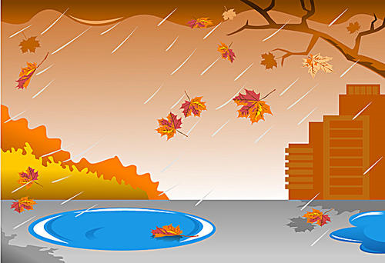
fall
fall
落下
秋天

Slide 9
Read and tick.
1. The last “fall” means .
√
autumn
pretty
cute
cool
2. Which season does Robin like?
Spring.
Autumn.
Summer.
√
All the four seasons.
Which season do you like best? Why? Complete the sentence.
I like best because .

Slide 10
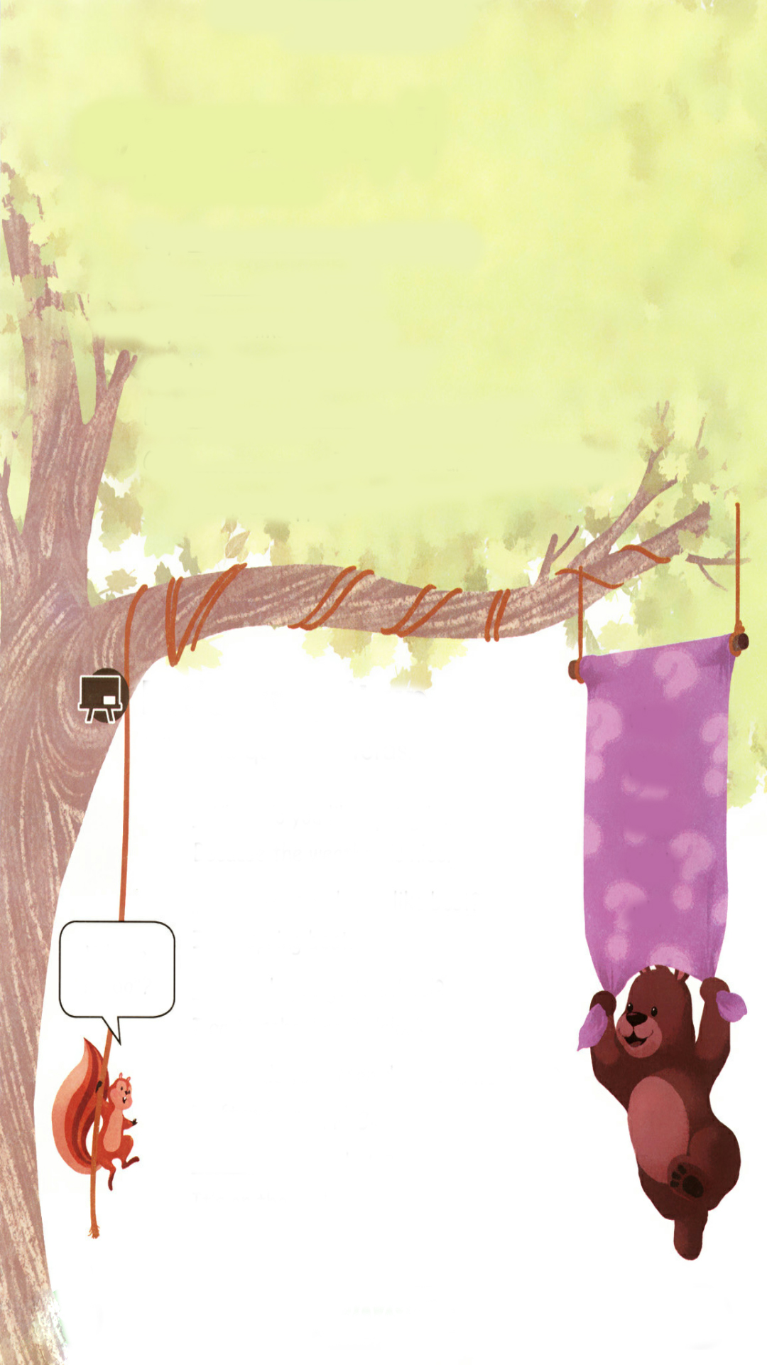
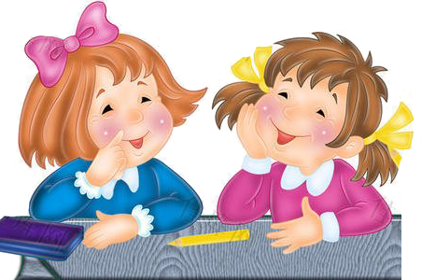
Let’s check
Listen and write.
Boy: ?
Girl: .
Boy: Do you like summer?
Girl: No, I don’t. It’s too hot.
Boy: ?
Girl: . The colours are beautiful. I can pick fresh apples.
When is your birthday
It’s in summer
Which season do you like best
Autumn

Slide 11
听力材料：
Boy：When is your birthday?
Girl：It’s in summer.
Boy：Do you like summer?
Girl：No, I don’t. It’s too hot.
Boy：Which season do you like best?
Girl：Autumn. The colours are beautiful. I can pick fresh apples.

Slide 12

Let’s wrap it up
老师进行七八笔，画出个“吊死鬼”Hangman的方式来猜英语单词的方法。（猜when, what, where, which, why）。学生猜对了，就把相关的字母写下来；如果猜错了，就画上一笔；如果最终没猜出来，“吊死鬼”自然就画成功了。
____ ____ ____
Y
A B C D E F G H I J K
L M N O P Q R S T U V
W X Y Z

Slide 13
Fill in the question words.
what
when
where
which
why
do you like spring best?
Because the weather is nice.
Why
season do you like best?
I like spring best.
Which
Where is “do”?
do you go to school?
I go to school at 8 o’clock.
When
do you often do on the weekend?
I often go shopping.
What
is your photo?
It’s on the wall.
Where

Slide 14
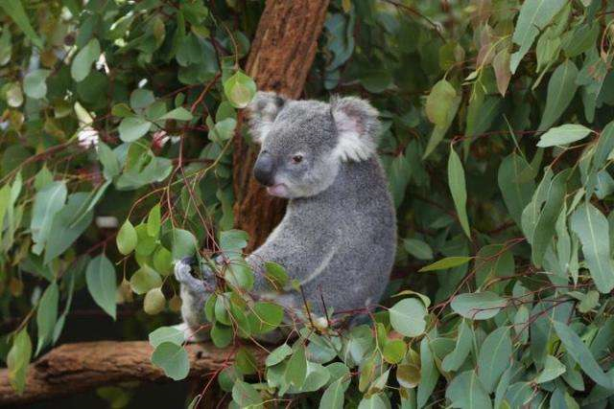
Story time
Which animal do you like best?
Koala.
Where is koala from?
Australia.

Slide 15
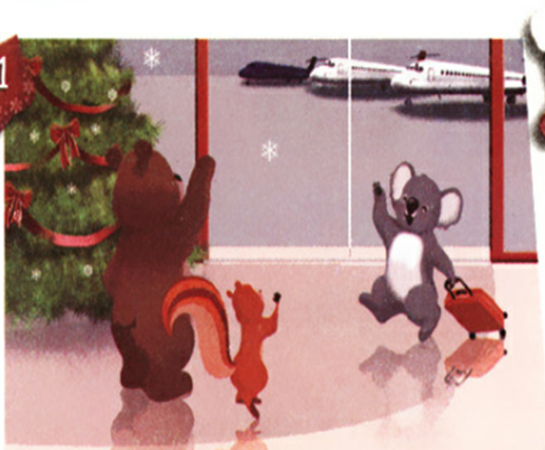
Watch and answer the questions.
点击画面 播放视频
Who are they?
They are Zip, Zoom and Koala.
Where are they? Are they in Australia or China?
They are in China.
Which season is it now? Why?
Zip & Zoom: Welcome!
Koala: Thank you. Merry Christmas!
Zip & Zoom: Merry Christmas!
Winter. Because it’s Christmas Day.

Slide 16
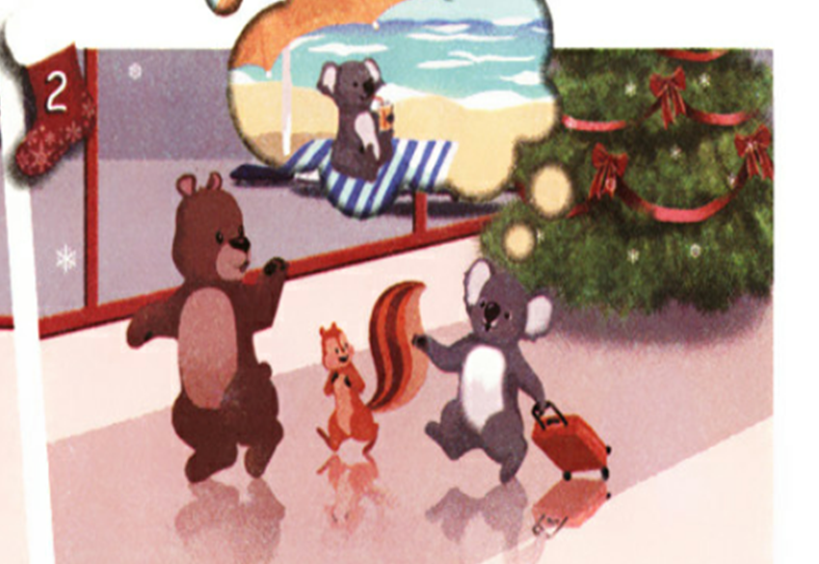
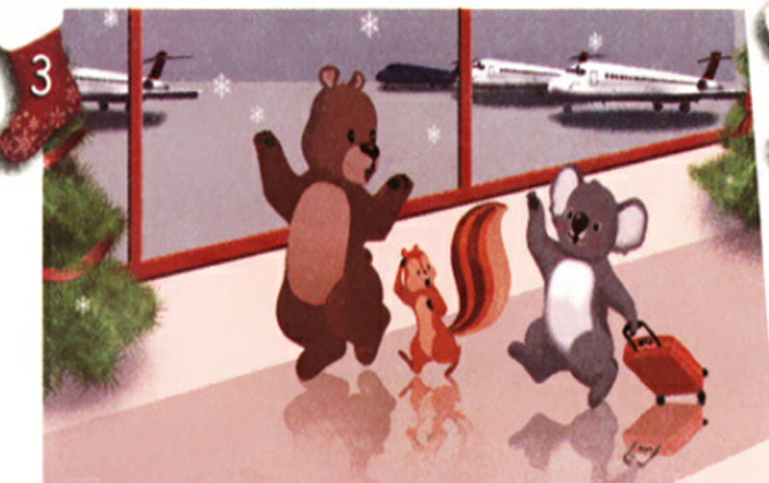
Listen, read and answer the questions.
Zoom: What do you usually do on Christmas Day?
Koala: I usually go to the beach and swim in the sea!
What does Koala usually do on Christmas Day?
Koala usually swims.
Why Koala can swim on Christmas Day?
Zoom: You swim in winter?!
Koala: Christmas is in summer in Australia, so we never have snow for Christmas.
Christmas is in summer in Australia.

Slide 17
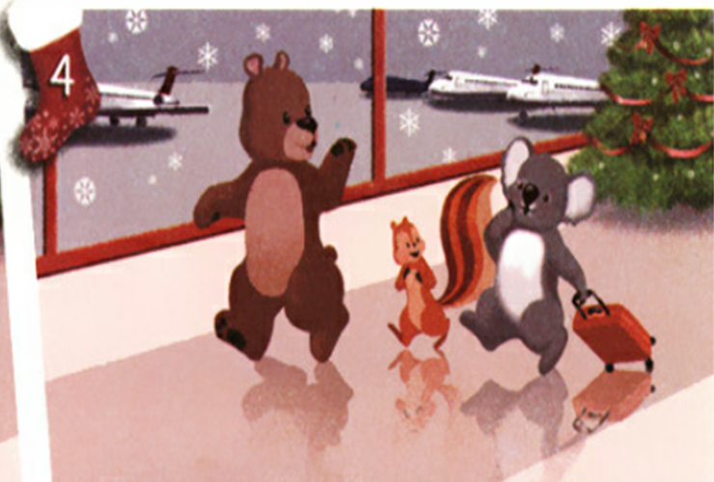
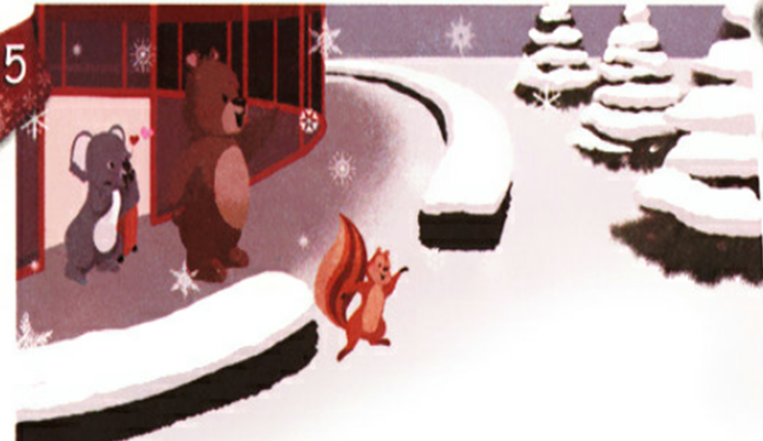
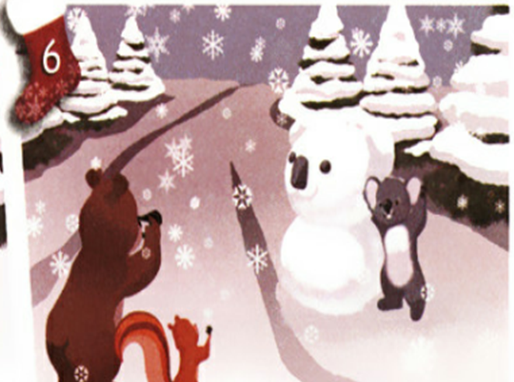
Zoom: Which season do you like best?
Koala: Summer. I like sunny days.
Which season does Koala like best?
Summer.
What do they do on Christmas Day in China?
Make a snowman.
Koala: Wow! A white Christmas!
Zoom: Let’s make a snowman.
Zip & Koala: Great!
Zip: Say “cheese”!
Koala: Cheese!

Slide 18
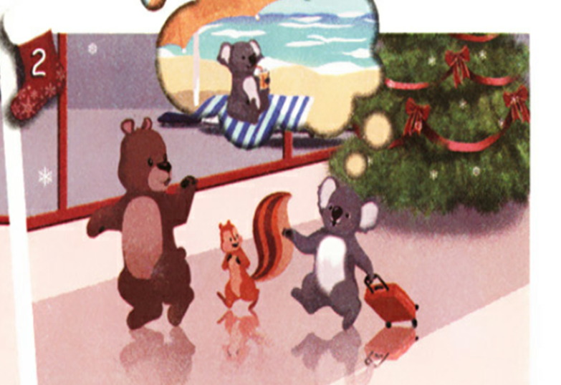



2
5
排序。
4
3
1
6

Slide 19




Practice
Role-play.

Slide 20

Exercises
一、翻译汉语。
美丽的鲜花
可爱的颜色
1.beautiful flowers 2.lovely colours
3.lots of __4.want to paint
5.play in the snow 6.go swimming
许多；大量
想涂画
在雪地里玩
去游泳

Slide 21
二、单项选择。
( ) 1.It’s snowing. I can ____ a snowman.
A.make B.have C.take
( ) 2.Robin________swim in summer.
A.can B.cant C.can’t
( ) 5.I like winter ________I can play in the snow.
A.for B.as C.because
A
A
C

Slide 22
三、给下列句子选择合适的答语。
（ ）What’s the weather like in summer?
（ ）Which season do you like best?
（ ）When do you play sports?
（ ）When is the best time to go to Beijing?
C
B
A
D
I play sports at 5:00 p.m.
I like summer best.
It’s sunny and hot.
Autumn.

Slide 23


Summary
1.能够正确听、说、认、读单词：spring，summer，autumn，winter，because等。
2.能简单介绍自己最喜欢的季节及原因。
3.能够掌握why，what，when，where，which等五个特殊疑问词不同的功能和用法。
七彩课堂
伴你成长

Slide 24

Homework
ONE
TWO
Make sentences like read and write.
Read the story to your parents.
七彩课堂
伴你成长
Act the story out in groups.

Slide 25








