Slide 1


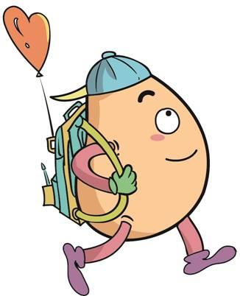





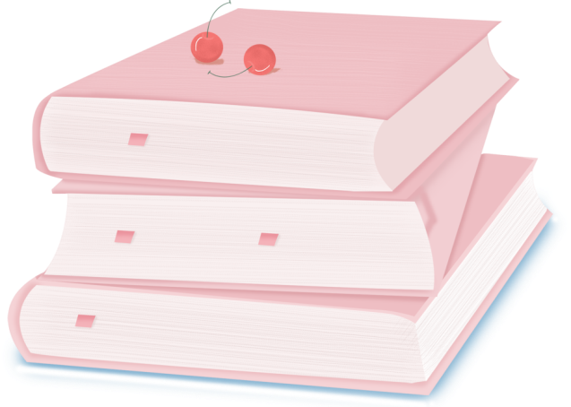
人 教 PEP 版 英 语 五年 级 下 册
Unit 2
My favourite season
Part B
Let’s try & Let’s talk

Slide 2
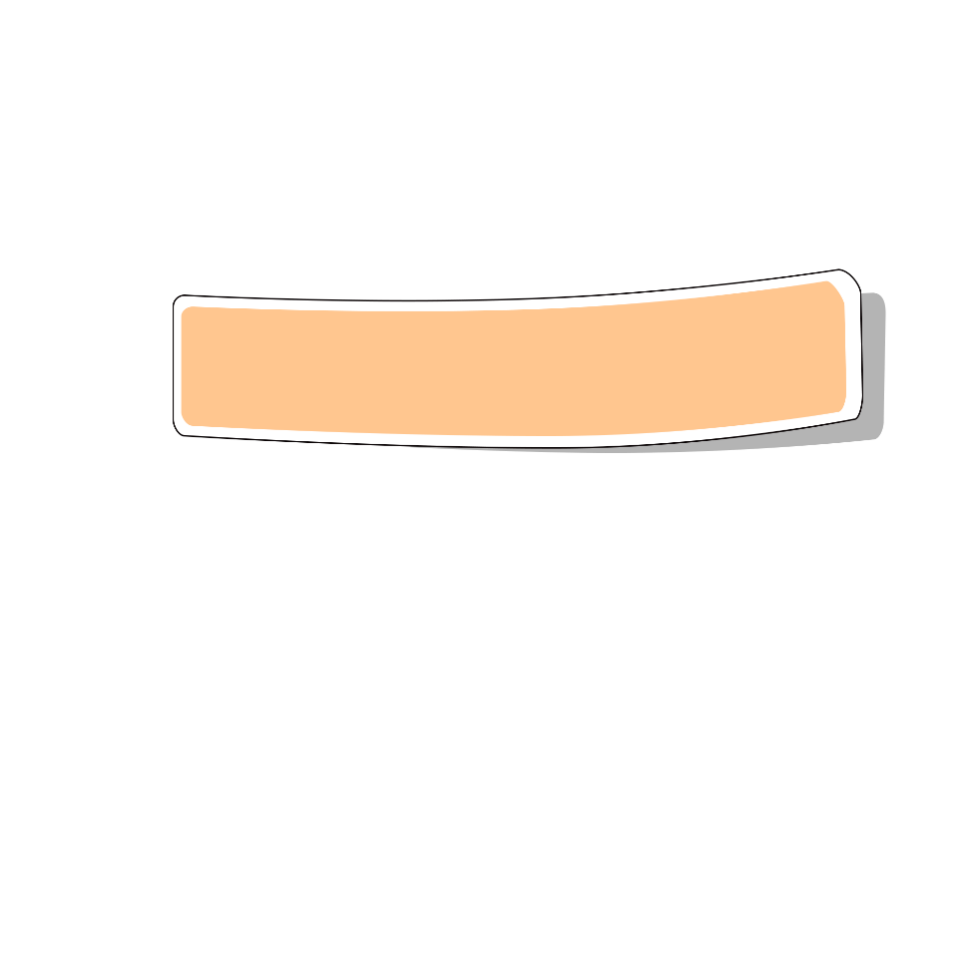
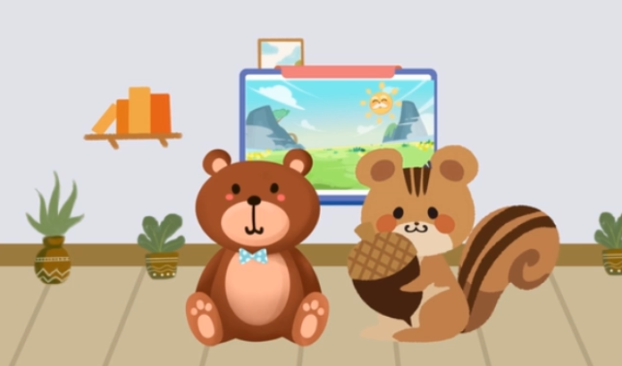
Warm up

Slide 3
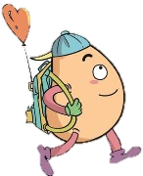
Lead in
Free talk！
Which season do you like best?
summer
spring
winter
autumn

Slide 4
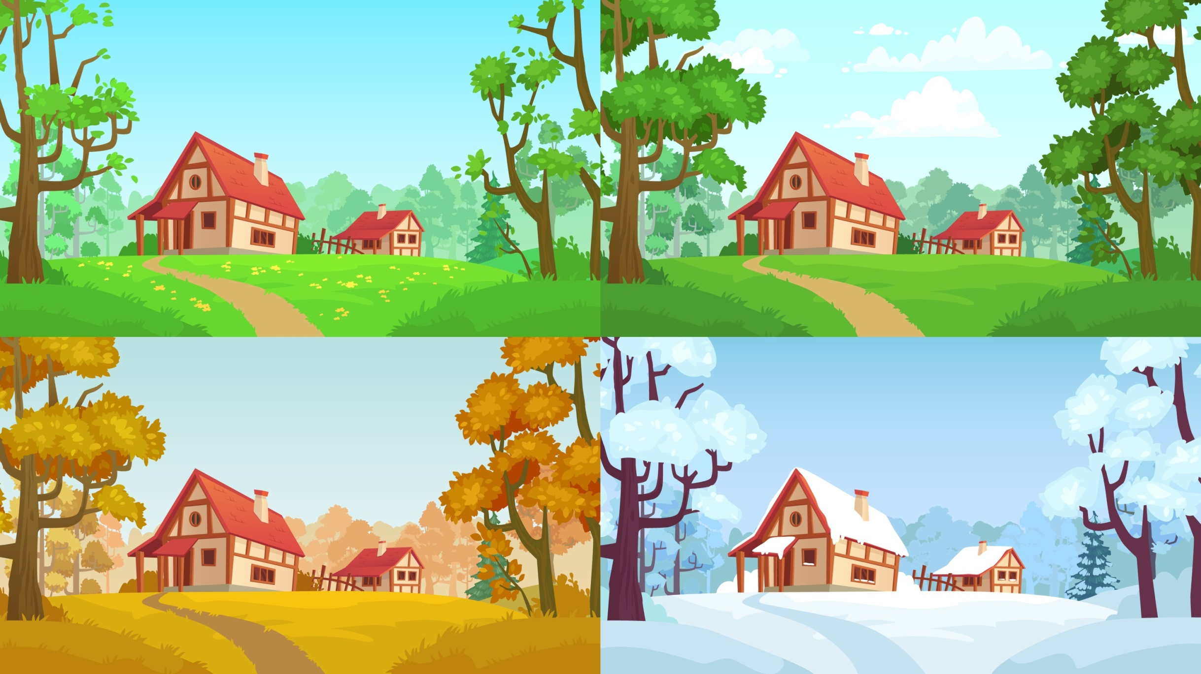
Why do you like this season best?

Slide 5
Presentation
Talk about your favourite season.
Talk about Zhang Peng’s favourite season.
Amy and Miss White talk about their favourite seasons.
Ask others about their favourite seasons and why they like them.

Slide 6


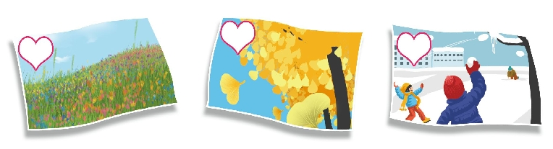
Let’s try
Zhang Peng and John are looking at some pictures. Which is Zhang Peng’s picture? Listen and tick.
√

Slide 7
Let’s check！
Zhang Peng：Look at my picture, John.
John：It’s pretty. So you like spring best?
Zhang Peng：Yes. Spring is beautiful. There are
lots of flowers. The trees are green.

Slide 8
Listen and choose.
根据对话内容选择正确答案
1. Zhang Peng’s favourite season is _____ .
A. spring B. summer
2. ____ is beautiful. There are lots of___.
A. Winter; birds B. Spring; flowers

Slide 9

Let’s talk
Watch and answer！
1. Which season does Amy like best? Why?
2. Which season does Miss White like best? Why?

Slide 10
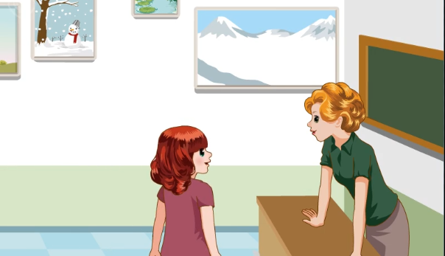

Slide 11
1. Which season does Amy like best? Why?
2. Which season does Miss White like best? Why?
She likes autumn best. Because the weather is good and the colours are beautiful.
She likes summer best.
Because she likes summer vacation.

Slide 12
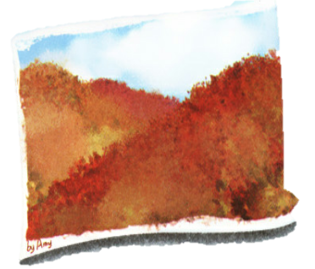
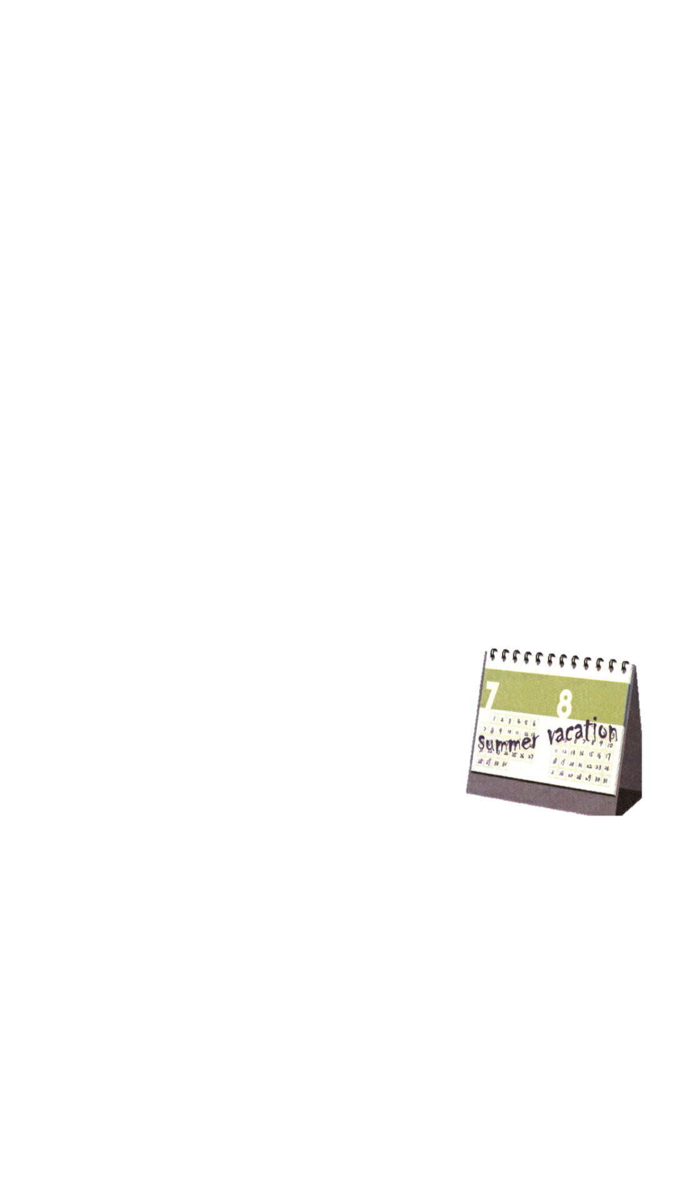
Read and fill in the blank.
Amy: Hello, Miss White. Look at my picture.
Miss White: Good job! I like the trees.
The colours are very________!
Amy: Yes. I like ______ best. The ______ is good
and the ______ are ________! ______
season do you like ______, Miss White?
Miss White: _______.
Amy:_____?
Miss White:Because __________________!
pretty
autumn
weather
colours
beautiful
Which
best
Summer
Why
I like summer vacation

Slide 13

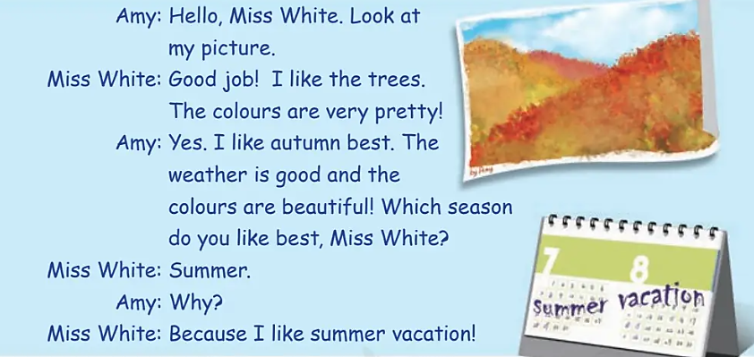
Listen to the tape.

Slide 14
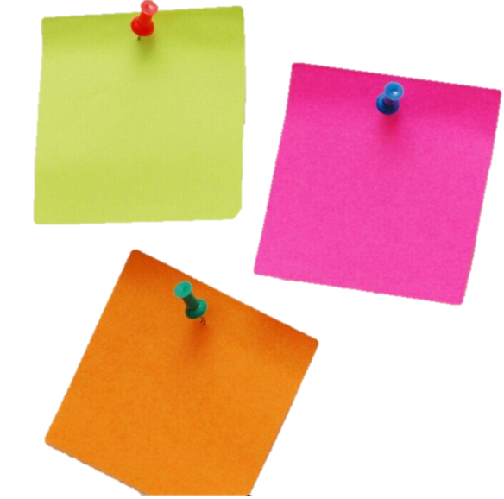
Role play
1.Read it together.
2.Each student
reads a sentence.
3. Read in roles.
自己分配角色。
Tip: Choose one to read in two. 选择一种两人练习。

Slide 15
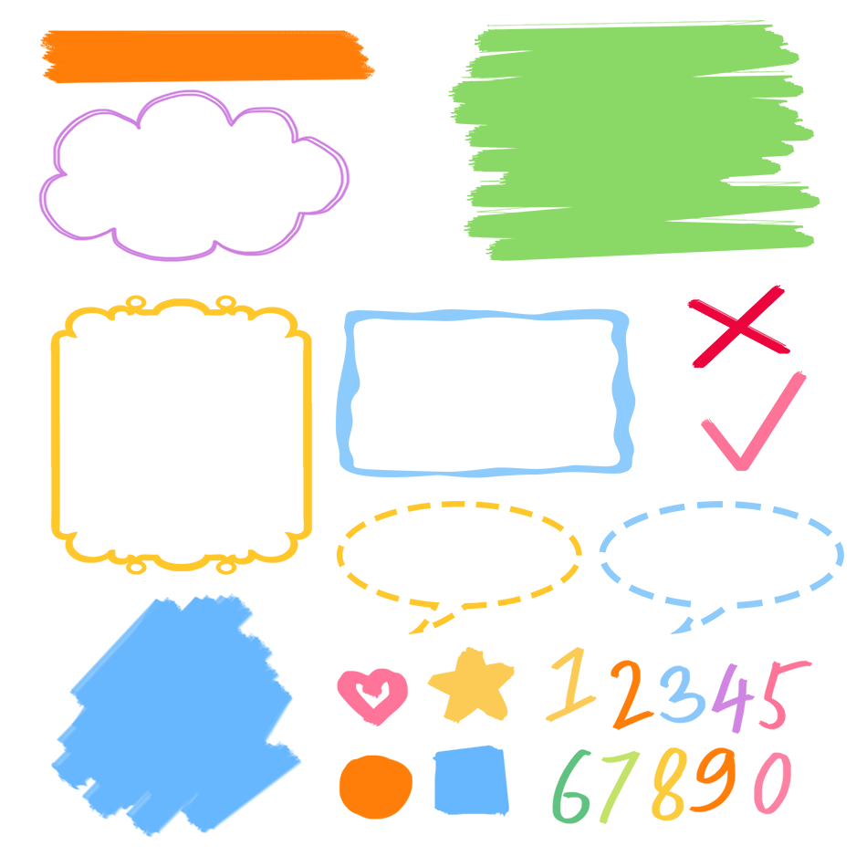
流利地朗读
流利地表演
有感情地表演

Slide 16
Listen and repeat
描述某人最喜爱的事物的常用语
Amy: Hello, Miss White. Look at my picture.
Miss White: Good job! I like the trees. The colours are very pretty!
Amy: Yes. I like autumn best. The weather is good and the colours are
beautiful! Which season do you like best, Miss White?
Miss White: Summer.
Amy: Why?
Miss White: Because I like summer vacation!
为什么
假期
暑假
因为
winter vacation寒假

Slide 17
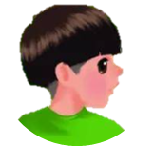
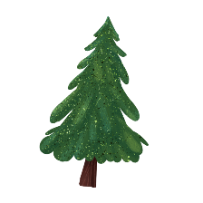


Language point.
I like autumn best.
描述某人最喜爱的事物的常用语
主语+like/likes+名词/代词+best.
句型：
此句式描述某人最喜爱的事物的常用语。其中“like…best”意思是“最喜欢……”
I like the red dress best.
I like English best.

Slide 18
—Why?
—Because I like summer vacation!
用于询问或回答原因
由why引导的特殊疑问句，用来询问原因。Why的意思是“为什么”。通常用because引导的句子进行回答。
注意：
当主语是第三人称单数时，问句中的do变为does。
Why does she like spring?
Because there are lots of flowers.

Slide 19
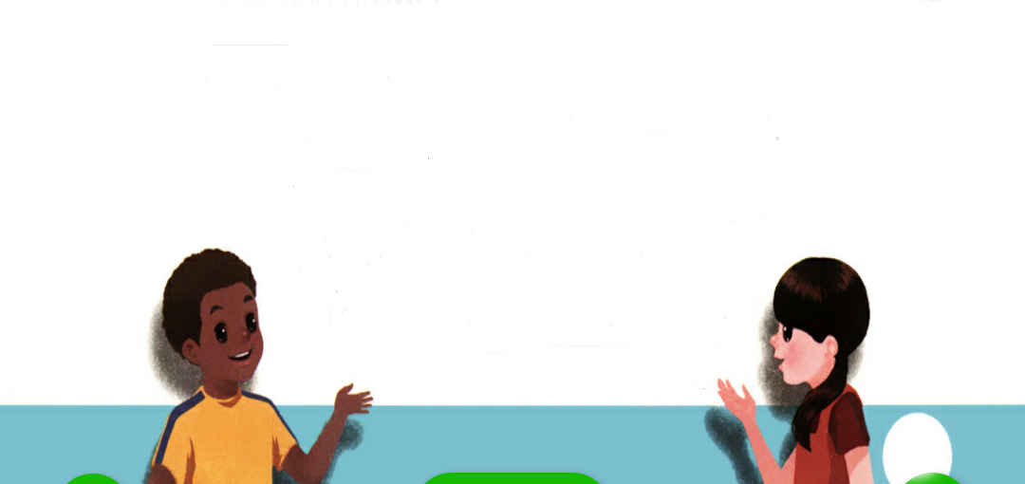
Ask and answer.
Which season do you like best ?
I like spring best.
Because there are pretty flowers.
Why?

Slide 20
Ask and answer.
Which season do you like best ?
I like winter best.
Because I like snow.
Why?

Slide 21
Ask and answer.
Which season do you like best ?
I like spring best.
Because ther are many flowers in spring.
Why?

Slide 22
Make dialogues based on the following information.
I like summer best. Because I can go swimming.
I like autumn best. Because the weather is good and the colours are beautiful.
I like winter best. Because winter is white and I like snow.
I like spring best. Because there are pretty flowers.

Slide 23
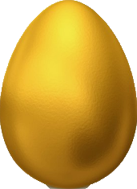
Play a game.
两名学生用剪刀石头布游戏分出谁砸金蛋，不砸金蛋的学生负责问“Which season do you like best? Why?”，砸金蛋的学生按照砸出来的季节说出特点。
summer
summer
winter
autumn
spring
winter
autumn
winter
autumn
spring
summer
autumn
spring
summer

Slide 24
Exercises
一、单项选择
( )1. --Which season do you like _______?
--I like summer best.
A. favourite B. best C. nice
( )2. I like autumn best. Because the _________ are pretty!
A. colours B. snow C. colour
B
A

Slide 25
( )3. --________ do you like winter?
--Because I like snow.
A. Why B. When C. When
( )4. I like summer best. Because I like ________.
A. the snow B. summer vacation C. pick apples.
( )5. I like ______ best. There are beautiful flowers everywhere.
A. spring B. winter C. swim
A
B
A

Slide 26
二、英译汉。
看
做得好
1.look at _____________ 2.good job ____________
3.very pretty ___________ 4.summer vacation _________
5.which season __________ 6.my picture ____________
非常漂亮
暑假
哪个季节
我的图画

Slide 27
二. 阅读对话，并判断句子正（T）误（F）。
Wu Fan:What’s your favourite season?
Chen Li: Spring is my favourite season.
Wu Fan: Why do you like spring?
Chen Li: Because I can fly kites.Which season do you like best?
Wu Fan: I like winter best.When it snows,I can make a snowman.
（ ）1. Chen Li’s favourite season is summer.
（ ）2. Chen Li likes flying kites in spring.
（ ）3. Wu Fan likes spring too.
（ ）4. Wu Fan likes winter best.Because he can make a snowman.
F
T
F
T

Slide 28

Summary
学习了下列句型：
1. I like autumn best.
2.—Why?
—Because I like summer vacation!

Slide 29
Homework
ONE
TWO
Act the dialogue out with your friends.
Make a short dialogue using the sentences we have learnt.
Play games in pairs like “Ask and answer”.

Slide 30







