Slide 1







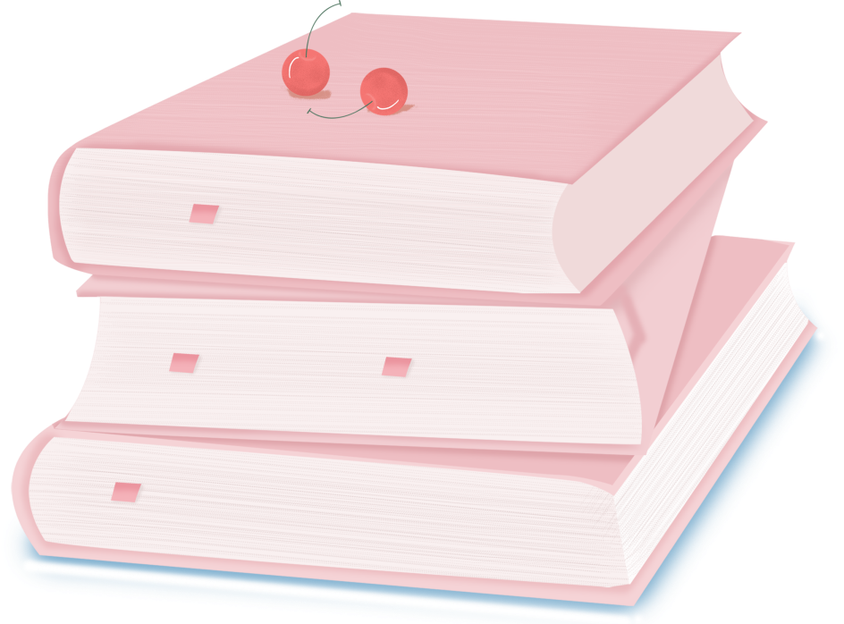

人 教 PEP 版 英 语 五 年 级 下 册
Unit 2
My favourite day
Part B
Let’s try & Let’s talk

Slide 2

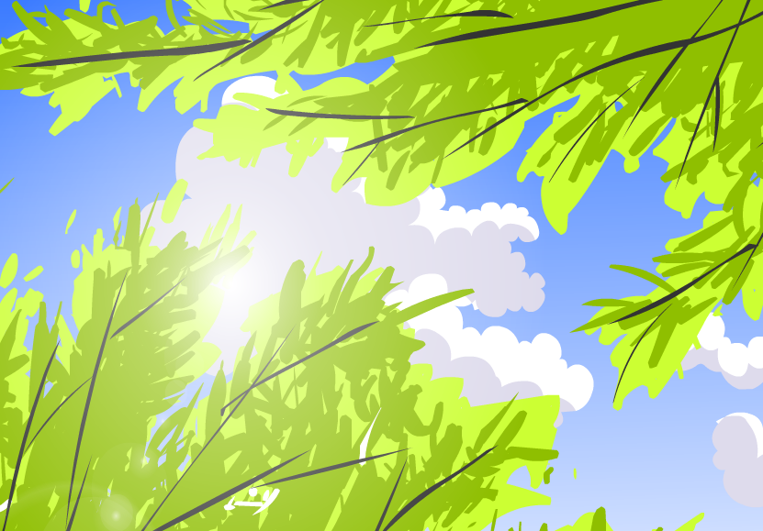
Warm up
Let’s sing!
点击画面 播放视频

Slide 3


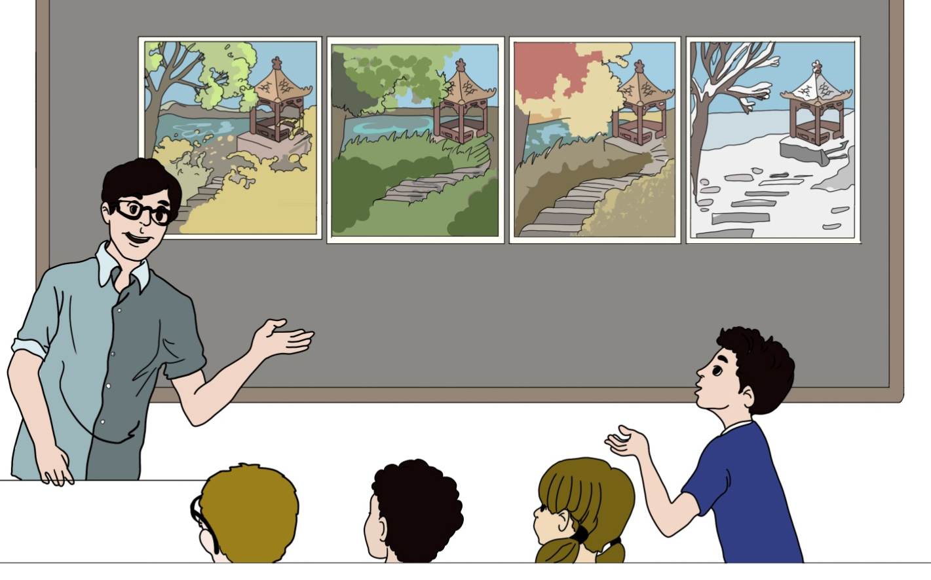
Make a dialogue.
Which season do you like best?
点击画面 播放视频
Summer. I can go swimming every day.
…

Slide 4


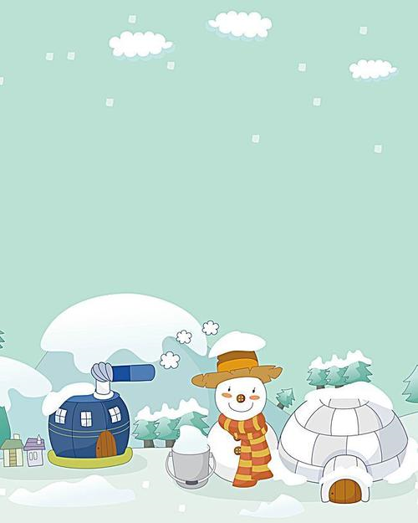
Lead in
Which season does Mike like best?
Winter.
Mike will draw a picture about winter.

Slide 5
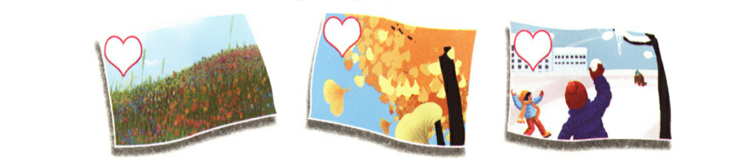
Presentation
Let’s try
All students draw pictures about the seasons.
What season is it?
spring
autumn
winter

Slide 6

Zhang Peng and John are looking at some pictures. Which is Zhang Peng’s picture? Listen and tick.
√

Slide 7
听力原文：
Zhang Peng：Look at my picture, John.
John：It’s pretty. So you like spring best?
Zhang Peng：Yes. Spring is beautiful. There are
lots of flowers. The trees are green.

Slide 8
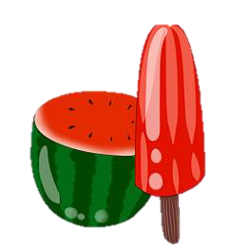
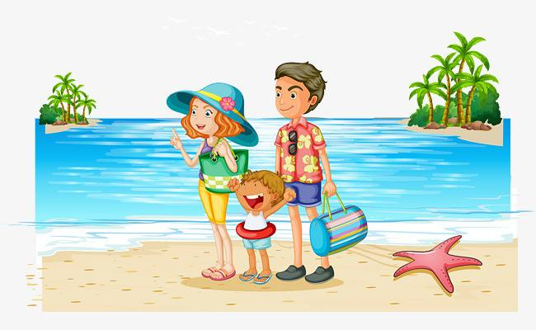
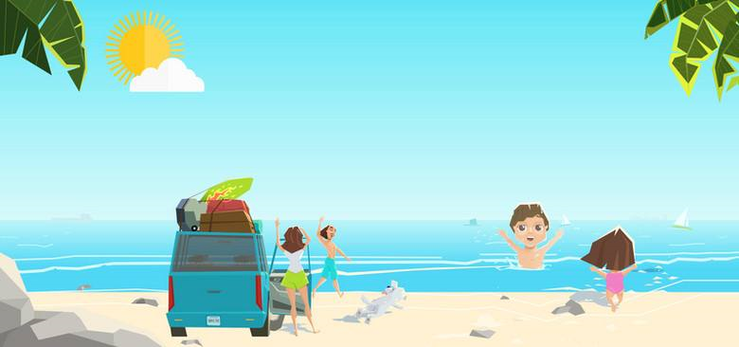

I like summer. Because I like summer vacation.
vacation
假期
summer vacation
暑假
winter vacation
寒假

Slide 9
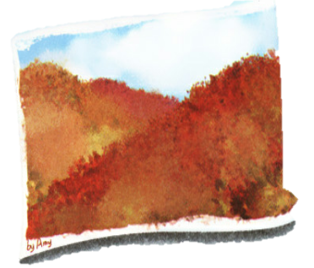

Let’s talk
Listen and answer the question.
Which season does Amy like best?
Autumn.
Which season does Miss White like best? Why?
Summer. Because she likes summer vacation.

Slide 10
Listen again and fill in the blank.
Amy:
Miss White:
Amy:
Miss White:
Amy:
Miss White:
Hello, Miss White. Look at my picture.
Good job! I like the trees.
The colours are very________!
Yes. I like ______ best. The ______ is good and the ______ are ________! ______ season do you like ______, Miss White?
_______.
_____?
Because __________________!
pretty
autumn
weather
colours
beautiful
Which
best
Summer
Why
I like summer vacation

Slide 11
Language points
1. I like autumn best.
【详解】此句式描述某人最喜爱的事物的常用语。其中“like…best”意思是“最喜欢……”
句型结构：主语+like/likes+名词/代词+best.
e.g. I like the red dress best.
I like blue best.

Slide 12
2. —Why?
—Because I like summer vacation!
【详解】问句是由why引导的特殊疑问句，用来询问原因。Why的意思是“为什么”。通常用because引导的句子进行回答。
【注意】当主语是第三人称单数时，问句中的do变为does。
e.g. — Why does your father go to the hospital?
— Because my grandpa is ill.

Slide 13
Read and act in pairs.
Amy:
Miss White:
Amy:
Miss White:
Amy:
Miss White:
Hello, Miss White. Look at my picture.
………! I like ……...
The colours are ………..!
Yes. I like ………..best. The weather is …….. and the colours are ………..! Which season do you like best, Miss White?
…….
Why?
Because ………………….!

Slide 14
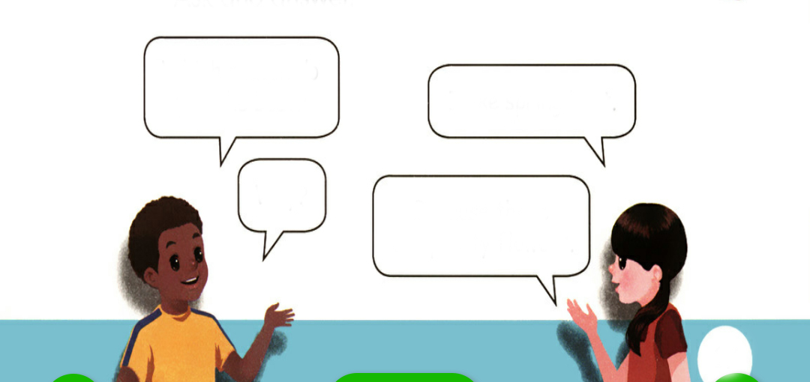
Practice
Ask the question and then pass it on.
Which season do you like best?
I like spring best.
Why?
Because there are pretty flowers.

Slide 15
Choose and answer the questions.
Which season do you like best?
I like…
Why?
Because …
I like autumn best.
Because the weather is good and the colours are beautiful.
I like summer best.
Because I can go swimming.
2
1
I like winter best.
Because winter is white and I like snow.
I like spring best.
Because there are pretty flowers.
3
4

Slide 16
Read together and talk in pairs.
I like summer best. Because I can go swimming.
I like autumn best. Because the weather is good and the colours are beautiful.
I like winter best. Because winter is white and I like snow.
I like spring best. Because there are pretty flowers.

Slide 17
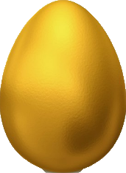
Choose and answer the question.
两名学生用剪刀石头布游戏分出谁砸金蛋，不砸金蛋的学生负责问“Which season do you like best? Why?”，砸金蛋的学生按照砸出来的季节单词回答问题。
summer
summer
winter
autumn
spring
winter
autumn
winter
autumn
spring
summer
autumn
spring
summer

Slide 18

Exercises
一、英译汉。
看
做得好
1.look at _____________ 2.good job ____________
3.very pretty ___________ 4.summer vacation _________
5.which season __________ 6.my picture ____________
非常漂亮
暑假
哪个季节
我的图画

Slide 19
二、选择题。
( ) 1. Look _________the trees, please.
A.to B.on C.at
( ) 2. There_________many pretty flowers in spring.
A.is B.are C.be
( ) 3. －_________ do you like summer best?
－Because I can go swimming every day.
A.What B.Which C.Why
( ) 4. －_________season do you like best? －Autumn.
A.Which B.Where C.Why
C
B
C
A

Slide 20

三、连词成句。
1.umbrella，at，the，look，orange (.)
____________________________________
2.winter，why，best，you，do，like (?)
____________________________________
3.beautiful， are，very，the， colours (.)
____________________________________
Look at the orange umbrella.
Why do you like winter best?
The colours are very beautiful.

Slide 21


Summary
学习了下列单词：
good job，because，vocation等
2.学习了下列句型：
— Which season do you like best?
— I like…best.
Because…
七彩课堂
伴你成长

Slide 22

Homework
ONE
TWO
Act the dialogue out with your friends.
Make a short dialogue using the sentences we have learnt.
七彩课堂
伴你成长
Play games in pairs like “Ask and answer”.

Slide 23








