Slide 1


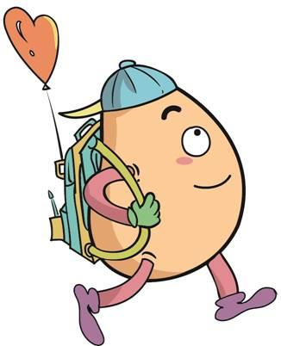





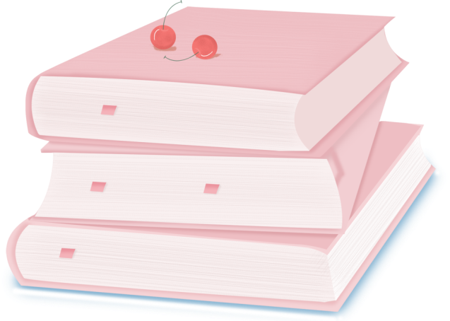
人 教 PEP 版 英 语 五年 级 下 册
Unit 2
My favourite season
Part A
Let’s learn & Read and match

Slide 2
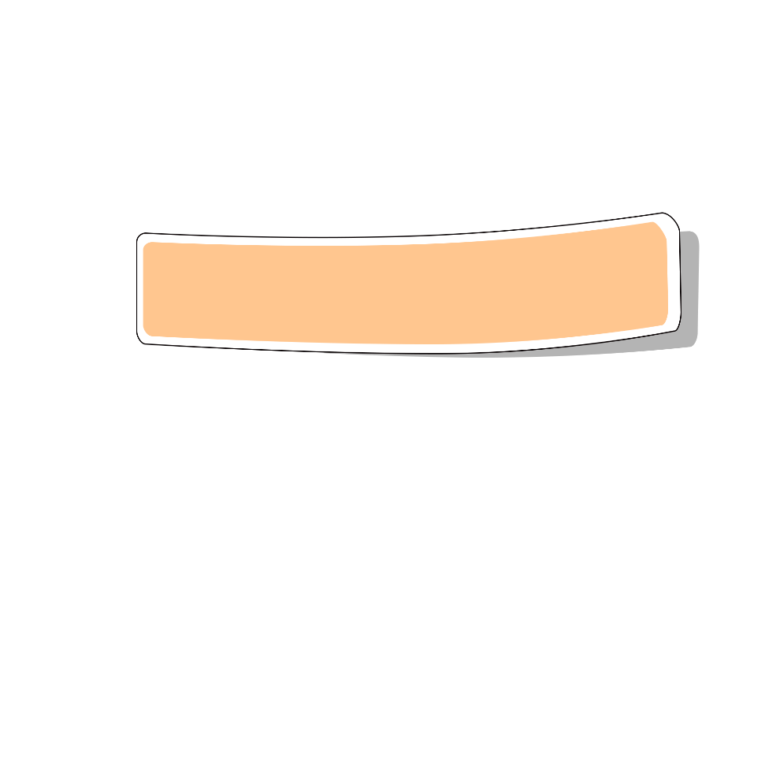
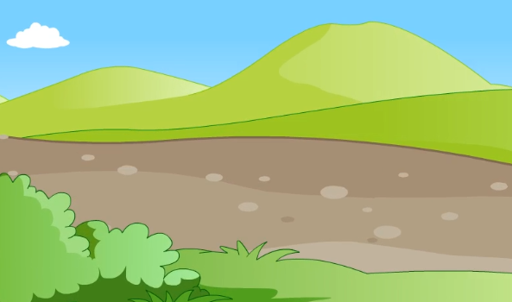
Warm up

Slide 3
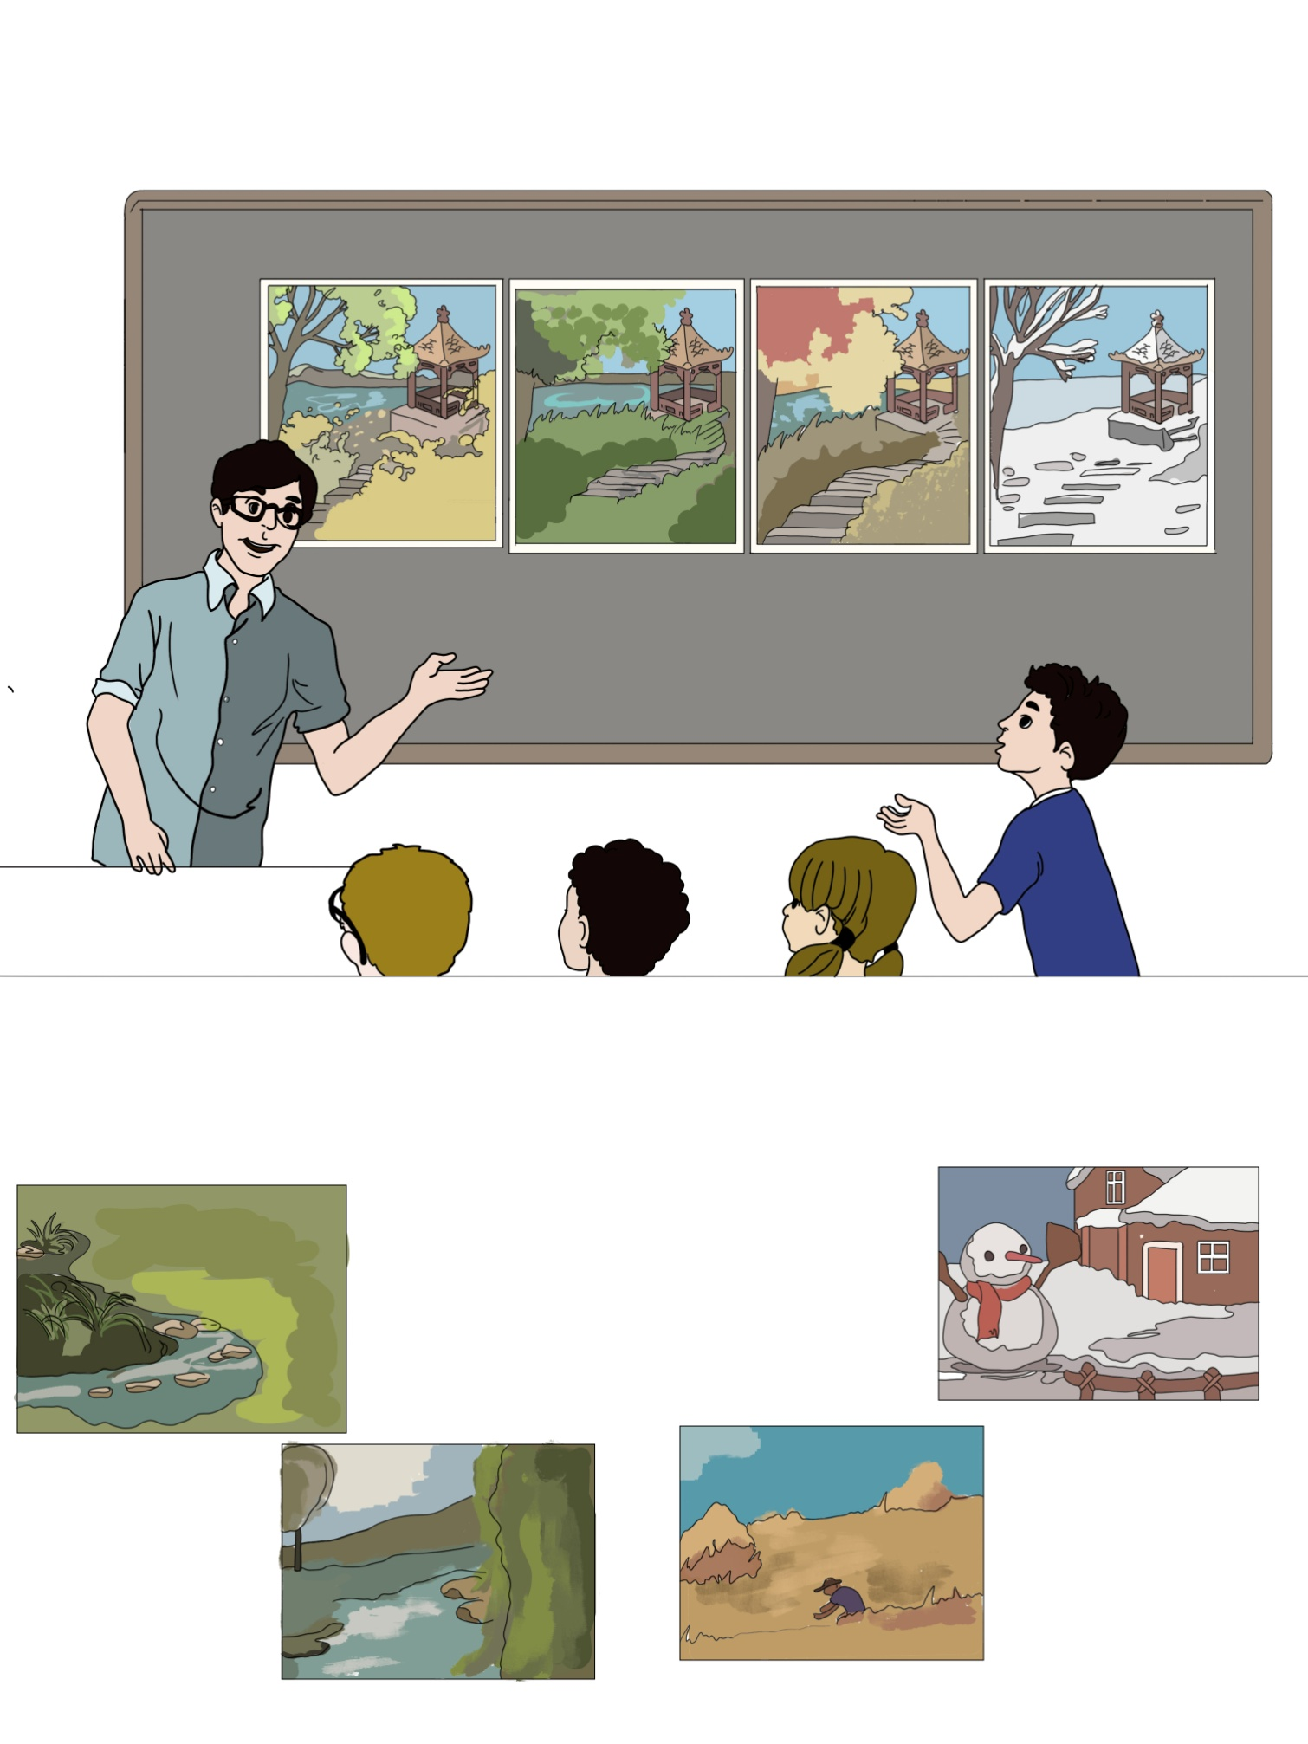
Lead in
Which season do you like best?

Slide 4
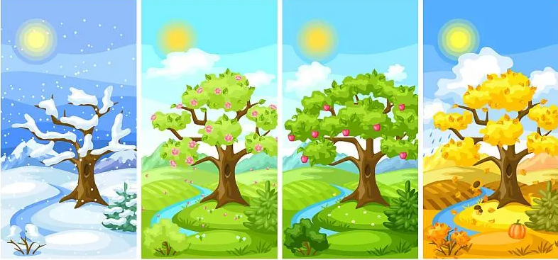
Let‘s learn the seasons！

Slide 5
Presentation
Talk about your favourite season.
Learn how to speak four seasons in English.
Talk about your favourite season.
Talk about why you like this season.

Slide 6

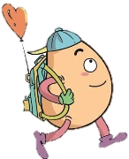
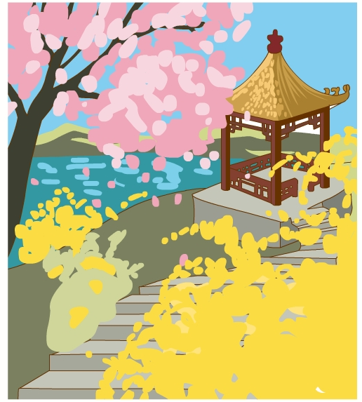

Let’s learn
Learn new words！
spring春天
注：季节前不加the.
I like spring best.

Slide 7
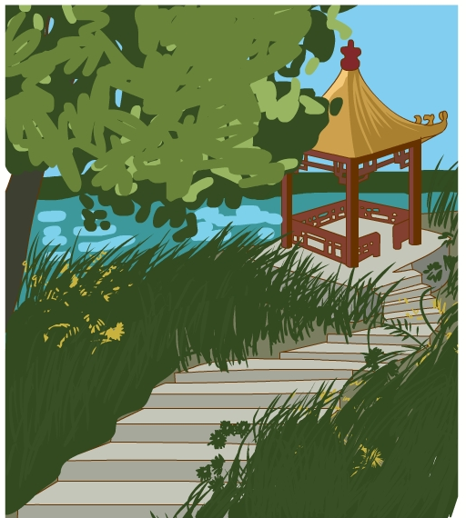
summer夏天
summer vacation暑假
拓展
I like summer best.

Slide 8
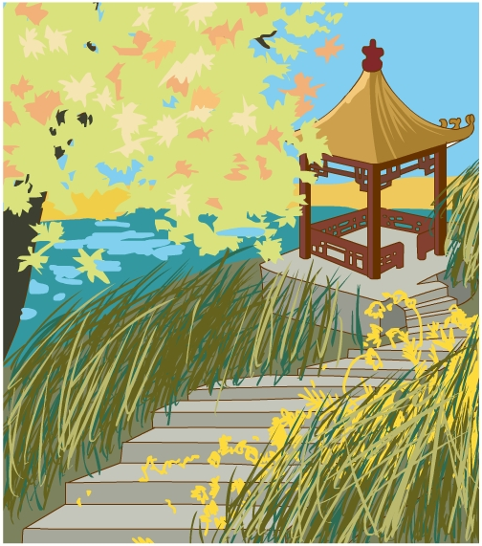
autumn秋天
My favourite season is autumn.

Slide 9
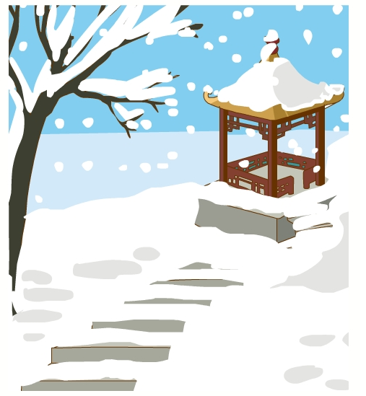
winter冬天
winter vacation寒假
拓展
I like winter best.

Slide 10
season季节
spring
summer
autumn
winter
There are four seasons in a year.

Slide 11
Read quickly！
summer
season
spring
winter
autumn

Slide 12
Play a game！
What’s missing?
spring
summer
autumn
winter

Slide 13

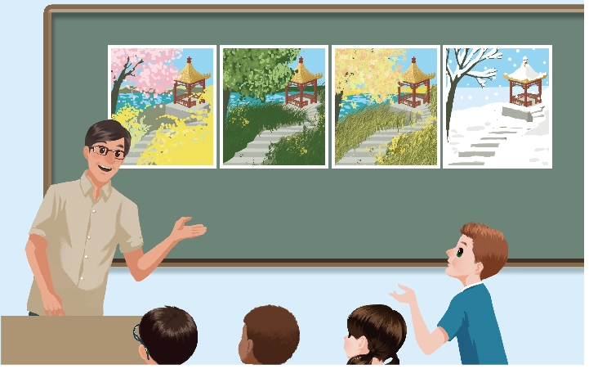
Listen to the tape.
spring
summer
autumn
winter
Summer. I can go swimming every day!
Which season do you like best?
我可以每天游泳

Slide 14

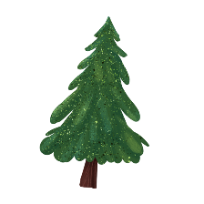

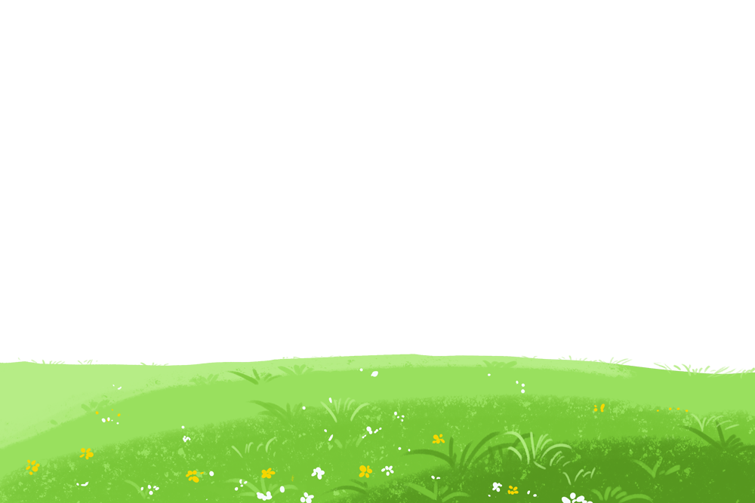
Language point.
— Which season do you like best?
— Summer.
询问某人最喜欢的事物
句型：
—Which + 事物 + do you like best?
— Which season do you like best?
— Winter.

Slide 15
Look and say.
Which season do you like best?
spring
fly a kite
I like .
I can .

Slide 16
Look and say.
Which season do you like best?
I like .
I can .
summer
go swimming every day

Slide 17
Look and say.
Which season do you like best?
autumn
eat fresh fruit
I like .
I can .

Slide 18
Look and say.
Which season do you like best?
winter
go skating
I like .
I can .

Slide 19

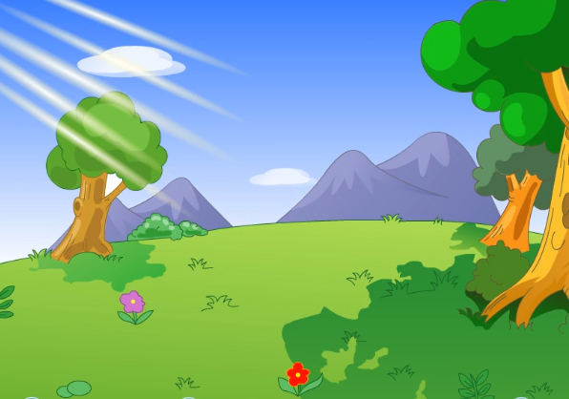
Watch the video.
Read and match

Slide 20
Look and read.
Spring is green with flowers and songs.
春日新绿百花开，歌声飞扬。
Summer is hot and the days are long.
夏日酷热，白天长。
Autumn is golden and farmers are busy.
金秋农民收麦忙。
Winter is white and the year is gone.
冬日白茫茫，又是一年将尽时。
忙碌的
金黄色的
过去的；用完了

Slide 21
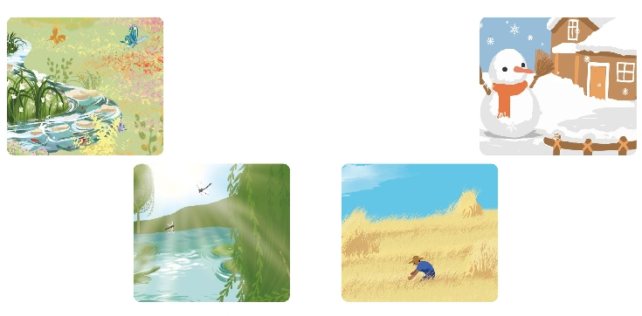
Read and match.
Spring is green with flowers and songs.
Summer is hot and the days are long.
Autumn is golden and farmers are busy.
Winter is white and the year is gone.

Slide 22
Chant together.
Spring is green with flowers and songs.
Summer is hot and the days are long.
Autumn is golden and farmers are busy.
Winter is white and the year is gone.

Slide 23
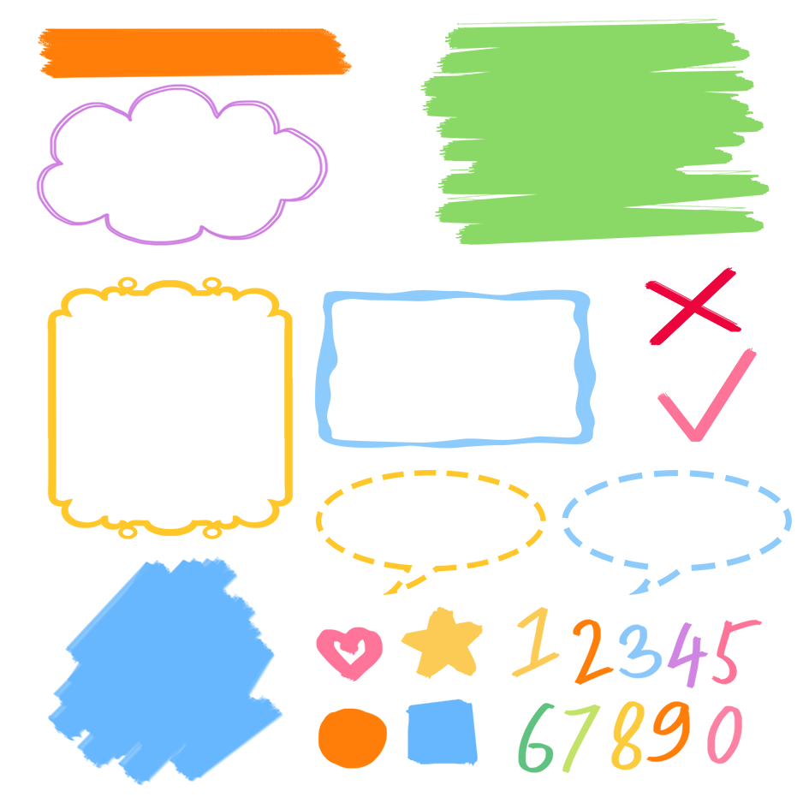
了解季节相关词组
记忆季节相关词组
熟练运用季节相关词组

Slide 24
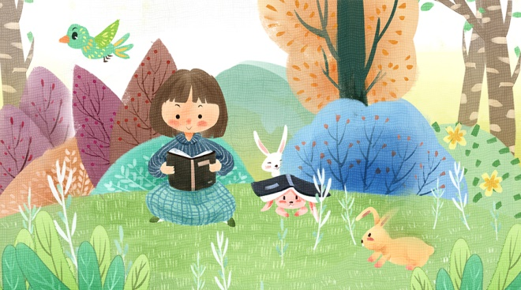
Good to know
A year’s plan starts with spring; a day’s plan starts with early morning.
一年之计在于春，一日之计在于晨。
We must manage our time well!
我们必须合理安排自己的时间！

Slide 25
Exercises
一、根据提示补充句子。
1.Which _________（季节）do you like best?
2._________（夏天）is hot and the days are long.
3.I like _________（春天）best.
4._________（冬天）is snowy and cold.
5._________（秋天） is windy and cool.
season
Summer
spring
Winter
Autumn

Slide 26
二、单项选择
( )1. What _____ your favourite season?
A. are B. is C. does
( )2. What’s the weather _______today?
A. like B. look C. do
( )3.The autumn is always sunny and ____.
A. cold B. hot C. cool
B
A
C

Slide 27
( )4. There are____seasons in a year.
A. four B. ten C. twelve
( )5. In spring, it’s ______.
A. sun and wind B. wind and warm C. windy and warm
A
C

Slide 28

Summary
学习了下列单词：
season, spring, summer, autumn, winter, golden,
busy, gone.
2.学习了下列句型：
—Which season do you like best?
—Summer.…

Slide 29
Homework
ONE
TWO
Say and do the actions in pairs.
Make a short dialogue using the sentences we have learnt.
Ask your dad what his favorite season is.

Slide 30







