Slide 1







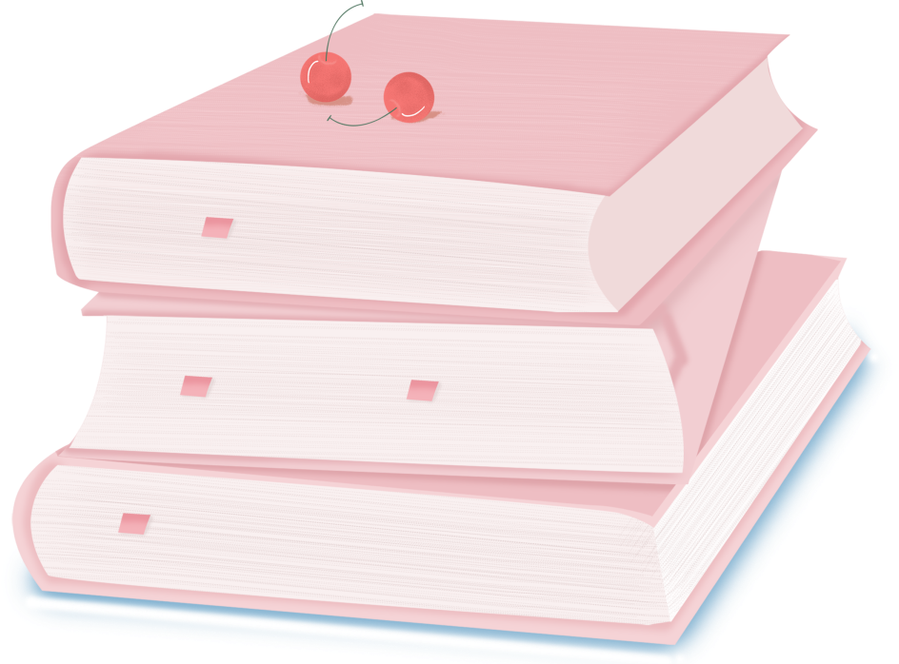

人 教 PEP 版 英 语 五 年 级 下 册
Unit 2
My favourite season
Part A
Let’s learn & Read and match

Slide 2

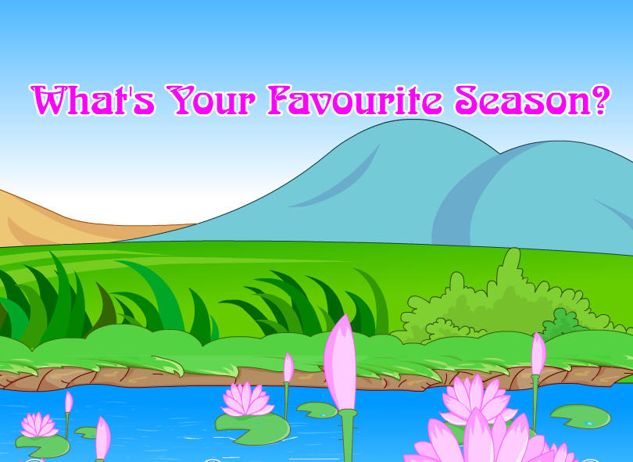
Warm up
Let’s sing.
点击画面 播放视频

Slide 3

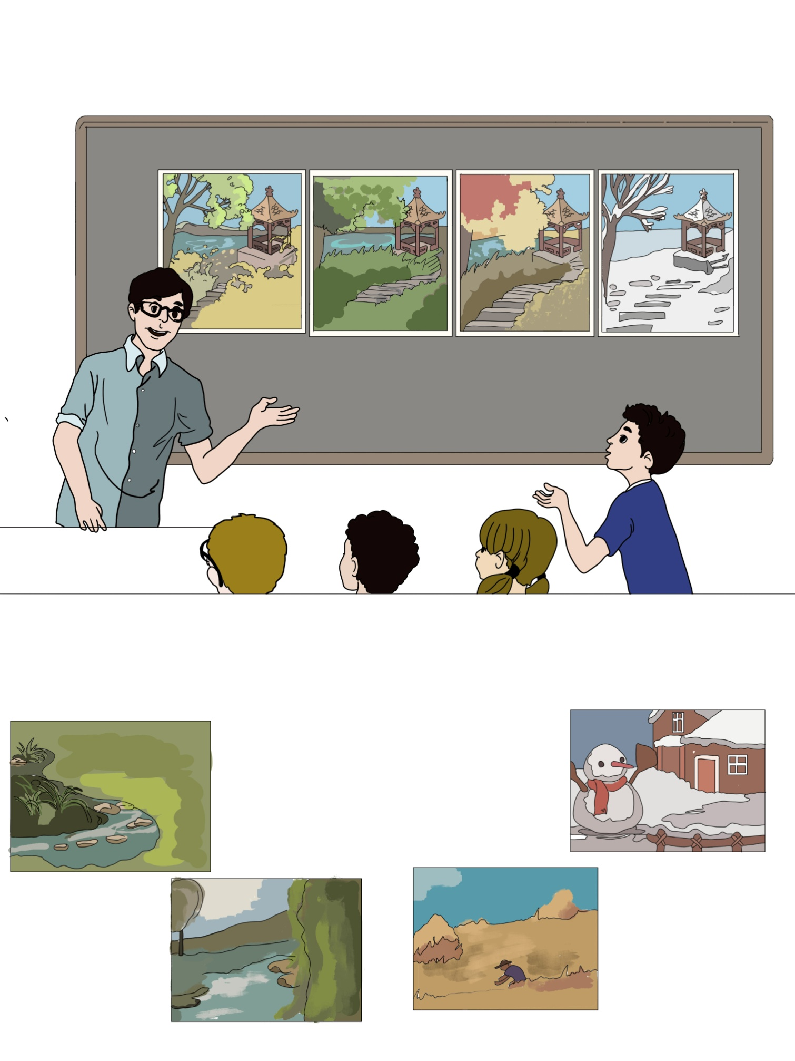
Lead in
Ask and answer.
Which season do you like best?
Summer.

Slide 4

Presentation
Let’s learn
Look at these pictures. And read after the video.
season
季节
spring
summer
autumn
winter

Slide 5

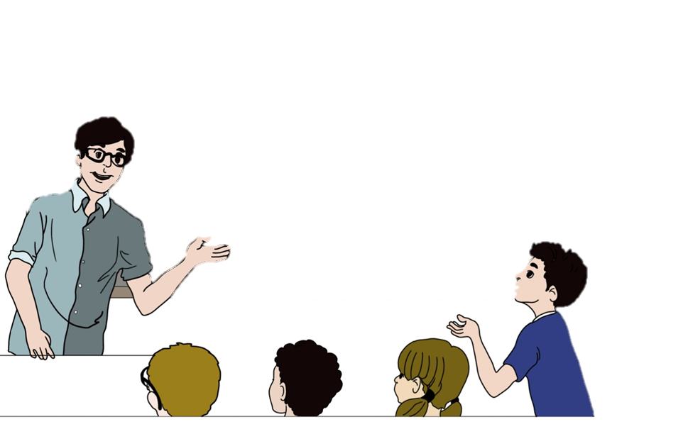
Which season do you like best?

Slide 6
spring
春天

Slide 7
Which season do you like best?

Slide 8
summer
夏天

Slide 9
Which season do you like best?

Slide 10
autumn
秋天

Slide 11
Which season do you like best?

Slide 12
winter
冬天

Slide 13
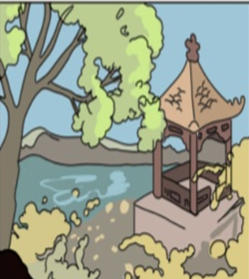
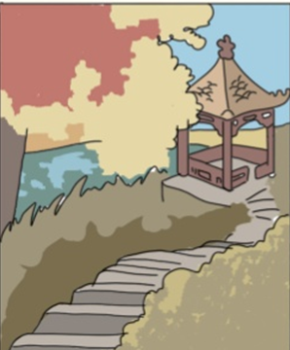
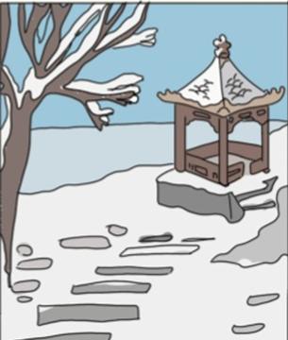
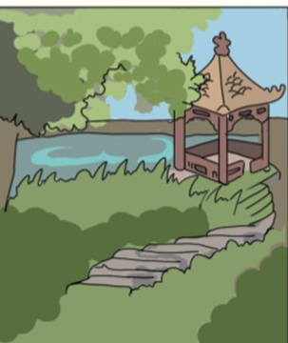
Game: What’s missing?
summer
autumn
winter
spring

Slide 14
Which season do you like best?
Summer.
I can go swimming every day!
I can go
swimming every day!
我每天可以游泳。
这是一个表达喜欢夏季的根本原因。

Slide 15
Translate the sentences and match.
I like spring. It’s pretty.
I like winter. I like snow.
我喜欢春天。她很美。
我喜欢冬天。我喜欢雪。
I like autumn. I can eat fresh apples and bananas.
I like summer. I can go swimming every day.
我喜欢秋天。我可以吃到新鲜的苹果和香蕉。
我喜欢夏天。我可以每天去游泳。

Slide 16
Make sentences like this.
Which season do you like best?
I like .
I .

Slide 17
Practice
Read and match
Watch the video.
点击画面 播放视频
golden
金黄色的
busy
忙碌的
gone
过去的；用完了

Slide 18
Translate sentences and match.
Spring is green with flowers and songs.
Summer is hot and the days are long.
Autumn is golden and farmers are busy.
Winter is white and the year is gone.
冬天是白色的，一年过去了。
春天是绿色的有花朵和歌曲。
夏天是炎热的，并且天很长。
秋天是金色的，农民们很忙。

Slide 19
Watch again and read after the video.
点击画面 播放视频
Spring is green with flowers and songs.
Summer is hot and the days are long.
Autumn is golden and farmers are busy.
Winter is white and the year is gone.
冬天是白色的，一年过去了。
春天是绿色的有花朵和歌曲。
夏天是炎热的，而且天很长。
秋天是金色的，农民们很忙。

Slide 20
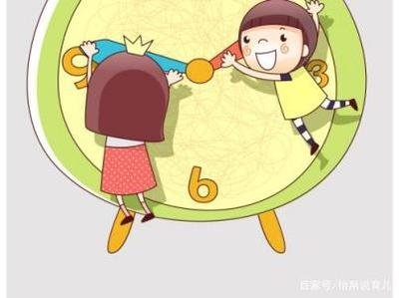
I want to know
A year’s plan starts with spring; a day’s plan starts with early morning.
一年之计在于春，一日之计在于晨。
We must manage our time well!
我们必须合理安排自己的时间！

Slide 21

Exercises
一、译成汉语。
1.go swimming___________ 2.every day___________
3.be busy ___________ 4.be gone_____________
5.be golden ___________ 6.like best____________
游泳
每天
忙碌
过去了
金黄色
最喜欢

Slide 22
二、单项选择。
( ) 1.I like summer best. The days are____ in summer.
A. short B. long C. black
( ) 2.Winter is white. I like the____.
A. rain B. bees C. snow
( ) 3.Autumn is ____and farmers are busy.
A. white B. golden C. green
B
C
B

Slide 23
三、根据提示补充句子。
1.Which _________（季节）do you like best?
2._________（夏天）is hot and the days are long.
3.I like _________（春天）best.
4._________（冬天）is snowy and cold.
5._________（秋天） is windy and cool.
season
Summer
spring
Winter
Autumn

Slide 24


Summary
学习了下列单词： season, spring, summer, autumn, winter, golden, busy, gone.
2.学习了下列句型：
—Which season do you like best?
—Summer.…
七彩课堂
伴你成长

Slide 25

Homework
ONE
TWO
七彩课堂
伴你成长
Make a short dialogue using the sentences we have learnt.
Say and do the actions in pairs.
Ask your dad what his favorite season is.

Slide 26








