Slide 1


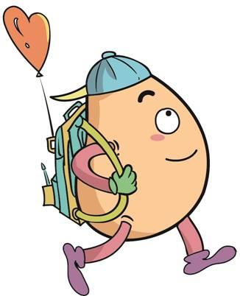





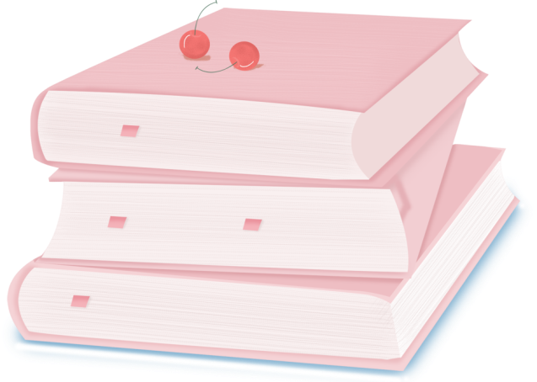
人 教 PEP 版 英 语 五年 级 下 册
Unit 2
My favourite season
Part A
Let’s spell

Slide 2


Review
season
summer
winter
autumn
favourite
spring

Slide 3
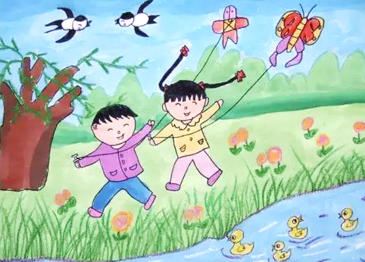
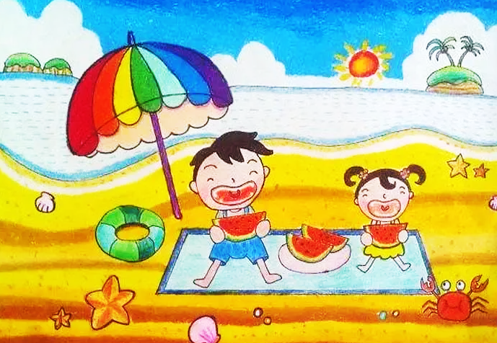
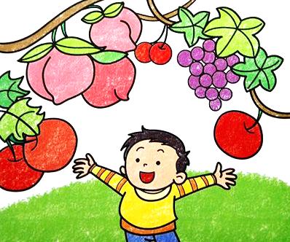
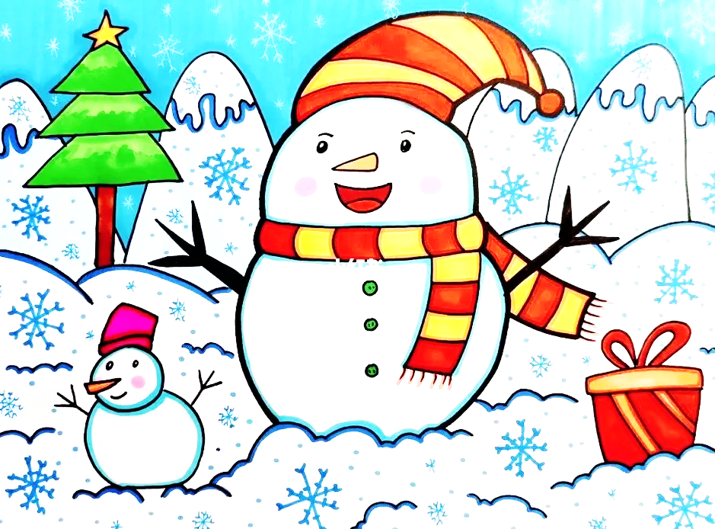
Which season do you like best? Why?
I like... best. Because I can ...

Slide 4
Lead in
观察这些句子，分别指出带有br，gr的单词有哪些。
You like brown,
I like green.
You like apples,
I like grapes.
You love your brorher best,
I love my grandpa best.
We are different.

Slide 5
Presentation
How to spell br and gr?
学习br/gr在单词中的发音规则
学习br/gr在单词中的发音规则
学习br/gr的发音要领

Slide 6



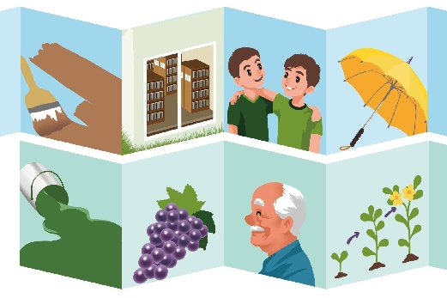
Let’s spell
Listen and read.
br
umbrella
brown
library
brother
gr
green
grapes
grandpa
grow

Slide 7

Read the words。
brown/braʊn/
棕色的
I like brown best.

Slide 8
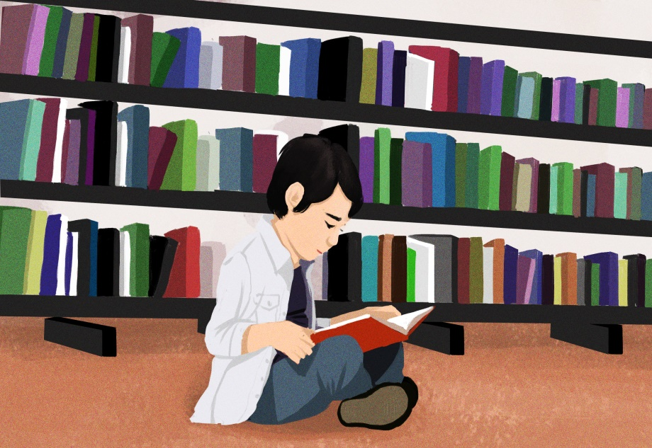
library/ˈlaɪbrəri/
We read books in the library.

Slide 9
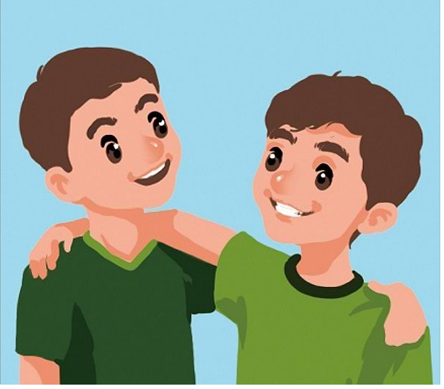
brother/ˈbrʌðə(r)/
They are brothers.

Slide 10

umbrella/ʌmˈbrelə/
This is a yellow umbrella.

Slide 11



brown
library
brother
umbrella
br
/br/

Slide 12
Let’s read！
brown
breath
umbrella
bridge
library
brush
breakfast
bring
brother

Slide 13

Read the words。
green/ɡriːn/
绿色
拓展
green food 绿色食品
green tea 绿茶
green light 绿灯
I like green best.

Slide 14

grapes/greɪps/
葡萄
These are purple grapes.

Slide 15
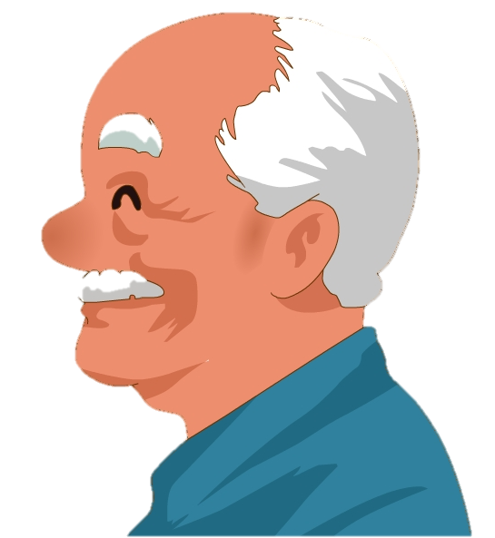
grandpa/ˈɡrænpɑ/
grandma 奶奶
grandparents 祖父母
拓展
This is my grandpa.

Slide 16
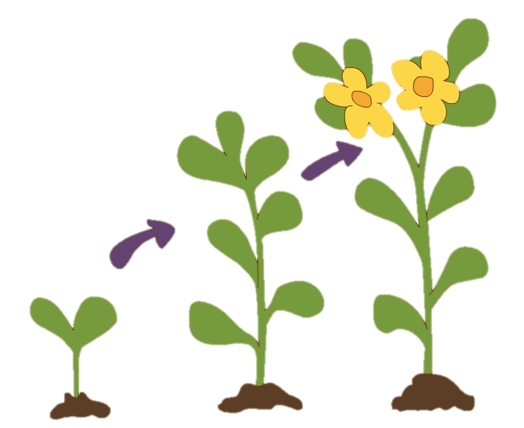
生长
grow/ɡrəʊ/
拓展
grow up长大
grow flowers种花
He likes to grow flowers.

Slide 17


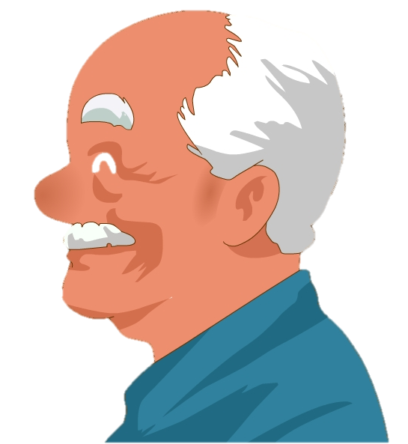
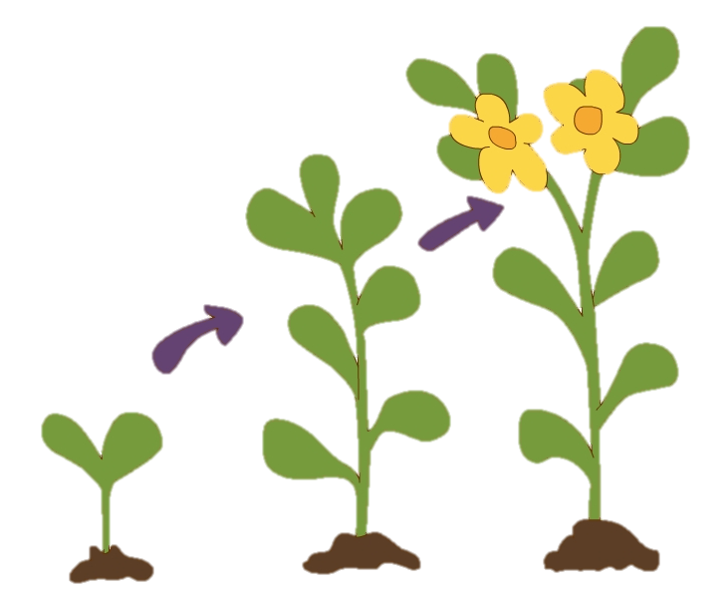
green
grapes
grandpa
grow
gr
/gr/

Slide 18
Let’s read！
grapes
grey
green
group
playground
great
grade
grow
grandpa

Slide 19
Let’s learn.
字母组合br和gr的发音规则
br和gr是常见的字母组合，在英语中有着不同的发音规则，其中, br通常发/b/和/r/两个音，而gr通常发/g/和/r/两个音。
gr和br发音的区别： gr发音时，是舌根音， br是双唇音。
br与gr的发音口决：
1. br读音口诀： 嘴唇紧闭，空气停滞，然后爆破发音, b-r的发音就呈现出来.
2. gr读音口诀：舌头抵住上腭，喉咙发出浊音, g-r的发音就实现了。

Slide 20
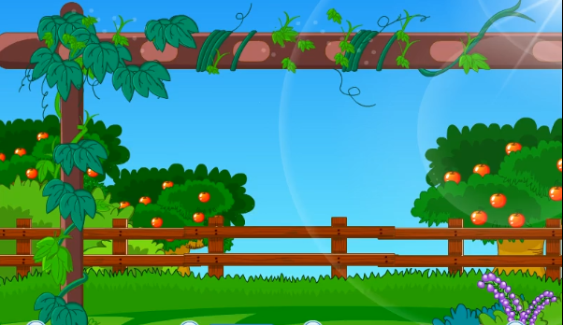
Let’s chant.

Slide 21
Green grapes grow.
Green grapes grow.
Grandpa and my brother watch
green grapes grow.
Brown bread bakes.
Brown bread bakes.
Grandma and my brother watch
Brown bread bakes.
听到gr时坐正，听到br时拍下手。

Slide 22
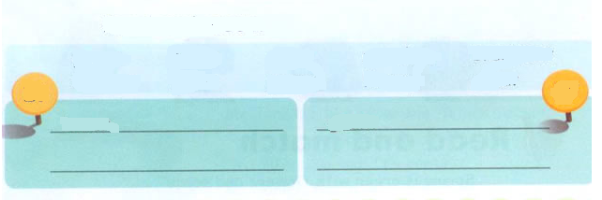
Read and group.
green brown grow grandma breakfast brother grass grapes library great
br
gr
brown
breakfast
green
grow
grandpa
brother
library
grass
grapes
great

Slide 23
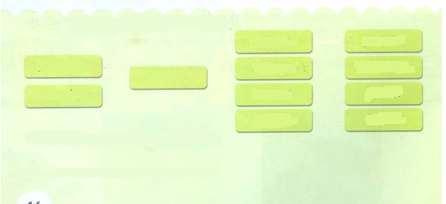
Choose, write and say.
green
grapes.
Grandpa
orange
potatoes.
grows
Grandma
brown
grass
purple
apples.
Grandpa grows green grapes
1.________________________.
2._________________________.
Grandma grows purple grapes
Group work: 1.小组讨论如何连词成句。2.将所造句子认真写入横向线内(大写、空隙、标点)

Slide 24
Play a game.
Passing Words.
green brown
grow grandma breakfast brother grass grapes library great
将全班分成八个人一组，每个小组排成一个长队，请第一位学生选其中一个词，小声告诉下一位学生，如此这样，直到小声传到本队的最后一名学生时，就请这位最后的学生大声说出他所听到的单词，然后请第一名学生也大声说出自己刚一开始传给第二名学生的单词，这样就可以判断出他们一组，每个组员是否都传递了正确的读音。

Slide 25
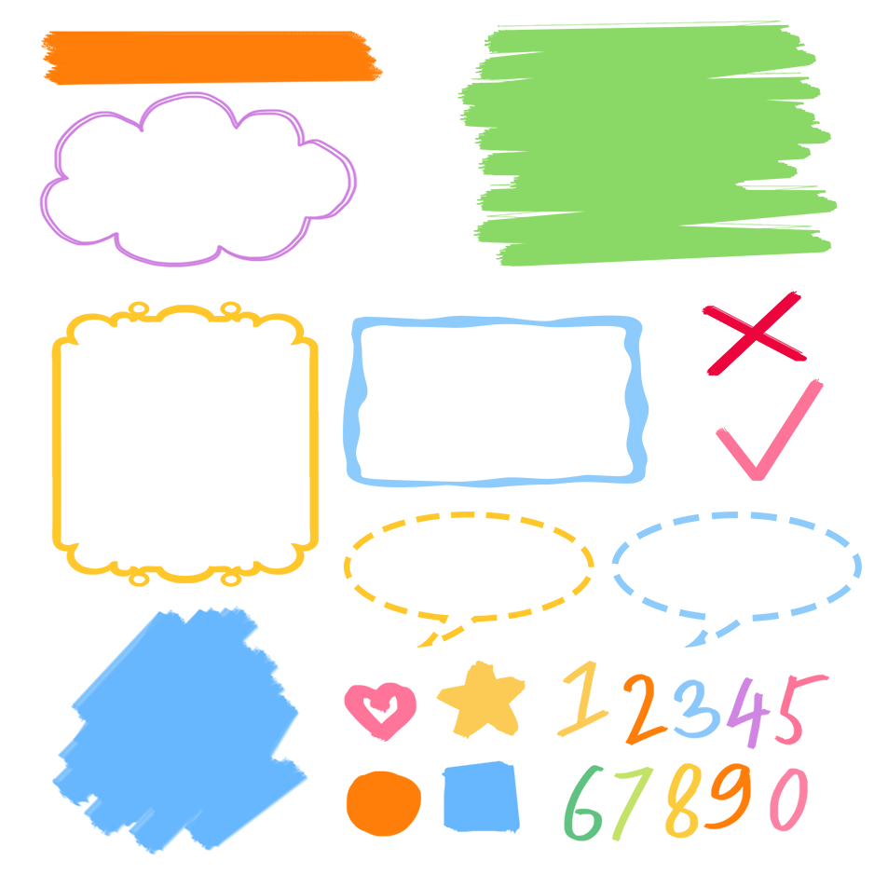
了解br,gr的发音规则
记忆br,gr的发音规则
根据发音规则读出生词

Slide 26
Exercises
一、判断划线部分读音是（T）否（F）相同
( ) 1. A. green B. grass C. brown
( ) 2. A. great B. glass C. grate
( ) 3. A. break B. bring C. library
( ) 4. A. umbrella B. brother C. grape
( ) 5. A. grandpa B. grandma C. grow
F
F
T
F
T

Slide 27

二、给单词分类。
green
brown
play
grandma
great grow
grandpa
library
breakfast brother
bring
plant
please place
green brown play grandma library plant breakfast
please great brother grow place grandpa bring

Slide 28

Summary
学习了字母组合br与gr的发音规则，即br在单词中发/br/音，gr在单词中发/gr/音。
brown library brother umbrella
green grapes grandpa grow

Slide 29
Homework
ONE
TWO
Read the words.
Make sentences using the words we have learnt.
Collect the words with “gr” and “br”.

Slide 30







