Slide 1









人 教 PEP 版 英 语 五 年 级 下 册
Unit 2
My favourite season
Part A
Let’s spell

Slide 2



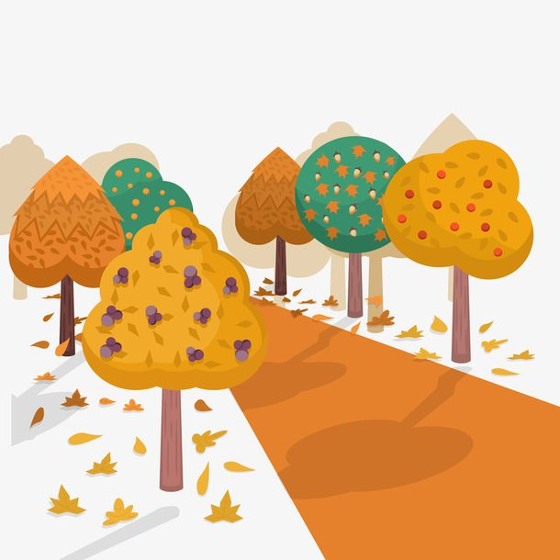
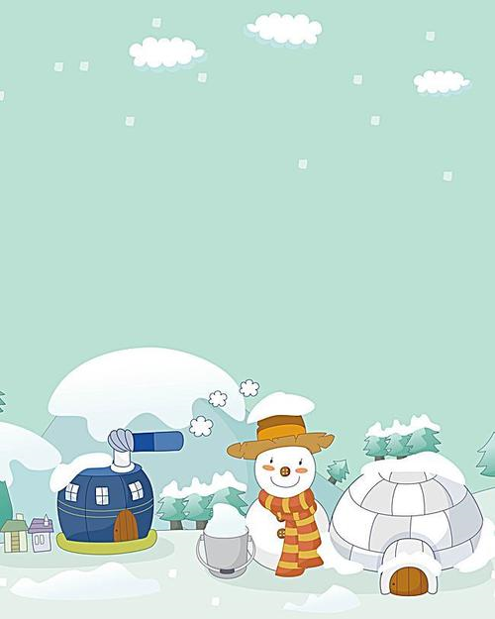
Warm up
Which season do you like best? Why?
I like…

Slide 3


Lead in
Which fruit do you like best?
Do you know which fruit I like best?
Which season do you like best?
…
…

Slide 4
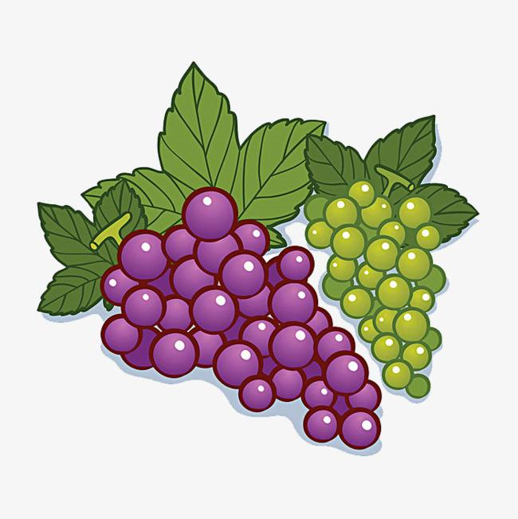

Presentation
I like grapes.
I like green grapes.
grow
Green grapes grow.
Who likes green grapes?
Let’s listen to a chant.

Slide 5

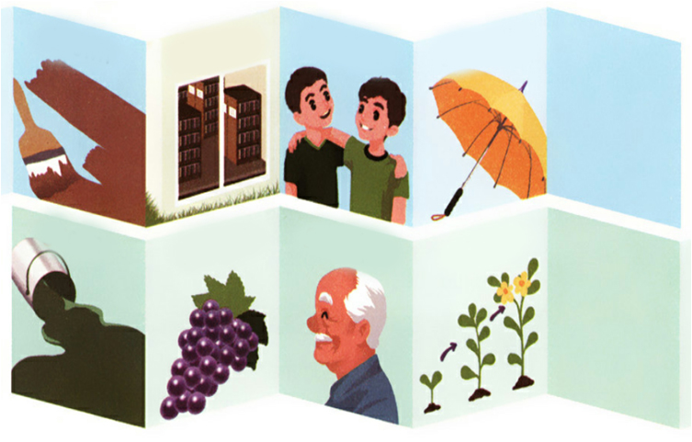
Read, listen and chant
Listen and answer the question.
点击画面 播放视频
Who likes green grapes?
Grandpa and Brother.

Slide 6

Read them and summarize.
grapes
green
grandpa
grow
｝
gr
/gr/

Slide 7
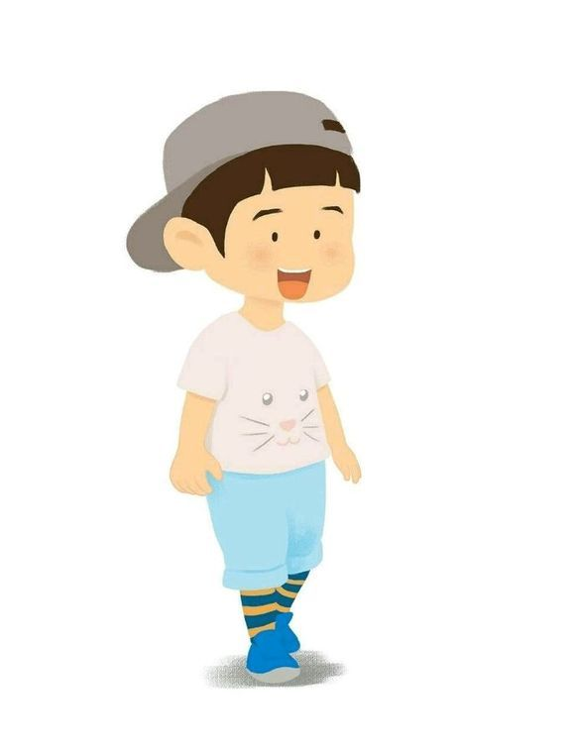

brother
bread
Brother likes bread, too.
What colour is this bread?
Let’s listen.

Slide 8
Watch the video and answer the question.
点击画面 播放视频
点击画面 播放视频
What colour is this bread?
Brown.

Slide 9
Read them and summarize.
brown
brother
bread
｝
br
/br/

Slide 10
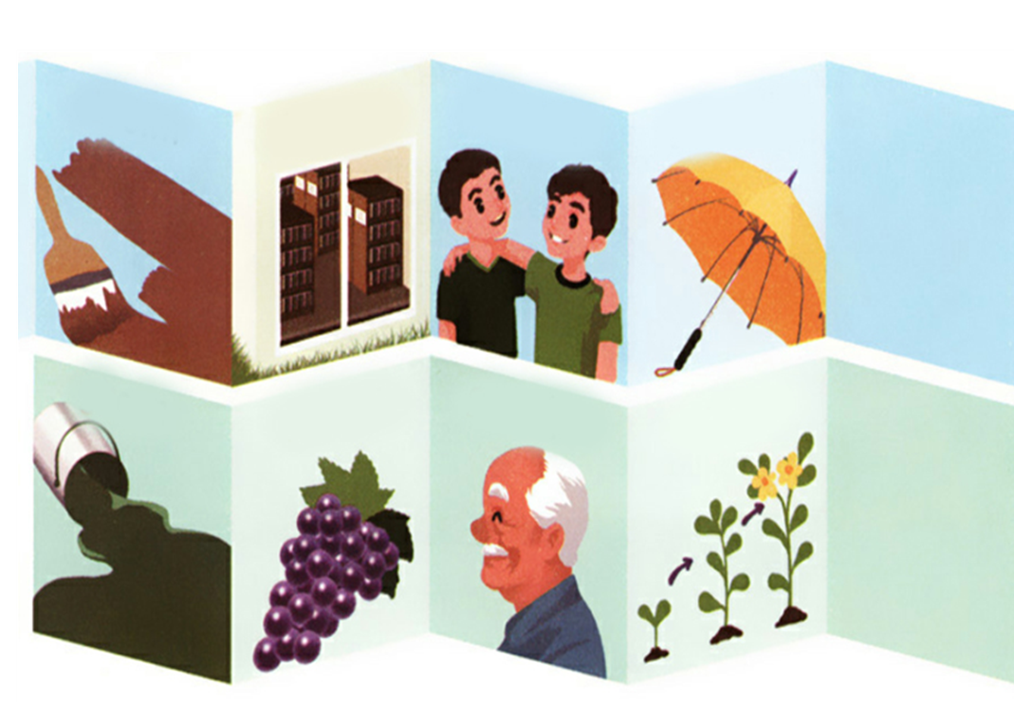
Listen and read.
brown
library
brother
umbrella
green
grapes
grandpa
grow

Slide 11
Can you read them quickly?
点击画面 播放视频
grandpa
grow
green
grapes
brother
umbrella
library
brown

Slide 12
Let’s chant together.
Green grapes grow,
Green grapes grow,
Grandpa and my brother
Watch green grapes grow.
Brown bread bakes,
Brown bread bakes,
Grandpa and my brother
Watch brown bread bake.

Slide 13
Practice
Passing Words.
green brown
grow grandma breakfast brother grass grapes library great
将全班分成八个人一组，每个小组排成一个长队，请第一位学生选其中一个词，小声告诉下一位学生，如此这样，直到小声传到本队的最后一名学生时，就请这位最后的学生大声说出他所听到的单词，然后请第一名学生也大声说出自己刚一开始传给第二名学生的单词，这样就可以判断出他们一组，每个组员是否都传递了正确的读音。

Slide 14
Read and group
green brown grow grandma breakfast brother grass grapes library great
br
gr
brown breakfast
brother library
green grow grandma
grass grapes great

Slide 15
Bingo.
给学生分发数张九格纸（横向三个格，竖向也三个格），在屏幕上显示所有要听写的单词，一旦有不会写的，就可以按照屏幕抄下所听到的单词，在听写的时候，学生可以随心所欲的把所听到的单词写在任意一个方格里，当你写出的单词无论是横向、竖向还是斜向，只要有一种情况的三个单词都含有br，或都含有gr，你就可以喊出“Bingo!”，并且圈出这组单词。
每一次喊出“Bingo!”时，就给同桌看一眼，让同桌确认自己“Bingo!”是否正确。
green brown grow grandma breakfast brother grass grapes library great

Slide 16
Choose, write and say
green
grapes.
Grandpa
yellow
potatoes.
grows
brown
grass.
Grandma
purple
apples.
1. Grandpa grows green grapes.
2.

Slide 17

Exercises
一、英译汉。
棕色的
兄弟
1. brown___________ 2. brother___________
3. umbrella_________ 4. green ____________
5. grow __________ 6. grapes_____________
雨伞
绿色的
生长
葡萄

Slide 18
二、判断划线部分读音是（T）否（F）相同。
( ) 1. A. green B. grass C. brown
( ) 2. A. great B. glass C. grate
( ) 3. A. break B. bring C. library
( ) 4. A. umbrella B. brother C. grape
( ) 5. A. grandpa B. grandma C. grow
F
F
T
F
T

Slide 19

三、给单词分类。
green
brown
play
grandma
great grow
grandpa
library
breakfast brother
bring
plant
please place
green brown play grandma library plant breakfast
please great brother grow place grandpa bring

Slide 20


Summary
字母/字母组合
发音
词语
brown library
brother umbrella
br
/br/
七彩课堂
伴你成长
gr
/gr/
green grapes
grandpa grow

Slide 21

Homework
ONE
TWO
Read the words.
Make sentences using the words we have learnt.
七彩课堂
伴你成长
Collect the words with “gr” and “br”.

Slide 22








