Slide 1


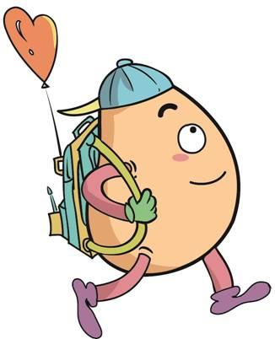






人 教 PEP 版 英 语 五年 级 下 册
Unit 2
My favourite season
Part A
Let’s try & Let’s talk

Slide 2

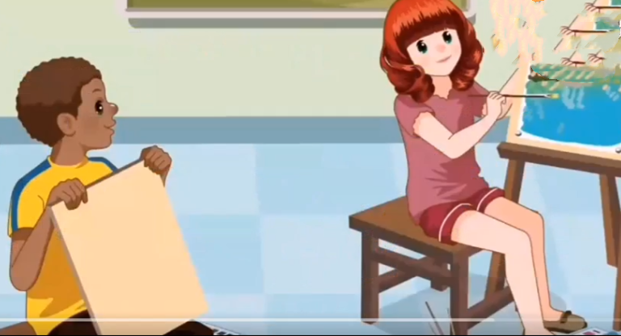
Warm up

Slide 3
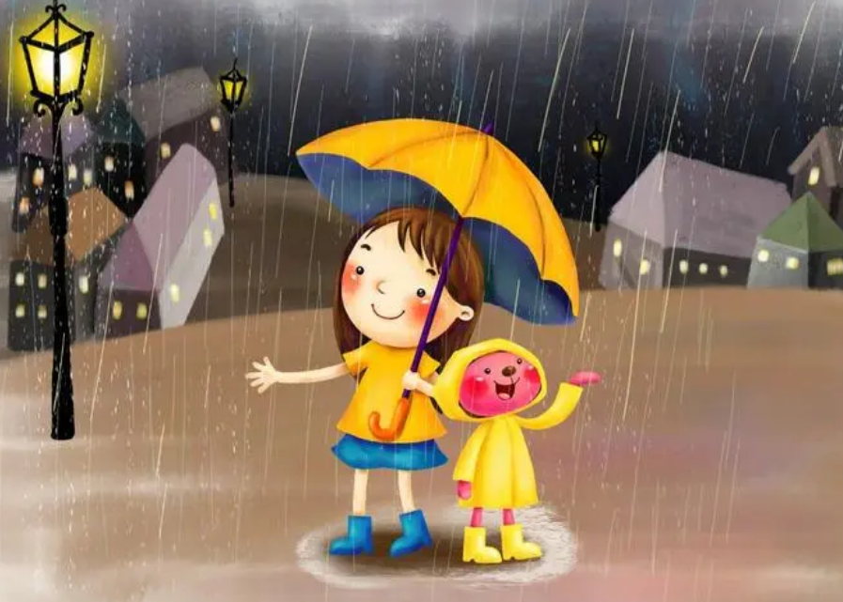
Lead in.
What’s the weather like today?
It’s rainy and cold.

Slide 4
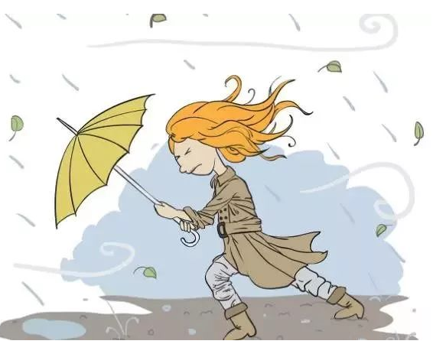
What’s the weather like today?
It’s windy and cold.

Slide 5
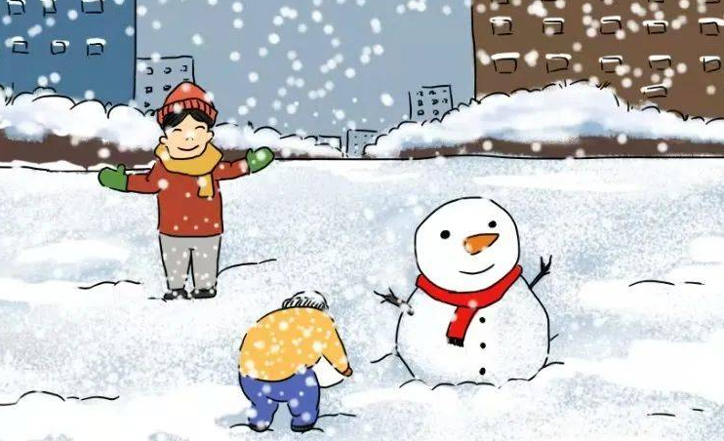
What’s the weather like today?
It’s snowy and cold.

Slide 6
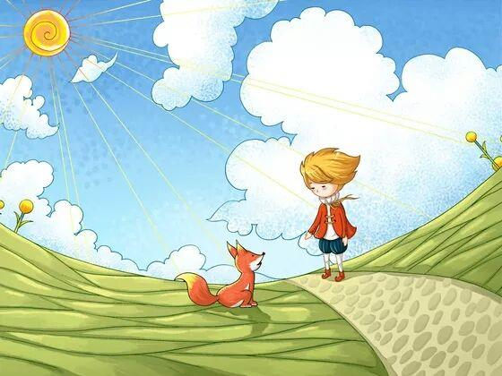
What’s the weather like today?
It’s sunny and warm.

Slide 7

What’s your favourite weather?

Slide 8
Presentation
Talk about your favourite season?
Mike and Chen Jie talk about weather.
Wu Binbin talks about his favourite weather.
Zoom and Zip talk about their favourite season.

Slide 9



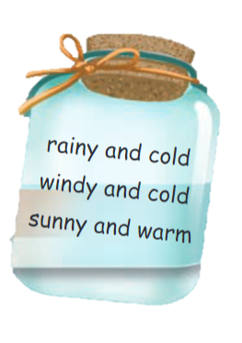

Listen and write.
Let’s try
What is the weather like today?
Rainy and cold
Windy and cold
Sunny and warm
windy and cold
It’s .

Slide 10
Let’s check！
Mike: It's a windy day.
Chen Jie: Yes. It's cold, too.
Mike: What's your favourite season, Chen Jie?
Chen Jie: Autumn. It is beautiful here in Beijing.

Slide 11




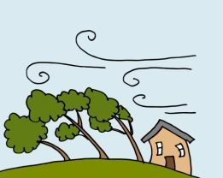
Read and match.
cloudy
warm
sunny
hot
windy
cold
snowy
cool
rainy

Slide 12

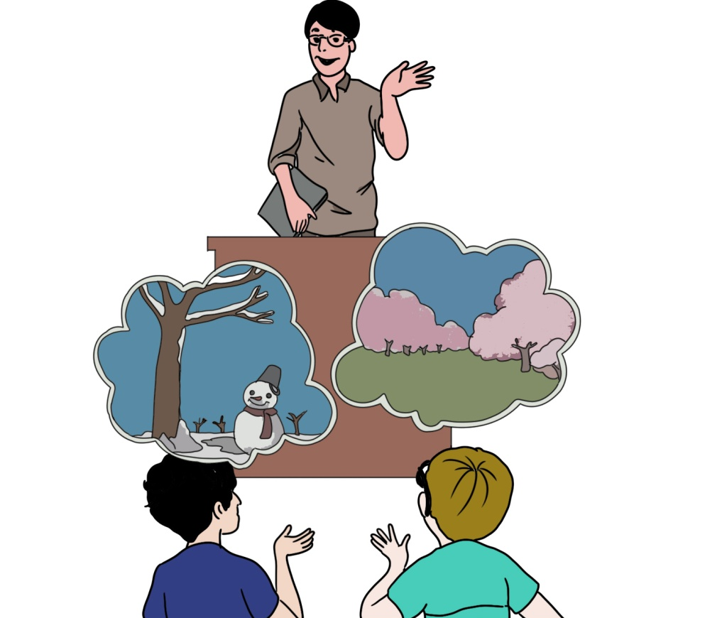
Let’s talk
Watch and answer！
How many seasons are there?
2. Which season does Mike like best?
3. Which season does Mr Jones like best?
4. Which season does Wu Binbin like best?

Slide 13
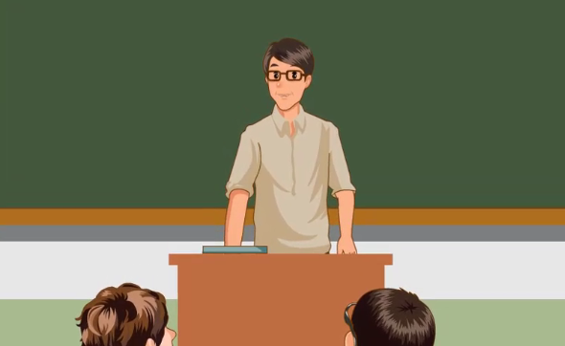

Slide 14
How many seasons are there?
2. Which season does Mike like best?
3. Which season does Mr Jones like best?
4. Which season does Wu Binbin like best?
There are four seasons.
He likes winter best.
He likes winter best.
He likes spring best.

Slide 15
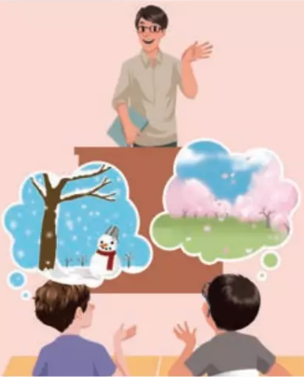
Listen to the tapeand read after it.
Mr Jones: Do you like the music, children?
Mike: Yes. It’s very beautiful. What is it?
Mr Jones: The Four Seasons. Today we’ll draw the seasons. Which season do you like best, Mike?
Mike: Winter. I like snow.
Mr Jones: I like snow, too. Which season do you like best, Wu Binbin?
Wu Binbin: Spring. It’s pretty.
Mr Jones: Yes, it is.

Slide 16

Read and act.
1.Read it together.
2.Each student
reads a sentence.
Tip: Choose one to read in two. 选择一种两人练习。
3. Read in roles.
自己分配角色。

Slide 17
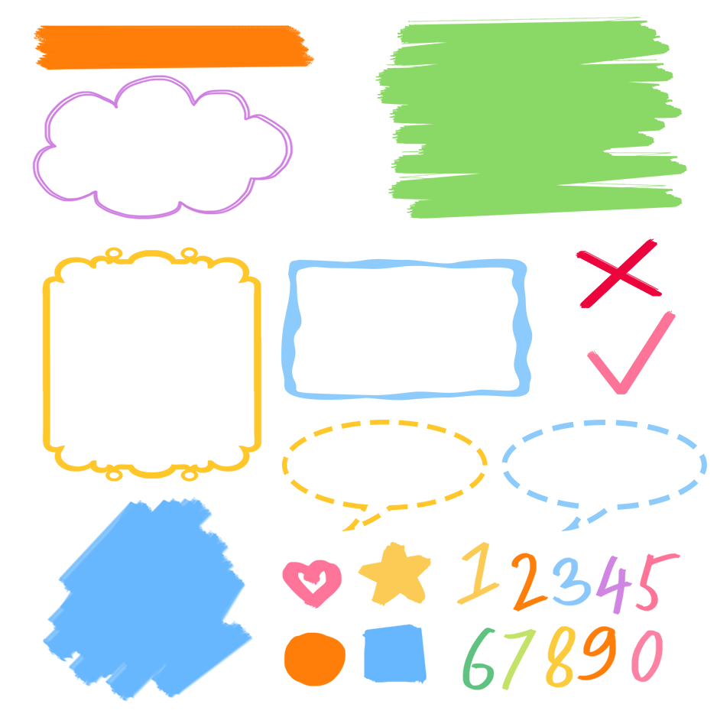

流利地朗读
流利地表演
有感情地表演

Slide 18
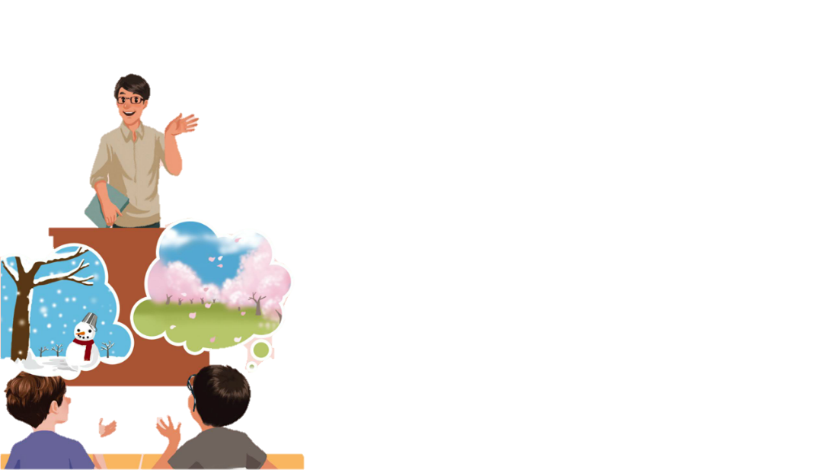
Listen and repeat.
Mr Jones: Do you like the music, children?
Mike: Yes. It’s very beautiful. What is it?
Mr Jones: The Four Seasons. Today we’ll draw
the seasons. Which season do you
like best, Mike?
Mike: Winter. I like snow.
Mr Jones: I like snow, too. Which season do you
like best, Wu Binbin?
Wu Binbin: Spring. It’s pretty.
Mr Jones: Yes, it is.
询问某人最喜欢哪个季节
季节
雪
哪一个
最；最高程度地

Slide 19

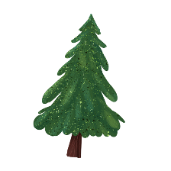


Language point.
— Which season do you like best?
— Winter.
Which
哪一个
询问某人最喜欢的事物
句型：
—Which + 事物 + do you like best?
— Which music do you like best?
— Which pen do you like best?

Slide 20
Which season do you like best?
=What’s your favourite season?
同义句转换
Which + 事物 + do you like best?
=What’s your favourite + 事物 ?
两个句子都可以用来询问他人最喜欢的事物。
Which season do you like best?
=What’s your favourite season ?

Slide 21
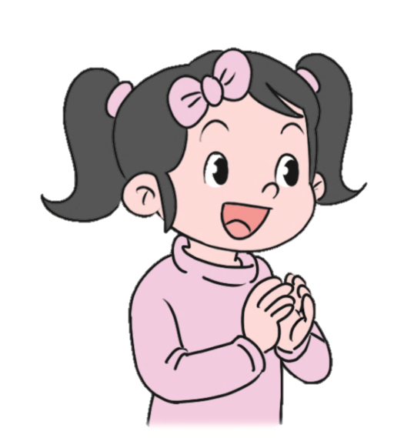
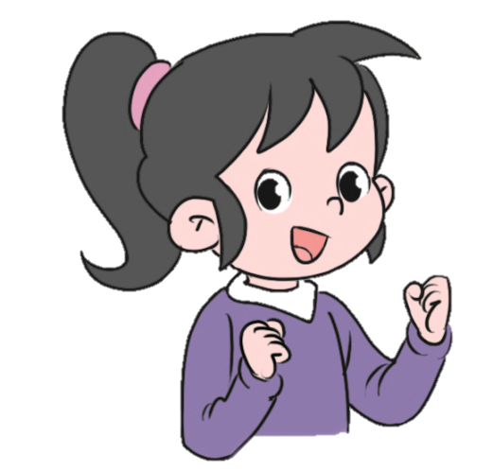
Let’s practice.
Which season do you like best?
I like summer best.
Which subject do you like best?
I like English best.

Slide 22
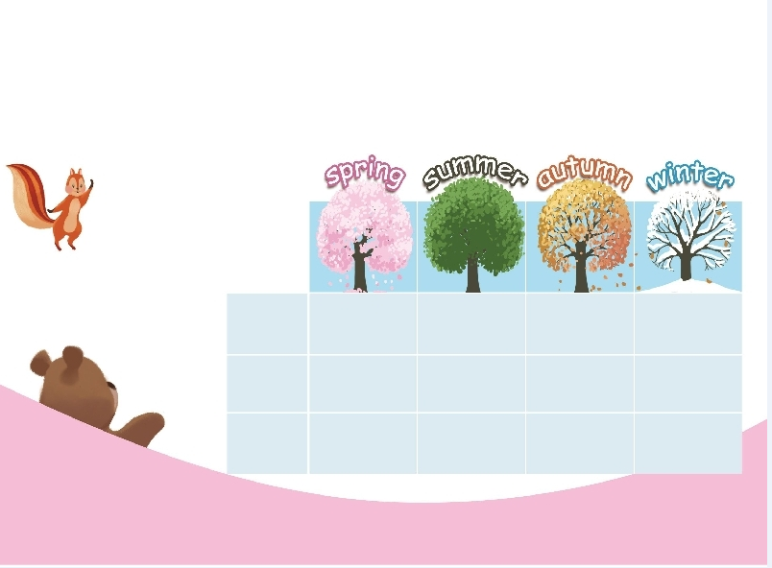
Role play
Which season do you like best? Ask and answer.
Which season do you like best?
Winter.
Zoom
√

Slide 23
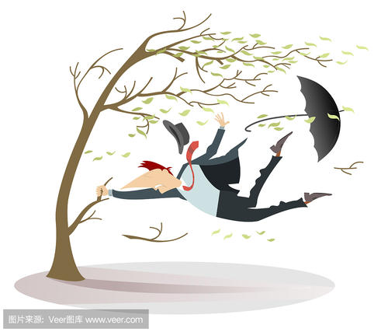
Make dialogues according to the following pictures.
A: Which season do you like best?
B: Autumn.
A: Why?
autumn
B: It’s windy and cool.
windy and cool

Slide 24
Make dialogues according to the following pictures.
A: Which season do you like best?
B: …
A: Why?
B: …
spring
sunny and warm

Slide 25
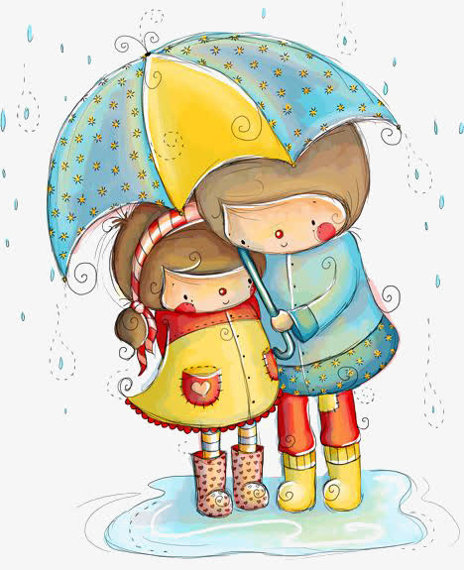
Make dialogues according to the following pictures.
A: Which season do you like best?
B: …
A: Why?
B: …
summer
rainy

Slide 26
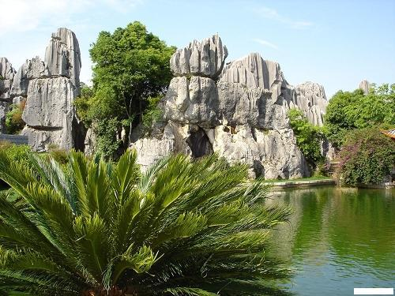
Good to know
Because the summer is not hot, the winter is not cold, the climate is pleasant, the urban temperature is between 0-29 °c, and the annual temperature difference is the smallest in the country! Such climatic features make Kunming famous as "spring city" both at home and abroad!

Slide 27

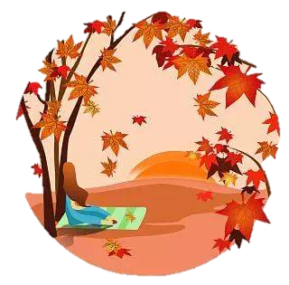
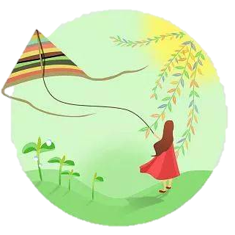
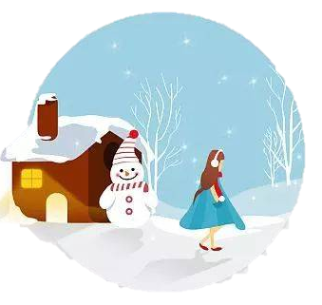
Exercises
一、图文配对。
spring
winter
summer
autumn

Slide 28
二、根据要求写出相应的单词和短语
1. 四季________________ 2. snow(形容词)________
3. sun(形容词)_________ 4.wind(形容词)_________
5. cold(反义词)_________ 6. child(复数)___________
7. 哪一个_______________8. good(最高级)________
four seasons
snowy
sunny
windy
hot
children
which
best

Slide 29
三、按照要求完成句子。
1.I like green best.(对划线部分提问)
____________________________________
2.best, she, which, like, does, season (?)(连词成句)
___________________________________
3.My favourite season is summer. (对划线部分提问)
___________________________________
Which colour do you like best?
Which season does she like best?
What’s your favourite season?

Slide 30

Summary
1. 学习了下列单词：
season, which, best, snow.
2.学习了下列句型：
—Which season do you like best?
— Winter.

Slide 31
Homework
ONE
TWO
Act the dialogue out with your friends.
Make a short dialogue using the sentences we have learnt.
Paint the seasons of a year.

Slide 32







