Slide 1









人 教 PEP 版 英 语 五 年 级 下 册
Unit 2
My favourite season
Part A
Let’s try & Let’s talk

Slide 2


Warm up
Let’s sing.
点击画面 播放视频

Slide 3



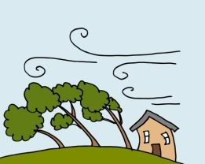

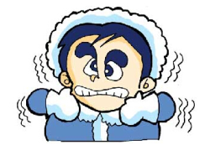
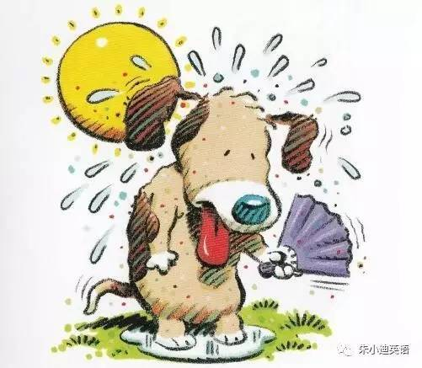
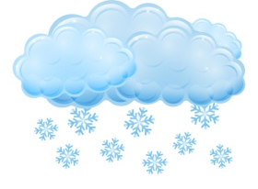
Match the words together with the pictures.
sunny rainy cloudy windy snowy hot cold

Slide 4

Lead in
What’s the weather like today?
sunny rainy cloudy windy snowy hot cold warm
It’ s .

Slide 5

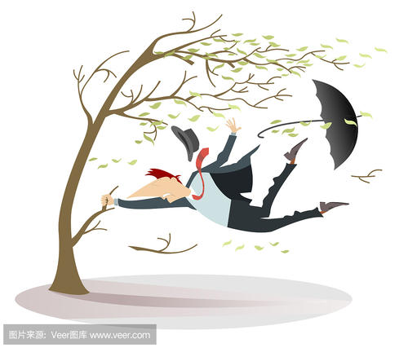
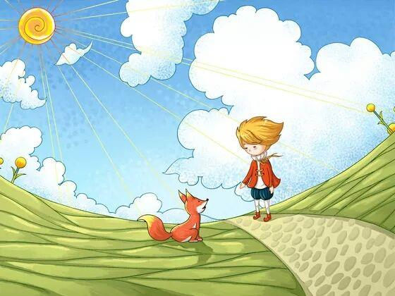
What’s the weather like in the first picture?
rainy and cold
windy and cold
sunny and warm
What weather are Mike and Zhang Peng talking about?

Slide 6
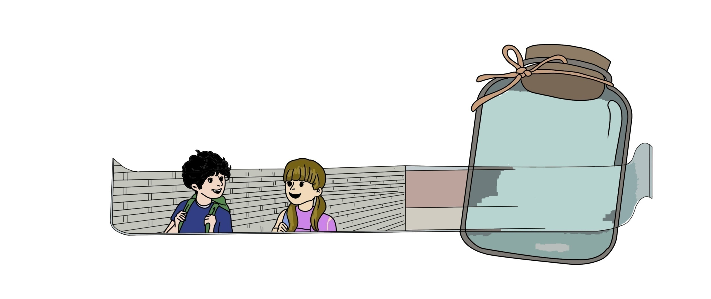

What is the weather like today?
Listen and write.
rainy and cold
windy and cold
sunny and warm
It’ s .
windy and cold

Slide 7
听力原文：
Mike: It's a windy day.
Chen Jie: Yes. It's cold, too.
Mike: What's your favourite season, Chen Jie?
Chen Jie: Autumn. It is beautiful here in Beijing.

Slide 8
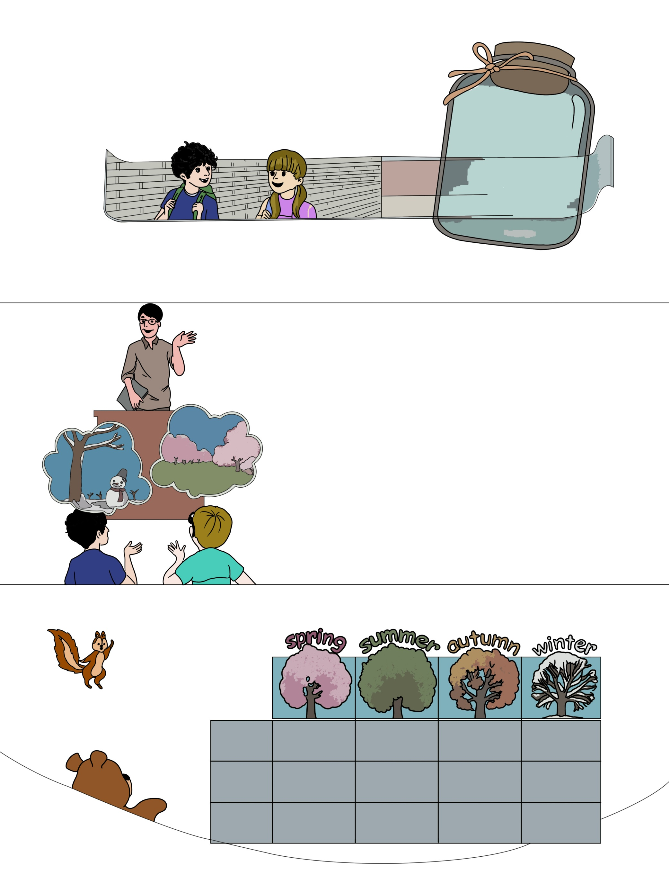
Presentation
Let’s talk
Watch the video.
点击画面 播放视频
What’s the meaning of “which”, “best” and “snow” in Chinese, please?
which
哪一个
[wɪtʃ]
best
[best]
最；最高程度地
snow
[snəu]
雪

Slide 9
Watch again and answer the questions.
点击画面 播放视频
1. Which season does Mike like best?
Winter.
2. Which season does Wu Binbin like best?
Spring.

Slide 10
Language points
Which season do you like best?
【详解】以特殊疑问词which引导的特殊疑问句。which意思是“哪一个”，用以对选择物品进行提问。
句型结构：Which+物品+一般疑问句+?
E.g. Which class do you like best?
Which pen do you like best?

Slide 11
Listen to the tape and read after it.
Mr Jones:
Mike:
Mr Jones:
Mike:
Mr Jones:
Wu Binbin:
Mr Jones:
Do you like the music, children?
Yes. It’s very beautiful. What is it?
The Four Seasons. Today we’ll draw the seasons. Which season do you like best, Mike?
Winter. I like snow.
I like snow, too. Which season do you like best, Wu Binbin?
Spring. It’s pretty.
Yes, it is.

Slide 12
1. Read the text freely in groups.
2. Act it out group by group.
Find the best group.

Slide 13
Practice
Which season do you like best? Ask and answer.
Which season do you like best?
Winter.
✔
Zoom

Slide 14




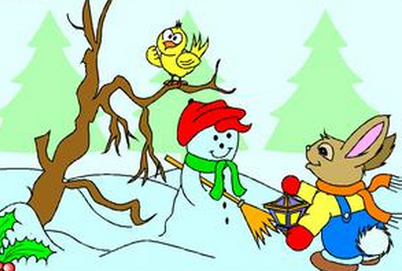
Exercises
一、给图片标序号。
B
A
D
C
A. spring B. summer C. autumn D. winter

Slide 15
二、英译汉。
1.rainy and cold _________ 2.windy and warm__________
3.sunny and hot __________4.cloudy and cool__________
5.snowy and cold__________
多雨并且寒冷
有风并且温暖
晴朗并且炎热
多云并且凉爽
有雪并且寒冷

Slide 16
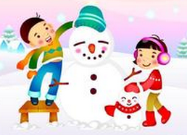

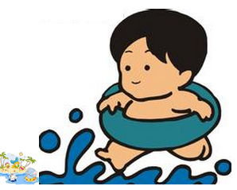
三、判断正（T）误（F）。
( ) 1.－Which season do you like best? －Winter.
( ) 2.－Which season do you like best? －Spring.
( ) 3.－Which season do you like best? －Summer.
T
F
T

Slide 17
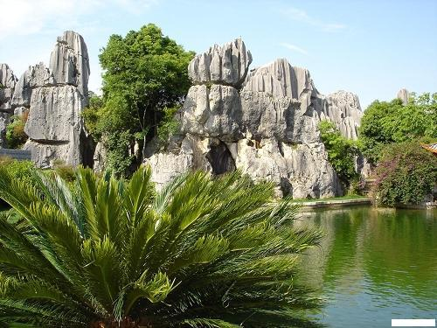
I want to know
中国春城——昆明
因夏无酷暑、冬无严寒、气候宜人，城区温度在0—29℃之间，年温差为全国最小，这样的气候特征使昆明以“春城”而享誉中外！
Because the summer is not hot, the winter is not cold, the climate is pleasant, the urban temperature is between 0-29 °c, the annual temperature difference is the smallest in the country! Such climatic features make Kunming famous as "spring city" both at home and abroad!

Slide 18
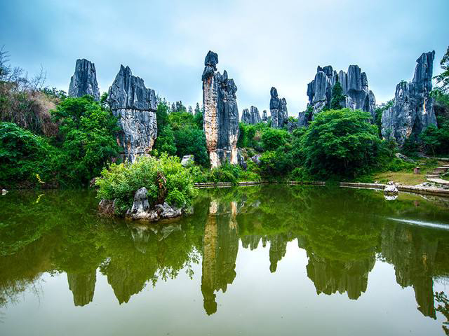
I love my country。
我爱我的祖国。

Slide 19


Summary
学习了下列单词：
which, best, snow
2.学习了下列句型：
—Which season do you like best?
— Winter.
七彩课堂
伴你成长

Slide 20

Homework
ONE
TWO
Act the dialogue out with your friends.
Make a short dialogue using the sentences we have learnt.
七彩课堂
伴你成长
Paint the seasons of a year.

Slide 21








