Slide 1


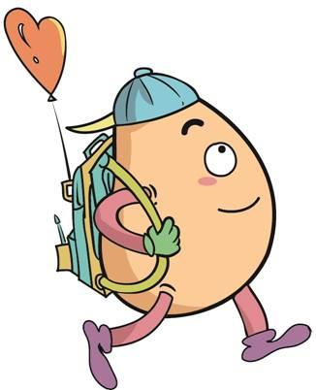





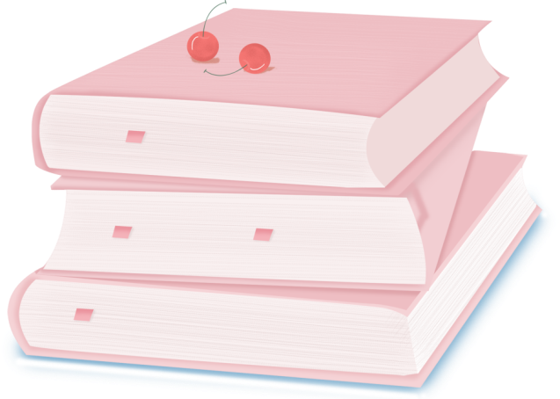
人 教 PEP 版 英 语 五年 级 下 册
Unit 1
My day
Part B
Let’s learn & Do a survey

Slide 2
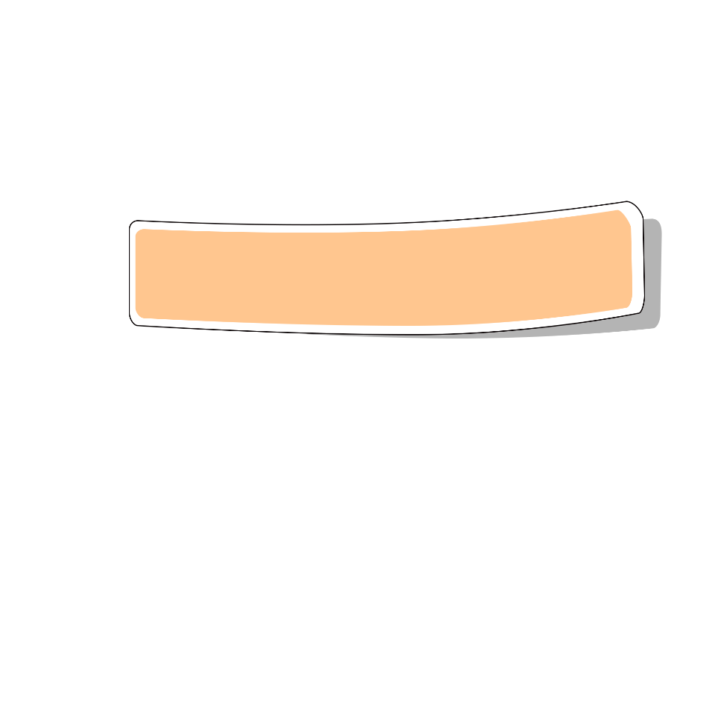
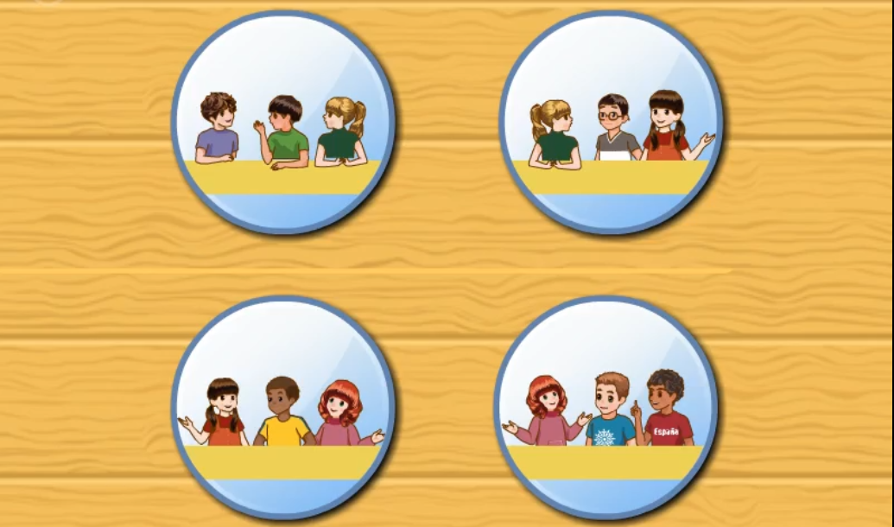
Warm up

Slide 3
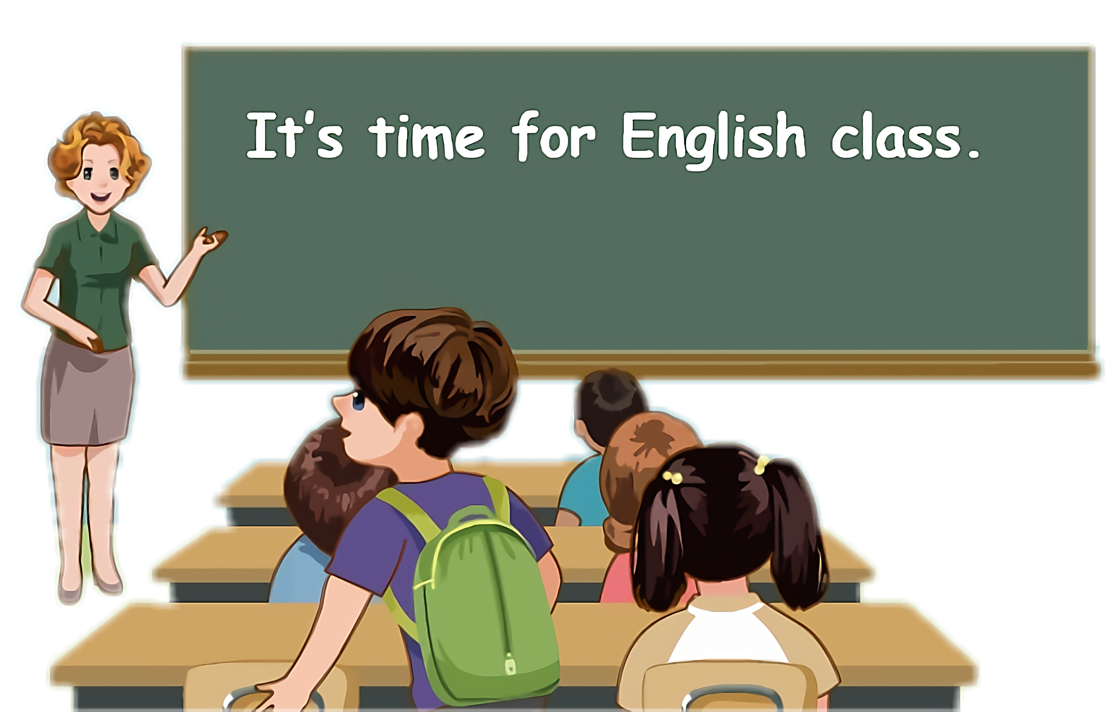
Lead in
Children, what do you do on the weekend?

Slide 4

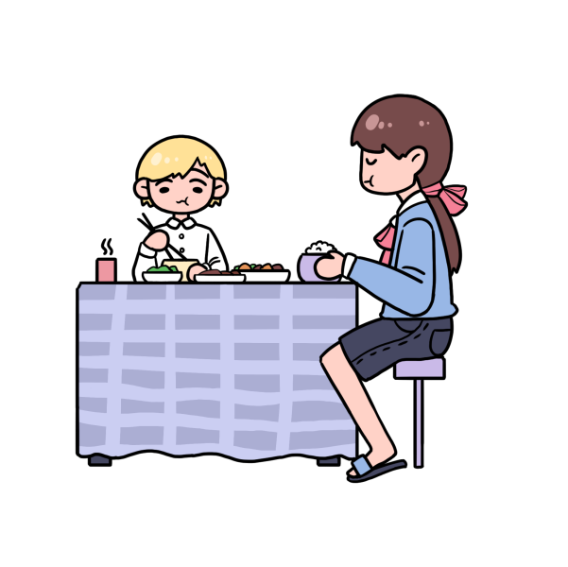
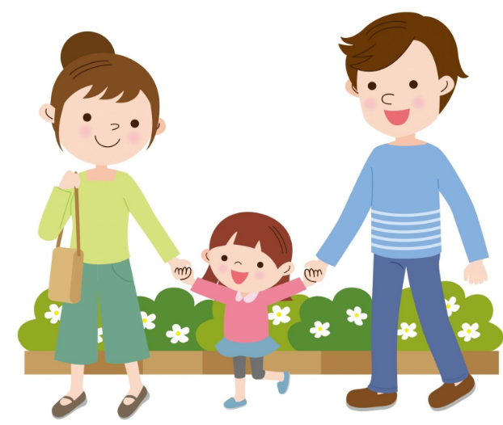
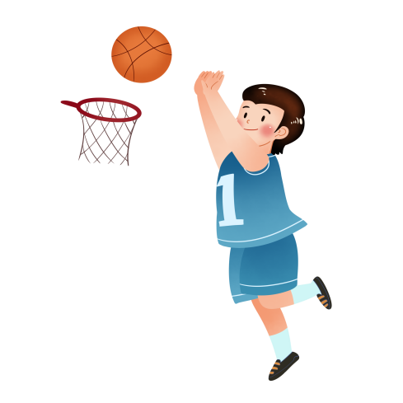
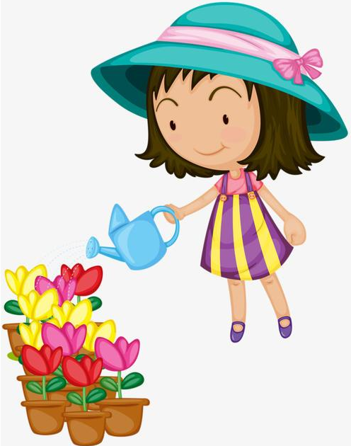
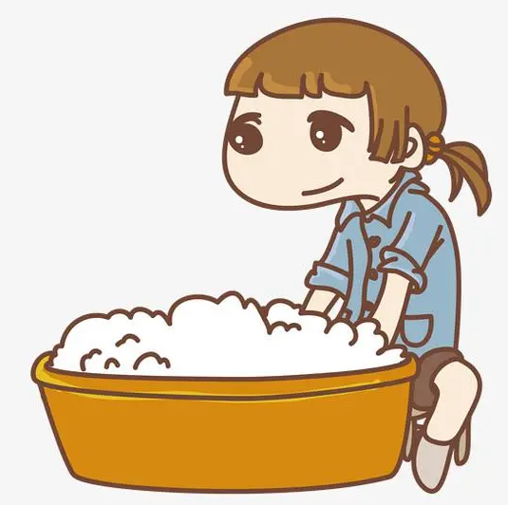
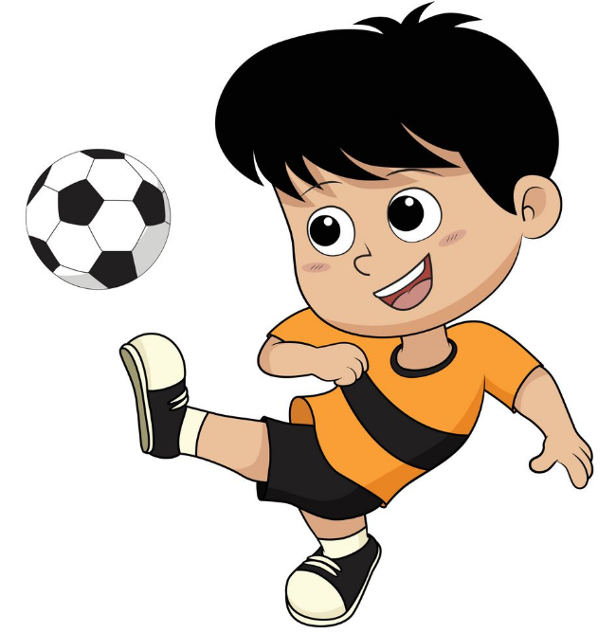

Free talk.
eat breakfast
go for a walk
play basketball
water flowers
wash clothes
play football
watch TV

Slide 5
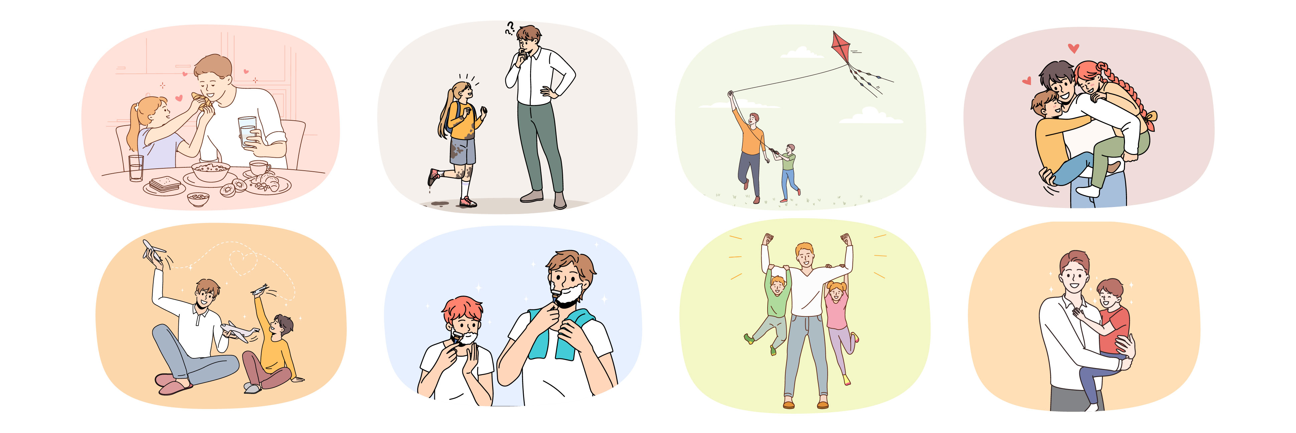
Let’s introduce weekend activities.

Slide 6
Talk about the activities on the weekend.
Learn new expressions about weekend activities.
Talk about Sarah’s weekend activities.
Talk about my weekend activities.

Slide 7

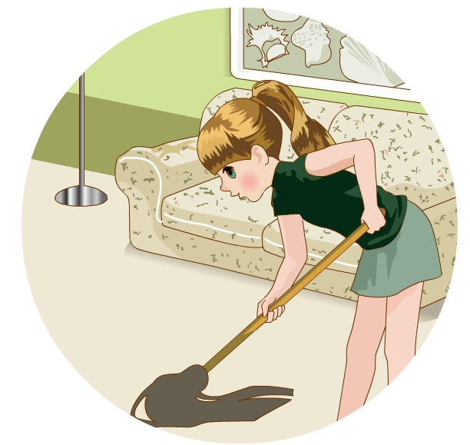

Let’s learn
Learn new words！
clean my room
打扫我的房间
拓展
sweep the floor扫地
I often ___________ on Saturdays.
clean my room

Slide 8
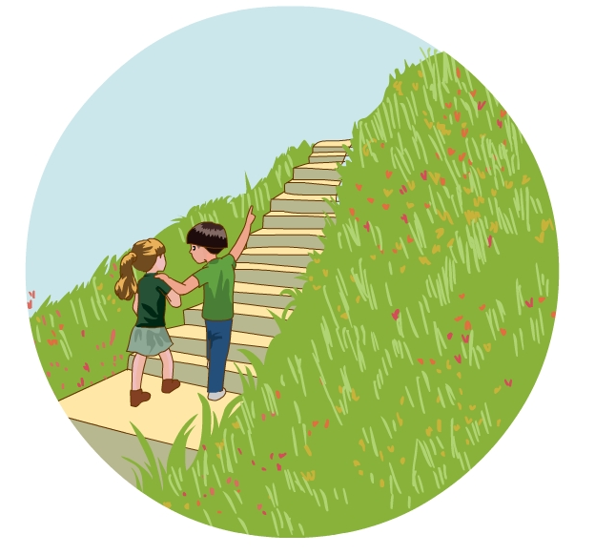
go for a walk去散步
take a walk
同义
go for a row去划船
go for music去听音乐
拓展
go for a walk
I usually ___________ on the weekend.

Slide 9
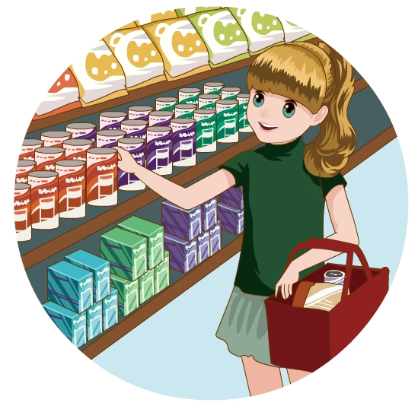
go shopping去购物
go swimming去游泳
go fishing去钓鱼
go running去跑步
go skating去滑冰
拓展
go+v-ing
go shopping
I sometimes ___________with my mum.

Slide 10
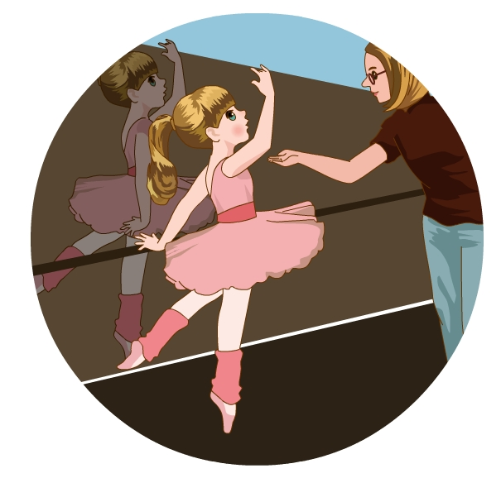
take a dancing class
上舞蹈课
同义
have a dancing class.
take a/an +科目 class上......课
eg. take /have an English class
短语
I always ________________on Sundays.
take a dancing class

Slide 11
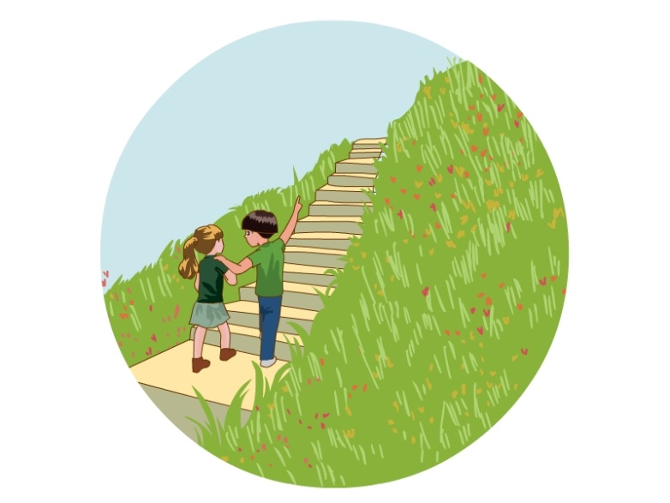
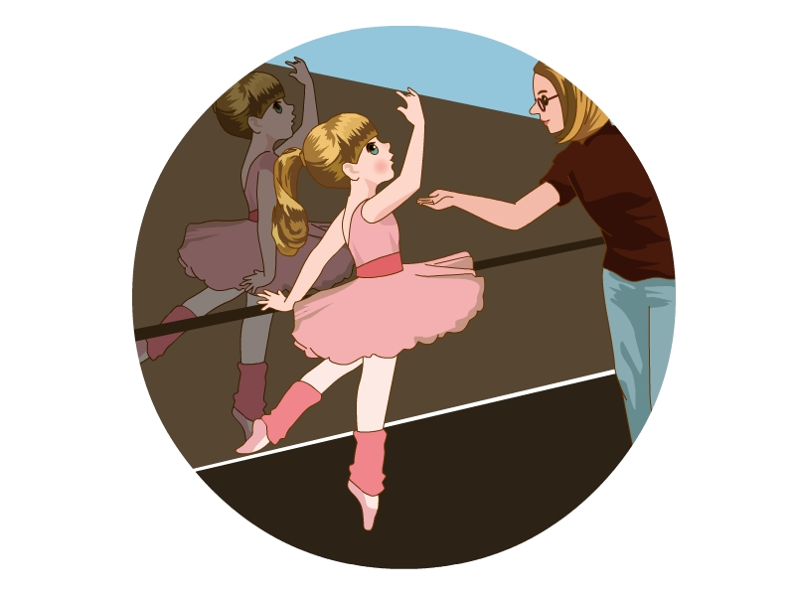
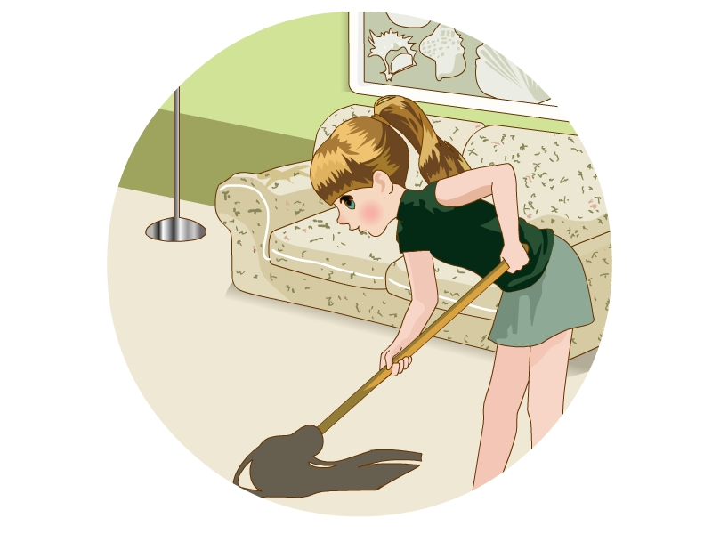
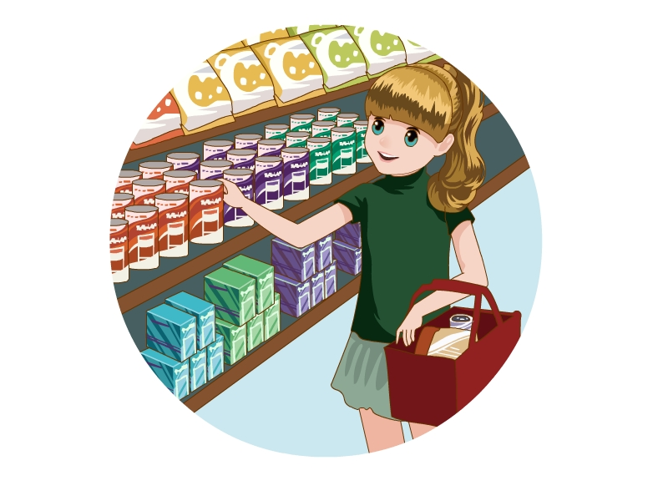
Read quickly！

Slide 12

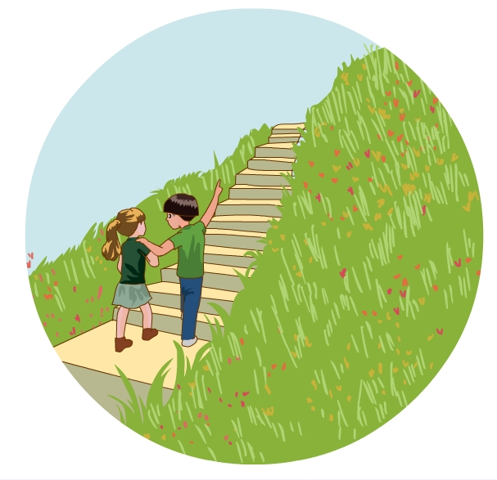
go shopping
go for a walk
have a dancing class
clean my room

Slide 13
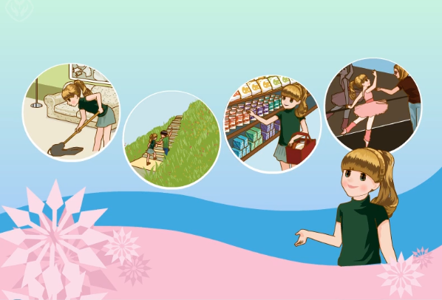
Watch and answer！
What does Sarah do on Saturdays?

Slide 14
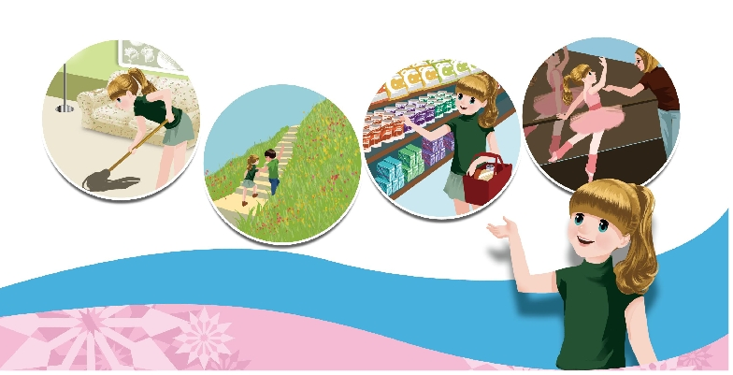
Listen and say！
take a dancing class
clean my room
go shopping
go for a walk
I often take a dancing class on Saturdays!
I often clean my room on Saturdays!
I often go for a walk on Saturdays!
I often go shopping on Saturdays!

Slide 15
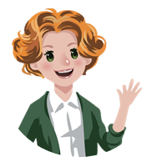
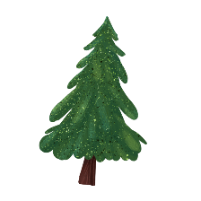


Language point.
频度副词的位置
频度副词通常放在句中，一般位于实义动词前，be动词或情态动词后。有时也位于句首。
He is always hungry. 他总是饿。(be动词后)
He often gets up late.他经常起床很晚. (实义动词前)
Sometimes we walk to school.有时我们步行去学校.(放在句首)

Slide 16
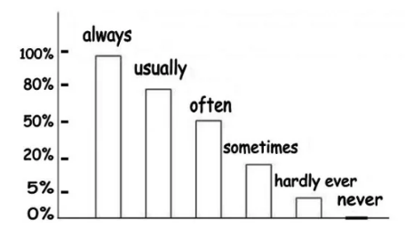
Language point.
频度副词的频率排列顺序
频度副词表示动作所发生的频率，其排列顺序是：always＞usually ＞ often ＞ sometimes ＞ hardly ever ＞ never
I always have some bread and milk for breakfast.
She usually goes to school by bus.
He is often late for school.
He sometimes reads books in the evening.
He hardly ever eats meat.
I never drink beer.

Slide 17

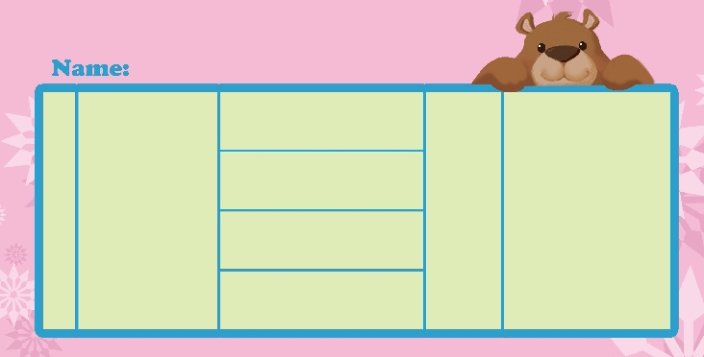
Do a survey
Look, tick and write.
What do you do on the weekend?
I sometimes go shopping with my mum on the weekend.
clean my room
always
often
sometimes
go shopping
on Saturdays on Sundays
on the weekend
I
with
go for a walk
take a dancing class

Slide 18
What do you do on the weekend?
I often clean my room on the weekend.
clean my room
always
often
usually
sometimes
go shopping
on Saturdays on Sundays
on the weekend
I
with
go for a walk
take a dancing class

Slide 19
What do you do on the weekend?
I usually take a dancing class with my friends on Saturdays.
clean my room
always
often
usually sometimes
go shopping
on Saturdays on Sundays
on the weekend
I
with
go for a walk
take a dancing class

Slide 20
What do you do on the weekend?
I always go for a walk with my parents on Sundays.
clean my room
always
often
usually
sometimes
go shopping
on Saturdays
on Sundays
on the weekend
I
with
go for a walk
take a dancing class

Slide 21
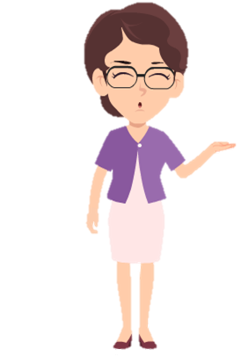

Make dialogues using the following phrases.
clean my room
do morning exercises
go shopping
read books
have a dancing class
see a film
go for a walk
watch TV
What do you do on the weekend?
I ____on the weekend.

Slide 22
Write something about your weekend.
I am Mary. I’m very busy on the weekend. I often clean my room on Saturdays…

Slide 23
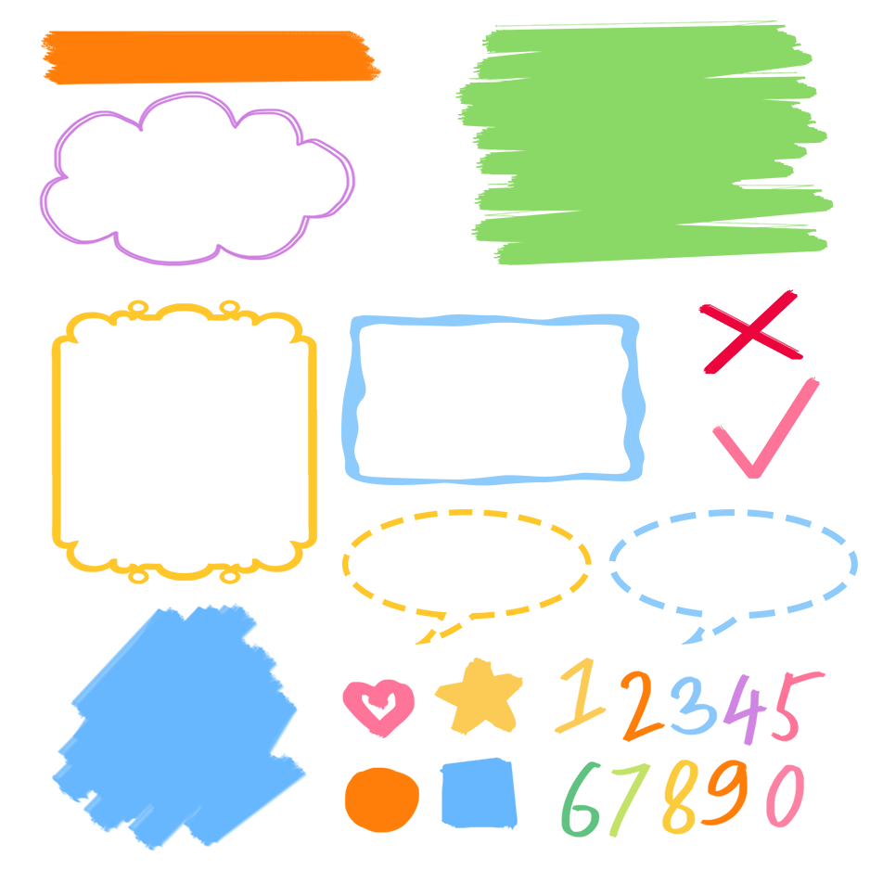
了解周末活动词组
记忆周末活动词组
熟练运用周末活动词组表达

Slide 24

Good to know
There is a history in all men’s lives.
--Shakespeare
每个人的生命里都有一部历史。
--莎士比亚

Slide 25
Exercises
一、单项选择
( ) 1. I ____ go fishing on Sundays.
A. some times B. sometimes C. some time
( ) 2. I always go ________ a walk on Saturdays.
A. at B. in C. for
( ) 3.Let’s take a ________ class together.
A. dance B. danceing C. dancing
B
C
C

Slide 26
二、按照要求完成句子。
1.I often clean my room on Saturdays.(对划线部分提问)
____________________________________
2.Sundays, my, a, I, for, mum, on, walk, often, go,with (.)(连词成句)
_________________________________________
3.usually, the, do, what, weekend, you, on, do,(?) (连词成句)
____________________________________
When do you usually clean your room?
I often go for a walk with my mum on Sundays.
What do you usually do on the weekend?

Slide 27

Summary
1. 学习了下列短语：clean my room, go for a walk, go shopping, take a dancing class.
2. 复习了表示频度的副词：sometimes, often, usually, always.
3. 学习了描述自己周末做某事的句型：
I sometimes go shopping with my mum on the weekend.

Slide 28
Homework
ONE
TWO
Listen, read and recite the new phrases.
Talk about your weekend and write a short passage.
Do “Do a survey” with your friends.

Slide 29







