Slide 1









人 教 PEP 版 英 语 五 年 级 下 册
Unit 1
My day
Part B
Let’s learn & Do a survey

Slide 2


Warm up
Choose and read the phrase.
1
wash my clothes
play football
3
draw cartoons
2
do homework
play the pipa
play basketball
4
5
6
read books
watch TV
play ping-pong
7
8
9

Slide 3

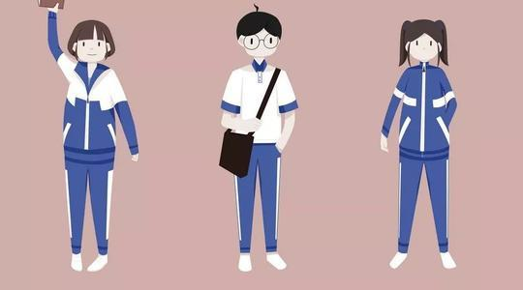
接龙。
I often read books.
Sometimes I go shopping.
What do you do on the weekend?
I usually play ping-pong.
I sometimes draw pictures.
What do you do on the weekend?
What do you do on the weekend?

Slide 4

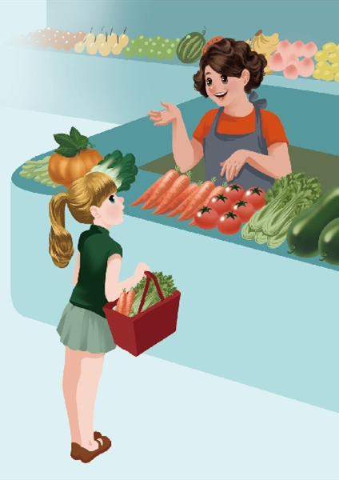
Lead in
What does Sarah do on the weekend?
She often watches TV and plays ping-pong with her father.
She usually washes her clothes. Sometimes she cooks dinner.
Sarah is very busy on the weekend. What does she do on Saturdays? Let’s see.

Slide 5
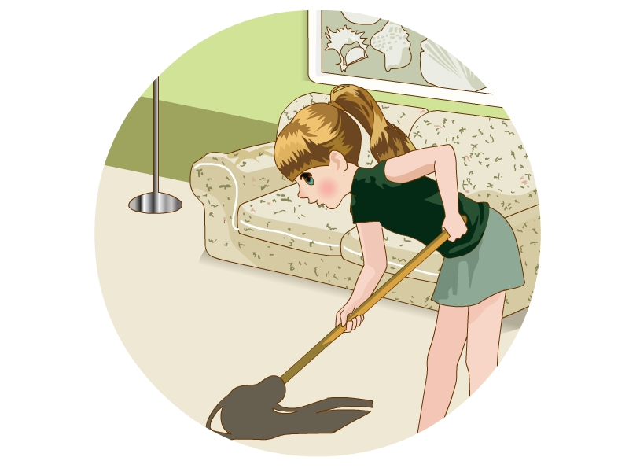
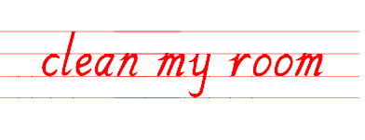

Presentation
I often clean my room on Saturdays!
clean my floor 扫地
clean my window 擦窗户
联想
打扫我的房间

Slide 6
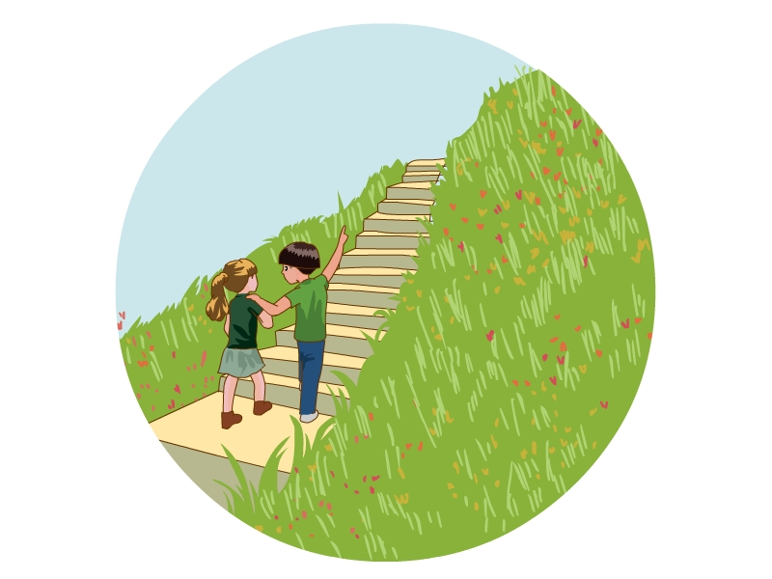
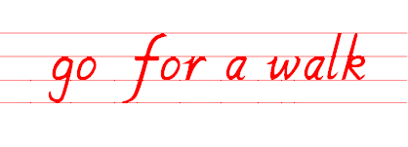
I always go for a walk on Saturdays!
同义短语
take a walk 散步
去散步

Slide 7
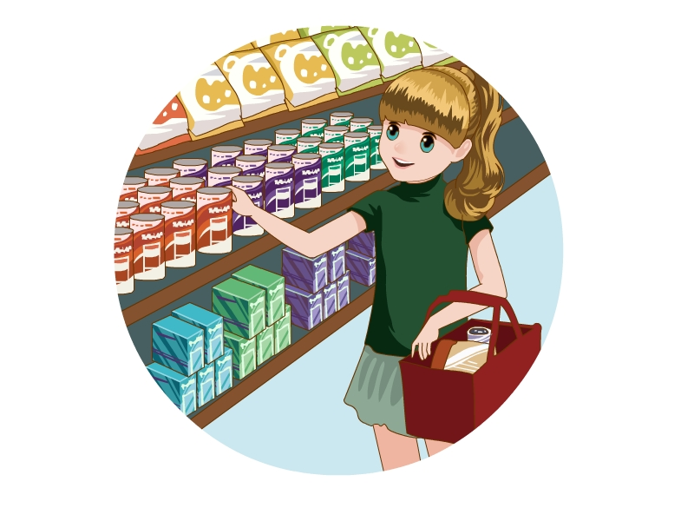
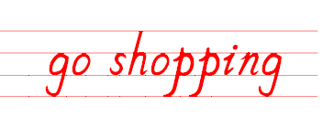
I sometimes go shopping with my mother on Saturdays!
去购物

Slide 8
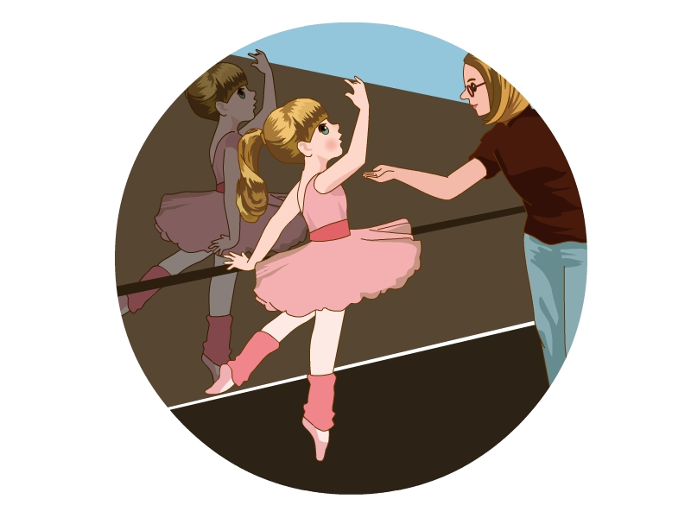
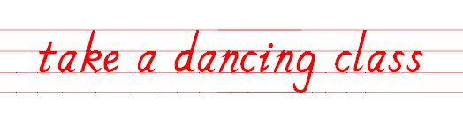
I usually take a dancing class on Saturdays!
拓展
take：学习；上（课）
上舞蹈课

Slide 9
Read the phrases and act it out as quickly as you can.

Slide 10
Say it out as quickly as you can.

Slide 11

Let’s learn
take a dancing class
clean my room
go shopping
go for a walk
I often clean my room on Saturdays!

Slide 12
找到活动名称与频率副词。
I am Sarah. I am very busy on the weekend. I often watch TV and play ping-pong on the weekend. I always go for a walk with my mother and father on Saturdays. Sometimes I go shopping, too. I have a lot of fun, but I am also hard-working. I usually wash my clothes and clean my room on Saturdays. I usually take a dancing class on Sundays.

Slide 13
比较发生频率的发小。
1. Sometimes I go shopping, too.
有时（30%）
2. I often watch TV and play ping-pong on the weekend.
经常（60%）
3. I usually take a dancing class on Sundays.
通常（80%）
4. I always go for a walk with my mother and father on Saturdays.
总是（100%）

Slide 14
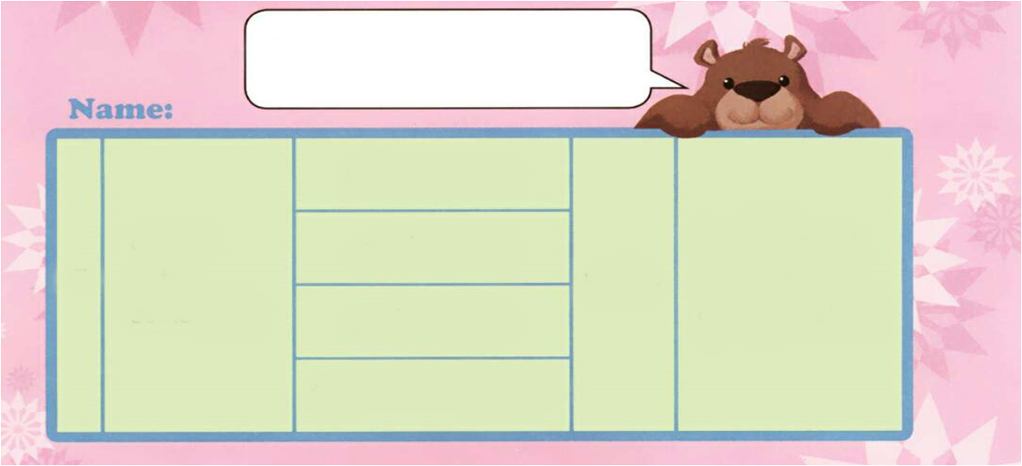
Do a survey
What do you do on the weekend?
I sometimes go shopping with
my mum on the weekend.
clean my room
always
on Saturdays
go shopping
I
often
on Sundays
with…
sometimes
go for a walk
on the weekend
take a dancing class

Slide 15

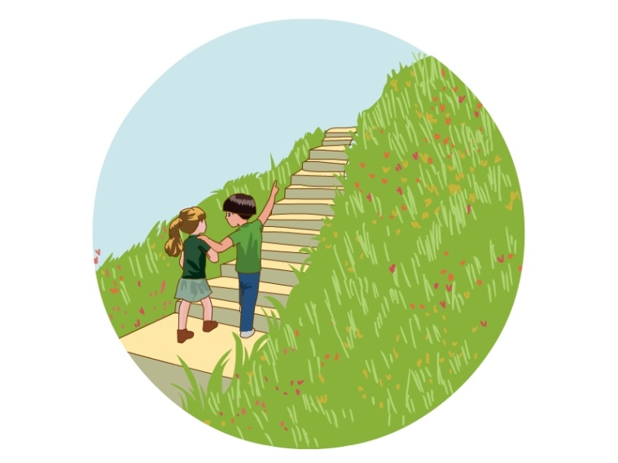
Practice
连一连

Slide 16
连一连

Slide 17


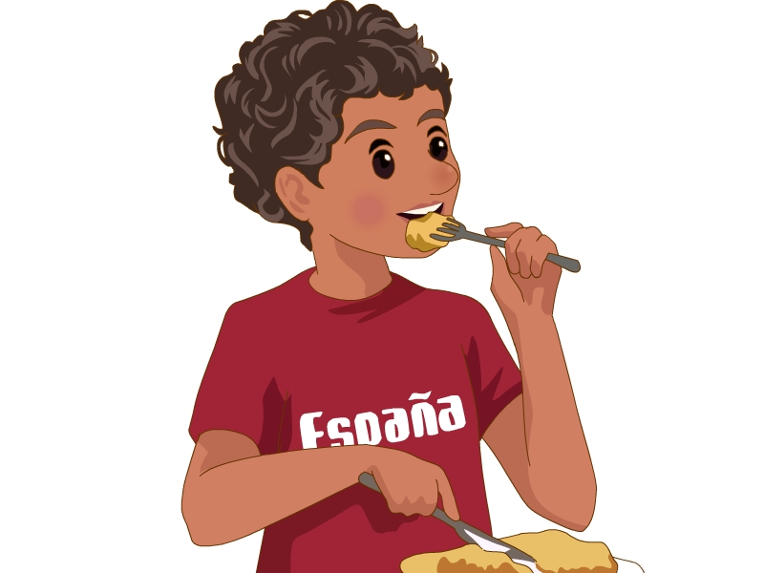
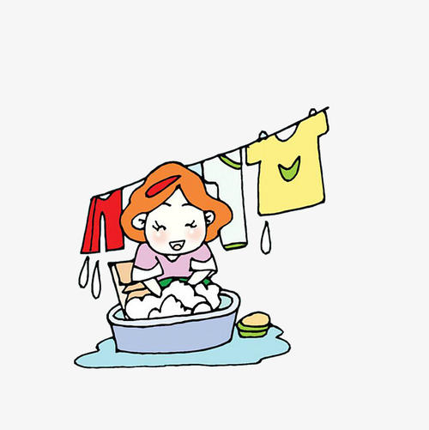
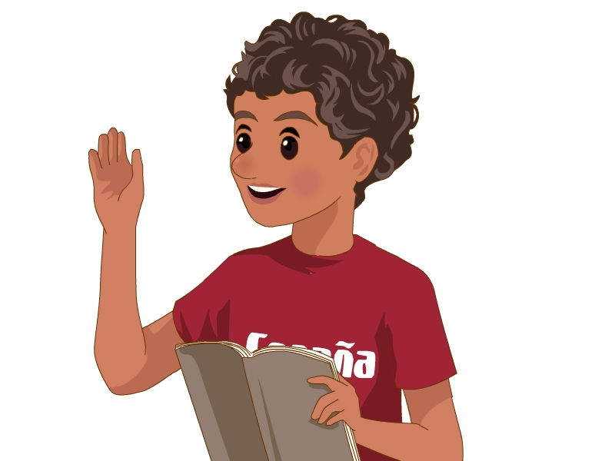

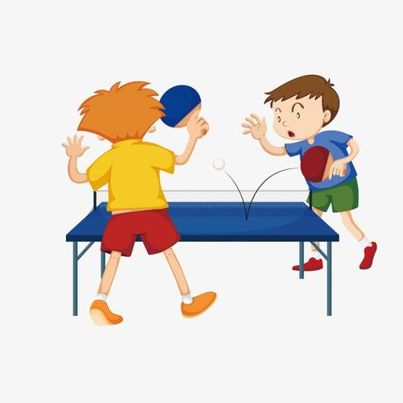
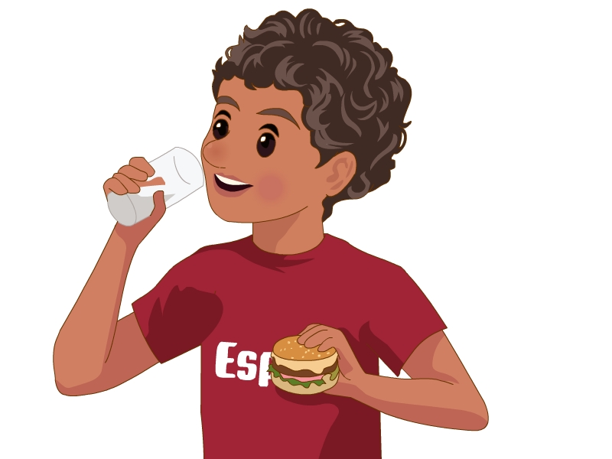
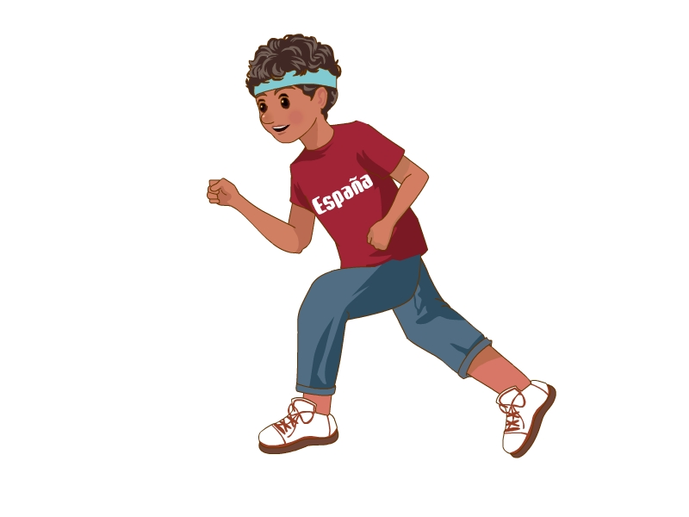
One student acts, the other one guesses.

Slide 18

Write something about your weekend. Then talk with your partner.
I am Amy. I am very busy on the weekend. I usually taking a dancing class on Saturdays…

Slide 19

Exercises
一、英译汉。
打扫我的房间
去散步
1. clean my room __________ 2. go for a walk ________
3. go shopping ________ 4. take a dancing class ________
5. on the weekend ______ 6. on Saturdays ________
去购物
上舞蹈课
在周末
在星期六

Slide 20
二、单项选择。
( ) 1. I always go ________ a walk on Saturdays.
A. at B. in C. for
( ) 2. I often go _______ on the weekend.
A. shop B. shopping C. shoping
( ) 3. Let’s take a ________ class together.
A. dance B. danceing C. dancing
C
B
C

Slide 21
三、连词成句。
1. sometimes, my, I, weekend, clean, on, room, the (.)
___________________________________________
2. with, football, often, friends, I, my, play (.)
___________________________________________
3. I, take, usually, dancing, Sundays, on, a, class (.)
___________________________________________
I sometimes clean my room on the weekend.
I often play football with my friends.
I usually take a dancing class on Sundays.

Slide 22


Summary
1. 学习了下列短语：clean my room, go for a walk, go shopping, take a dancing class。
2. 复习了表示频度的副词：sometimes, often, usually, always。
3. 学习了描述自己周末做某事的句型：
I sometimes go shopping with my mum on the weekend.
七彩课堂
伴你成长

Slide 23

Homework
ONE
TWO
七彩课堂
伴你成长
Talk about your weekend and write a short passage.
Listen, read and recite the new phrases.
Do “Do a survey” with your friends.

Slide 24








