Slide 1


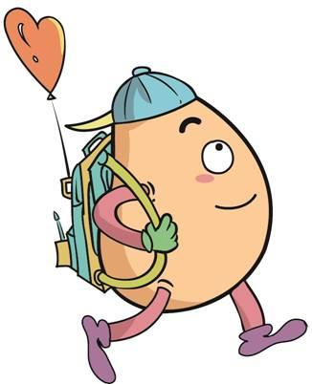





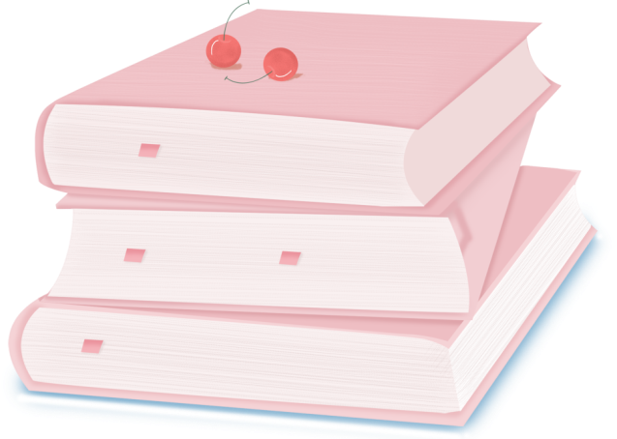
人 教 PEP 版 英 语 五年 级 下 册
Unit 1
My day
Part B & Part C
Read and write—Story Time

Slide 2
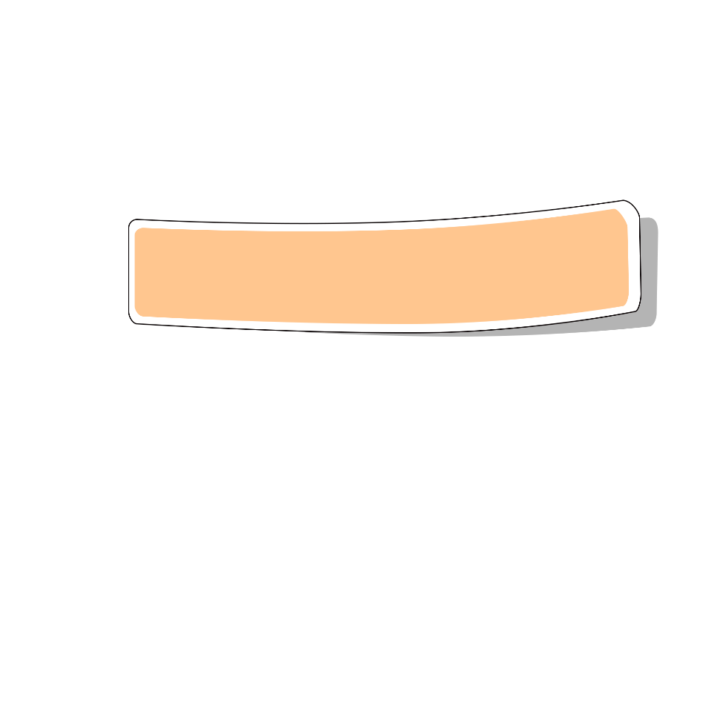
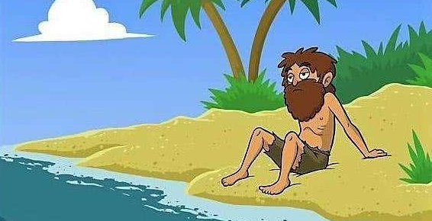
Lead in

Slide 3
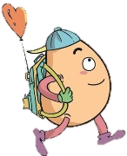

Free talk.
Do you know something about Robinson Crusoe?
Let’s learn the story about Robinson.

Slide 4
《鲁滨逊漂流记》是英国的一部小说作品，它的作家是丹尼尔·笛福，故事里的主人公名叫鲁滨逊，他从小喜好航海。有一次，他越过大西洋，在太平洋上，整条船上的人们都沉入海底，不幸遇难，只有他一人漂流到无人小岛，在这个荒无人烟的小岛上，性格坚强的鲁滨逊坚强得生活下来。他在那里自己盖房子，种谷物，养山羊，打野兽，斗野人。后来，他救了一个土人，鲁滨逊给他起名叫“星期五”，并且收他为自己的仆人。28年以后，他终于又回到原来所生活的地方。

Slide 5
Presentation
How to know the stories?
Talk about Robin’s story.
Talk about Mike’s activities.
Talk about Zip’s day.

Slide 6

Read and write
Read and answer.
1. Where is Robinson live?
2. Does Robinson get up early?
3.What does Robinson do in the afternoon?
4. What is Friday good at?

Slide 7
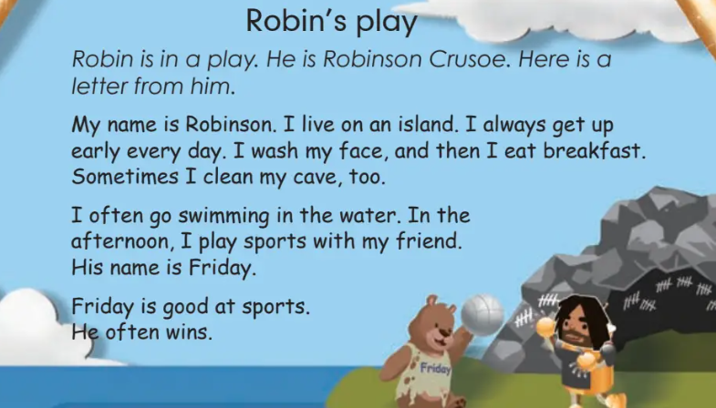

Slide 8
1. Where is Robinson live?
2. Does Robinson get up early?
3.What does Robinson do in the afternoon?
4. What is Friday good at?
He lives on an island.
Yes, he does.
In the afternoon, he plays sports with his friend Friday.
He is good at sports.

Slide 9

Listen and answer.
What does Robinson do in the daily life?

Slide 10
Listen and repeat.
Robin’s play
在岛上
Robin is in a play. He is Robinson Crusoe. Here is a letter from him.
My name is Robinson. I live on an island. I always get up early every day. I wash my face, and then I eat breakfast. Sometimes I clean my cave, too.
I often go swimming in the water. In the afternoon, I play sports with my friend. His name is Friday.
Friday is good at sports. He often wins.
来自他的一封信
洗我的脸
吃早餐
有时
打扫我的洞穴
去游泳
擅长
赢

Slide 11
Tick or cross.
Robinson and Friday always get up late in the morning.
( )
Robinson only cleans his cave on Fridays.
( )
Robinson and Friday play sports together in the afternoon.
( )
X
X
√

Slide 12
Robin’s play
Robin is in a play. He is Robinson Crusoe. Here is a letter from him.
My name is Robinson. I live on an island. I always get up early every day. I wash my face, and then I eat breakfast. Sometimes I clean my cave, too.
I often go swimming in the water. In the afternoon, I play sports with my friend. His name is Friday.
Friday is good at sports.
He often wins.
Question1
Question2
Question3

Slide 13

Write a letter to Robinson. Tell him what you often do every day.
Dear Robinson,
My name is ___________. I live in __________.
I often ____________ and ________________.
In the afternoon, I __________with _________.
I hope you can get off your island soon.
Yours.
_________
Linda
a city
read books
play sports
play football
my friends
Linda

Slide 14

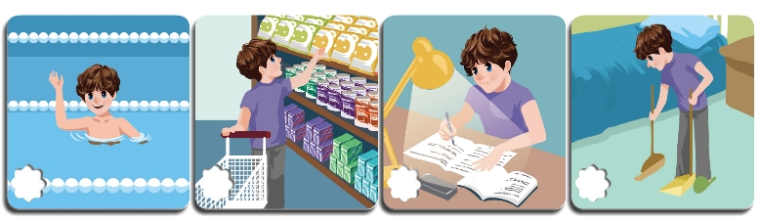
Let’s check
Listen and tick.
What does Mike do on the weekend?
√
√

Slide 15
Amy: Mike, let’s go swimming on the weekend.
Mike: I’m sorry. I can’t.
Amy: Why not?
Mike: I always clean my room and do my homework
on the weekend.
Amy: OK.
Mike:Have fun!

Slide 16
Give answers about yourself.
What do you do on the weekend?
1. I often _______________________.
2. I always _____________________________.
3. I sometimes_________________________________.
clean my room on the weekend.
do homework on the weekend.
go shopping with my mum on the weekend.

Slide 17

Let’s wrap it up
Read the following words.
homework sports class running
ping-pong the pipa kung fu dinner
swimming shopping morning exercises

Slide 18
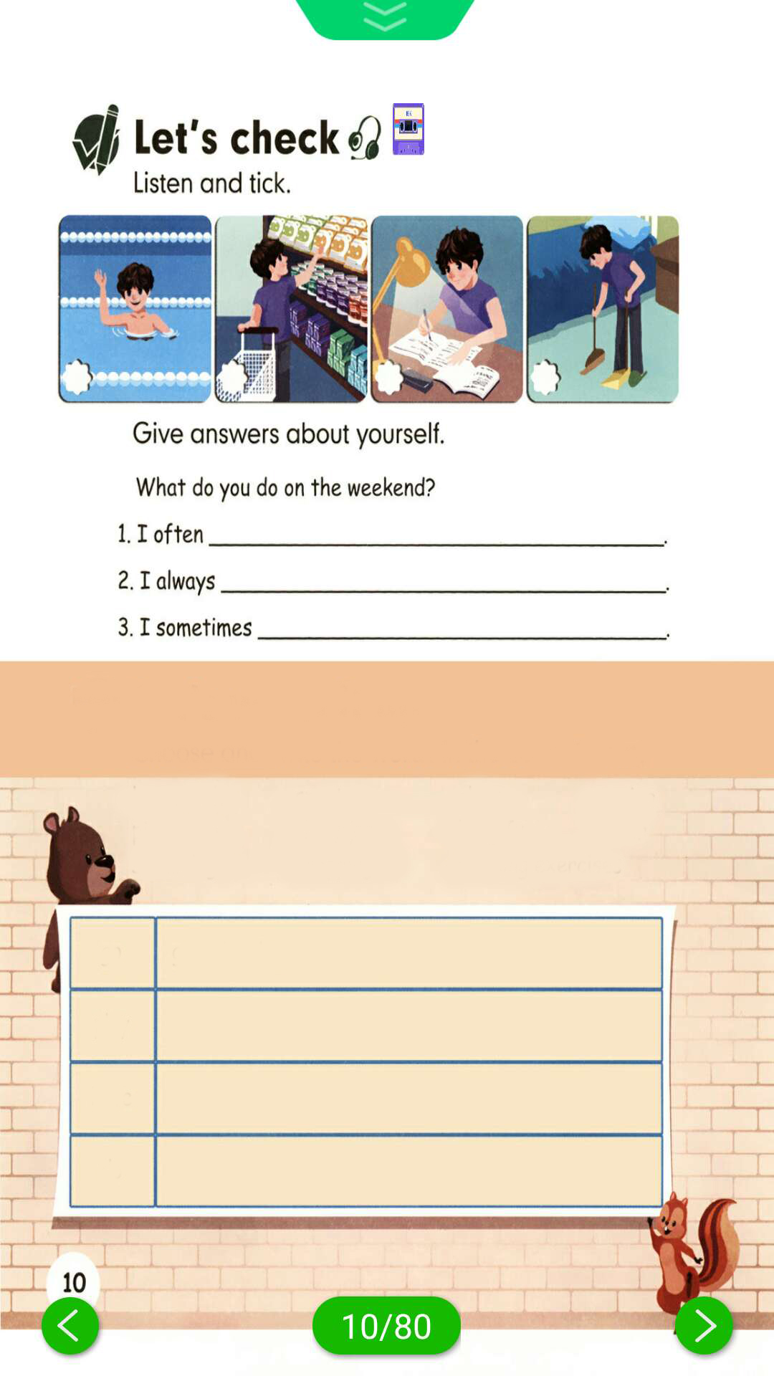
Choose and write the words in the correct rows.
homework sports class running
ping-pong the pipa kung fu dinner
swimming shopping morning exercises
go go swimming
play
have
do
go running go shopping
play sports play ping-pong play the pipa
have… class have dinner
do homework do kung fu do morning exercises

Slide 19

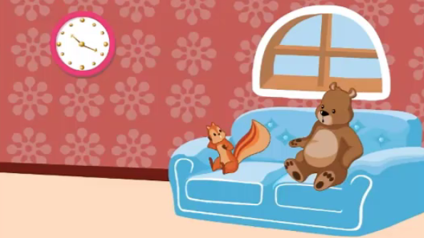
Story time
Watch the video.

Slide 20
Read and answer.
1.What does Zip usually do on the weekend?
2. How about this weekend?
She often watches TV.
This weekend she has a show. She’ll play the pipa.

Slide 21
Listen and fill in the table.
What does Zip do every day?
I | Monday | Tuesday | Wednesday | Thursday | Friday | weekend
usually collect nuts in the afternoon
often dry nuts
eat nuts
often watch TV

Slide 22
Choose the right answers.
1. The story is about _______ day.
A. Zoom’s B. Zip’s
2. Today is _______.
A. Saturday B. Sunday
3. What will Zip do this weekend?
A. Watch TV B. Have a show

Slide 23
Play in roles.
Zip: It’s Saturday now. Zoom, I’m always very busy.
Zoom: Why?
Zip: Let me see. From Monday to Wednesday, I usually collect nuts in the afternoon.
Zoom: What else?
Zip: On Thursday, I often dry my nuts in the sun.
Zip: On Friday, I eat nuts with my friends.
Zoom: What do you usually do on the weekend?
Zip: I often watch TV, but this weekend I have a show.I’ll play the pipa.
Zoom: When?
Zip: Saturday, at 12 o’clock. Oh, no!

Slide 24
Listen and repeat.
Zip: It’s Saturday now. Zoom, I’m always very busy.
Zoom: Why?
Zip: Let me see. From Monday to Wednesday, I usually
collect nuts in the afternoon.
Zoom: What else?
Zip: On Thursday, I often dry my nuts in the sun.
Zip: On Friday, I eat nuts with my friends.
Zoom: What do you usually do on the weekend?
Zip: I often watch TV, but this weekend I have a show.
I’ll play the pipa.
Zoom: When?
Zip: Saturday, at 12 o’clock. Oh, no!
从……到……
还有别的吗？
星期前面用on
v.弄干，变干
adj.干燥的
在周末
有一场演出show.n.
show. v.给……看

Slide 25
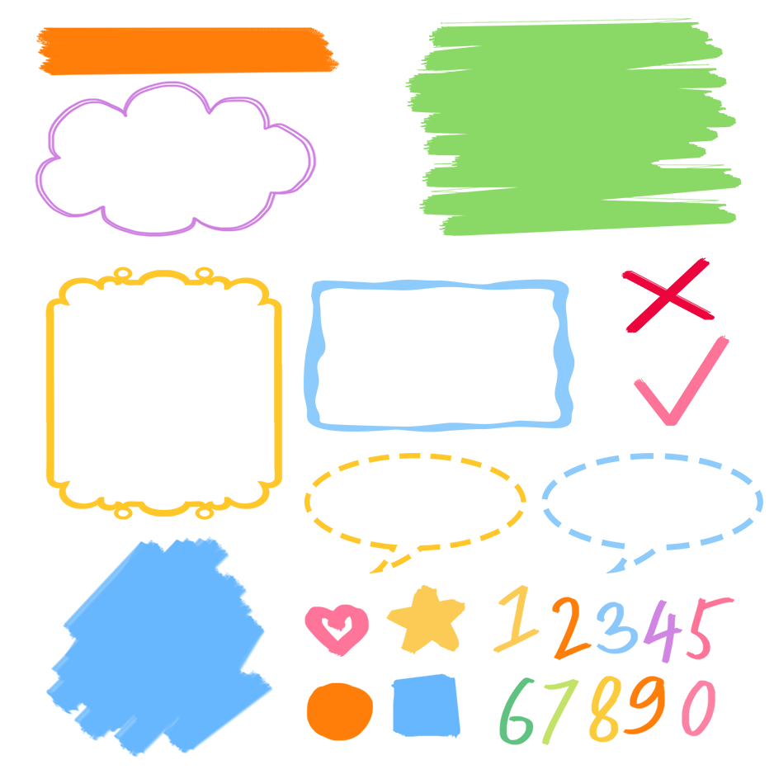
流利地朗读
流利地表演
有感情地表演

Slide 26
Exercises
一、英汉互译。
1. 擅长 __________
2. 从...到..._____________________
3. clean my cave________________
4. a letter from ...__________________
5. 在一个岛上_______________
6. wash my face____________
7. every day ____________
be good at
from... to...
打扫我的洞穴
来自......的一封信
on an island
洗我的脸
每天

Slide 27
二、按照要求完成句子。
1.I often go swimming in the winter.(对划线部分提问)
____________________________________
2.afternoon, together, often, the, play,they, in, sports (.)(连词成句)
_________________________________________
3.I often watch TV on the weekend. (划线部分提问)
____________________________________
What do you often do in the winter?
They often play sports together in the afternoon.
When do you often watch TV?

Slide 28
三、阅读短文，判断正(T)误(F).
I’m Wang Gang. I’m an English teacher. I go to work from Monday to Friday. I usually get up at 6:00 in the morning. Then I do morning exercises. I eat breakfast at 7:00. After breakfast I go to work. I usually have two classes in the morning and one in the afternoon. I usually play sports at 4:00 p.m. I go home at 5:30 p.m. After dinner I usually watch TV and read books. Then I go to bed at 10:00 p.m. What about you?
( )1. Wang Gand is a policeman.
( )2. He eats breakfast at 7:00
( )3. He has three classes in the morning
( )4. He usually plays sports at 3:00 in the afternoon.
( )5. He goes to bed at 10:00 in the evening.
F
T
F
F
T

Slide 29

Summary
1. 学习了下列单词：play, letter, live, island, always, cave, go swimming, win等。
2. 学习了如何用英语写信。
3.学习了go，play，have，do动词的搭配
4. 学习了一个故事。

Slide 30
Homework
ONE
TWO
Read the story for five times, then try to act it out.
Ask your friend some questions about his/her weekend.
Write a letter to your friend.

Slide 31







