Slide 1




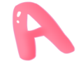

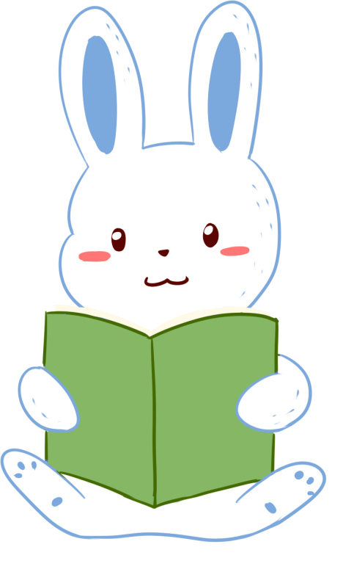
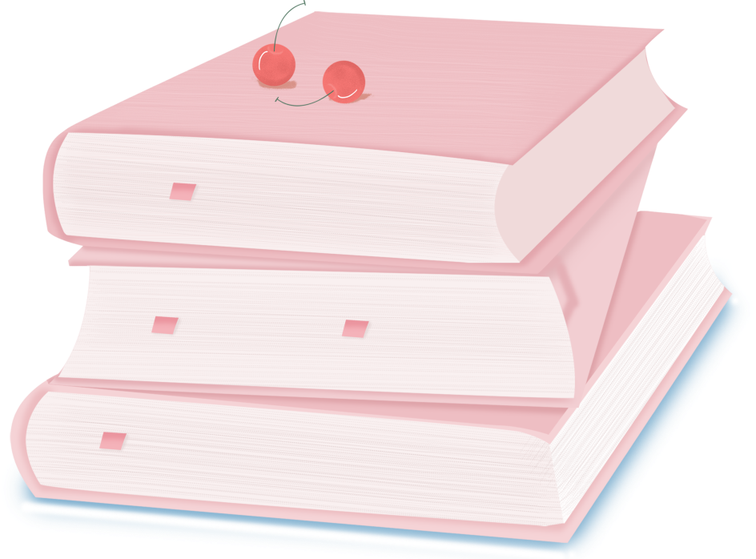

人 教 PEP 版 英 语 五 年 级 下 册
Unit 1
My day
Part B & Part C
Read and write – Story time

Slide 2


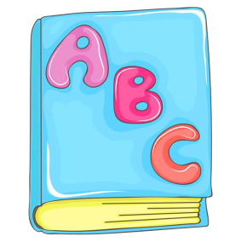

Warm up
Can you make sentences and translate them?
do morning exercises
eat breakfast
have…class
play sports
eat dinner
clean my room
go for a walk
go shopping
take a dancing class
my father
my mum
my brother
my sister
my friends
my grandma
my grandpa
my uncle
my aunt
on the weekend
on Saturdays
on Sundays
in the morning
in the afternoon
in the evening
sometimes
often
usually
always
I

Slide 3

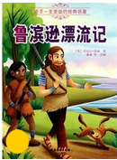
Lead in
Do you know Robinson? Do you hear something about him?
《鲁滨逊漂流记》是英国的一部小说作品，它的作家是丹尼尔·笛福，故事里的主人公名叫鲁滨逊，他从小喜好航海。有一次，他越过大西洋，在太平洋上，整条船上的人们都沉入海底，不幸遇难，只有他一人漂流到无人小岛，在这个荒无人烟的小岛上，性格坚强的鲁滨逊坚强得生活下来。他在那里自己盖房子，种谷
物，养山羊，打野兽，斗野人。后来，他救了一个土人，鲁滨逊给他起名叫“星期五”，并且收他为自己的仆人。28年以后，他终于又回到原来所生活的地方。
Let’s watch the story about Robinson.

Slide 4
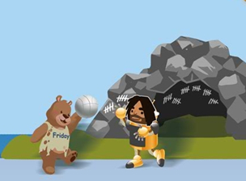
Presentation
Pre-reading
Look at the picture.
Where does Robinson live?
He lives on an island.
What does he do?
He plays sports with his friend, Friday.

Slide 5
While-reading
Step 1: Skimming reading
Robin is in a play. He is Robinson Crusoe. Here is a letter from him.
Run your eyes over the text. Underline the activities and circle the frequency words.
（快速阅读文章，在文中用直线划出日常活动，用圆圈圈出频度副词。)

Slide 6

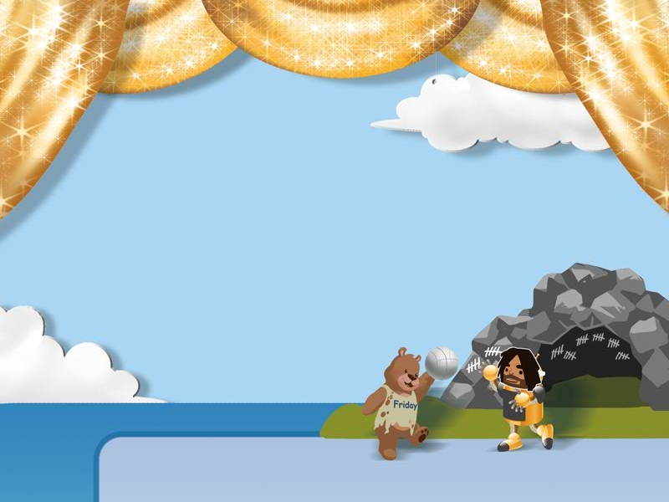
Let’s check.
Robin’s play
Robin is in a play. He is Robinson Crusoe. Here is a
Letter from him.
My name is Robinson. I live on an island. I always get up
early every day. I wash my face, and then I eat breakfast.
Sometimes I clean my cave, too.
I often go swimming in the water. In the
afternoon, I play sports with my friend.
His name is Friday.
Friday is good at sports.
He often wins.

Slide 7
Tick or cross then find the clues in the text.
Robinson and Friday always get up late in the morning. ( )
×
Robinson only cleans his cave on Fridays. ( )
×
Robinson and Friday play sports together in the afternoon.
( )
√

Slide 8
Let’s check.
Robin’s play
Robin is in a play. He is Robinson Crusoe. Here is a
Letter from him.
My name is Robinson. I live on an island. I always get up
early every day. I wash my face, and then I eat breakfast.
Sometimes I clean my cave, too.
I often go swimming in the water. In the
afternoon, I play sports with my friend.
His name is Friday.
Friday is good at sports.
He often wins.

Slide 9

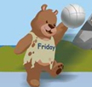
Step 2:
Intensive reading
Fill in the blanks!
________
Robinson
__________
on an island
______________________
good at sports
name
live
get up early every day
often wins
________________________________________________
wash my face eat breakfast
always
in the afternoon
sometimes
___________
clean my cave
often
___________________
go swimming in the water
__________________
play sports with Friday

Slide 10

Listen and read after the tape.
Robin’s play
戏剧；剧本
信
Robin is in a play. He is Robinson Crusoe. Here is a letter from him.
My name is Robinson. I live on an island. I always get up early every day. I wash my face, and then I eat breakfast. Sometimes I clean my cave, too.
I often go swimming in the water. In the afternoon, I play sports with my friend. His name is Friday.
Friday is good at sports. He often wins.
居住
岛
总是
山洞；洞穴
去游泳
获胜

Slide 11
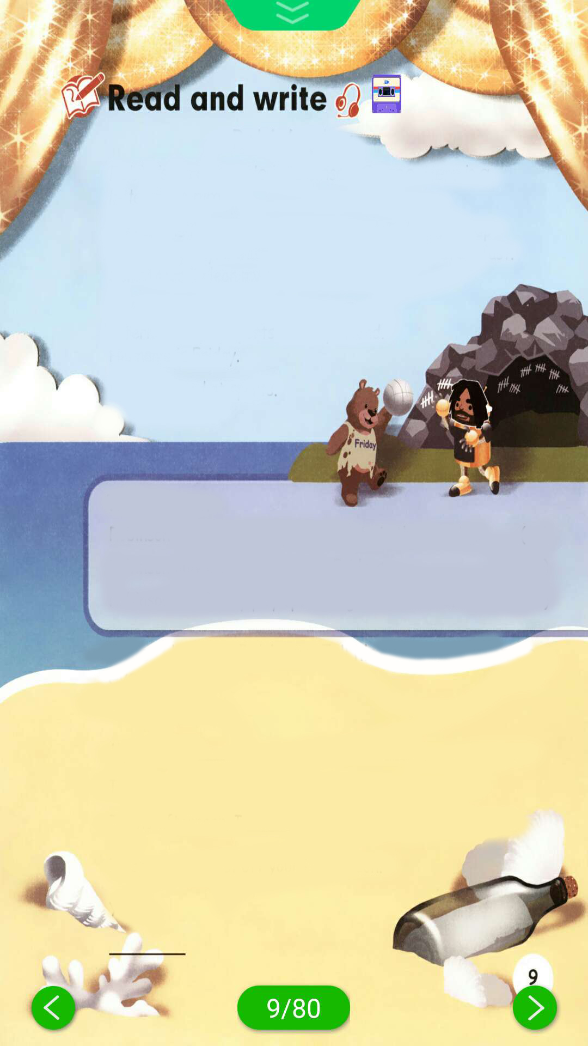
Post-reading
Act out.
Robin’s play
Robin is in a play. He is Robinson Crusoe. Here is a
letter from him.
My name is Robinson. I… I…
early every day. I …, and then I …
Sometimes I…, too.
I… in the water. In the
afternoon, I… with my friend.
His name is Friday.
Friday is good at sports.
He often wins.

Slide 12
Write a letter to Robinson.
Tell him what you often do every day.
Dear Robinson,
My name is _______. I live in ______.
I often _______________ and _________.
In the afternoon, I __________ with __________.
I hope you can get off your island soon.
Yours,
_______
Li Hua
a city
do morning exercises
play sports
go for a walk
my father
Li Hua

Slide 13
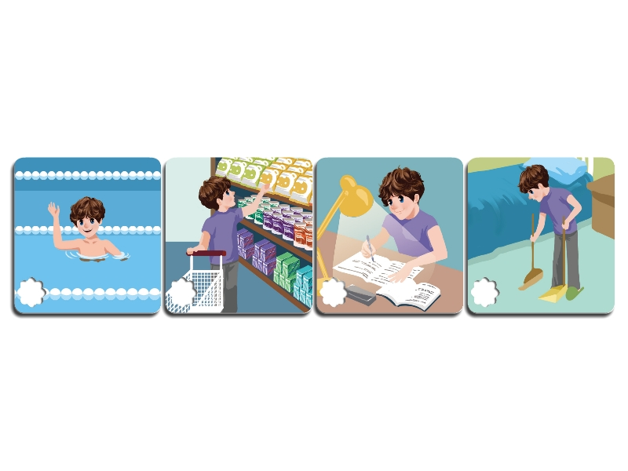
Let’s check
Listen and tick.
√
√

Slide 14
听力原文：
Amy:
Mike:
Amy:
Mike:
Amy:
Mike:
Mike, let’s go swimming on the weekend.
I’m sorry. I can’t.
Why not?
I always clean my room and do my homework on the weekend.
OK.
Have fun!

Slide 15
Give answers about yourself.
What do you do on the weekend?
I often .
I always .
I sometimes .

Slide 16
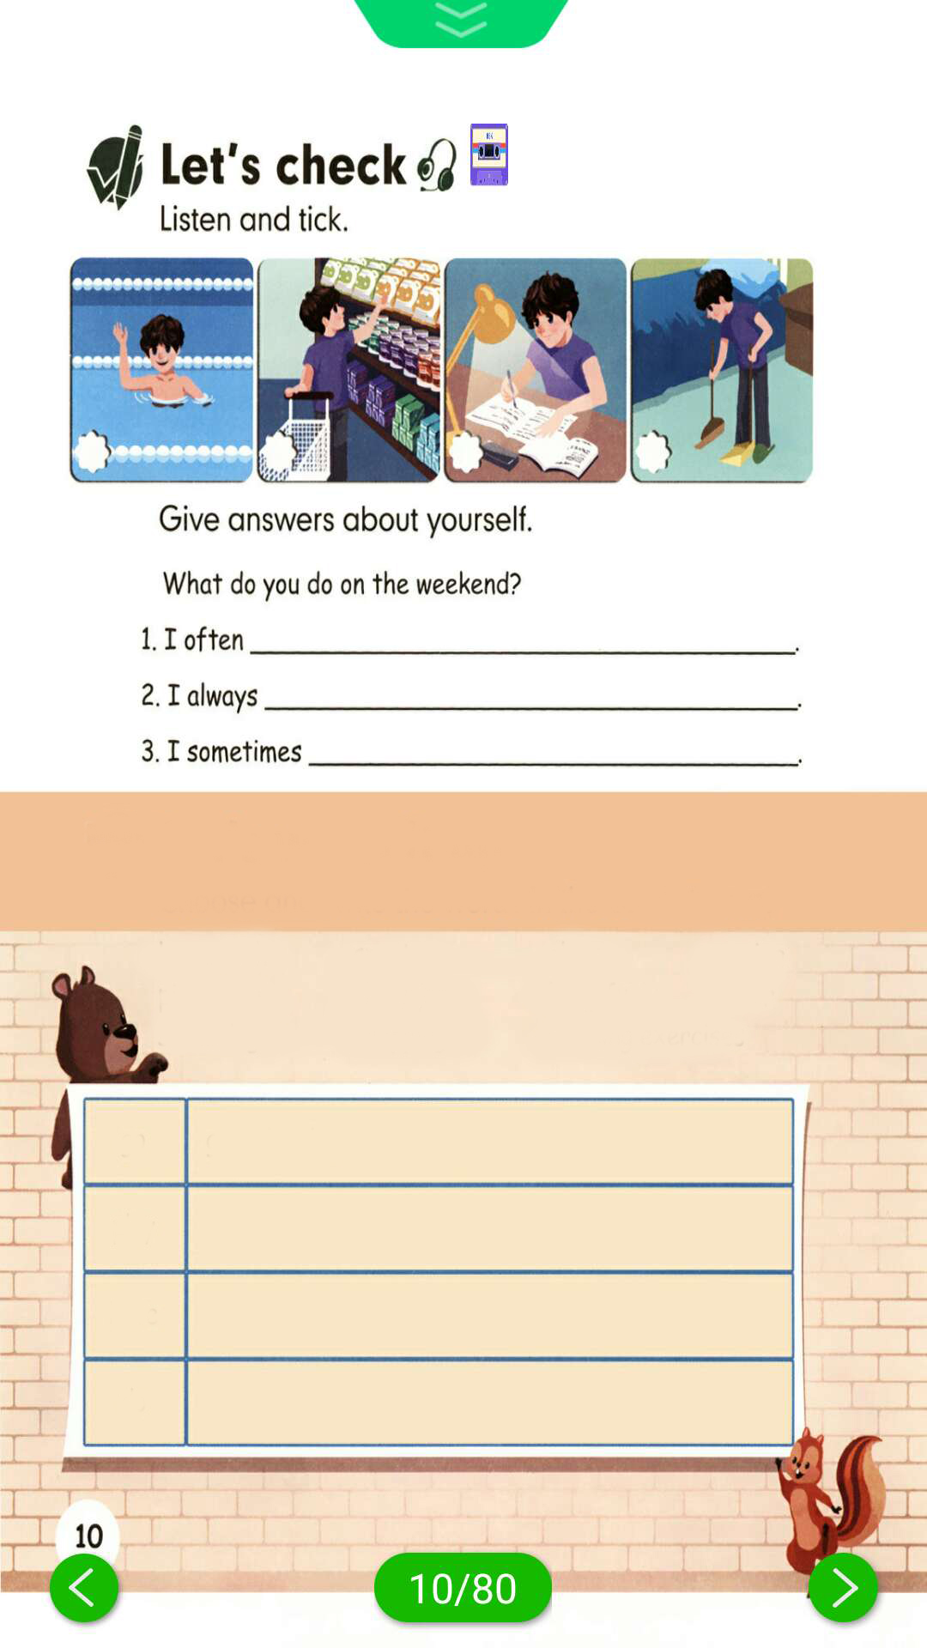
Let’s wrap it up
Choose and write the words in the correct rows.
homework sports class running
ping-pong the pipa kung fu dinner
swimming shopping morning exercises
go go swimming
play
have
do
go running go shopping
play sports play ping-pong play the pipa
have… class have dinner
do homework do kung fu do morning exercises

Slide 17
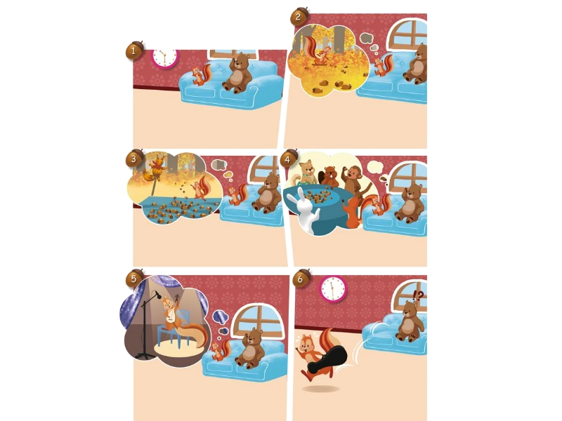
Story time
Zip is always very busy.
Guess: What does Zip do every day?

Slide 18
Listen and answer.
What does Zip usually do on the weekend?
She often watches TV.
How about this weekend?
The weekend she has a show. She’ll play the pipa.

Slide 19
Listen again and fill in the table.
I | Monday | Tuesday | Wednesday | Thursday | Friday | weekend
usually collect nuts in the afternoon
often dry nuts
eat nuts
often watch TV

Slide 20
Let’s watch.
点击画面 播放视频

Slide 21

Exercises
一、英译汉。
1. a letter ____________ 2. an island _____________
3. live on ____________ 4. wash my face ____________
5.clean my cave __________ 6. play the pipa ____________
一封信
一个岛
居住
洗脸
打扫洞穴
演奏琵琶

Slide 22
二、单项选择。
( ) 1. Here is a letter________ your mum.
A. at B. in C. from
( ) 2. Robinson lives on________ island.
A. a B. an C. some
( ) 3. I________ go for a walk.
A.sometimes B.some times C.sometime
C
B
A

Slide 23
( ) 4. I usually collect leaves _____ Monday to Wednesday.
A. from B. on C. at
( ) 5. I eat bread ______ my sister.
A. and B. but C. with
( ) 6. I often dry my wet clothes ______ the sun on the weekend.
A. in B. of C. off
A
C
A

Slide 24
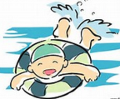


三、看图，完成句子。
1.-What do you do on the weekend?
-I often ______________ on Saturdays.
2.-What do you do on the weekend?
-I usually _______________ on Sundays.
3.-What do you do on the weekend?
-I sometimes __________________ on Saturdays.
go swimming
go shopping
clean my room

Slide 25


Summary
1. 学习了下列单词：play, letter, live, island, always, cave, go swimming, win等。
2. 学习了如何用英语写信。
3.学习了go，play，have，do动词的搭配
4. 学习了一个故事。
七彩课堂
伴你成长

Slide 26

Homework
ONE
TWO
Tell the play to your parents.
七彩课堂
伴你成长
Ask your friend some questions about his/her weekend.
Write a letter to your friend.

Slide 27





