Slide 1


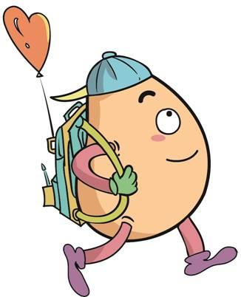






人 教 PEP 版 英 语 五年 级 下 册
Unit 1
My day
Part B
Let’s try & Let’s talk

Slide 2
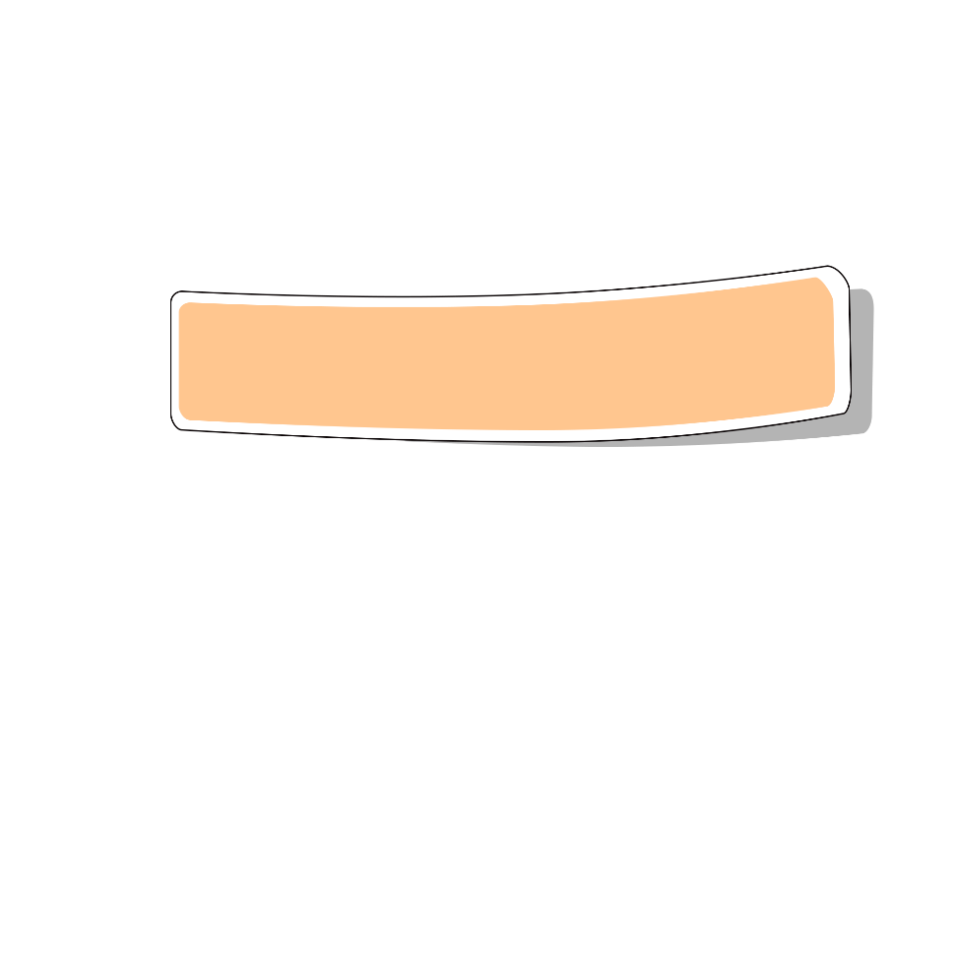
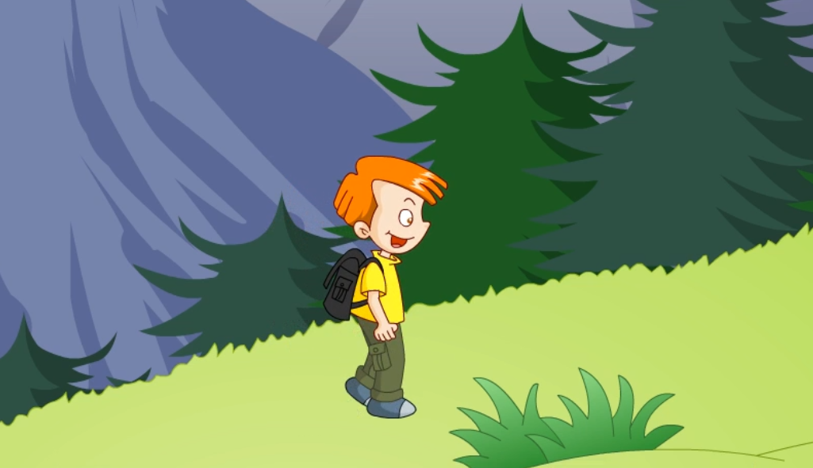
Warm up

Slide 3

Lead in
Free talk！
—What can we do on the weekend?
wash clothes
do morning exercises
eat breakfast
go shopping
watch TV
clean room
—we can .

Slide 4
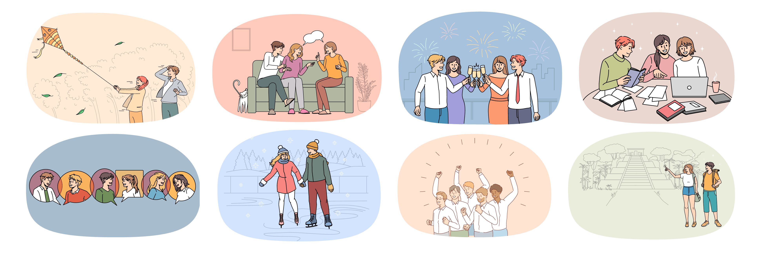
Let’s introduce weekend life.

Slide 5

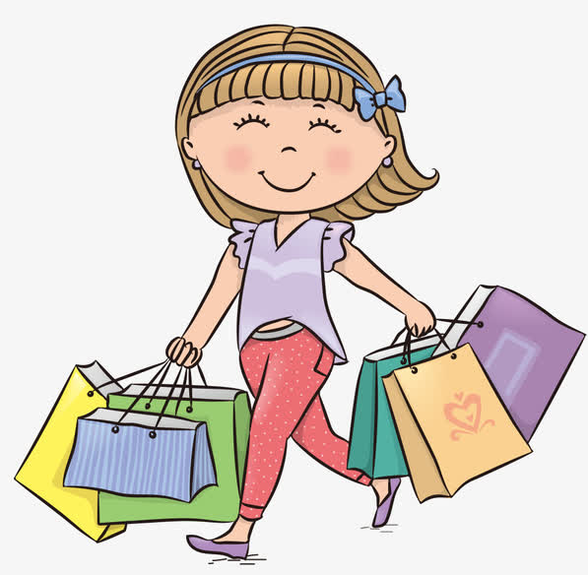
Let’s learn！
go shopping
/ɡəʊ ˈʃɒpɪŋ/ 去购物
go swimming去游泳
go fishing去钓鱼
go running去跑步
go skating去滑冰
拓展
go+v-ing
She likes to go shopping.

Slide 6
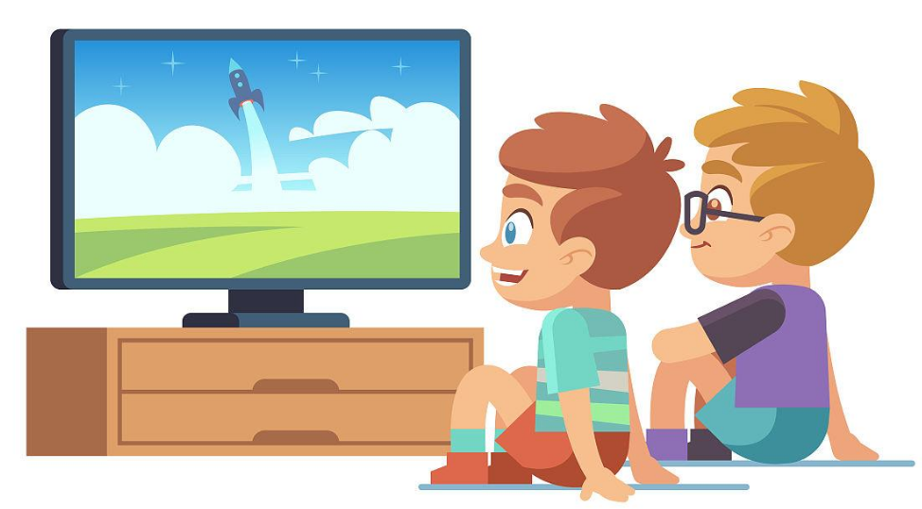
watch TV
/wɒtʃ ˌtiː ˈvi/ 看电视
They often watch TV in the evening.

Slide 7
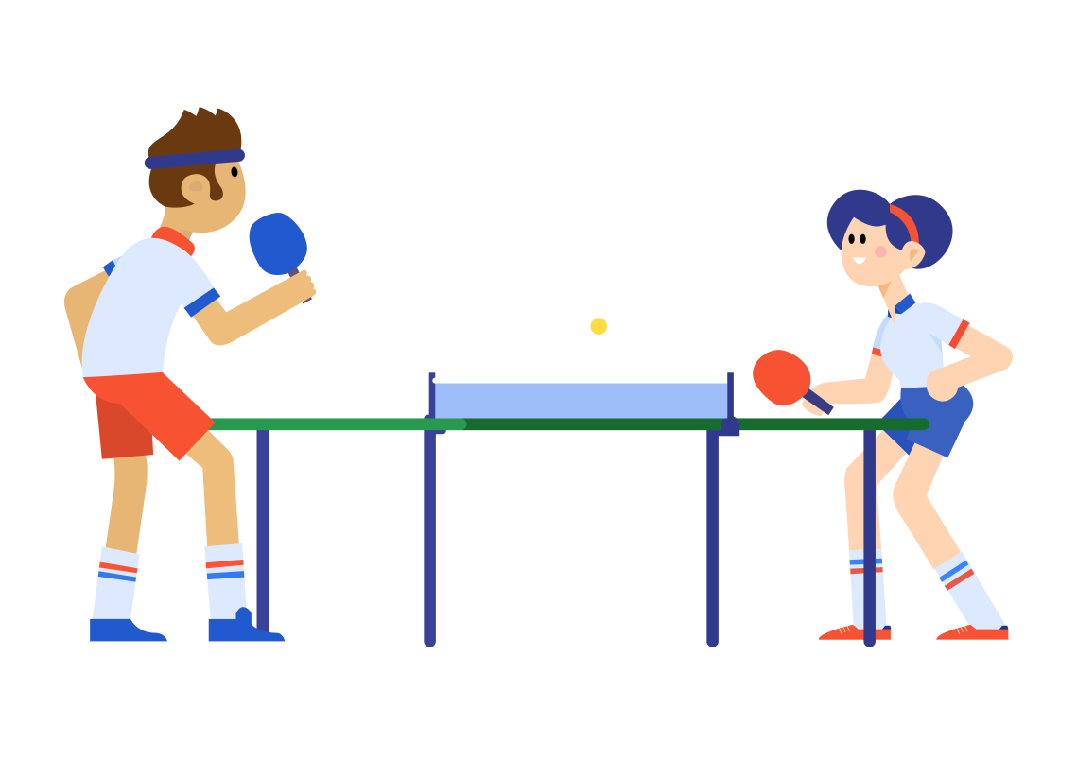
play ping-pong
/pleɪ pɪŋ pɒŋ/ 打乒乓球
注意：球类前面不加the.
play football
play basketball
They are playing ping-pong.

Slide 8
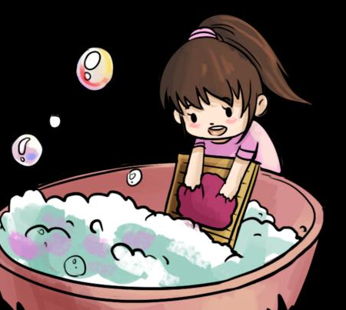
wash clothes
/wɒʃ kləʊðz/
洗衣服
I usually wash my clothes on the weekend.

Slide 9
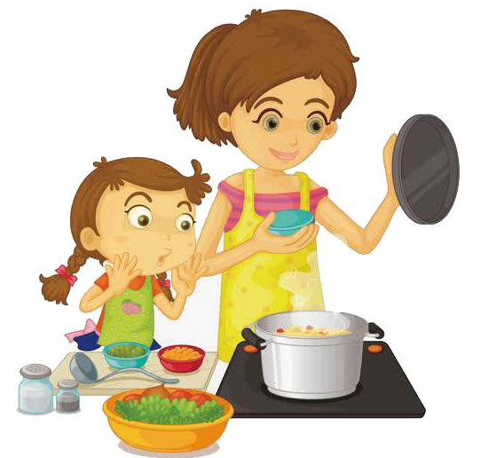
cook dinner
/kʊk ˈdɪnə(r)/
做晚餐
cook breakfast做早饭
cook lunch做午饭
拓展
Sometimes I cook dinner with my mum.

Slide 10

do homework
/duː ˈhəʊmwɜːk/
做作业
I do my homework every day.

Slide 11
Presentation
Talk about what to do on the weekend?
Talk about my weekend.
Talk about Sarah’s weekend.
Talk about my partner’s weekend.

Slide 12
Let’s discuss!
This is my weekend.
get up | 7:00 a.m.
clean my room | 8:30 a.m.
go shopping | 10:00 a.m.
play sports | 2:30 p.m.
read books | 4:00 p.m.
watch TV | 7:00 p.m.
go to bed | 9:30 p.m.
What does our friend Sarah do on the weekend?

Slide 13



Let’s try
Where is Sarah? Listen and circle.

Slide 14
Let’s check！
In the shop.
Sarah: Hello, Mrs Green. Good to see you.
shopkeeper: Hi, Sarah. Welcome to our shop again.
Sarah: I want to buy some vegetables.
shopkeeper: Here are some fresh carrots. You don’t often shop
here on Saturdays.
Sarah: No, not often.

Slide 15
Listen and choose.
1. Sarah wants to buy some _____ .
A. vegetables B. meat
2. Sarah doesn’t often shop here on ____. A. Sundays B. Saturdays

Slide 16

Let’s talk
Watch and answer！
1.Why is Sarah shopping today?
2.What does Sarah do on the weekend?
3.What does Sarah usually do?

Slide 17
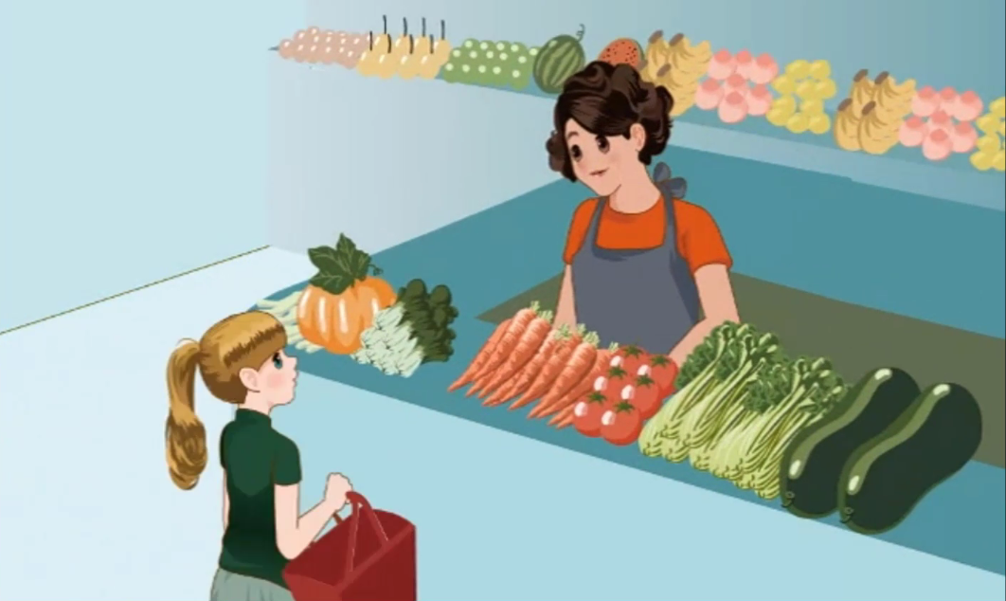

Slide 18
1.Why is Sarah shopping today?
2.What does Sarah do on the weekend?
3.What does Sarah usually do?
Sarah’s mum worked last night. So she is shopping today.
She often watches TV and plays ping-pong with her father.
She usually washes clothes. Sometimes she cooks dinner.

Slide 19
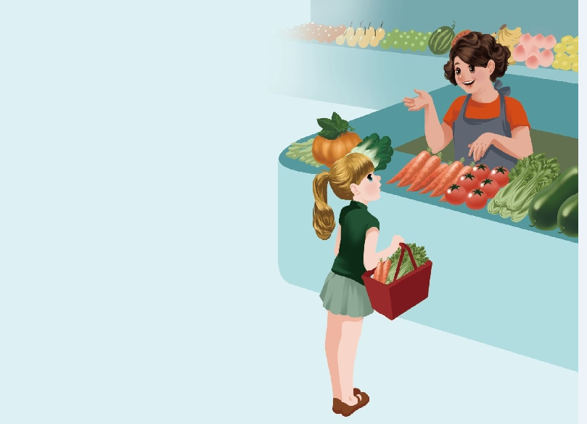
Read in roles.
Shopkeeper: Why are you shopping today?
Sarah: My mum worked last night. So
I’m shopping today.
Shopkeeper: Good girl! So what do you do on
the weekend?
Sarah: I often watch TV and play ping-
pong with my father.
Shopkeeper: That sounds like a lot of fun.
Sarah: Yes, but I’m also hard-working. I
usually wash my clothes. Sometimes I
cook dinner.
Shopkeeper: You’re so busy! You need a robot
to help you!

Slide 20

Read and act.
1.Read it together.
2.Each student
reads a sentence.
Tip: Choose one to read in two. 选择一种两人练习。
3. Read in roles.
自己分配角色。

Slide 21
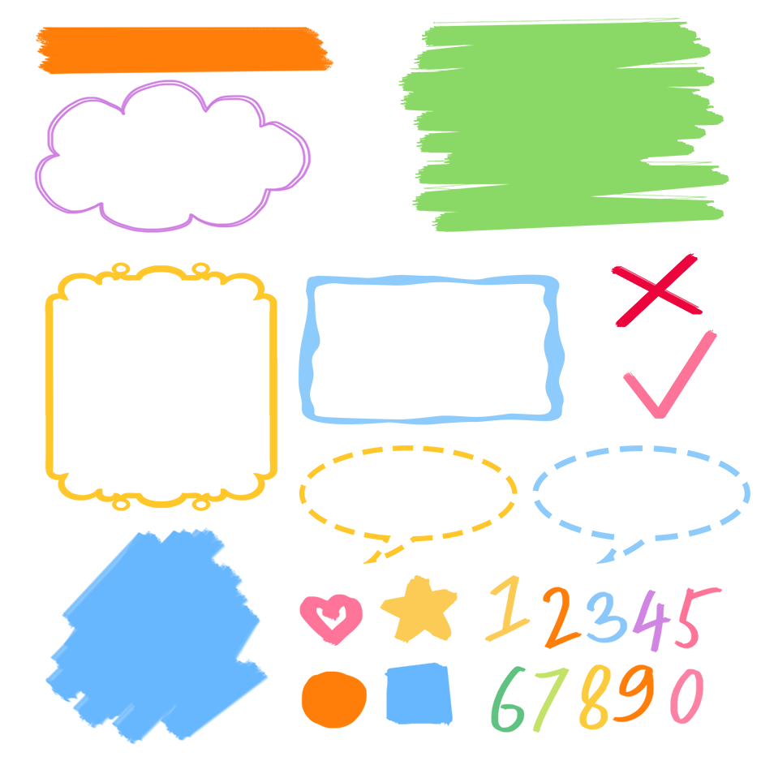
流利地朗读
流利地表演
有感情地表演

Slide 22
Listen and repeat.
为什么
Shopkeeper: Why are you shopping today?
Sarah: My mum worked last night. So I’m shopping
today.
Shopkeeper: Good girl! So what do you do on the weekend?
Sarah: I often watch TV and play ping-pong with my
father.
Shopkeeper: That sounds like a lot of fun.
Sarah: Yes, but I’m also hard-working. I usually wash
my clothes. Sometimes I cook dinner.
Shopkeeper: You’re so busy! You need a robot to help you!
昨晚
询问对方周末的活动安排
经常
看电视
听起来像……
球类前面不加the
洗衣服
通常
有时
做晚饭

Slide 23
Shopkeeper: Why are you shopping today?今天为什么你来买东西？
Sarah: My mum worked last night. So I’m shopping today.
我妈妈昨晚上班了，所以今天我买东西。
Shopkeeper: Good girl! So what do you do on the weekend?
好孩子！那么你周末做什么？
Sarah: I often watch TV and play ping-pong with my father.
我经常和爸爸一起看电视、打乒乓球。
Shopkeeper: That sounds like a lot of fun.听起来很有趣。
Sarah: Yes, but I’m also hard-working. I usually wash my clothes. Sometimes I cook dinner. 是的，但是我也很努力。我经常洗衣服，有时我做晚饭。
Shopkeeper: You’re so busy! You need a robot to help you!
你这么忙啊！你需要一个机器人来帮你！

Slide 24





Language point.
— What do you do on the weekend?
— I often watch TV and play Ping-Pong with my father.
用来询问对方周末的活动安排
句型：
—What do you do + 时间状语？
—I/We (+ 频度副词) + 动词（短语）（+其他）
— What do you do on Saturdays?
— I usually clean my room.

Slide 25
Language point.
I usually wash my clothes. Sometimes I cook dinner.
频度副词的用法
频度副词是表示频繁程度的副词，有always, usually, often, sometimes, seldom和never等.这些词表示经常性的动作或状态，而不是某一具体动作，常用于一般现在时中。
其频度大小依次为: always>usually>often>sometimes>seldom>never.

Slide 26
1. always意为”总是”，频度最大，中间没有间断。
eg. I always get up early.我总是很早起床。
2. usually意为”通常”，即很少例外，频度仅次于always.
eg. He usually goes to school by bus.他通常乘公共汽车上学。
3. often意为”经常”，在频度上不如usually.
eg. They often go swimming after school.放学后他们经常去游泳。
4. sometimes意为”有时”，频度比often小，表示偶尔发生，中间常有间断。
eg. Sometimes we take the subway to school.我们有时乘地铁上学。
5. seldom意为”很少，不常常”，频度小于sometimes,表示动作很少发生。 eg. Jim seldom does his homework at school. 吉姆很少在学校做作业。
6. never意为”从不”，频度为零，表示动作从未发生。
eg.The boy never eats meat.这个男孩从不吃肉。

Slide 27
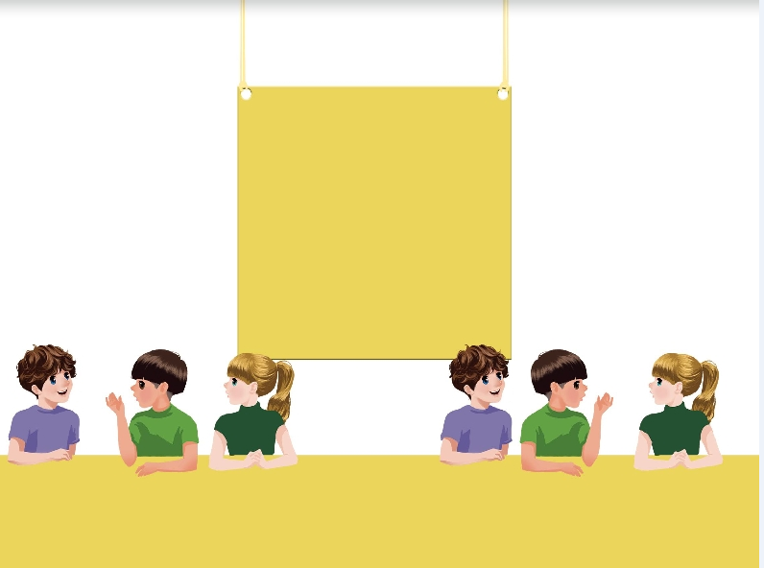
Ask the question and then pass it on.
do homework
watch TV
have...class
play sports with...
play music
wash my clothes
What do you do on the weekend?
What do you do on the weekend?
I usually clean my room.
I often go shopping.

Slide 28
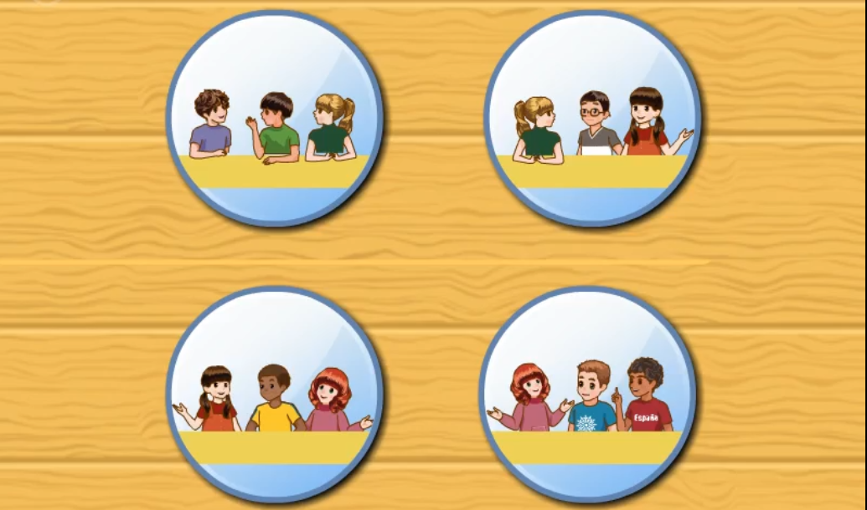
Watch the video.

Slide 29
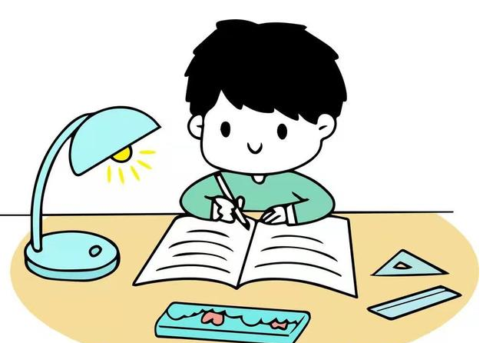
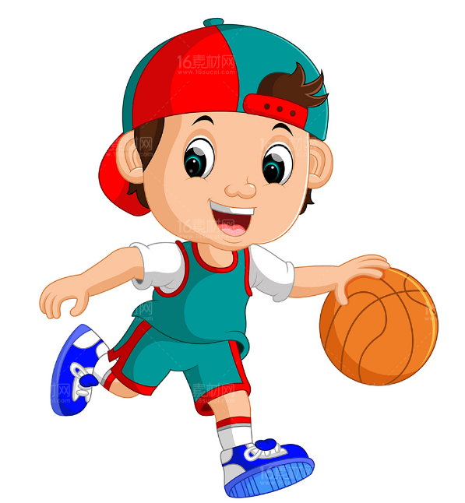
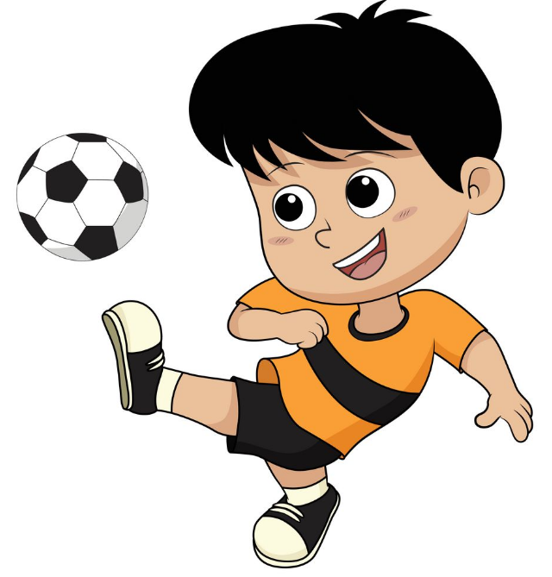
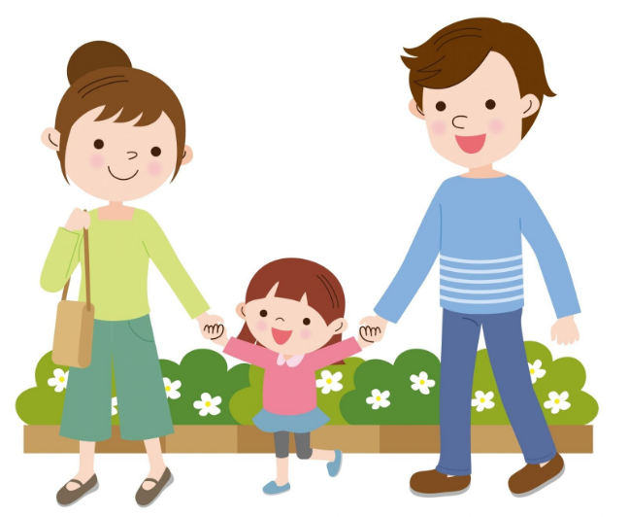
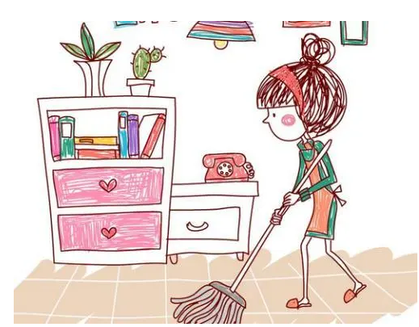
Ask and answer.
--What do you do on the weekend?
--I always/ often/ sometimes...

Slide 30
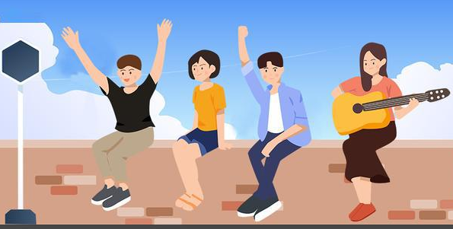
Good to know
If you love life, life will love you.
如果你爱生活，生活也会爱你。

Slide 31
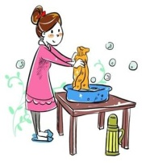
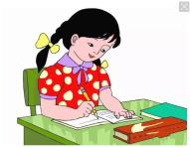
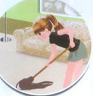

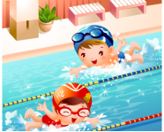
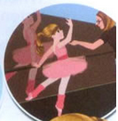
Exercises
一、看图填空
I often __________ . Sometimes I _____________
2. I often ___________on Saturdays. Sometimes I _____________.
3. I often __________ and ________________ on the weekend.
do homework
wash my clothes.
clean my room
go shopping.
go swimming
have a dancing class

Slide 32
二、按照要求完成句子。
1.I often go shopping on the weekend.(对划线部分提问)
____________________________________
2.often, play, I, watch, and, TV,my, with, ping-pong, father(.)(连词成句)
_________________________________________
3.My mum worked last night. (对划线部分提问)
_____________________________
What do you often do on the weekend?
I often watch TV and play ping-pong with my father.
What did your mum do last night?

Slide 33

Summary
1. 学习了下列短语：
go shopping, do homework, watch TV, play ping-pong, cook dinner, wash my clothes.
2.学习了下列句型：
— What do you do on the weekend?
— I often watch TV and play ping-pong with
my father.

Slide 34
Homework
ONE
TWO
Act the dialogue out with your friends.
Make a short dialogue using the sentences we have learnt.
Play games in pairs like “ask the question and then pass it on”.

Slide 35







