Slide 1









人 教 PEP 版 英 语 五 年 级 下 册
Unit 1
My day
Part B
Let’s try & Let’s talk

Slide 2


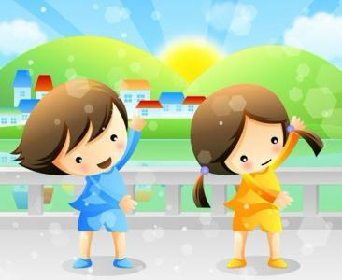

Warm up
I do you say.
do morning exercises
go shopping
read books

Slide 3
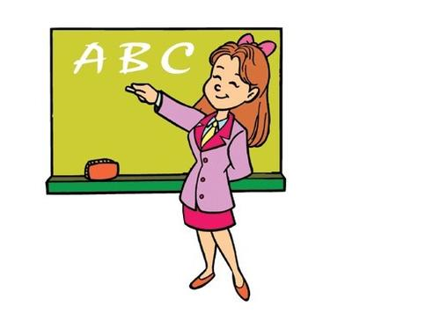
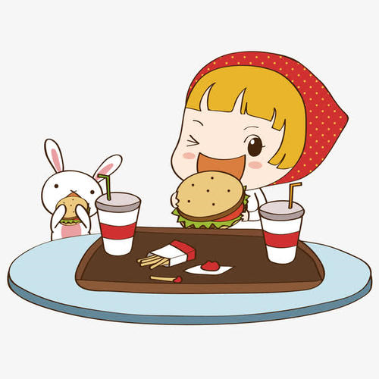
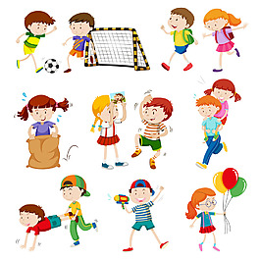
I do you say.
have English class
eat breakfast
play sports

Slide 4
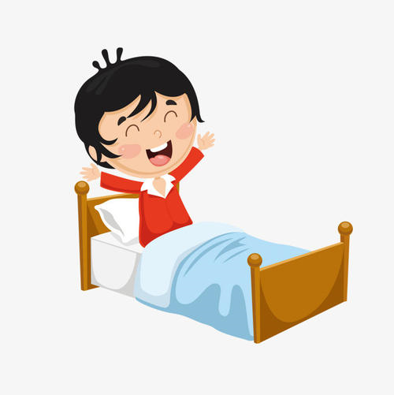
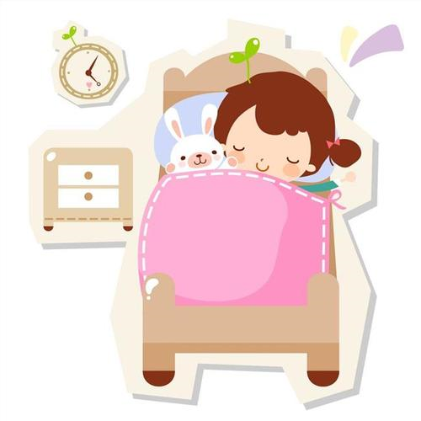
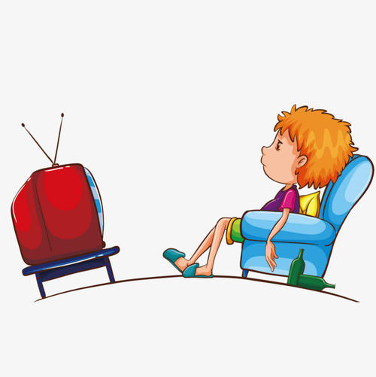
I do you say.
get up
go to bed
watch TV

Slide 5
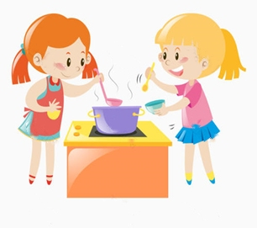
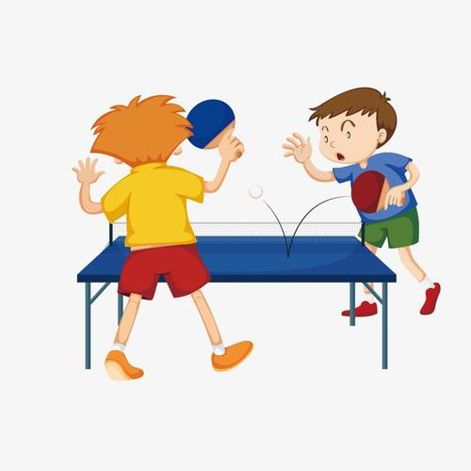
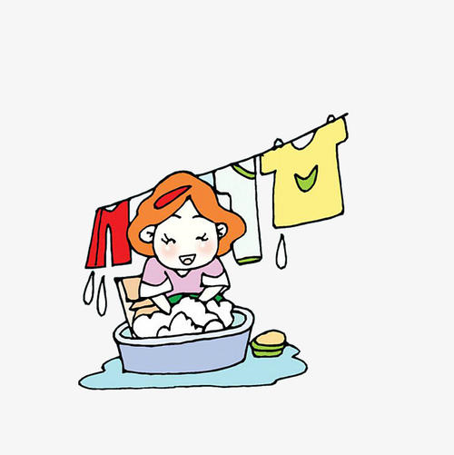
I do you say.
cook dinner
play ping-pong
wash my clothes

Slide 6
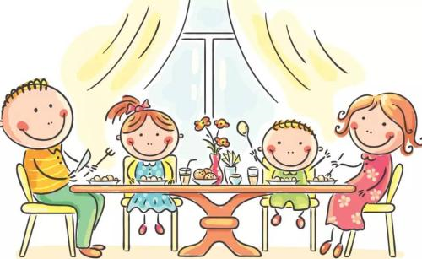
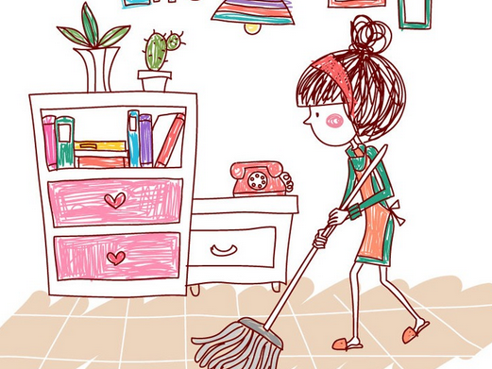

I do you say.
eat dinner
clean my room
do homework

Slide 7
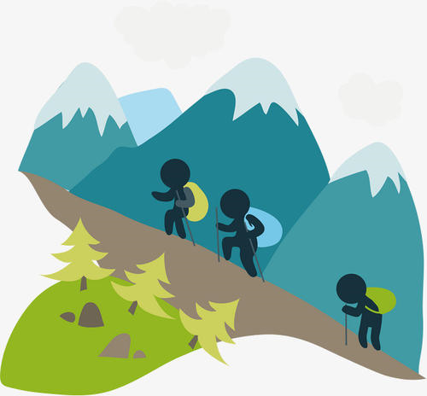


Let’s chant.
Every weekend I climb mountains.
What do you do? What do you do?
Every weekend I read some books.
What do you do? What do you do?
Every weekend I go shopping.
What do you do? What do you do?
Every weekend I go hiking.
What do you do? What do you do?

Slide 8


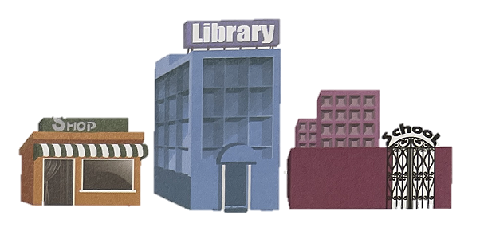
Lead in
Let’s try
Where is Sarah? Listen and circle.

Slide 9

听力原文：
Sarah:
Shopkeeper:
Sarah:
Shopkeeper:
Saran:
Hello, Mrs Green. Good to see you!
Hi, Sarah. Welcome to our shop again.
I want to buy some vegetables.
Here are some fresh carrots. You don’t often shop here on Saturdays.
No, not often.

Slide 10
Presentation
Do the activities as quickly as you can.
go shopping
work
watch TV
play ping-pong
wash my clothes
cook dinner

Slide 11
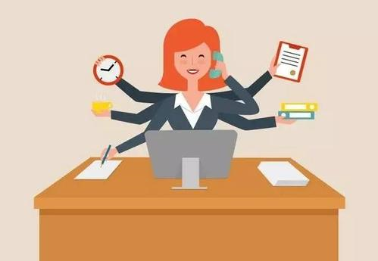

Say the activities as quickly as you can.

Slide 12
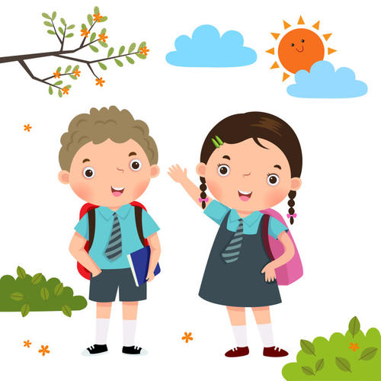
Free talk.
I often go shopping on the weekend.
What do you do on the weekend?
I often/usually…

Slide 13
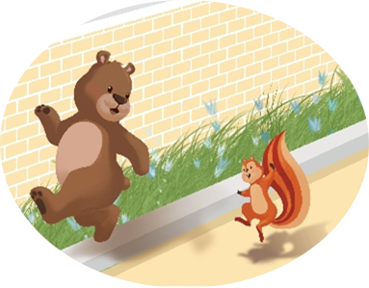
Role play.
Today is Sunday! What do you do on the weekend?
-What does Zip do on the weekend?
-Zip often goes shopping with her mum.
I often go shopping with my mum.

Slide 14
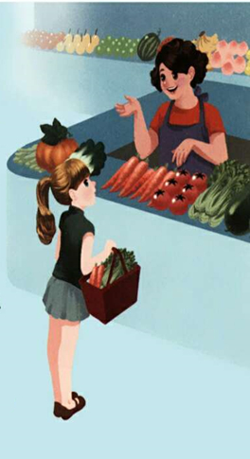
Let’s talk
Listen, answer and role play.
What does Sarah do on the weekend?
Sarah often watches TV and plays ping-pong with his father.
She usually washes her clothes. Sometimes she cooks dinner.

Slide 15
Pair work.
e.g.
S1: I often watch TV on the weekend.
What do you do on the weekend?
S2: I often/usually play basketball on the weekend.

Slide 16
Language points
-What do you do on the weekend?
-I often watch TV and play ping-pong with my father.
【详解】问句用来询问对方周末的活动安排。第一个do是助动词，没有实际意义。第二个do是实义动词，意思是“做，干”。
on the weekend可替换成其他时间，用来询问对方在某时做什么。
句型结构：What do you do + 时间状语？
回答：I/We (+ 频度副词) + 动词（短语）（+其他）.
eg. –What do you do on Saturday?
-I usually clean my room.

Slide 17
Free talk.
S1: What do you do on the weekend?
S2: I often cook dinner.
T: You often cook dinner. That sounds like a lot of fun.

Slide 18
Pair work.
e.g.
S1: I often play football on the weekend.
S2:That sounds like a lot of fun.

Slide 19
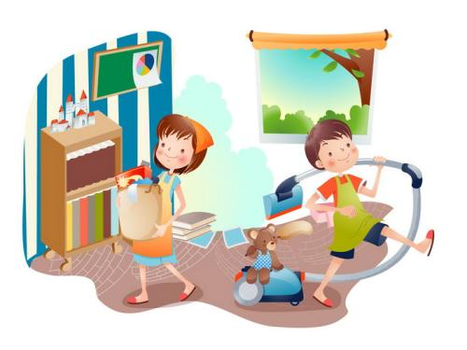
Free talk.
T: I often go shopping on the weekend.
Sometimes I watch TV, too.
Ss: That sounds like a lot of fun.
T: Yes, but I’m also hard-working.
I usually wash my clothes and clean my room.
Sometimes I cook dinner.
Are you hard-working on the weekend?

Slide 20
Listen and answer.
Sarah often watches TV and plays ping-pong on the weekend.
Is she hard-working on the weekend?
Yes, she is hard-working. She usually washes her clothes. Sometimes she cooks dinner.

Slide 21
Watch and read after it.
Shopkeeper:
Sarah:
Shopkeeper:
Sarah:
Shopkeeper:
Sarah:
Shopkeeper:
Why are you shopping today?
My mum worked last night. So I’m shopping today.
Good girl! So what do you do on the weekend?
I often watch TV and play ping-pong with my father.
That sounds like a lot of fun.
Yes, but I’m also hard-working. I usually wash my clothes. Sometimes I cook dinner.
You’re so busy! You need a robot to help you!
点击画面 播放视频

Slide 22
Read again and fill in the blanks.
What do you do on the weekend?
I often ________ and ________________my father.
I ______ wash my clothes.
Sometimes I _________.
watch TV
play ping-pong with
usually
cook dinner

Slide 23
Read and act out.
Shopkeeper:
Sarah:
Shopkeeper:
Sarah:
Shopkeeper:
Sarah:
Shopkeeper:
Why are you… today?
My mum… So… today.
Good girl! So what… ?
I often… and… with…
That sounds like a lot of fun.
Yes, but I’m also… I usually.. Sometimes I…
You’re so busy! You need a robot to help you!

Slide 24
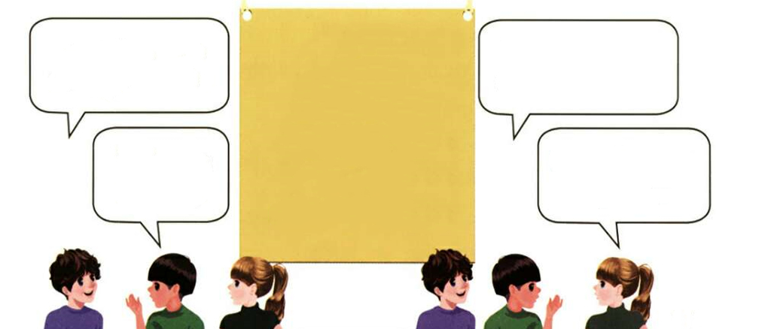
Practice
Ask the question and then pass it on.
do homework
watch TV
have…class
play sports with…
play music
wash my clothes.
What do you do on the weekend?
What do you do on the weekend?
I often go shopping.
I usually clean my room.

Slide 25
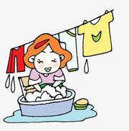
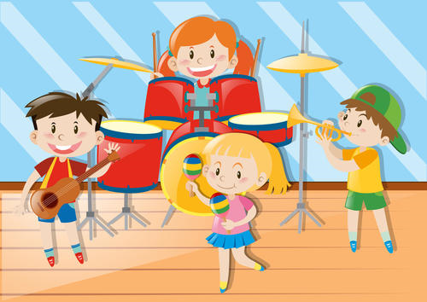

Choose and answer the question.
What do you do on the weekend?
I often…
1
2
3
4
5
6

Slide 26

Exercises
一、英译汉。
昨天晚上
在周末
1. last night _________ 2. on the weekend _______
3. watch TV _________ 4. play ping-pong _______
5. play music _________ 6. go shopping ________
看电视
打乒乓球
演奏音乐
购物

Slide 27


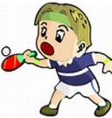
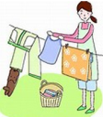

二、给图片标序号。
D
B
E
A
C
( ) ( ) ( ) ( ) ( )
A. play ping-pong B. watch TV C. wash my clothes
D. go shopping E. do homework

Slide 28
三、连词成句。
1. father, I, with, play, my, basketball, often (.)
_____________________________________
2. fun, like, that, a, of, sounds, lot (.)
_____________________________________
3. weekend, do, what, you, the, do, on (?)
_____________________________________
I often play basketball with my father.
That sounds like a lot of fun.
What do you do on the weekend?

Slide 29


Summary
学习了下列单词：
last, sound, why, shop, work, also, busy, need
2.学习了下列句型：
— What do you do on the weekend?
— I often watch TV and play ping-pong with
my father.
七彩课堂
伴你成长

Slide 30

Homework
ONE
TWO
Act the dialogue out with your friends.
Make a short dialogue using the sentences we have learned.
七彩课堂
伴你成长
Play games in pairs like “ask the question and then pass it on”.

Slide 31






