Slide 1


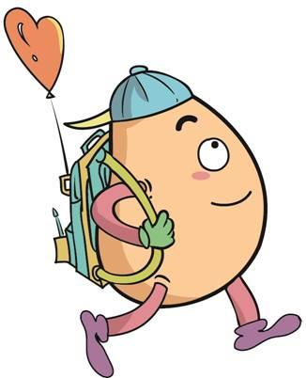






人 教 PEP 版 英 语 五年 级 下 册
Unit 1
My day
Part A
Let’s learn & Ask and write

Slide 2
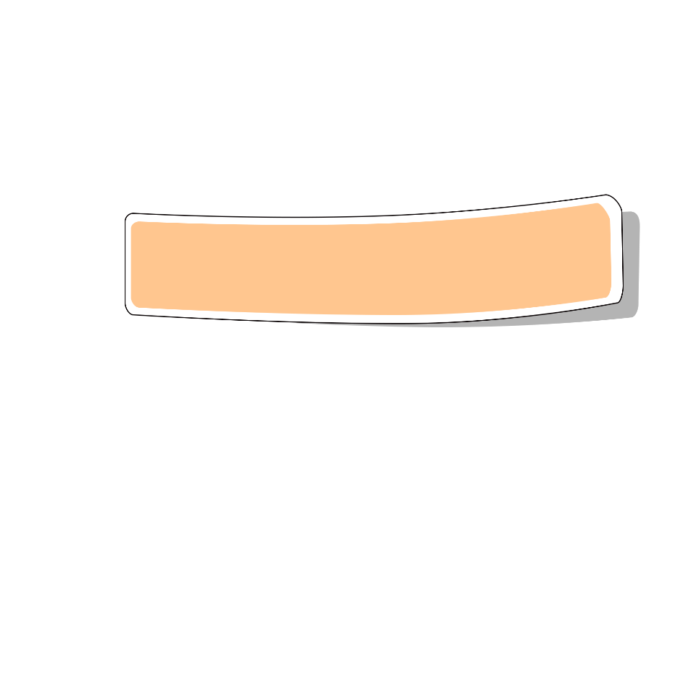
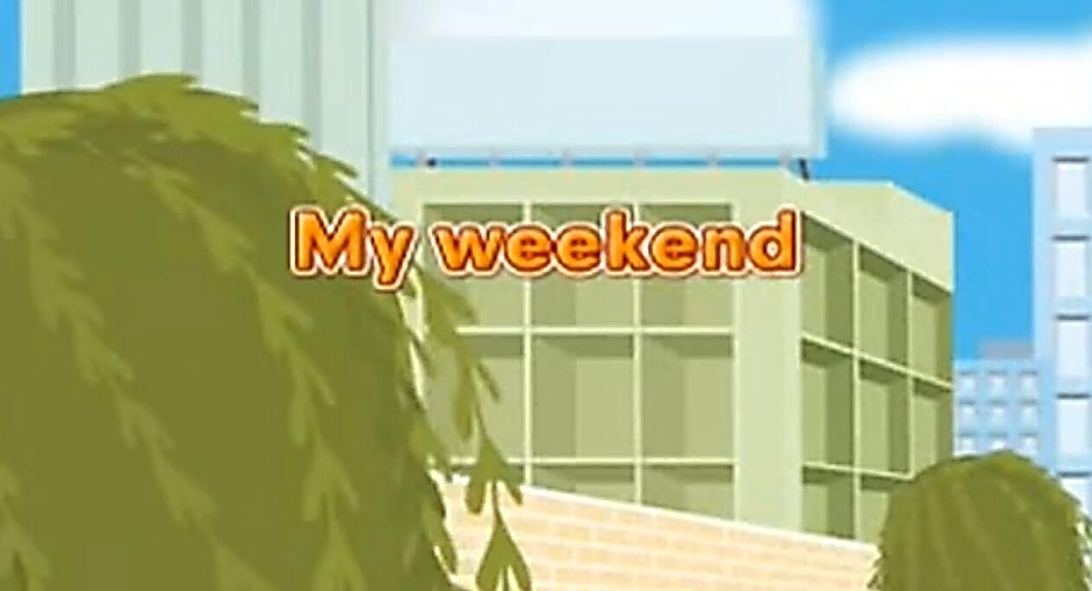
Warm up

Slide 3
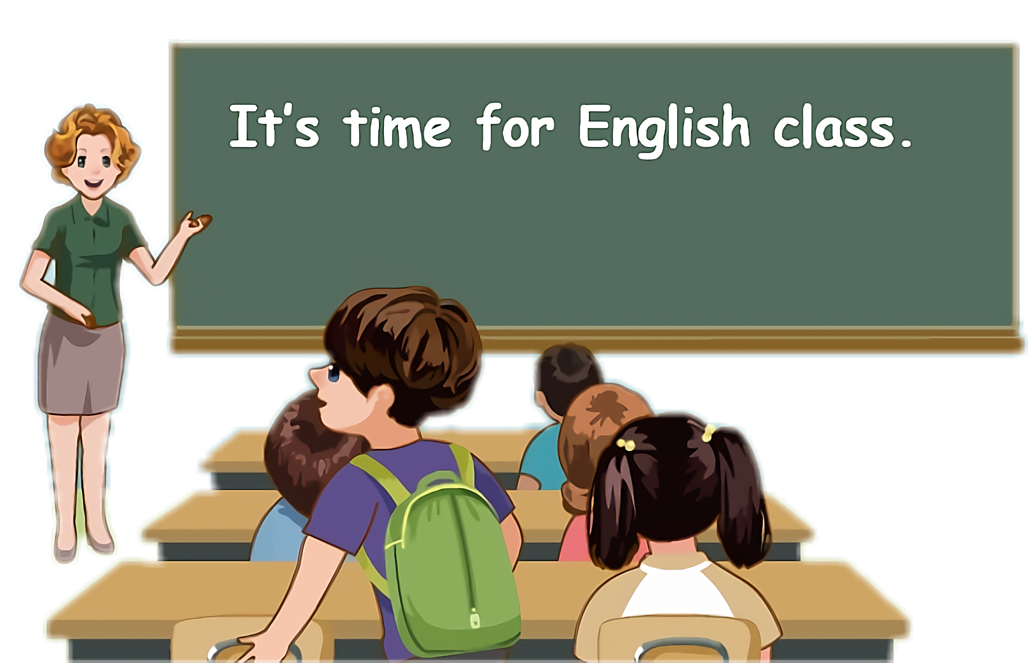
Lead in
Children, what can you do every day?

Slide 4
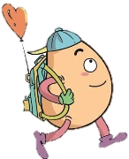
Let’s discuss！
read books
play computer games
watch TV
water flowers
do homework
listen to music
wash the clothes

Slide 5
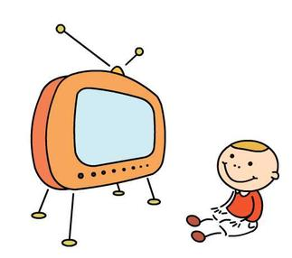
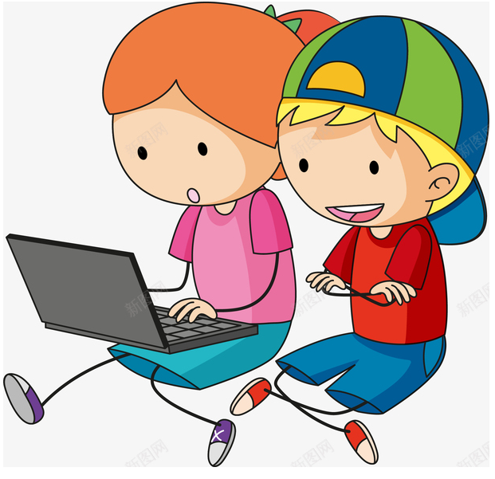


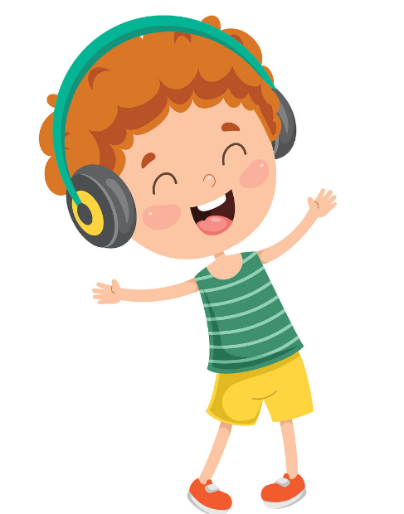
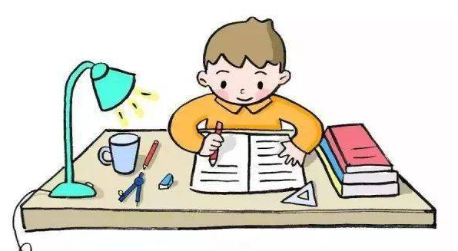
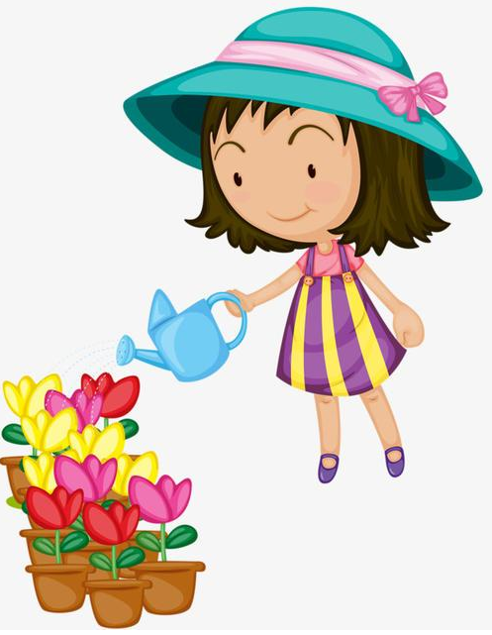
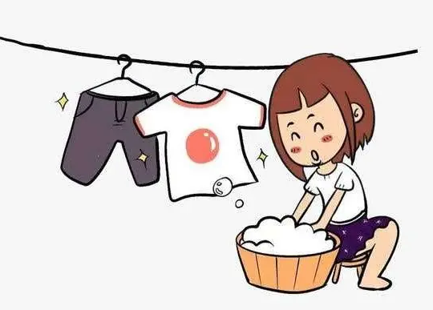
Let me introduce my day’s life.

Slide 6
Presentation
Talk about the timetable
Talk about our timetable.
Talk about Pedro’s timetable in Spain.
Talk about your partner’s timetable.

Slide 7
Let’s discuss!
Our timetable and Pedro’s timetable.
we
6:30 o’clock
8 o’clock
11:40
2 o’clock
7:00
 |  | Pedro
get up |  | 7 o’clock
start class |  | 9 o’clock
finish class |  | 1 o’clock
start class in the afternoon |  | 3 o’clock
eat dinner |  | 9:30

Slide 8
What does Pedro do at other time in Spain?
Let’s look at these pictures of Pedro in Spain.

Slide 9

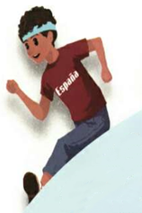
Let’s learn
Learn new words！
do morning exercises 晨练
注：exercise在此处作可数名词，常用复数形式。
I do morning exercises at 7:00 a.m.

Slide 10
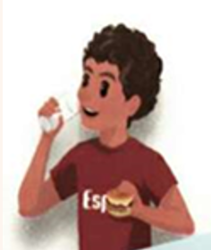
eat breakfast 吃早饭
同义短语: have breakfast.
拓展： eat lunch吃午饭
I often eat breakfast at 7:00 a.m.

Slide 11
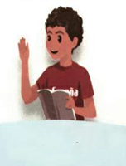
have... Class 上......课
拓展：have Chinese class上语文课
have English class上英语课
We have maths class at 9:00 a.m.

Slide 12
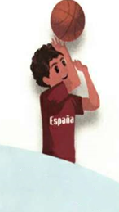
play sports 做运动
同义短语: do sports/ have sports
拓展：play football/ play basketball 球类前不加the
play the piano/ play the violin 乐器前必须加the
They often play sports after school.

Slide 13
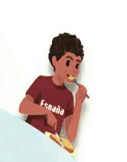
eat dinner 吃晚饭
同义短语: have dinner
I often eat dinner at 9:00 p.m.

Slide 14
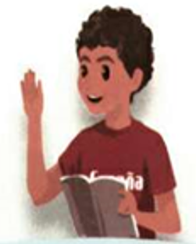

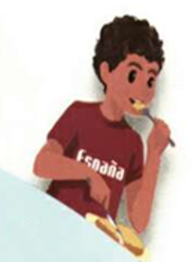
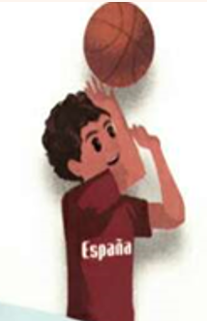
Match the phrases and pictures！
play sports
have... class
do morning exercises
eat breakfast
eat dinner

Slide 15
Watch and answer！
What does Pedro do during the day?
2. When did Pedro do these activities?

Slide 16
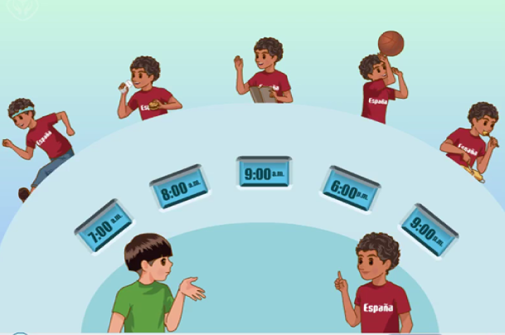

Slide 17
What does Pedro do during the day?
2. When does Pedro do these activities?
do morning exercises/ eat breakfast/ have... class/ play sports/ eat dinner
do morning exercises at 7:00 a.m./ eat breakfast at 8:00 a.m./ have... class at 9:00 a.m./ play sports at 6:00 p.m./ eat dinner at 9:00 p.m.

Slide 18

Play in roles.
When do you do morning exercises?
When do you have Chinese class?
When do you play sports?
When do you eat breakfast?
When do you eat dinner?
At 9 o’clock.
At 7 o’clock.
At 8 o’clock.
At 6 o’clock.
At 9 o’clock.

Slide 19
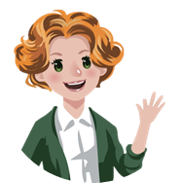
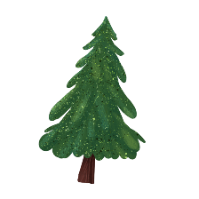

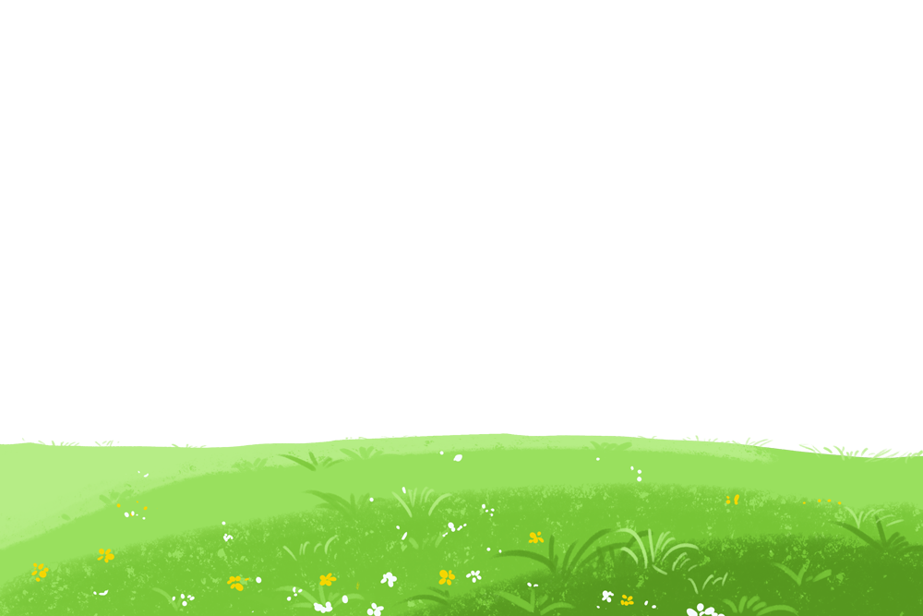
Language point.
认识时间
1. a.m. 午前,上午; p.m. 午后,下午
2. a.m.或p.m.前面要用阿拉伯数字而不用英文的数词
表示钟点。
eg. 8:30 a.m. 而不能用eight thirty a.m.
3. 用a.m.或p.m.表示整点时，不再用o’clock一词。
eg. 8:00 a.m. 而不能用8 o’clock a.m.

Slide 20
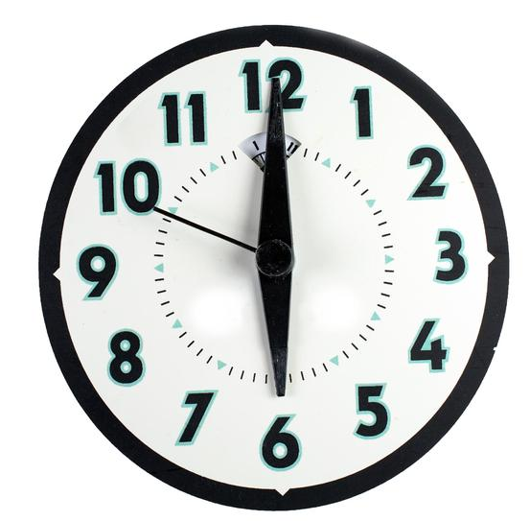
—When do you get up?
6:00 a.m.
— At _________.
上午六点

Slide 21
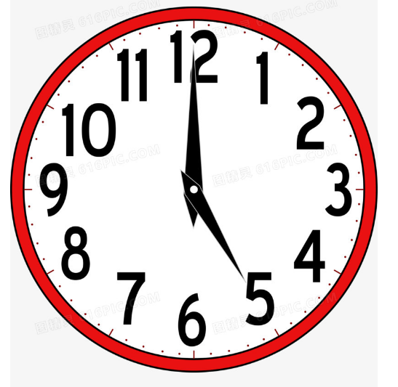
—When do you play sports?
5:00 p.m.
— At _________.
下午五点

Slide 22

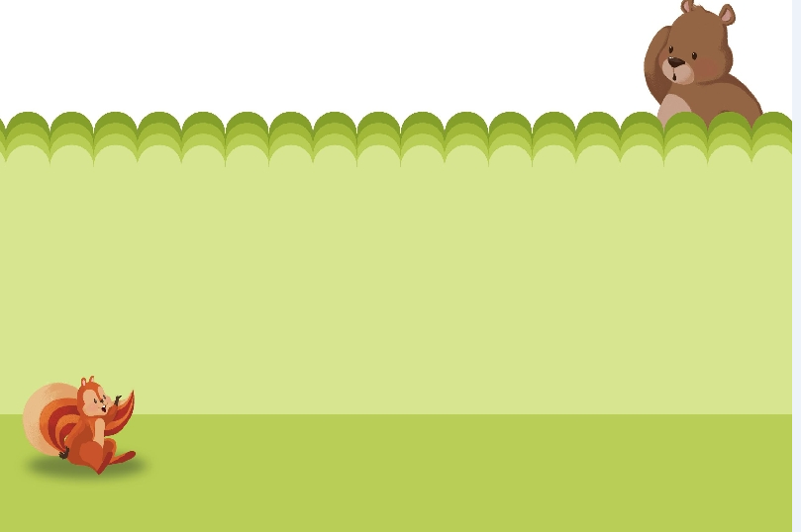
Ask and write
Ask about your partner’s timetable.
When do you do morning exercises?
When do you get up?
When do you have English class?
When do you eat breakfast?
When do you eat lunch?
When do you play sports?
When do you eat dinner?
When do you go to bed?
6:00 a.m.
6:30 a.m.
get up ________ do morning exercises ________
eat breakfast ________ have ... Class ________
eat lunch ________ play sports ________
eat dinner _________ go to bed ________
7:00 a.m.
9:00 a.m.
12:00 a.m.
4:00 p.m.
6:00 p.m.
9:00 p.m.
I get up at 6 :00 a.m.
I eat lunch at 12:00 a.m.
I play sports at 4:00 p.m.
I eat dinner at 6:00 p.m.
I have English class at 9:00 a.m.
I do morning exercises at 6:30 a.m.
I eat breakfast at 7:00 a.m.
I go to bed at 9:00 p.m.

Slide 23
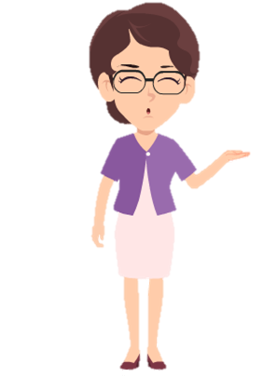
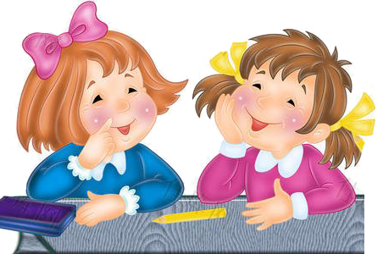
Make dialogues using the following phrases.
get up
do morning exercises
eat breakfast
have … class
eat lunch
play sports
eat dinner
go to bed
When do you _____?
I ____ at ____.

Slide 24
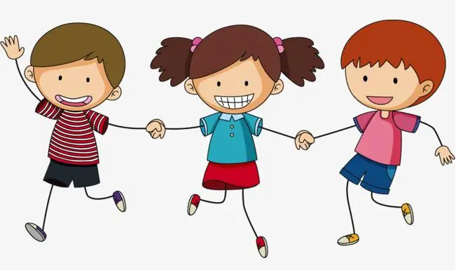
Play a game
接力表演
学生三个人一组进行表演，第一个人表演(起床)动作，第二个人说单词(get up)，第三个人说出句子。如: I get up at 6:30.

Slide 25
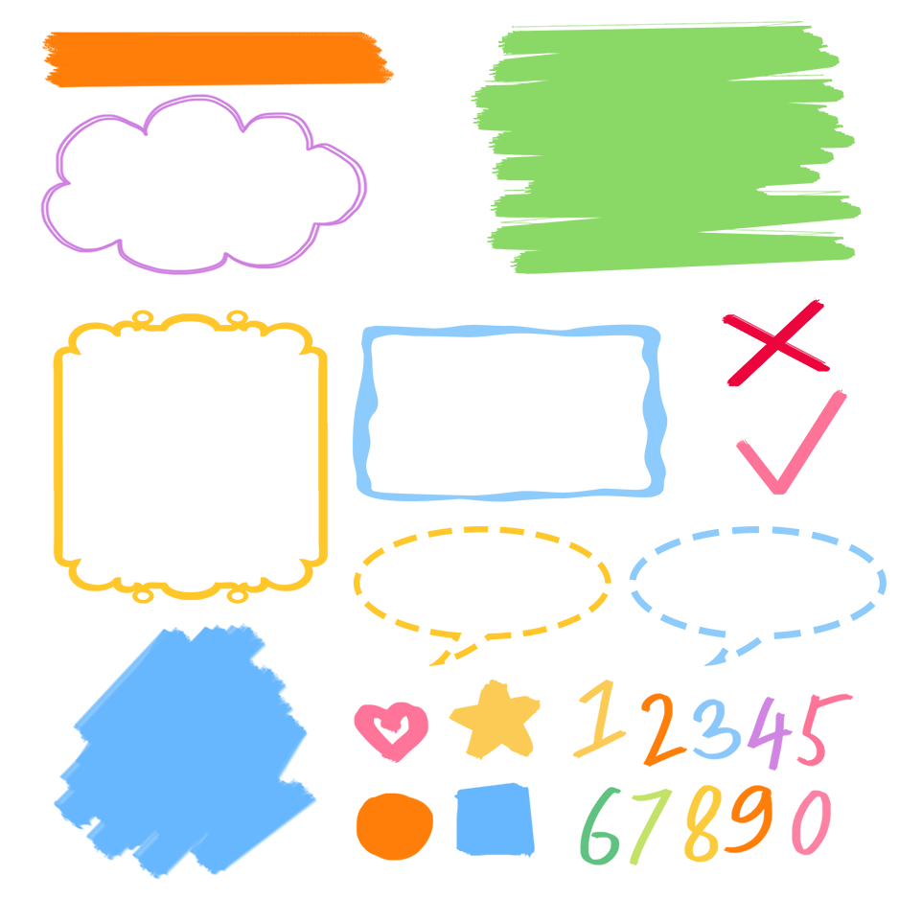
了解日常活动词组
记忆日常活动词组
熟练运用日常活动词组

Slide 26
Good to know
If you set your time straight, you save time. -- Bacon
合理安排时间,就等于节约时间。 ——培根
We must manage our time well!
我们必须合理安排自己的时间！

Slide 27
Exercises
一、英汉互译。
1. 吃早餐________________________
2. 吃午饭_____________________
3. 吃晚饭_______________________
4. play sports_________________
5. have English class_______________
6. do morning exercises____________
eat breakfast
eat lunch
eat dinner
进行体育运动
上英语课
做早操

Slide 28
二、单项选择
( )1.I get up ____ 6 o’clock.
A. on B. in C. at
( )2. When ____you do morning exercises?
A. do B. are C. is
( )3. --_____ do you go to bed every day?
--At 9 o’clock.
A. What B. Why C. When
C
A
C

Slide 29
三、按照要求完成句子。
1.I usually do morning exercises at 7 o’clock.(对划线部分提问)
____________________________________
2.English, when, an, have, do, class, you, (?)(连词成句)
___________________________________
When do you usually do morning exercises?
When do you have an English class?

Slide 30

Summary
1. 学习了下列单词：
when, do morning exercises, eat breakfast, have…
class, play sports, eat dinner.
2.学习了询问活动时间的句型：
—When do you do morning exercises?
—At 7 o’clock. /I do morning exercises at 7 o’clock.

Slide 31
Homework
ONE
TWO
Say and do the actions in Let’s learn.
Make a short dialogue using the sentences we have learnt.
Ask about your father’s timetable and write it down.

Slide 32
