Slide 1







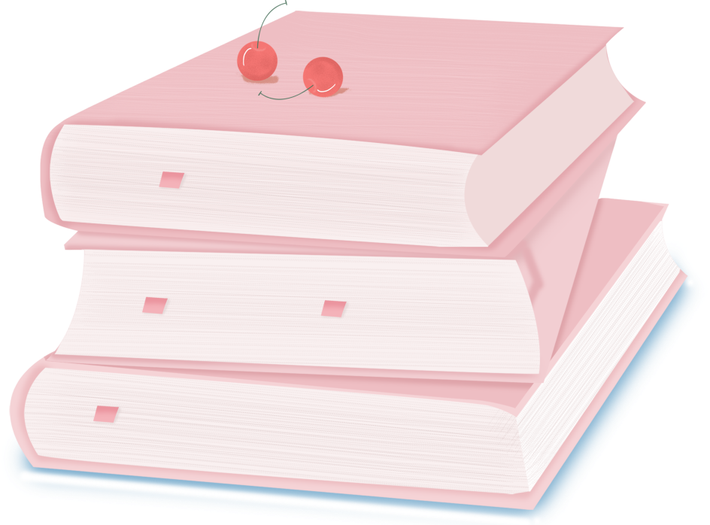

人 教 PEP 版 英 语 五 年 级 下 册
Unit 1
My day
Part A
Let’s learn & Ask and write

Slide 2

Warm up
Look and say.
Pedro’s Timetable.
get up | often at 7 o’clock
start class | usually at 9 o’clock
finish class in the morning | at 1 o’clock
go back to school after lunch | at 2:30
start class in the afternoon | at 3 o’clock
eat dinner | usually at 9:30 or 10 o’clock
T: Hi, Pedro. When do you get up?
S1: I often get up at 7o’clock.
T: When do you eat dinner?
S2: …

Slide 3

Lead in
Ask and answer.
When do we have the first class in the morning ?
We have the first class at 8:30.
When do we finish class in the morning ?
We finish class at 11:40.
When does Pedro finish class in the morning?
He finishes class at 1 o’clock.

Slide 4
Ask and answer.
When do we start class in the afternoon?
We start class at 2 o’clock in the afternoon.
When does Pedro start class in the afternoon?
He starts class at 3 o’clock in the afternoon.
What does Pedro do at other time in Spain?
Let’s look at these pictures of Pedro in Spain.

Slide 5
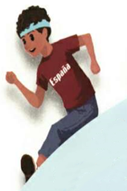
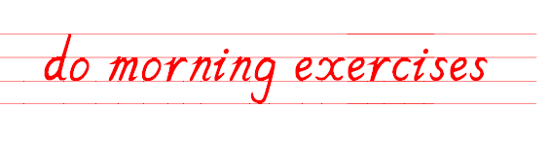

Presentation
Let’s learn

Slide 6
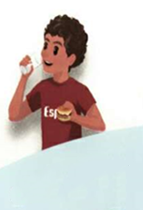
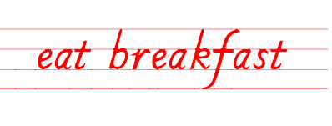

Slide 7
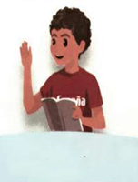
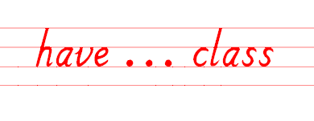

Slide 8
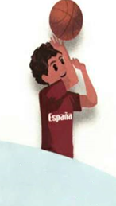
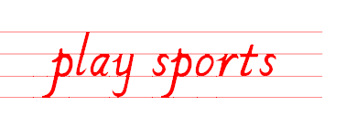

Slide 9
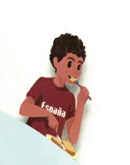
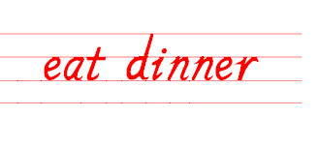

Slide 10

Read the words as quickly as you can.

Slide 11
Say the words as quickly as you can.

Slide 12
认识时间
7:00 a.m.
上午七点
下午六点
6:00 p.m.
8:00 a.m.
上午八点
晚上九点
9:00 p.m.
9:00 a.m.
上午九点
a.m. 午前；上午
p.m. 午后；下午

Slide 13
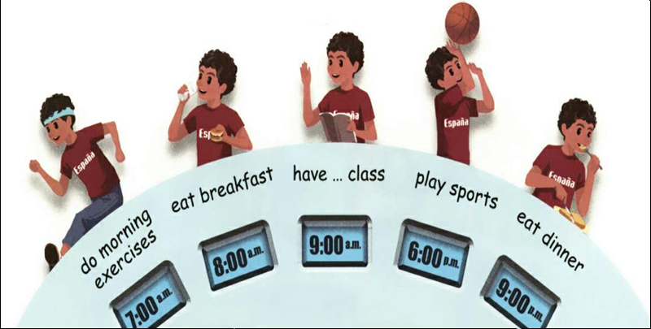
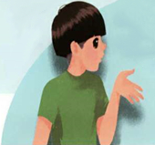
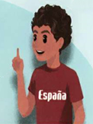
Look and say.
When do you do morning exercises?
At 7 o’clock.

Slide 14
Pair work.
When do you do morning exercises?
点击画面 播放视频
At 7 o’clock.

Slide 15
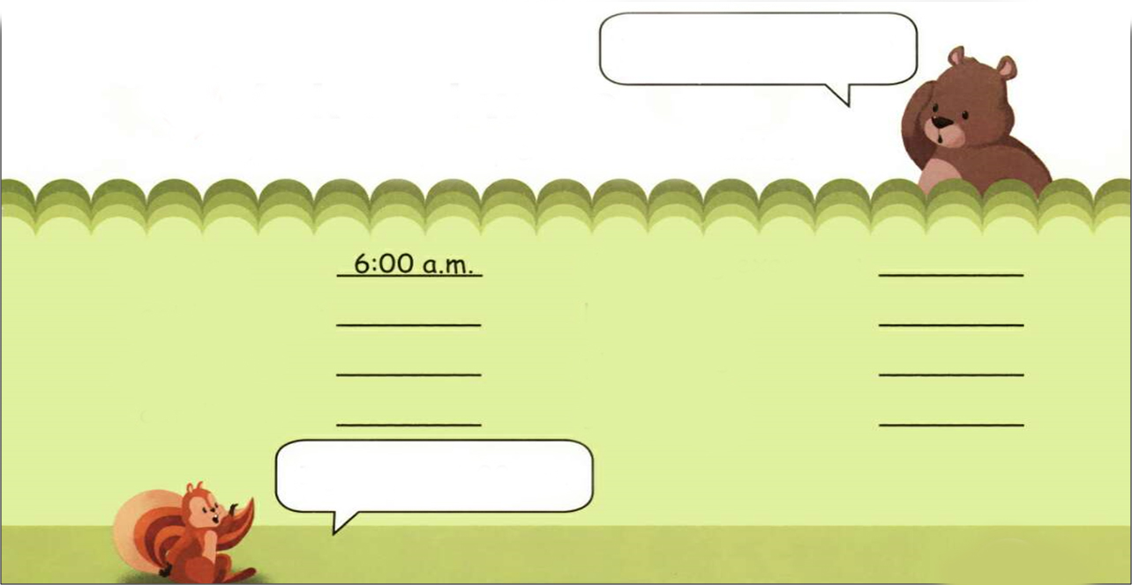
Practice
Ask and write
When do you get up?
Ask about your partner’s timetable.
get up
do morning exercises
eat breakfast
have … class
eat lunch
play sports
eat dinner
go to bed
I get up at 6:00 a.m.

Slide 16
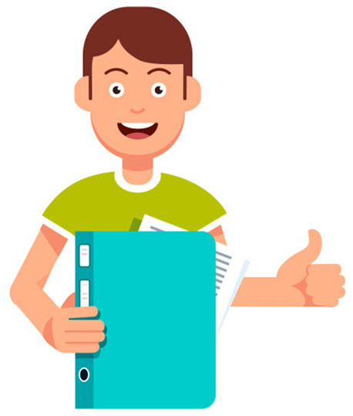
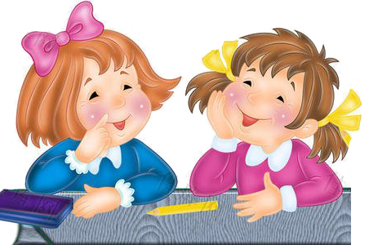
Practice in pairs.
get up
do morning exercises
eat breakfast
have … class
eat lunch
play sports
eat dinner
go to bed
When do you _____?
I ____ at ____.

Slide 17
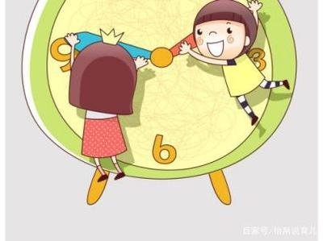
I want to know
If you set your time straight, you save time. -- Bacon
合理安排时间,就等于节约时间。 ——培根
We must manage our time well!
我们必须合理安排自己的时间！

Slide 18

Exercises
一、译成汉语。
1.eat dinner_____________ 2.eat breakfast_____________
3.eat lunch_____________ 4.do morning exercises _______
5.play sports_____________ 5.have English class________
吃晚餐
吃早餐
吃午餐
做早操
做运动
上英语课

Slide 19
二、单项选择。
( ) 1. When do you do morning ________?
A. exercising B. exercise C. exercises
( ) 2. When do you play ________?
A. sports B. sport C. sportes
( ) 3.When do you eat ________?
A. break fast B. breakfast C. brestfast
C
A
B

Slide 20
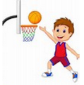
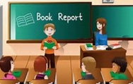
三、填一填。
play sports
-When do you __________?
-I _________ ____ 6:00 p.m.
play sports
at
9:00 a.m.
6:00 p.m.
-When do you ______________?
-I ______________ ____ 9:00 a.m.
have English class
have English class
at

Slide 21
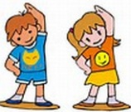
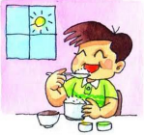
-When do you _________________?
-I ________________ ____ 6:00 a.m.
do morning exercises
do morning exercise
at
6:00 a.m.
7:00 a.m.
-When do you ____________?
-I ____________ ____ 7:00 a.m.
eat breakfast
eat breakfast
at

Slide 22


Summary
学习了下列单词：do morning exercises, eat breakfast, have… class, play sports, eat dinner
2.学习了询问时间的句型：
—When do you do morning exercises?
—At 7 o’clock. /I do morning exercises at 7 o’clock.

Slide 23

Homework
ONE
TWO
Say and do the actions in Let’s learn.
Make a short dialogue using the sentences we have learned.
七彩课堂
伴你成长
Ask about your father’s timetable and write down.

Slide 24

