Slide 1








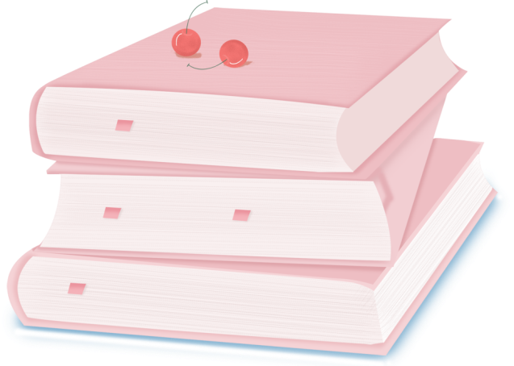
人 教 PEP 版 英 语 五年 级 下 册
Unit 1
My day
Part A
Let’s spell

Slide 2

Review
get up
eat breakfast
do morning exercises
go to school
start class
have an English class
eat lunch
finish class
play sports
eat dinner
go to bed
When do you…?
I usually… at….

Slide 3
Lead in
观察这些句子，分别指出带有cl，pl的单词有哪些。
My clothes are clear. My classmates are clever.
I often clean my classroom at four o’clock in the afternoon on Tuesdays.
Play basketball with the players on the playground, please.

Slide 4


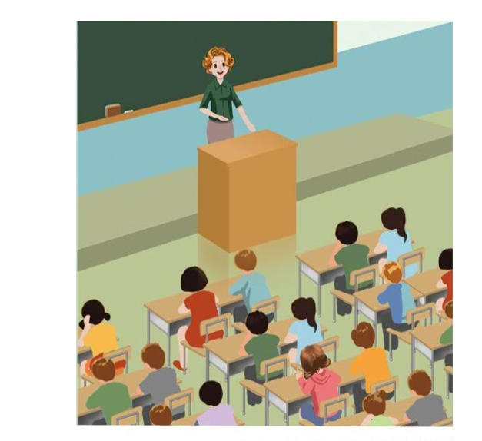
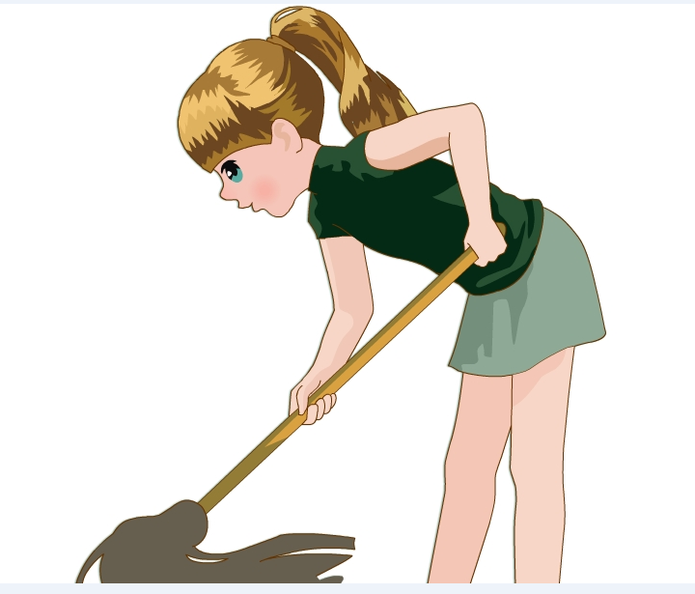
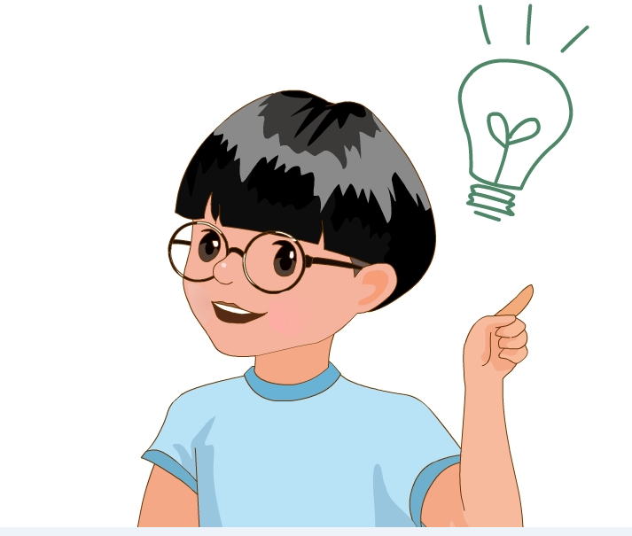
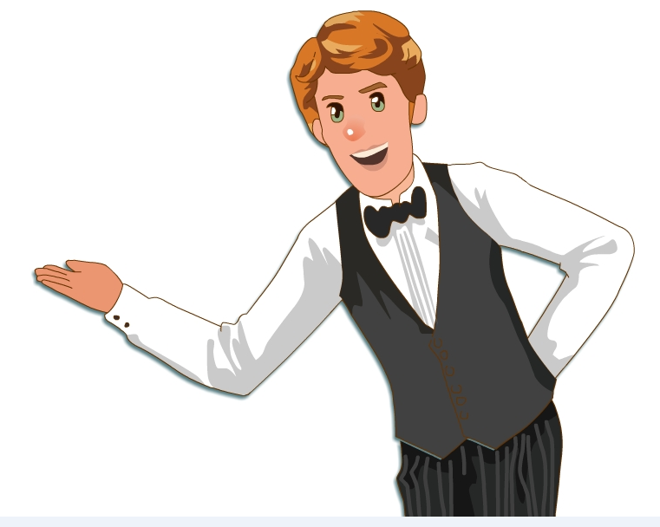
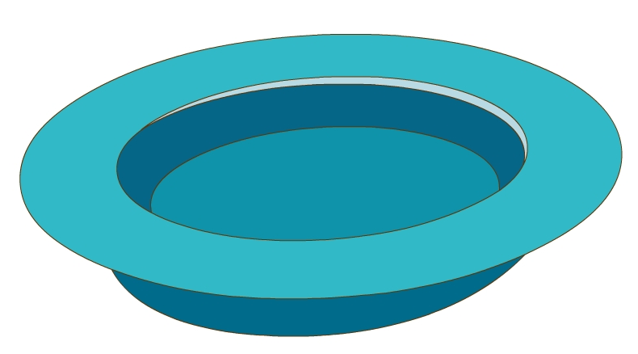

Let’s introduce the pronunciations of cl and pl.

Slide 5
Presentation
How to spell cl and pl?
学习cl 在单词中的发音规则
学习pl在单词中的发音规则
学习cl, pl的发音要领

Slide 6


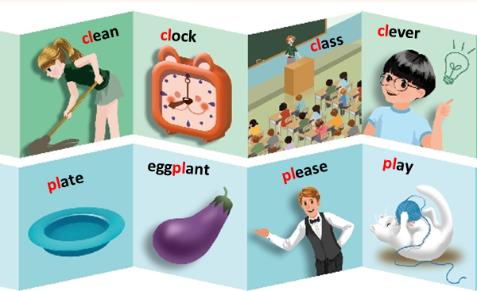
Let’s spell
Listen and read.

Slide 7
clean/kliːn/

Slide 8
clock/klɒk/

Slide 9
class/klɑːs/

Slide 10
clever/ˈklevə(r)k/

Slide 11
clean
clock
class
clever
cl
/kl/

Slide 12
单词闯关
clock
class
clean
clap
close
clear
clothes
cloudy
climb

Slide 13
plate/pleɪt/

Slide 14
eggplant/ˈeɡplɑːnt/

Slide 15
please/pliːz/

Slide 16
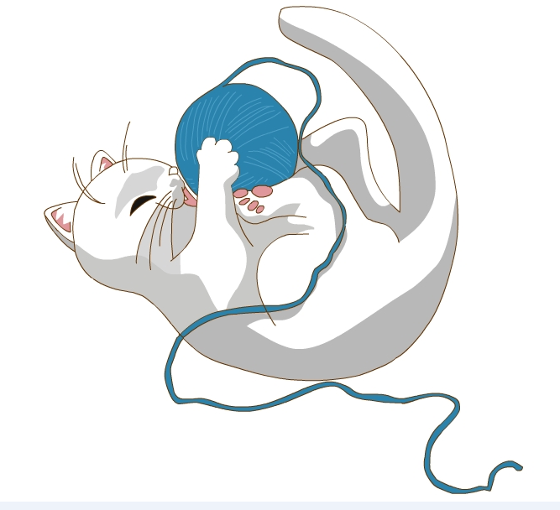
play/pleɪ/

Slide 17
plate
eggplant
please
play
pl
/pl/

Slide 18
单词闯关
plane
people
please
plate
place
plus
eggplate
plan
play

Slide 19
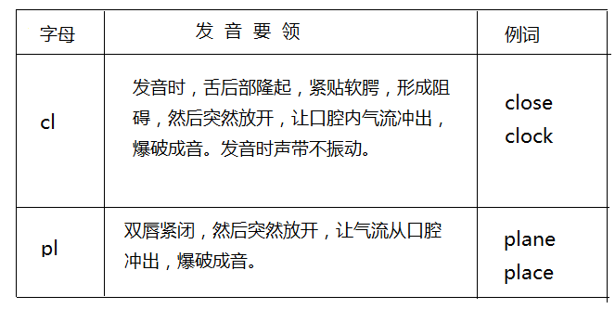
Let’s learn.

Slide 20
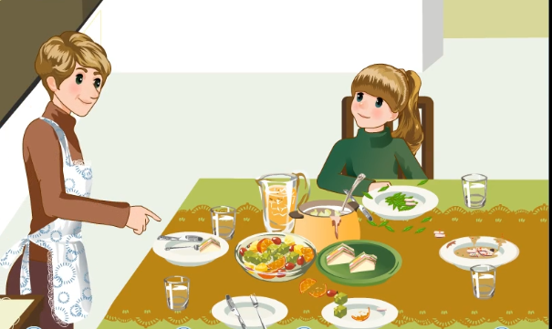
Let’s chant.

Slide 21
Please clean your plate.
Please clean your plate.
No more eggplant.
No more peas.
So clean your plate.
Please, please, please.
听到pl时坐正，听到cl时拍下手。

Slide 22
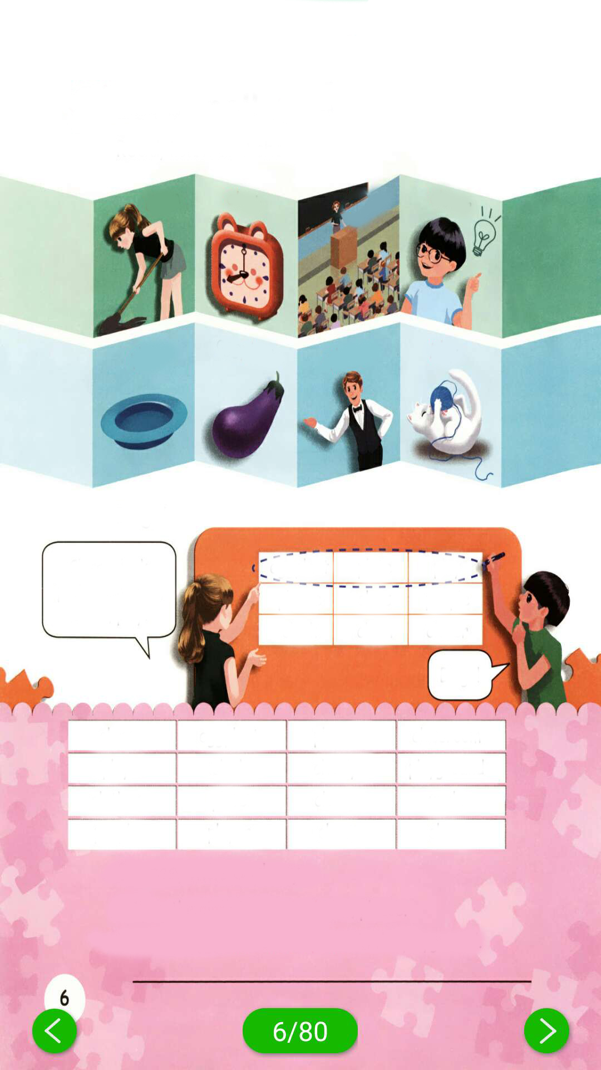
Bingo！
听写单词，在听写的时候，可以随心所欲地把所听到的单词写在任意一个方格里，当你写出的单词无论是横向、竖向还是斜向，只要有一种情况的三个单词都含有cl，或都含有pl，你就可以喊出“Bingo!”，并且圈出这组单词。
Class, clock, plate, eggplant, clean, play.
eggplant plate play
please class people
clock clean clever
Bingo!

Slide 23
Choose, write and say.
“cl” ＆ “pl” group
class eggplant please classroom
play clock cloudy playground
clothes plate clever uncle
people player clear clean
Clean the plate/ classroom, please.
Put two eggplants/ clocks/ plates in the playground.

Slide 24

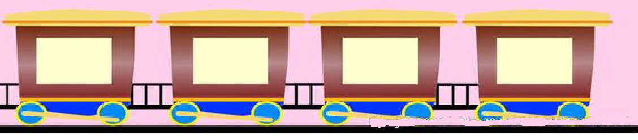
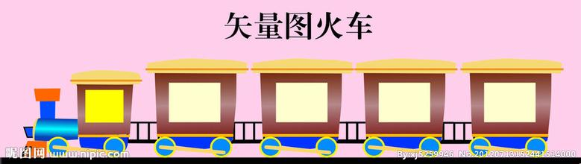
Let’s read！
people
eggplant
please
classroom
player
clock
cloudy
playground
clothes
plate
clever
uncle
clear

Slide 25
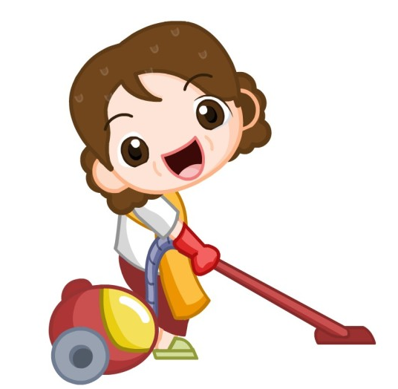
Let’s chant！
Clean, clean. Clean your room.
Clever, clever. You are clever.
Plate, plate. Clean your plate.
Please, please. This way, please.

Slide 26
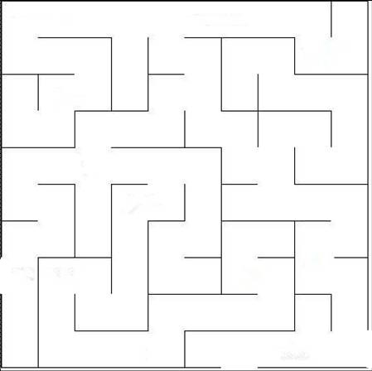
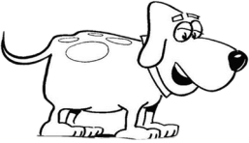
Play a game！
eggplant
clock
please
class
plate
play
clever
cloudy
clean
clear
plant
please
player

Slide 27
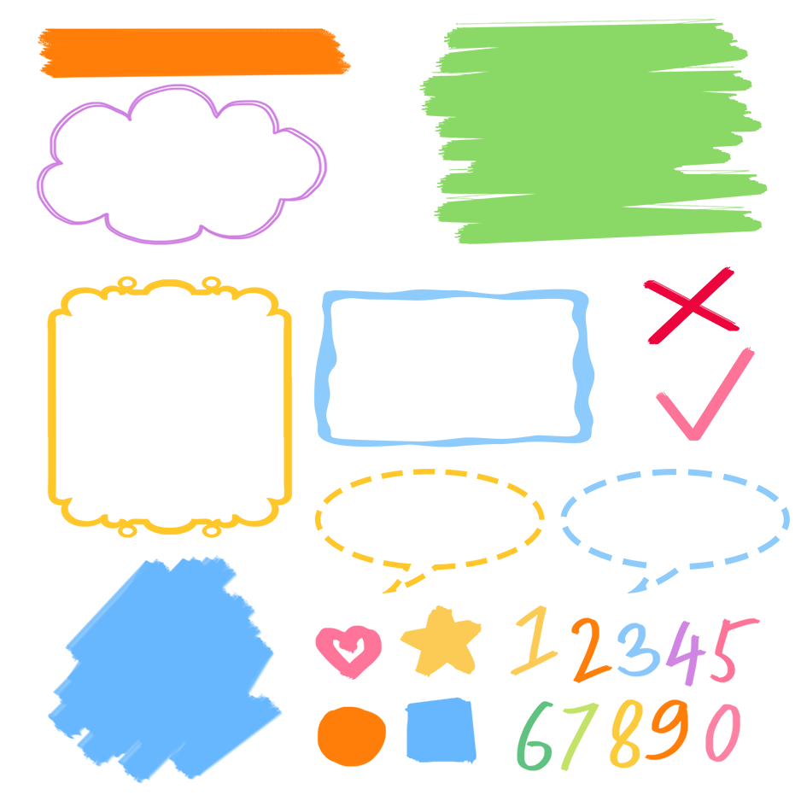
了解cl,pl的发音规则
记忆cl,pl的发音规则
根据发音规则读出生词

Slide 28
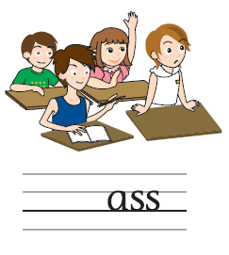
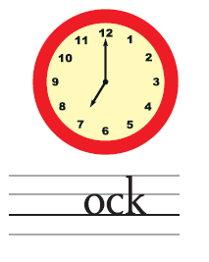
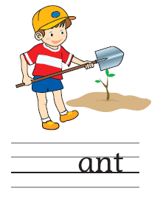

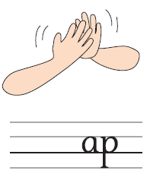
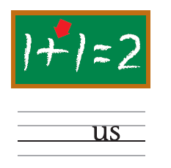
Exercises
一、看图片，补全单词（cl- pl-）。
cl
cl
pl
cl
cl
pl

Slide 29
二、找出下列单词中字母组合发音不同的单词
( )1. A. class B. clock C. clever D. uncle
( )2. A. circle B. clean C. classroom D. cloudy
( )3. A. please B. play C. plate D. people
( )4. A. player B. people C. eggplant D. playgournd
D
A
D
B

Slide 30

Summary
学习了字母组合cl与pl的发音规则，即cl在单词中发/kl/音，pl在单词中发/pl/音。

Slide 31
Homework
ONE
TWO
Find more words about cl and pl.
Play the Bingo game with your friends.
Sing the chant to your parents.

Slide 32







