Slide 1




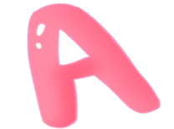


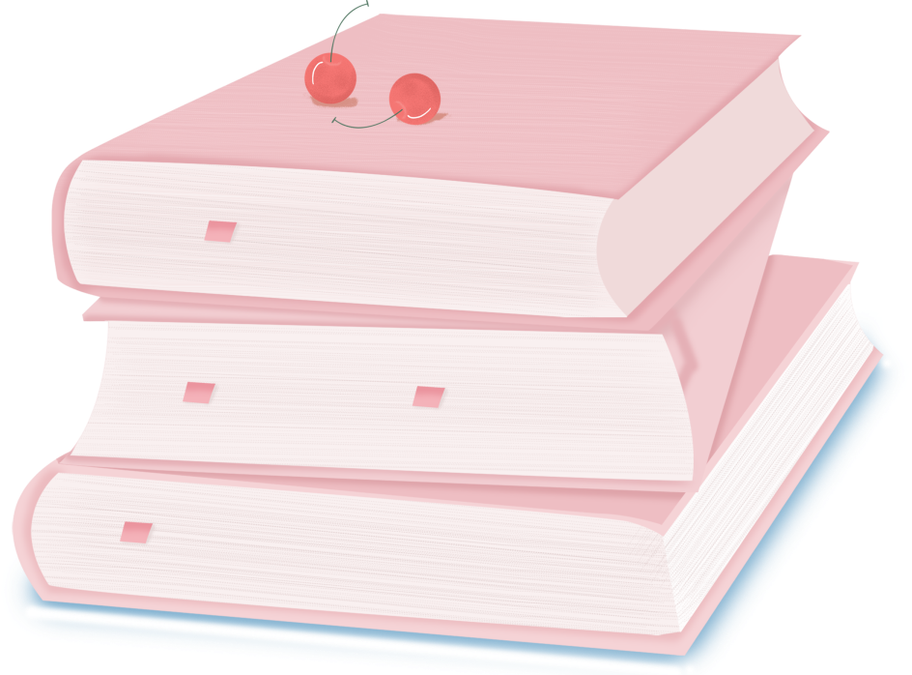

人 教 PEP 版 英 语 五 年 级 下 册
Unit 1
My day
Part A
Let’s spell

Slide 2

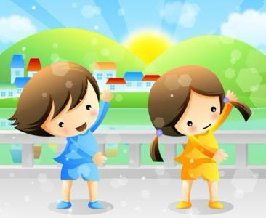
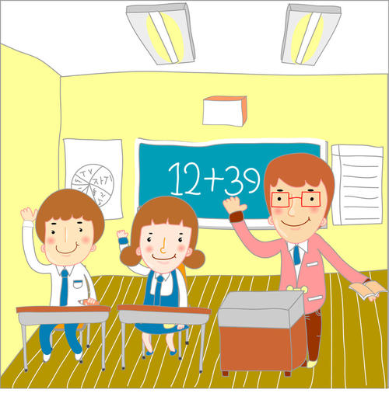
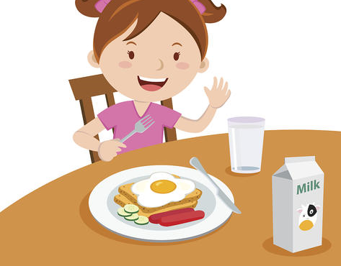
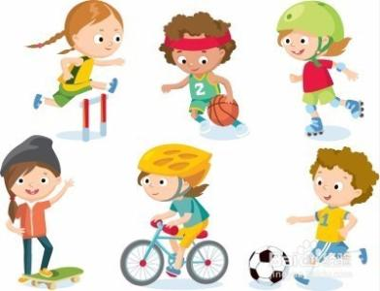

Warm up
A: When do you…?
B: I… at…

Slide 3

Lead in
Read after the tape.
My clothes are clear. My classmates are clever.
I often clean my classroom at four o’clock in the afternoon on Tuesdays.
Play basketball with the players on the playground, please.

Slide 4

观察这些句子，分别指出带有cl，pl的单词有哪些。
My clothes are clear. My classmates are clever.
My clothes are clear. My classmates are clever.
I often clean my classroom at four o’clock in the afternoon on Tuesdays.
I often clean my classroom at four o’clock in the afternoon on Tuesdays.
Play basketball with the players on the playground, please.
Play basketball with the players on the playground, please.
Today we’ll learn some words about cl or pl.

Slide 5
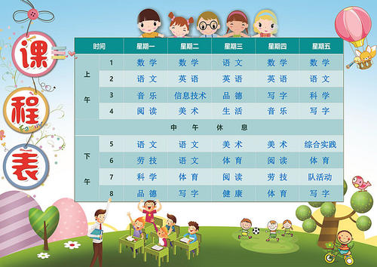
Presentation
It’s 8 o’clock. It’s time for maths.
When do you have Chinese class?
We have Chinese class at 9 o’clock.
Yes, you are so clever.
class
clock
cl-
clever

Slide 6
You finish class at 5 o’clock. Do you go home at 5 o’clock?
No, we clean our classroom at 5 o’clock.
clean
cl-
classroom

Slide 7
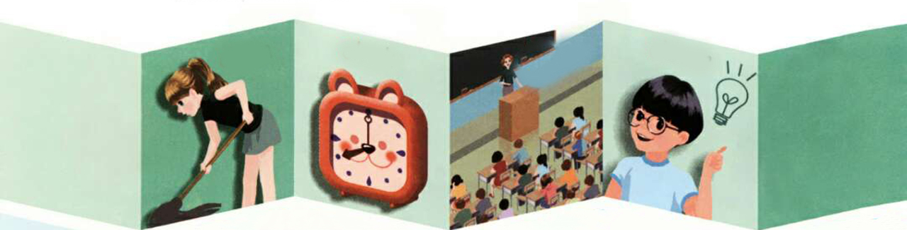

Let’s read.
clean
clock
class
clever

Slide 8

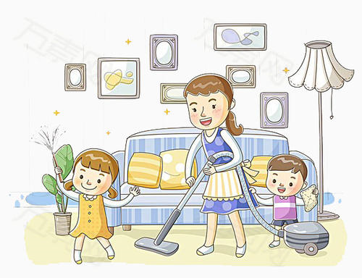
Do you play sports after school?
Yes, we play basketball.
Do you eat dinner at 6 o’clock?
Yes. And I eat an eggplant.
After dinner, please help your mum clean the plates.
play
eggplant
pl-
please
play

Slide 9
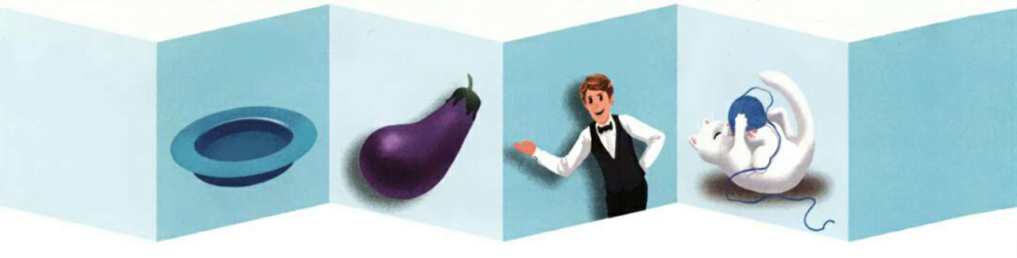
Let’s read.
plate
eggplant
please
play

Slide 10
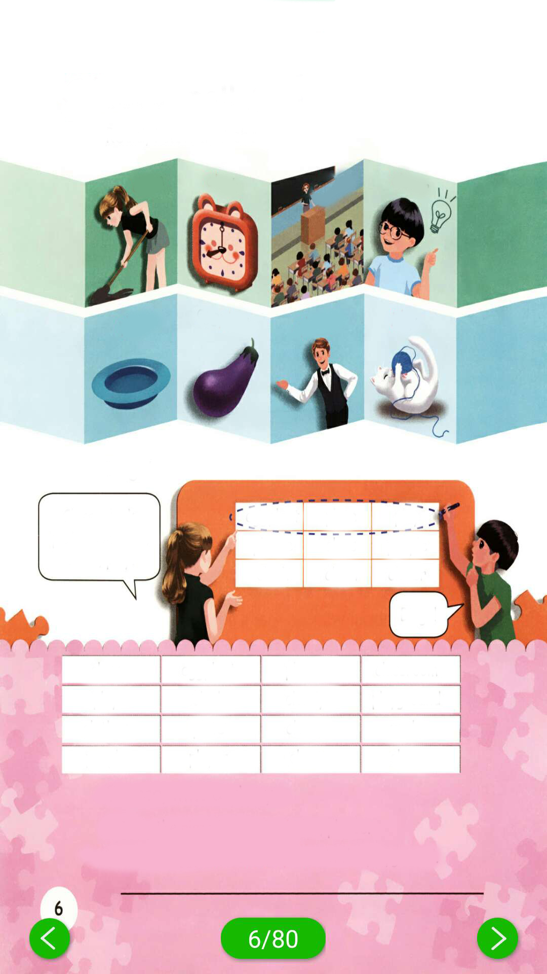
Read, listen and chant
点击画面 播放视频
clean
clock
class
clever
plate
eggplant
please
play

Slide 11
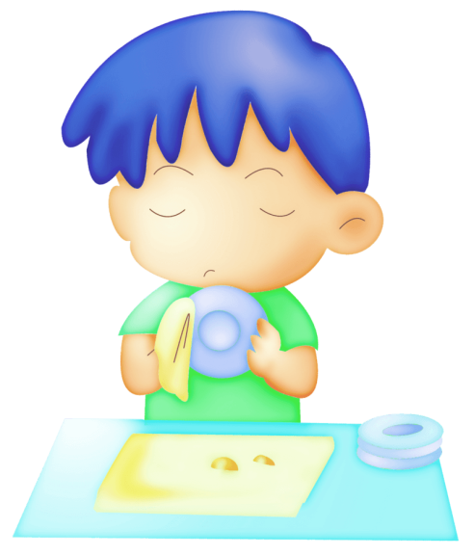

Let’s chant.
Please clean your plate.
Please clean your plate.
No more eggplant.
No more peas.
So clean your plate.
Please, please, please.
点击画面 播放视频
听到pl时坐正，听到cl时拍下手。

Slide 12
Let’s chant.
听到pl时坐正，听到cl时拍下手。
It’s 4 o’clock. Class is over.
Please clean your classroom.
Please clean your classroom.
Great! You’re so clever!
It’s 7 o’clock. Don’t play.
Please clean your plate.
Please clean your plate.
Great! You are so clever!

Slide 13
Bingo!
听写单词，在听写的时候，可以随心所欲地把所听到的单词写在任意一个方格里，当你写出的单词无论是横向、竖向还是斜向，只要有一种情况的三个单词都含有cl，或都含有pl，你就可以喊出“Bingo!”，并且圈出这组单词。
Class, clock, plate, eggplant, clean, play.
eggplant plate play
please class people
clock clean clever
Bingo!

Slide 14
Choose, write and say.
class eggplant please classroom
play clock cloudy playground
clothes plate clever uncle
people player clear clean
Clean the plate/ classroom, please.
Put two eggplants/ clocks/ plates in the playground.

Slide 15
Practice
Play a game “I’m fast”.
Read the word as fast as you can.
clean
clock
clever
class
clap
close
plate
play
eggplant
please
plane
place

Slide 16
Do you know more words like this?
clean
clock
plate
eggplant
class
clever
please
play
close
clothes
player
plus
clap
clear
place
plane
cloudy
club
plant
plan
Please read freely. Pay attention to cl and pl.

Slide 17

Exercises
一、读一读，判断下列字母发音是（T）否（F）相同。
( ) 1. A. people B. uncle C. table
( ) 2. A. plus B. play C. plate
( ) 3. A. clock B. clothes C. people
( ) 4. A. eggplant B. clock C. clean
T
T
F
F

Slide 18
二、填一填。
1. After dinner, _______(请) help your mum c_____ the ______(盘子).
2. It’s 2 o’ _______. Let’s have English c______.
3. Anne can do that. She is so _______(聪明的).
4. Put two e________ in the playground.
5. After school, I like ______(打) basketball with my c________.
please
lean
plates
clock
lass
clever
ggplants
playing
lassmats

Slide 19


Summary
字母组合cl与pl的发音规则，即cl在单词中发/kl/音，pl在单词中发/pl/音。

Slide 20

Homework
ONE
TWO
七彩课堂
伴你成长
Find more words about cl and pl.
Play the Bingo game with your friends.
Sing the chant to your parents.

Slide 21








