Slide 1


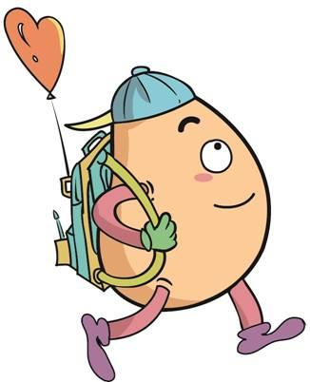





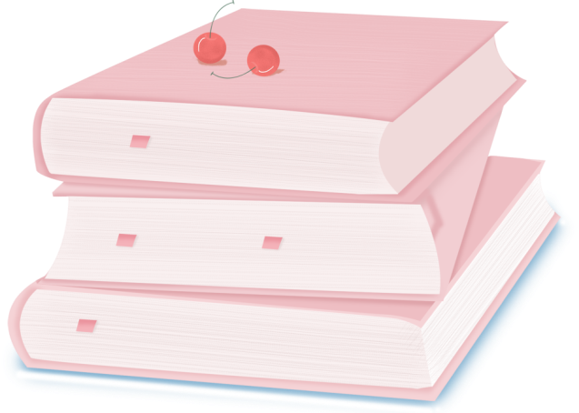
人 教 PEP 版 英 语 五年 级 下 册
Unit 1
My day
Part A
Let’s try & Let’s talk

Slide 2
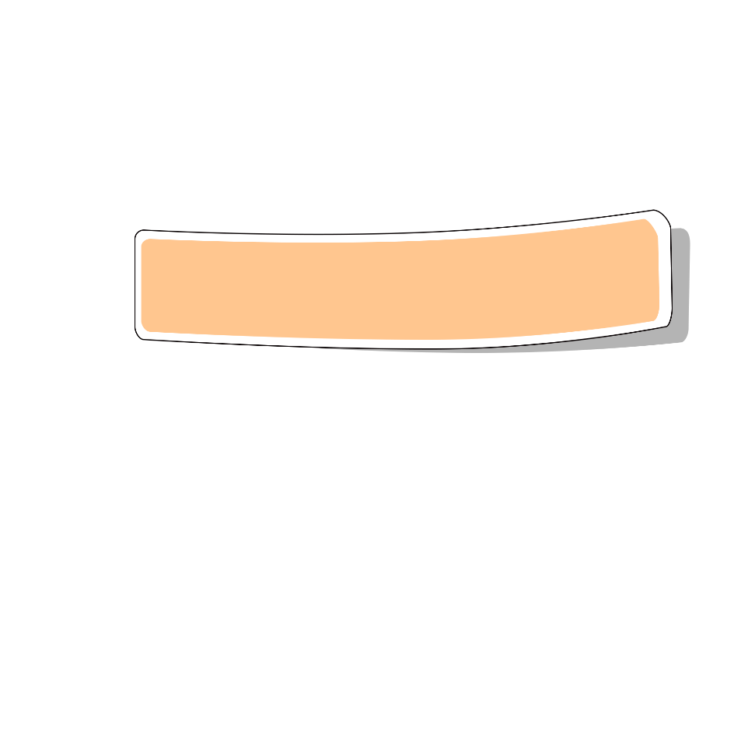
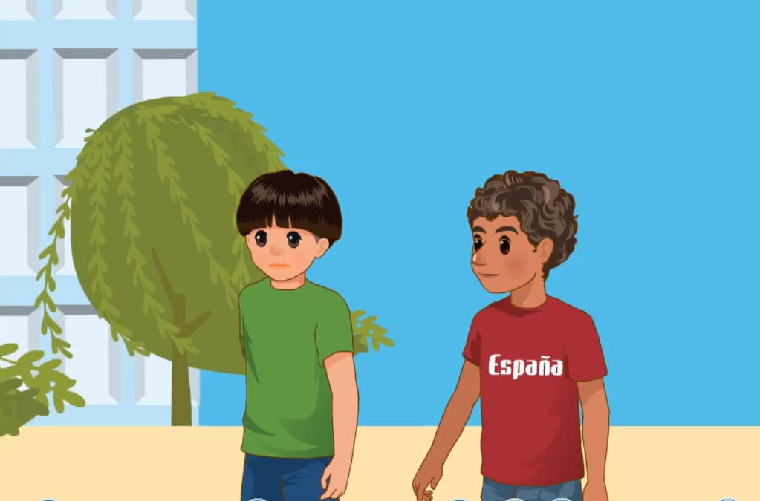
Warm up

Slide 3
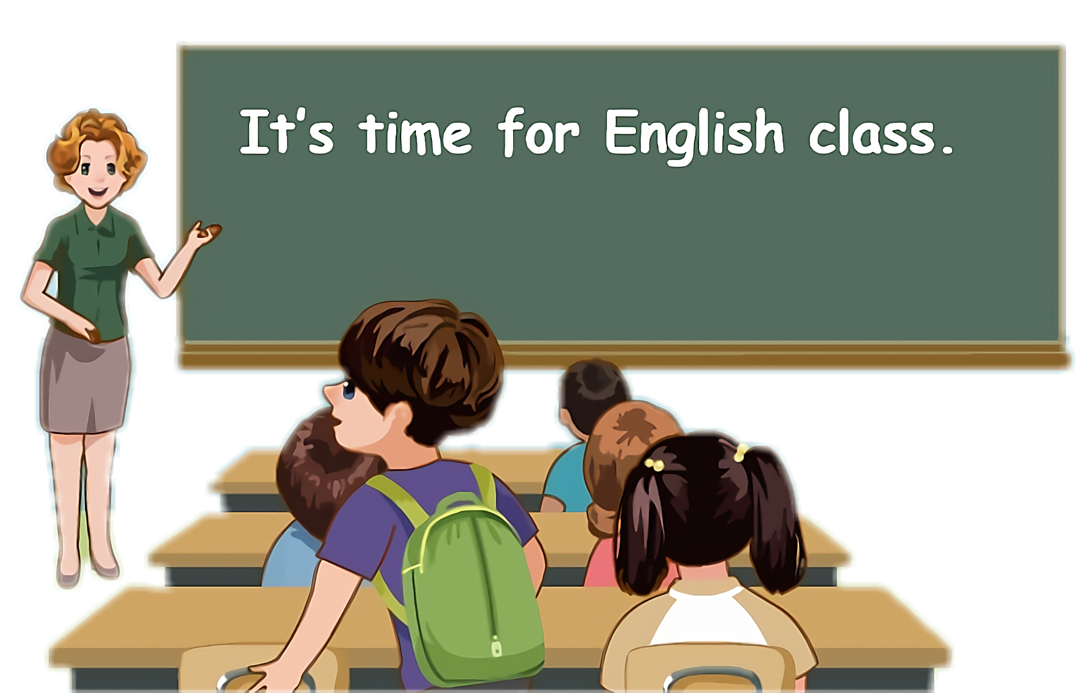
Lead in
Children, what is your schedule in school days?

Slide 4
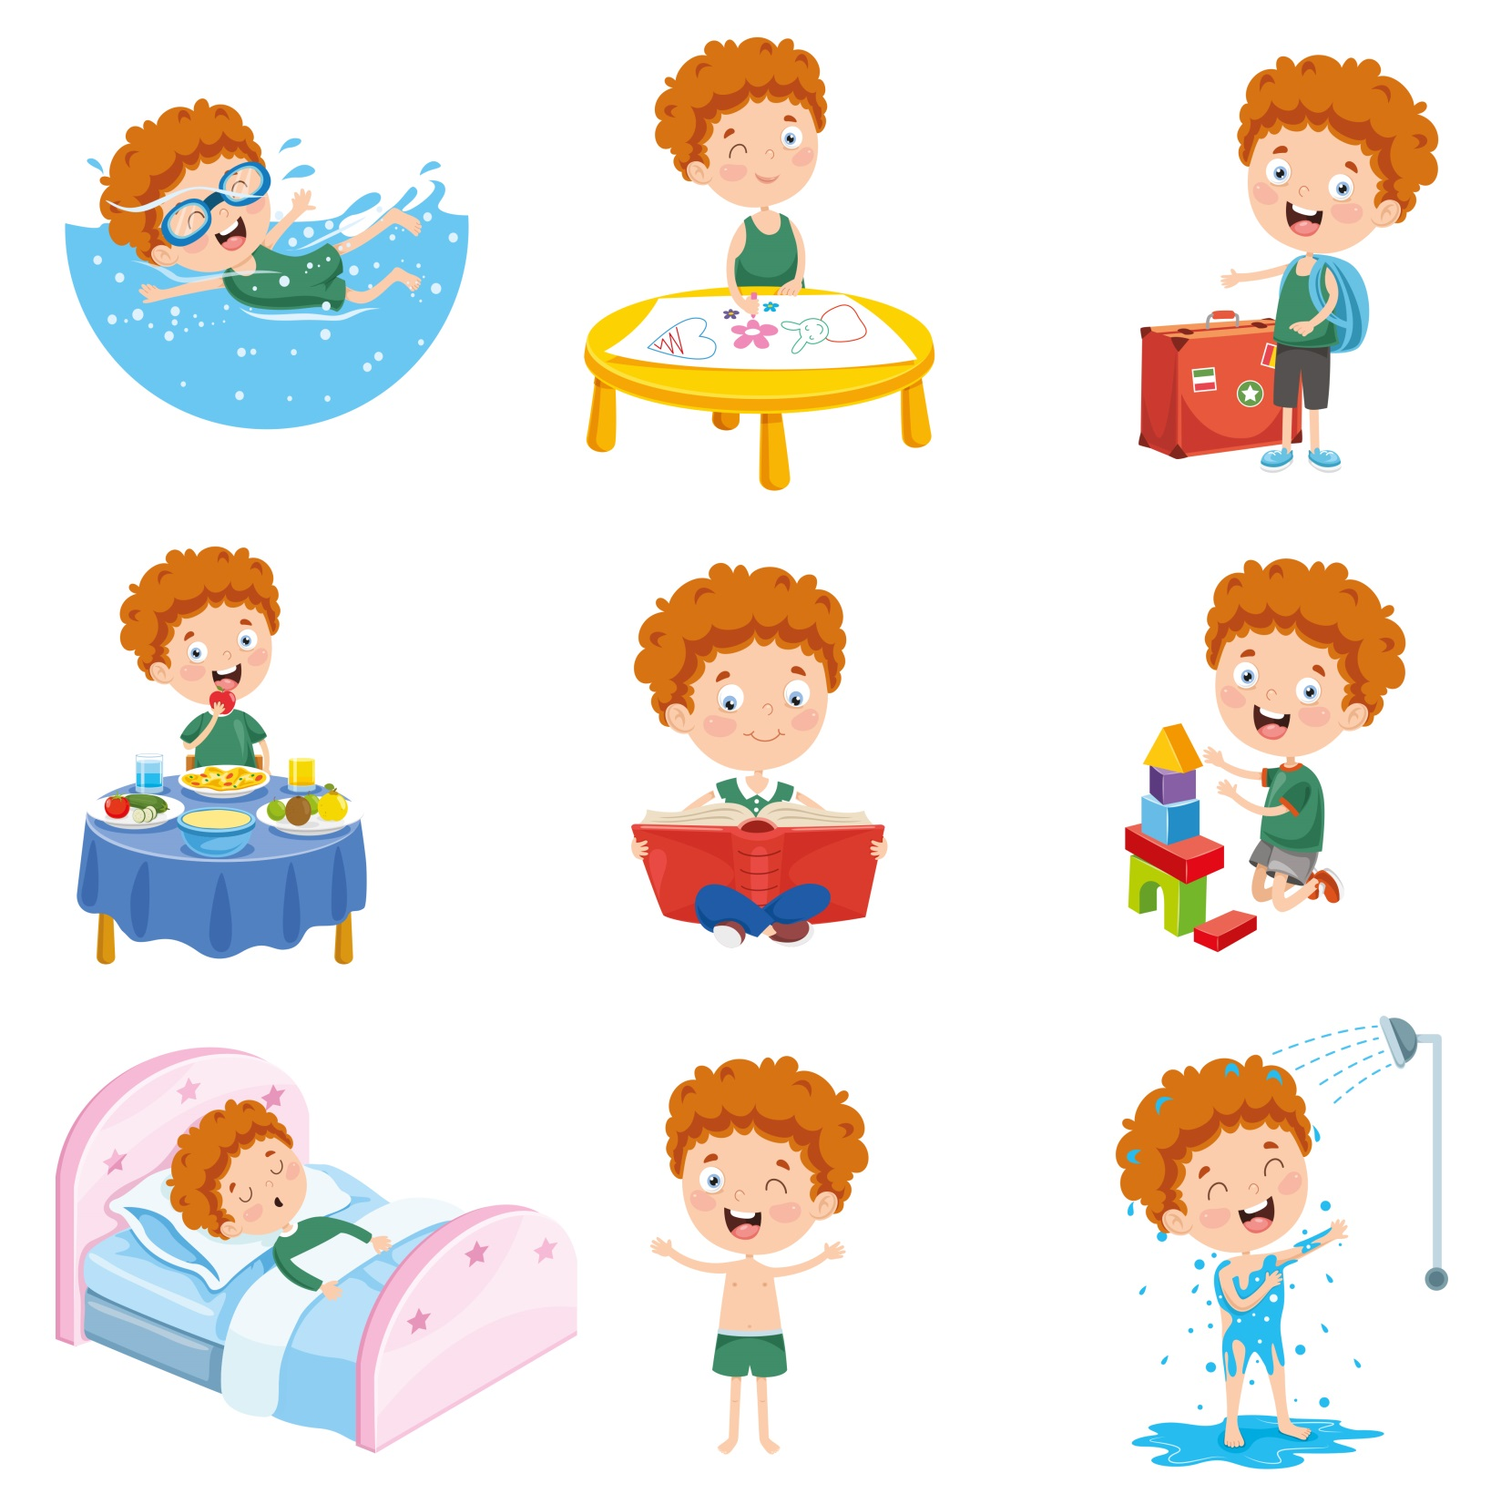


Let me introduce my school life.

Slide 5

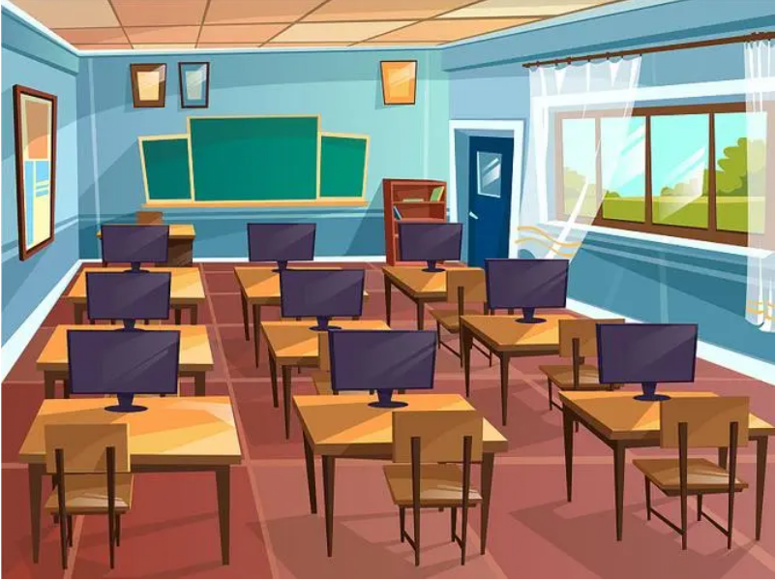

Let’s learn！
classroom
[ˈklɑːsruːm]
教室
This is our classroom.

Slide 6
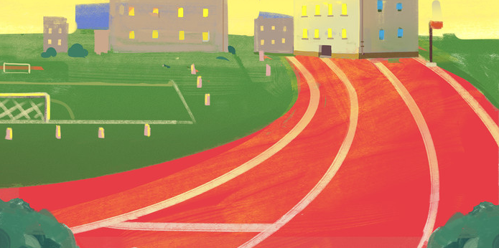
playground
[ˈpleɪɡraʊnd]
操场
We often play football on the playground.

Slide 7
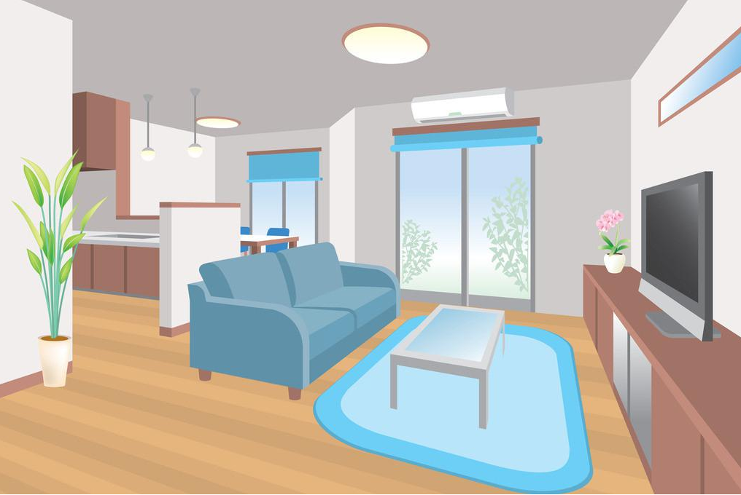
living room
[ˈlɪvɪŋ ruːm]
客厅
This is a living room.

Slide 8
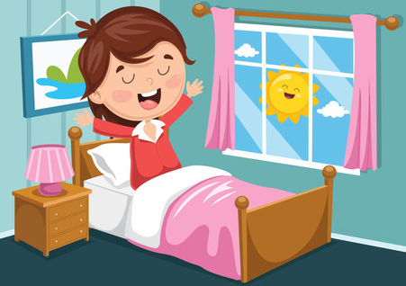
get up
[ˈɡet ʌp]
起床
I get up at 6 o’clock in the morning.

Slide 9
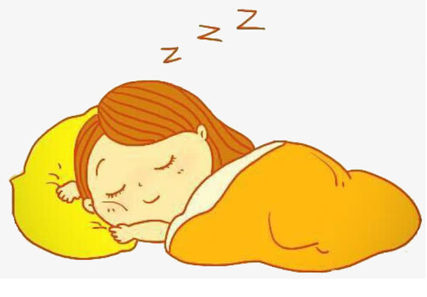
go to bed
[ɡəʊ tu bed]
上床睡觉
I go to bed at 9 o’clock in the evening.

Slide 10
Presentation
How to know the timetable?
Talk about the difference of Zhang Peng and Pedro’s timetable.
Talk about my timetable.
Talk about Pedro’s timetable in Spain.

Slide 11


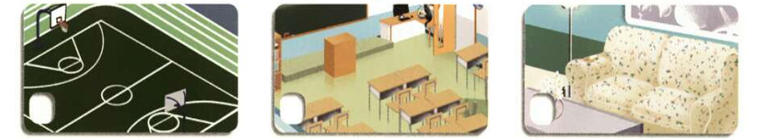
Let’s try
Zhang Peng has a new friend. His name is Pedro. He’s from Spain. Where are Zhang Peng and Pedro? Listen and tick.
√

Slide 12
Let’s check！
Pedro is a new student from Spain.
In the classroom.
Zhang Peng: Pedro, this is our new classroom. Do you like our school?
Pedro: Yes, but I am tired. In Spain, I always sleep a little in
the afternoon.
Zhang Peng: Really? When do you sleep?
Pedro: At about 2 o’clock.
Zhang Peng:Oh. That’s now, but we have a maths class at 2 o’clock.

Slide 13

Let’s discuss!
Let’s talk
This is my timetable.
get up | 6 o’clock
go to school
go back home
eat dinner
7: 30
5 o’clock
6: 30
What is our new friend Pedro’s timetable in Spain?

Slide 14
Watch and answer！
When does Pedro finish class in the morning?
2. Where does Pedro eat lunch?
3. When does Pedro go back to school after lunch?
4. When does Pedro eat dinner in Spain?

Slide 15
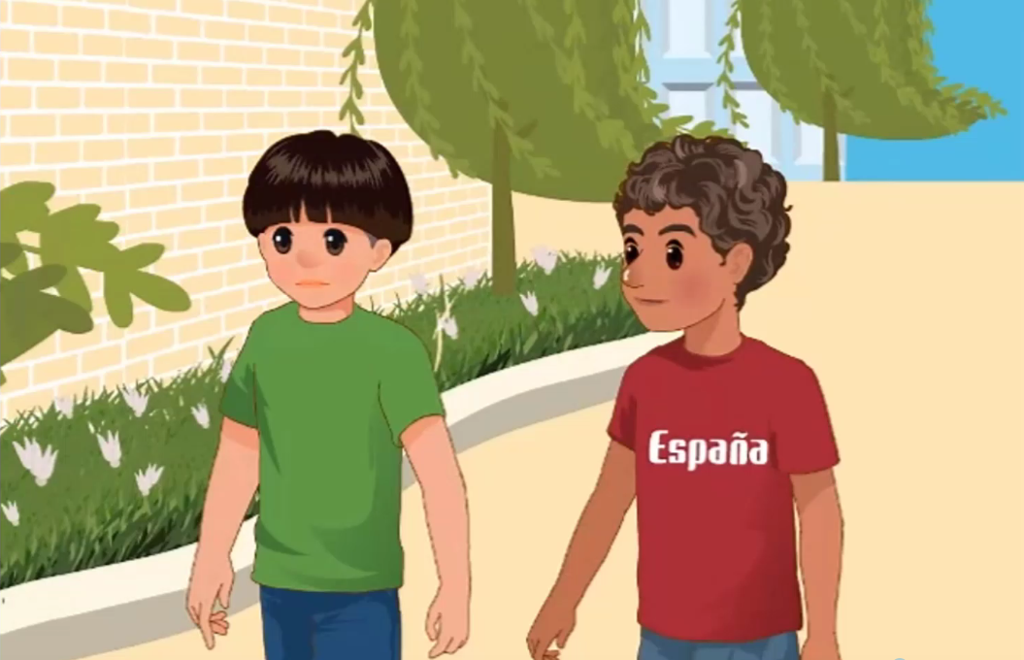

Slide 16
When does Pedro finish class in the morning?
2. Where does Pedro eat lunch?
3. When does Pedro go back to school after lunch?
4. When does Pedro eat dinner in Spain?
He finishes class at 1 o’clock .
He eats lunch at home.
He goes back to school at 2:30 after lunch.
He eats dinner at 9 :30 or 10 o’clcok.

Slide 17
Read again and fill in the blanks.
Complete Pedro’s timetable.
get up
start class
 | at 1 o’clock
sleep a little in the afternoon | at about 2 o’clock
 | at 2:30
start class in the afternoon
eat dinner
often at 7 o’clock
usually at 9 o’clock
finish class in the morning
go back to school after lunch
at 3 o’clock
usually at 9:30 or 10 o’clock

Slide 18
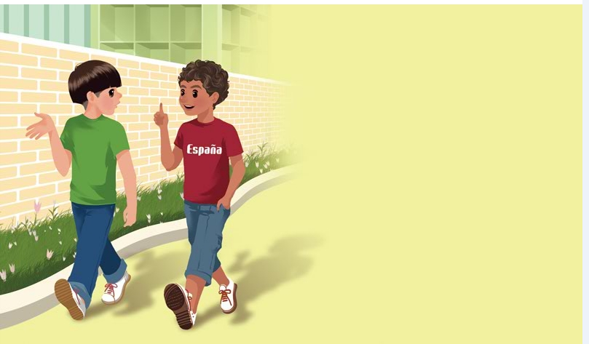
Read in roles.
Zheng Peng: When do you finish class in the morning?
Pedro: We finish class at 1 o’clock. Then we eat lunch at home.
Zhang Peng: Wow! When do you go back to school after lunch?
Pedro: At 2:30. Classes start at 3 o’clock.
Zhang Peng: When do you usually eat dinner in Spain?
Pedro: Usually at 9:30 or 10 o’clock.
Zhang Peng: Wow! That’s too late!

Slide 19
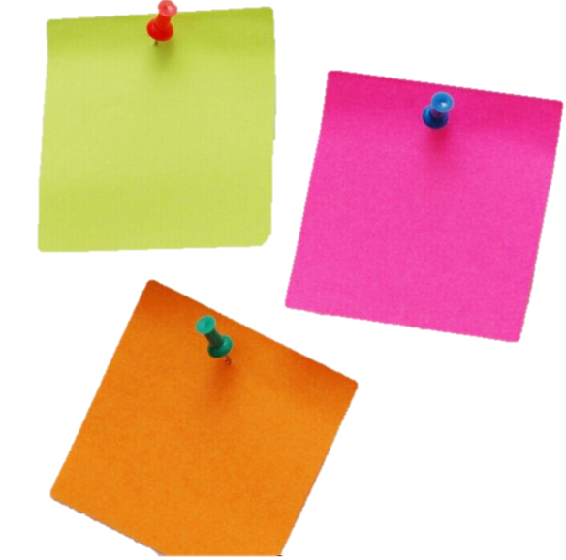
Read and act.
1.Read it together.
2.Each student
reads a sentence.
Tip: Choose one to read in two. 选择一种两人练习。
3. Read in roles.
自己分配角色。

Slide 20
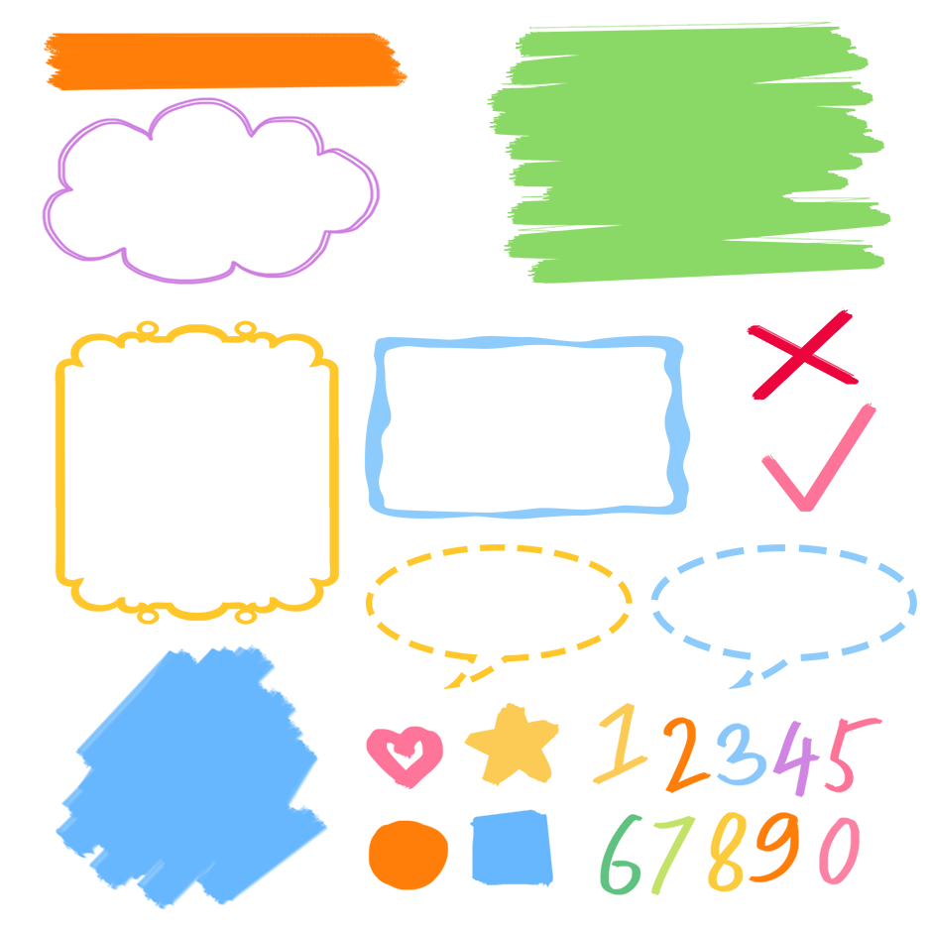
流利地朗读
流利地表演
有感情地表演

Slide 21
Listen and repeat.
询问什么时间在做什么事情
Zheng Peng: When do you finish class in the morning?
Pedro: We finish class at 1 o’clock. Then we eat
lunch at home.
Zhang Peng: Wow! When do you go back to school after
lunch?
Pedro: At 2:30. Classes start at 3 o’clock.
Zhang Peng: When do you usually eat dinner in Spain?
Pedro: Usually at 9:30 or 10 o’clock.
Zhang Peng: Wow! That’s too late!
在1点钟
吃午饭
开始
返回学校
在……之后
通常地
太晚

Slide 22


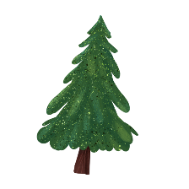


Language point.
什么时候
When
— When do you finish class in the morning?
— We finish class at 1 o’clock.
询问及回答什么时间在做什么事情
句型：
—When do you +动词(短语)原形+其它？
—I /We (+频度副词) +动词(短语)原形+ at+具体时间
— When do you go to school?
— I usually go to school at 7:00.

Slide 23
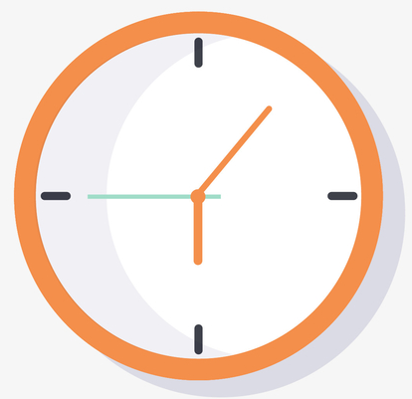
询问及回答什么时间在做什么事情
此句型的主语是第三人称单数(he, she或单数名词)时，助动词do要变成does.
询问时间还可用What time来提问， What time常用来询问具体的时间点，可以与When 进行互换。
— When does Linda get up?
— She often gets up at 6:00.
— What time does Linda get up?
— She often gets up at 6:05.

Slide 24
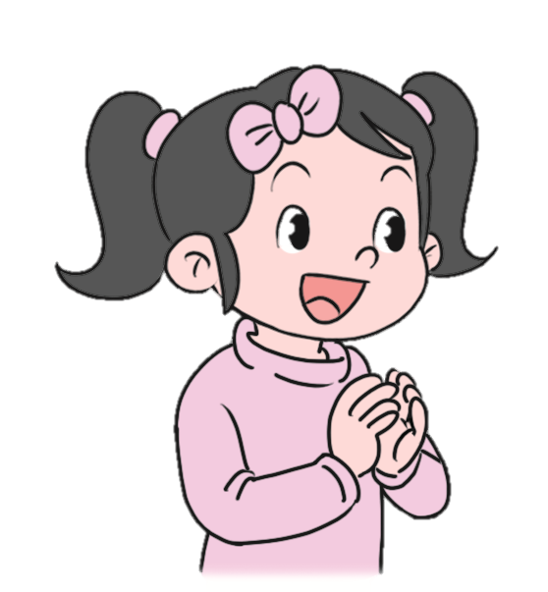
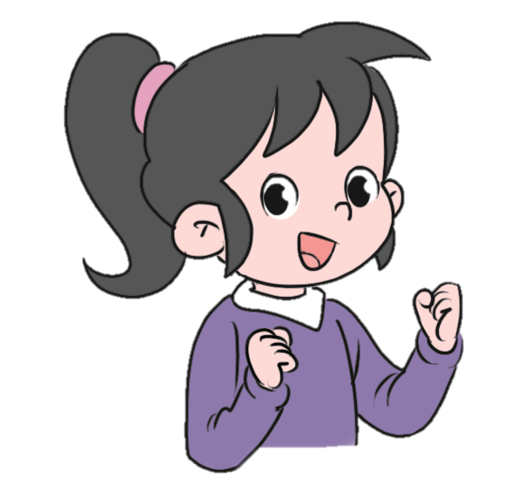
When do you get up?
I get up at 6 o’clock.
When do you go to bed?
I go to bed at 9 o’clock.

Slide 25
时间的表示方法
1. 整点：用基数词钟点+o’clock来表示整点，前用数字或英文均可。
eg. 8:00 --eight o’clock/ 8 o’clock.
2. 非整点：用基数词按钟点+分钟的顺序直接写出时间，后面决不可以有o’clock。
eg. 1:10- one ten. 8:30-eight thirty. 2:40-two forty
3.当分钟数是30分钟时，可用名词half(一半)表示，也可以直接读数. past意为“过”，用half past +整点。
eg. 9:30-half past nine(nine thirty).

Slide 26
时间的表示方法
4.如果分钟数少于等于30分钟，用介词past表示，用“分钟+past+小时”表示“几点几分”.
eg. 6:10--ten past six. 10:25--twenty-five past ten.
5.如果分钟数多于30分钟，可以用“（相差的）分钟+介词to+(下一个小时)”, to意“差”
8:35-twenty-five to nine(差二十五分钟九点);
5:50-ten to six (差十分钟六点)

Slide 27
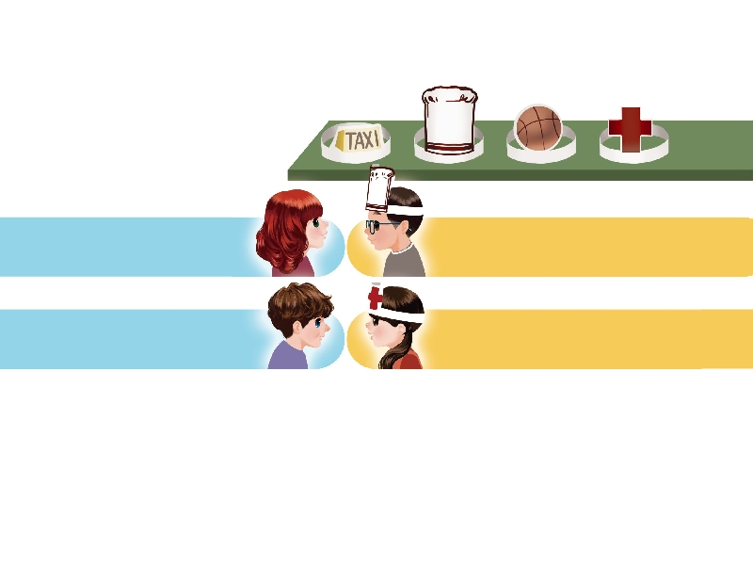
Play a game.
四个人一组，自选头饰，分别扮演出租车司机、厨师、篮球运动员、医生等角色。相互问答对方的生活作息时间。
When do you get up?
I get up at 5 o’clock.
At 6 o’clock in the morning.
I work at night.
When do you go to bed?

Slide 28
Good to know
时间，每天得到的都是二十四小时，可是一天的时间给勤勉的人带来智慧和力量，给懒散的人只留下一片悔恨。
——鲁迅
Every day, we have twenty-four hours. But to the industrious, it brings wisdom and strength; to the lazy, it leaves only great regret.
As Lu Xun.
We must cherish our time.我们必须珍惜时间。

Slide 29
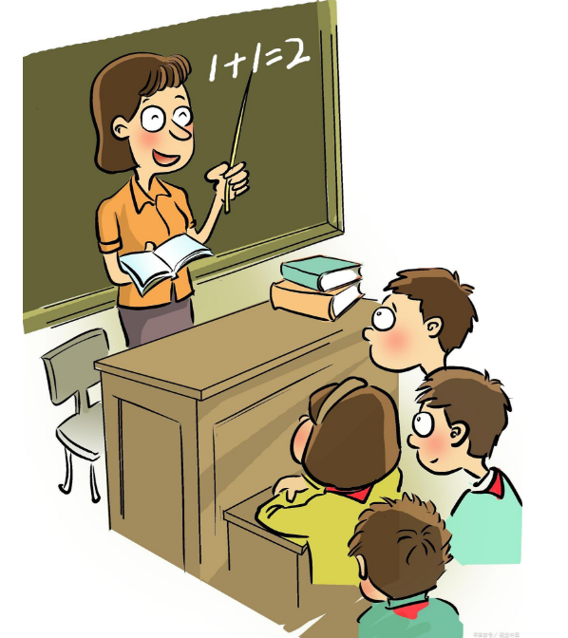
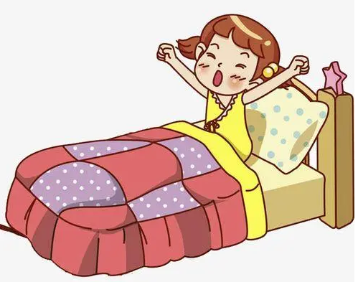
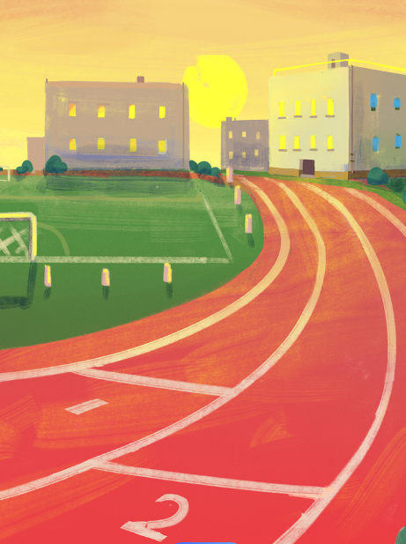
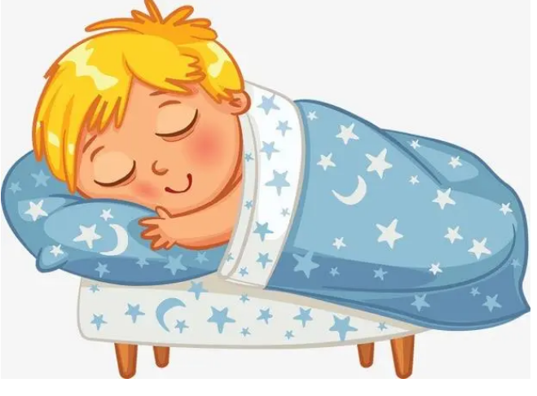
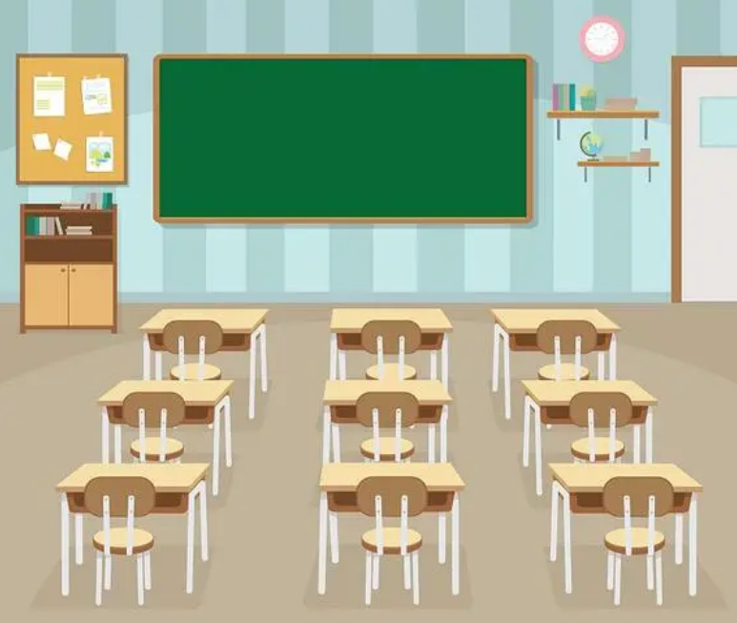
Exercises
一、图文配对。
classroom
get up
go to bed
playground
have class

Slide 30
二、按照要求完成句子。
1.I usually go to bed at 9 o’clock in the evening.(对划线部分提问)
____________________________________
2.school, when, back, after,do, go, you, to, lunch(?)(连词成句)
___________________________________
3.We have breakfast at home. (对划线部分提问)
_____________________________
When do you usually go to bed in the evening?
When do you go back to school after lunch?
Where do you have breakfast?

Slide 31

Summary
学习了下列单词及短语：
classroom, playground, living room,get up, go to bed,
2.学习了下列句型：
(1) —When do you finish class in the morning?
— We finish class at 1 o’clock.
(2)时间的表示方法。

Slide 32
Homework
ONE
TWO
Act the dialogue out with your friends.
Make a short dialogue using the sentences we have learnt.
Play games in pairs like “Role play”.

Slide 33







