Slide 1









人 教 PEP 版 英 语 五 年 级 下 册
Unit 1
My day
Part A
Let’s try & Let’s talk

Slide 2

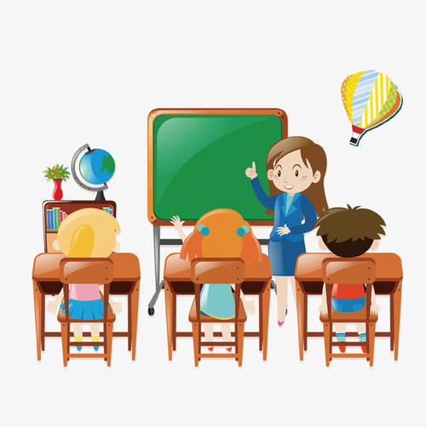
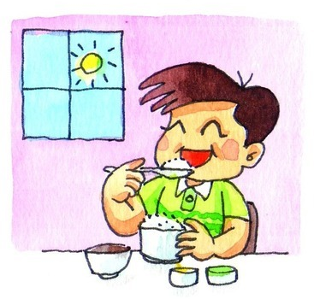
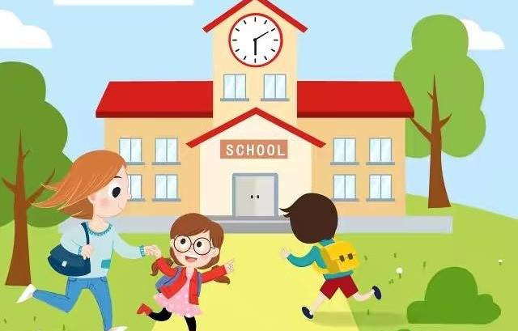
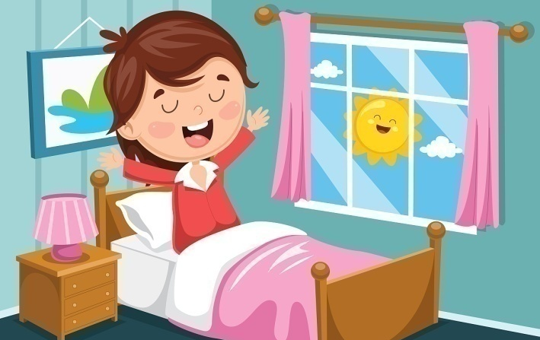

Warm up
Say and do like me.
For example:
T：Get up! Get up!
Ss：Get up! Get up!
T：Eat breakfast! Eat breakfast!
Ss：Eat breakfast! Eat breakfast!

Slide 3
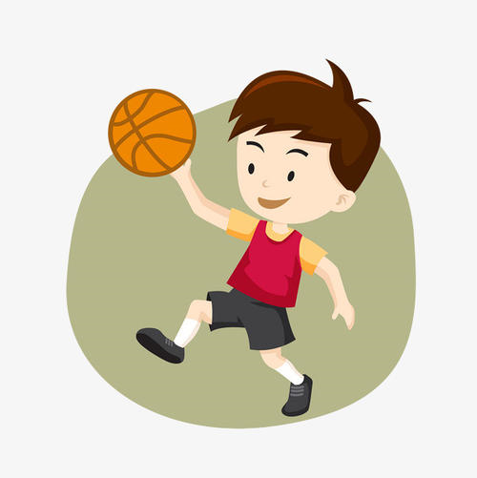
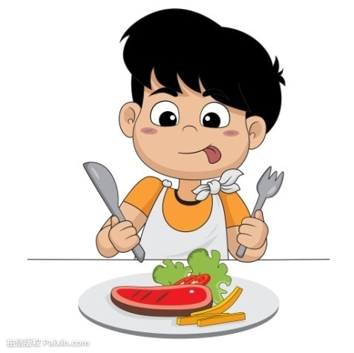
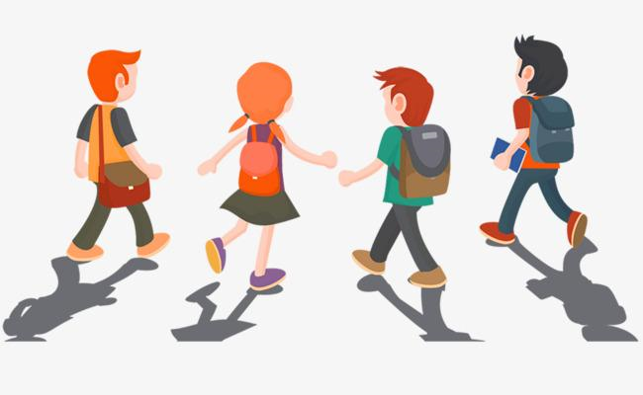
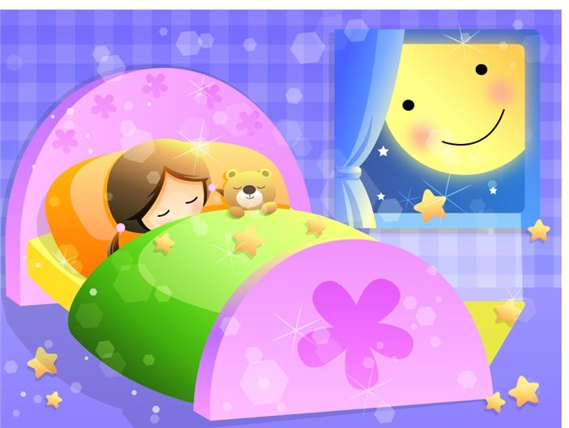
For example:
T：Get up! Get up!
Ss：Get up! Get up!
T：Eat breakfast! Eat breakfast!
Ss：Eat breakfast! Eat breakfast!

Slide 4

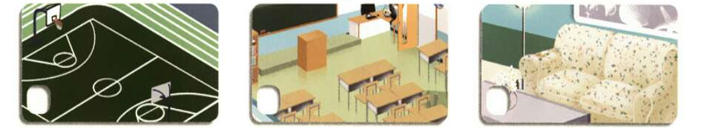
Lead in
What is it?
It’s a playground.
playground
[ˈpleigraund]
操场

Slide 5
What is it?
It’s a classroom.
classroom
[ˈklɑːsrum]
教室

Slide 6
What is it?
It’s a living room.
living room
客厅

Slide 7

Let’s try
Zhang Peng has a new friend. His name is Pedro. He’s from Spain.
Where are Zhang Peng and Pedro? Listen and tick.
√

Slide 8

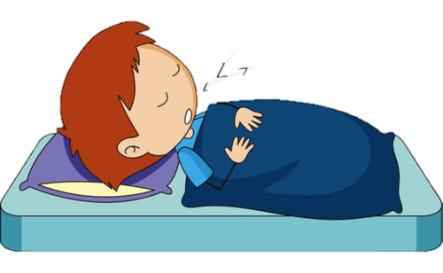
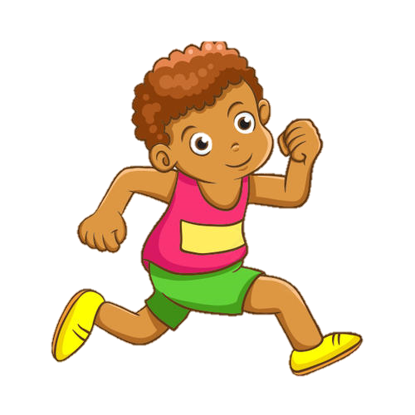
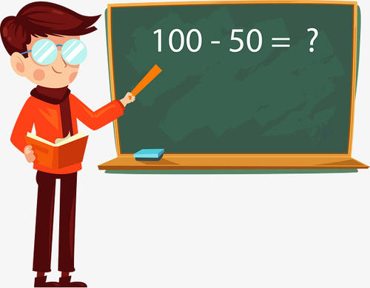
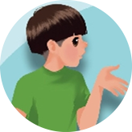

At about 2 o’clock, what does Pedro do in Spain?
At 2 o’clock, what does Zhang Peng do?
Listen again and match.

Slide 9
听力原文：
Pedro is a new student from Spain.
Zhang Peng:
Pedro:
Zhang Peng:
Pedro:
Zhang Peng:
Pedro, this is our new classroom. Do you like our school?
Yes, but I am tired. In Spain, I always sleep a little in the afternoon.
Really? When do you sleep?
At about 2 o’clock.
Oh. That’s now, but we have a maths class at 2 o’clock.
不一定要听出所有词，要学会抓关键点。如表示地点的单词或者词组。

Slide 10
-When do you get up?
-I get up at…
-When do you…?
-I… at…
Presentation
get up | 6 o’clock
go to work
go back home
eat dinner
7: 30
5 o’clock
6: 30
I get up at 6 o’clock in the morning. What about you?
This is my timetable.
What is our new friend Pedro’s timetable in Spain?

Slide 11
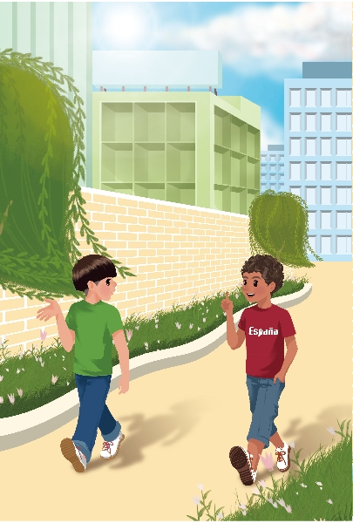
Main scene
点击画面 播放视频
When does Pedro… in Spain?
Listen and fill.
get up
start class
often at 7 o’clock
usually at 9 o’clock

Slide 12
Read and fill in the blanks.
I _____ get up ___ 7 o’clock.
____ do you _____?
often at
When get up
____ do you _________ in Spain?
_____ at _______.
When start class
Usually 9 o’clock
always
I _____ start class at 8 o’clock.

Slide 13
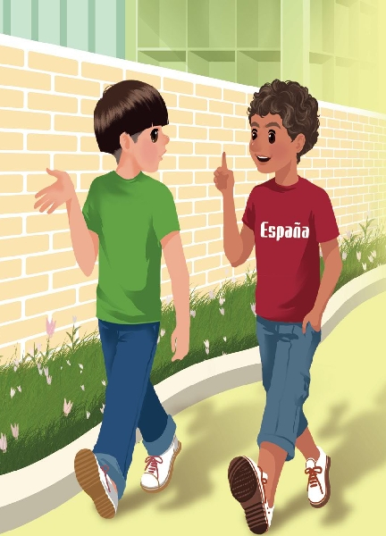
Let’s talk
Do you want to know more about Pedro’s timetable? Let’s listen.

Slide 14
Listen again and answer the questions.
1. When does Pedro finish class in the morning?
At 1 o’clock.
2. When does he go back to school after lunch?
At 2:30.
3. When does he usually eat dinner in Spain?
Usually at 9:30 or 10 o’clock.

Slide 15
Language points
1. -When do you usually eat dinner in Spain?
-Usually at 9:30 or 10 o’clock.
【详解】这组对话用来询问和回答他人什么时间做某事。when指事情发生的时间，有时答语会省略主语，直接回答具体的时间。
句型结构：When + 助动词（do/does）+ 主语（+频率副词）+
动词（短语）+其他?
回答：主语（+频率副词）+动词（短语）+ at + 时间点.
eg. -When do you go to school?
-I go to school at 7:00.

Slide 16
2. Classes start at 3 o’clock.
【详解】表达在具体的时间点用介词at。
eg. I get up at 6:30 in the morning.

Slide 17
Listen to the tape and read after it.
Zhang Peng:
Pedro:
Zhang Peng:
Pedro:
Zhang Peng:
Pedro:
Zhang Peng:
When do you finish class in the morning?
We finish class at 1 o’clock. Then we eat lunch at home.
Wow! When do you go back to
school after lunch?
At 2:30. Classes start at 3 o’clock.
When do you usually eat dinner in
Spain?
Usually at 9:30 or 10 o’clock.
Wow! That’s too late!

Slide 18
Read again and complete Pedro’s timetable.
Ask and answer according to the timetable.
A: When do you…? B: I/We… at…
get up
start class
 | at 1 o’clock
sleep a little in the afternoon | at about 2 o’clock
 | at 2:30
start class in the afternoon
eat dinner
often at 7 o’clock
usually at 9 o’clock
finish class in the morning
go back to school after lunch
at 3 o’clock
usually at 9:30 or 10 o’clock

Slide 19
Frequency words.
 | √ | √ | √ | √ | √ | √ | √
 | √ | √ |  | √ |  | √ | √
 |  | √ |  | √ |  | √ | √
 |  |  | √ |  | √
Sunday
Monday
Tuesday
Wednesday
Thursday
Friday
Saturday
always
usually
often
sometimes

Slide 20
1. Read the text freely in groups.
2. Act it out group by group.
Find the best group.

Slide 21




Practice
Act them in your group. Ask and answer.
头饰 | 职业名称 | 动词短语 | 时间
 | taxi driver | eat dinner | 10 o’clock at night
 | cook | get up | 5 o’clock
 | basketball player | get up | 5:30
 | doctor | go to bed | 6 o’clock in the morning
You’re a… When do you…?

Slide 22
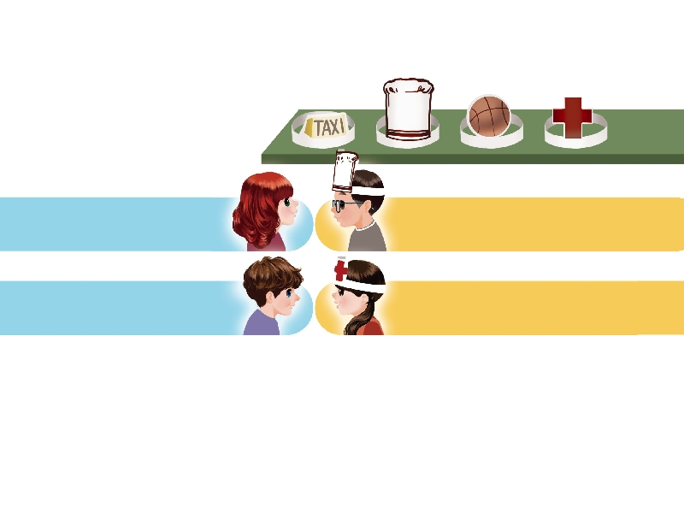
Role play.
四个人一组，自选头饰，分别扮演出租车司机、厨师、篮球运动员、医生等角色。相互问答对方的生活作息时间。
When do you get up?
I get up at 5 o’clock.
At 6 o’clock in the morning. I work at night.
When do you go to bed?

Slide 23

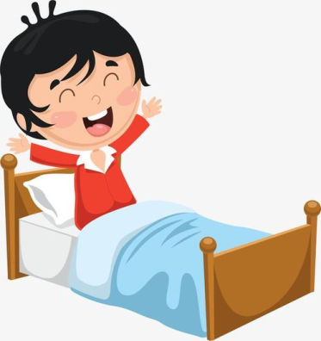
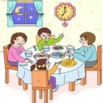

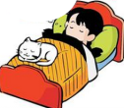
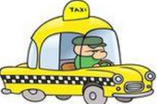
Exercises
一、看一看，读一读，标序号。
D
B
E
A
C
A. go to bed B.eat dinner C. a taxi driver D. get up E. go to school

Slide 24
二、英译汉。
放学
回学校
1. finish class_______ 2. go back to school_______
3. eat lunch ______ 4. at home_____________
5. too late____________
吃午饭
在家
太晚

Slide 25
三、连词成句。
1. o’clock, up, I, at, get, 6 (.)
________________________________________
2. football, you, when, play, do (?)
________________________________________
3. late, is, that, too (.)
___________________________________________
I get up at 6 o’clock.
When do you play football?
That is too late.

Slide 26
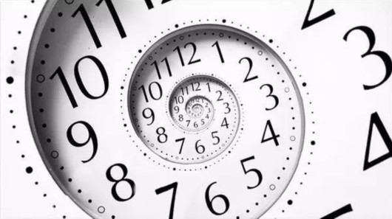
I want to know
时间，每天得到的都是二十四小时，可是一天的时间给勤勉的人带来智慧和力量，给懒散的人只留下一片悔恨。——鲁迅
Every day, we have twenty-four hours. But to the industrious, it brings wisdom and strength; to the lazy, it leaves only great regret.
As Lu Xun.

Slide 27
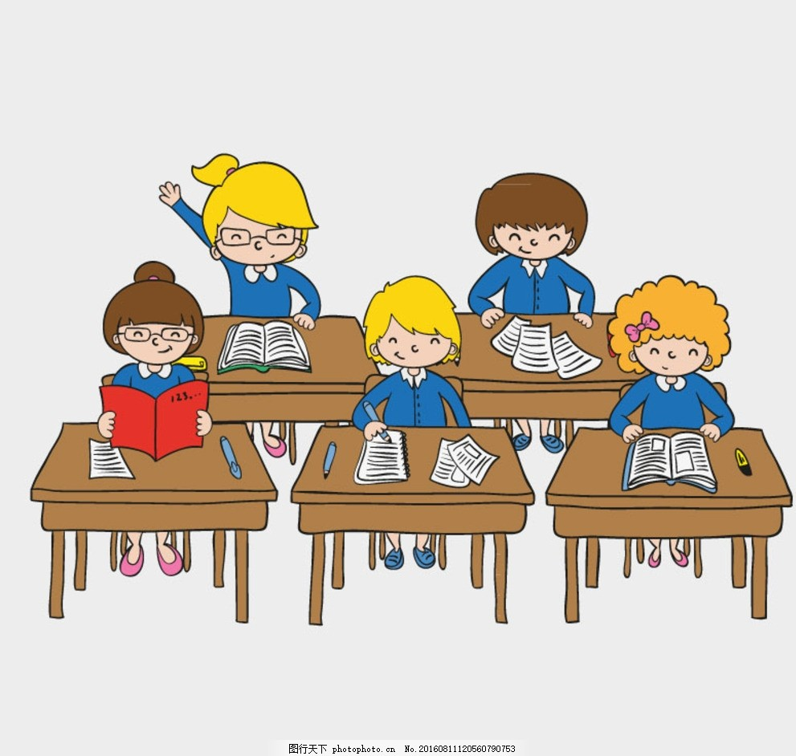
We must cherish our time.
我们必须珍惜时间。

Slide 28


Summary
学习了下列单词及短语：
when, get up, start class, finish class, eat lunch, go back to school, eat dinner, in Spain
2.学习了下列句型：
—When do you finish class in the morning?
— We finish class at 1 o’clock.
七彩课堂
伴你成长

Slide 29

Homework
ONE
TWO
七彩课堂
伴你成长
Make a short dialogue. Use the sentences we have learned.
Act the dialogue out with your friends.
Play games in pairs like “Role play”.

Slide 30








