Slide 1


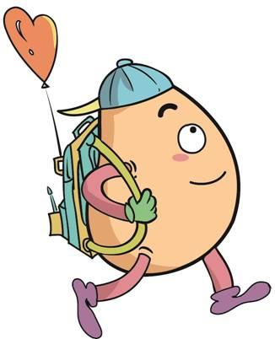






人 教 PEP 版 英 语 五年 级 下 册
Recycle 2
Mike’s summer camp
第二课时

Slide 2

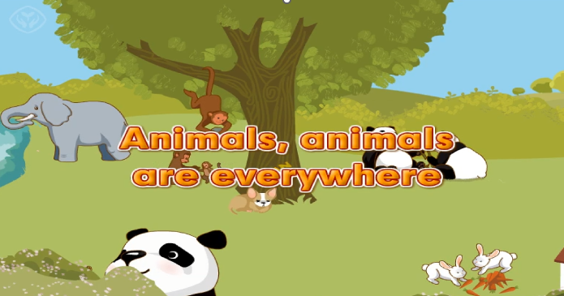
Warm up

Slide 3
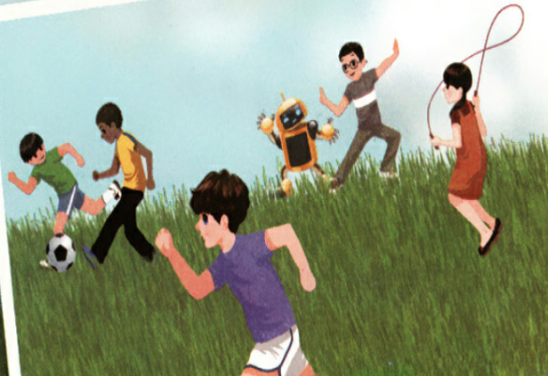
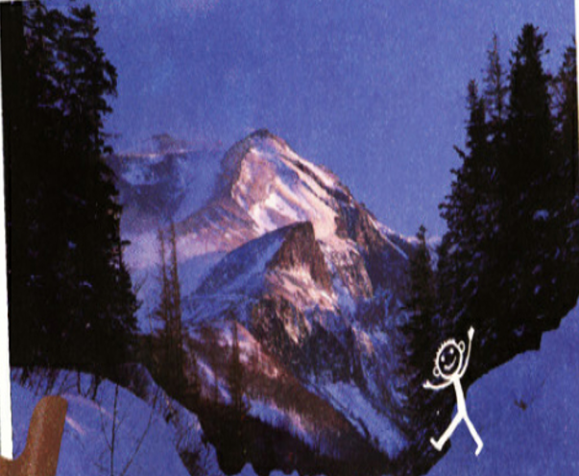

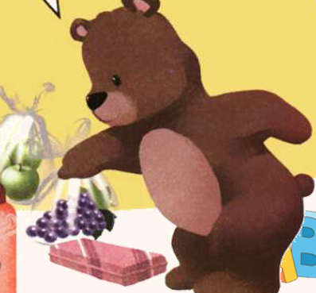

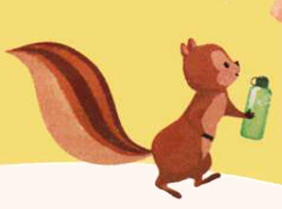
Let’s introduce the pictures.

Slide 4
Preaentation
Talk about the pictures
Talk about my picture to the beach.
Talk about your picture to the mountains.
Talk about whose things they are.

Slide 5
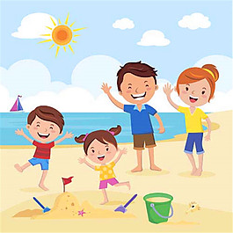
Lead in
Where are you?
I’m on the beach.
What season is it?
It’s summer.

Slide 6

I’m on the beach. It’s
summer. I’m playing.
My father, my mother
and my brother are here
too. They’re playing, too.
I’ll take some pictures.
We have a good time.

Slide 7
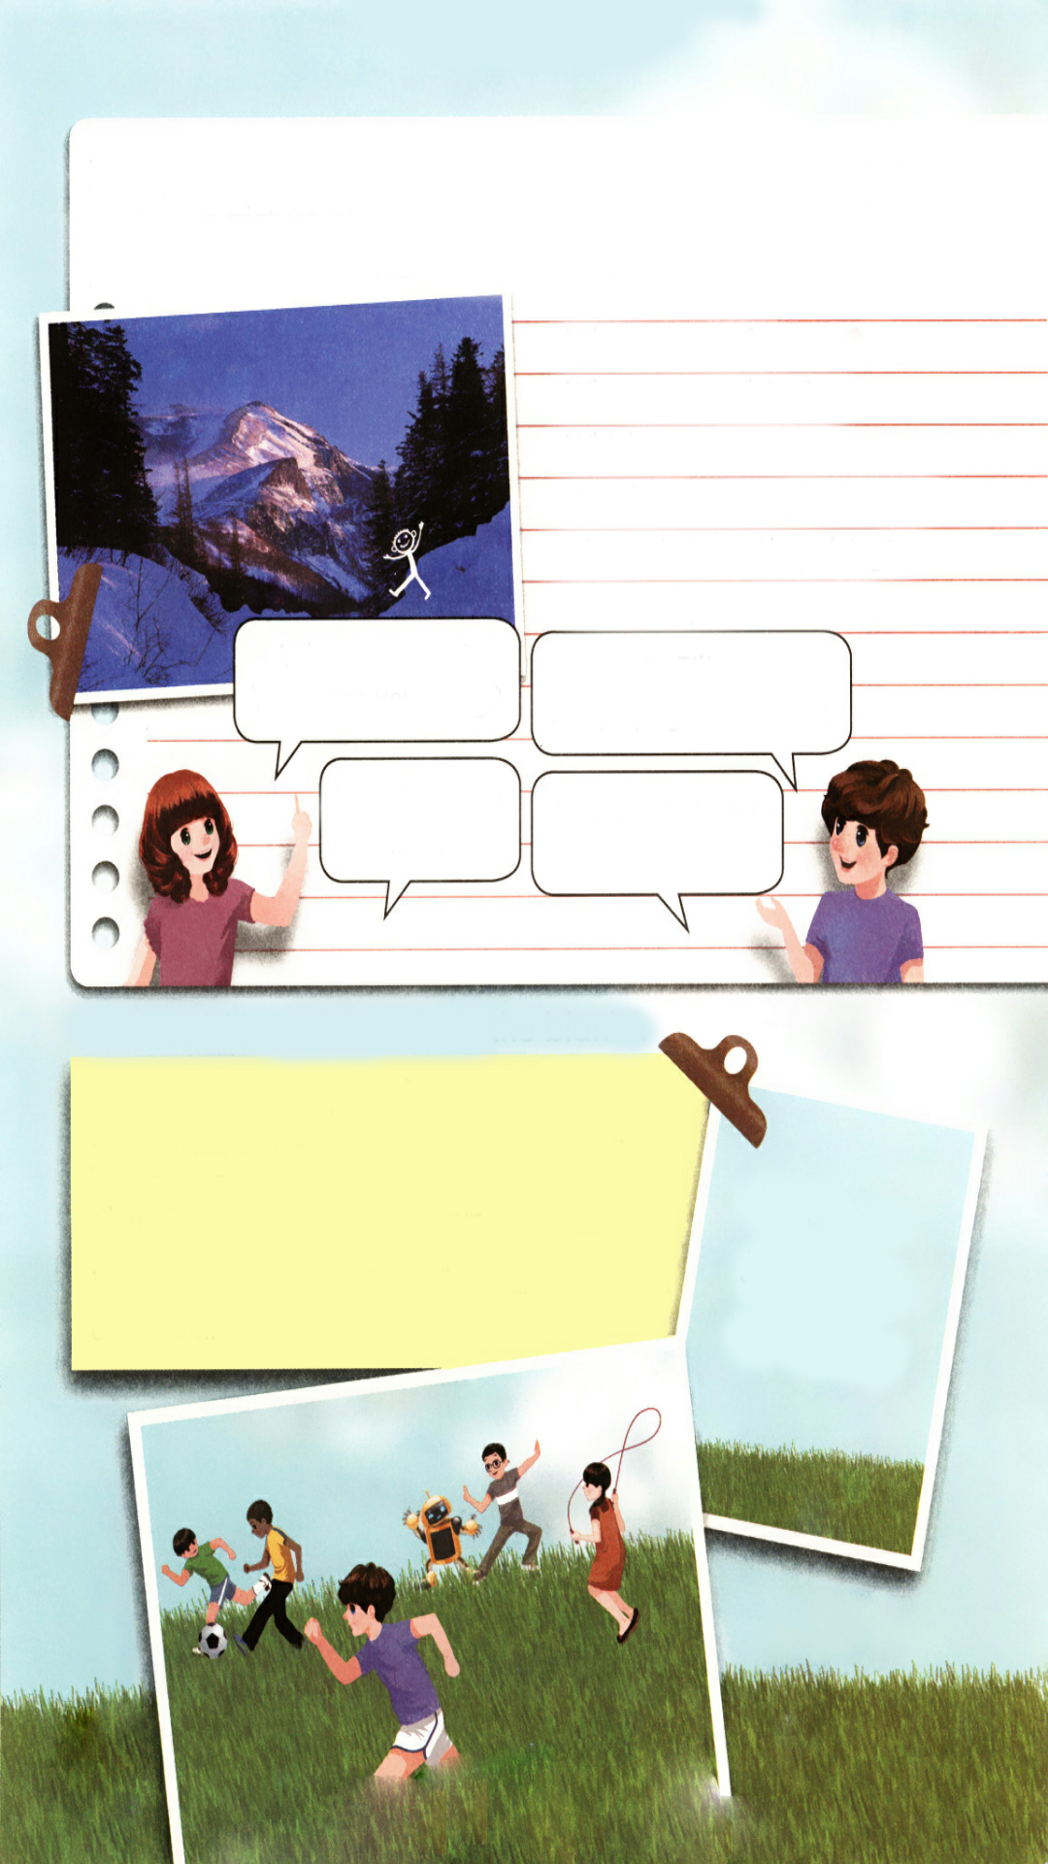
If you are in the picture. Can you answer the questions?
Where are you?
What are you doing?
Which season is it?
Are there any people there?
If so, what are they doing?
What will you do next?

Slide 8

Ask and answer.
Where are you ?
What are you doing?
I’m in Jilin now.
I’m playing in the snow.
Which season is it?
Winter. It is my favourite season.

Slide 9
Read and answer.
Look. This is Mike’s photo. What do you see?
Mike is running.
Zhang Peng and John are
playing football.
Chen Jie is jumping rope.
Wu Binbin and Robin are
doing kung fu.

Slide 10
Look at Mike’s photo. Fill in the blanks.
August 1st A Sports Day
Zhang Peng and John are football.
Chen Jie is rope. I am .
We are having lots of fun. Where are Wu Binbin and Robin?
playing
jumping
running
drink eat
jump play
run sleep

Slide 11
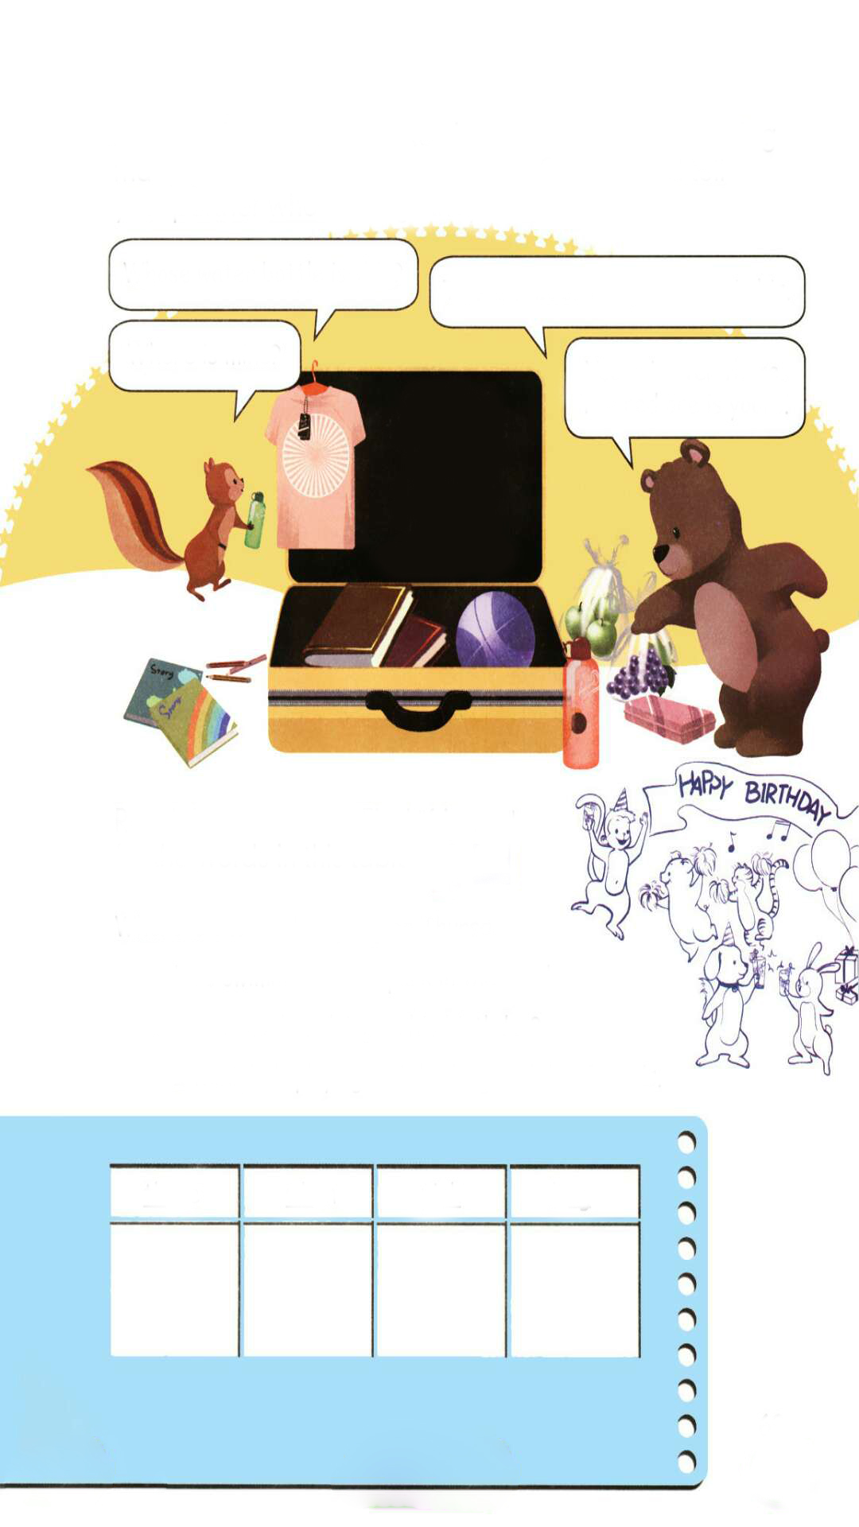
Zip and Zoom are going to visit you. They are preparing many gifts for you and your friends. Choose and tell your partner whose things they are.
Whose water bottle is this?
This is Fido’s. The green one is his.
Where is mine?
Yours is over there. The red one is yours.
our/ours
their/theirs
his/his
her/hers
my/mine
your/yours

Slide 12
Talk about the other gifts.
Whose … is this?
This is …s.
Where is …?
… is over there. … is yours.
our/ours
their/theirs
his/his
her/hers
my/mine
your/yours

Slide 13

Read the sentences.Find “friends” for the words in this table.
Where is the monkey going on Thursday?
He’s swimming in the park in the south.
What is the monkey doing on his birthday?
I think he’s playing and drinking with his friends.

Slide 14
Find “friends” for the words in this table.
three
when
pink
long
going
swimming
doing
playing
drinking
Thursday
south
birthday
think
where
what
think
drinking

Slide 15

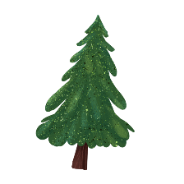


Language point.
We are having lots of fun.
【辨析】lots of和a lot of
【详解】该句为现在进行时。lots of意思是“许多的”，fun指“乐趣”，have fun 意思是“玩得开心”。
【辨析】lots of和a lot of
1. lots of和a lot of都可以作定语，即当作 many或 much那样来使用。因此，谓语动词的形式不是依据lot和lots来决定，而是依据of所引导的名词的数来决定，如: A lot of time has been wasted.有许多时间给浪费掉了。(a lot of= much)

Slide 16
Language point.
We are having lots of fun.
【辨析】lots of和a lot of
A lot of people have been present.已有许多人到了。(a lot of= many) There is lots of time to spare.时间绰绰有余。(lots of= much)
2. a lot of=lots of表示“许多的”，可以修饰可数名词复数和不可数名词。
3. a lot是表示程度的短语，意思是“很；非常”。如:thanks a lot(多谢)； know a lot about China(对中国了解很多)。
4. 书面语用a lot of较多，口语用lots of较多。

Slide 17
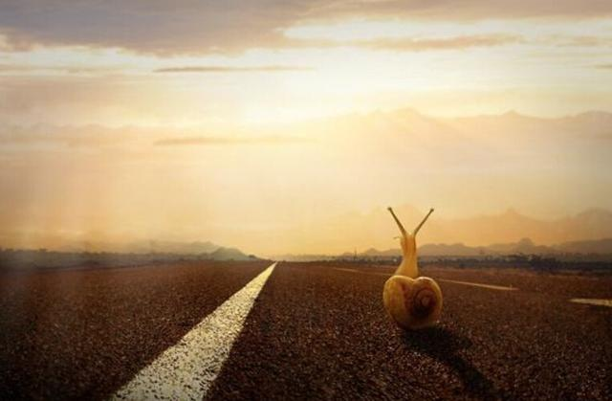
Good to know
All things are difficult before they are easy,
and every science.
万事开头难，每门科学都是如此。

Slide 18
Exercises
一、根据规律写出它们的朋友。(每道题至少写出三个来）
1. think ________________________________
2. where ________________________________
3. who ________________________________
4. long ________________________________
5. three ________________________________
ink pink trunk
what when which
whose whom whoever
sing ring young
thin maths thirteen

Slide 19
二、根据要求写单词。
1.we(名词性物主代词)_____ 2. he(形容词性物主代词)_____
3. their(主格)________ 4. my(名词性物主代词)_______
5.you(名词性物主代词)_____ 6. prepare(现在分词)________
7.swim(现在分词)_______ 8. have(第三人称单数)________
9.write(现在分词)_______ 10. old(反义词)________
ours
his
they
mine
yours
preparing
swimming
has
writing
new

Slide 20
三、对画线部分提问。
1.He is playing football on the playground.
_______________________________
2. My favourite season is winter.
________________________________________
3. This is Mike’s T-shirt.
___________________________________________
What is he doing on the playground?
What is your favourite season?
Whose T-shirt is this?

Slide 21

Summary
1.复习巩固了第四单元至第六单元的核心语言。
2.复习巩固了字母组合：th, wh, nk, ng的发音规则。

Slide 22
Homework
ONE
TWO
Act the dialogue out with your friends.
Write a poem using the sentences we have learnt.
Collect the words with th, wh, nk, ng.

Slide 23







