Slide 1









人 教 PEP 版 英 语 五 年 级 下 册
Recycle 2
Mike’s summer camp
Part two

Slide 2

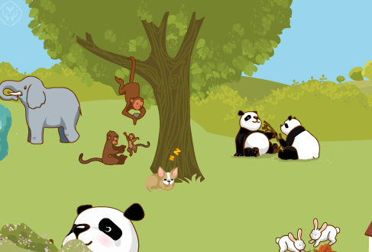
Warm up
Let’s sing.

Slide 3

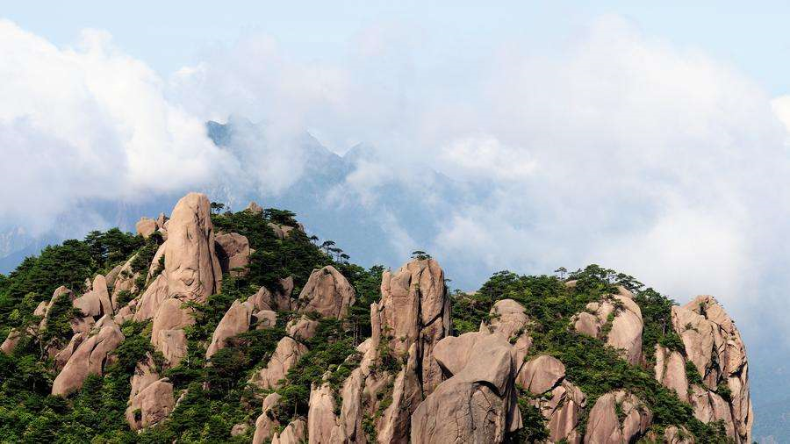
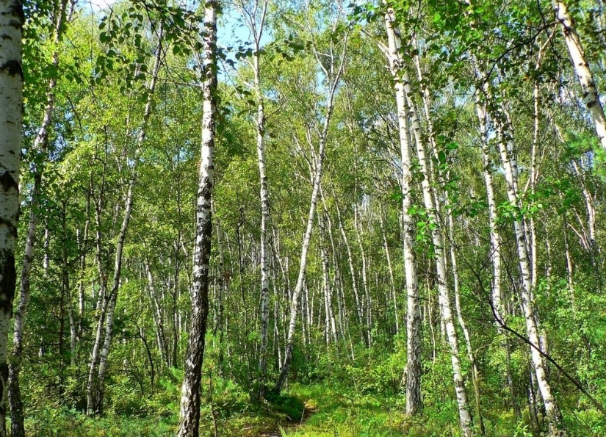
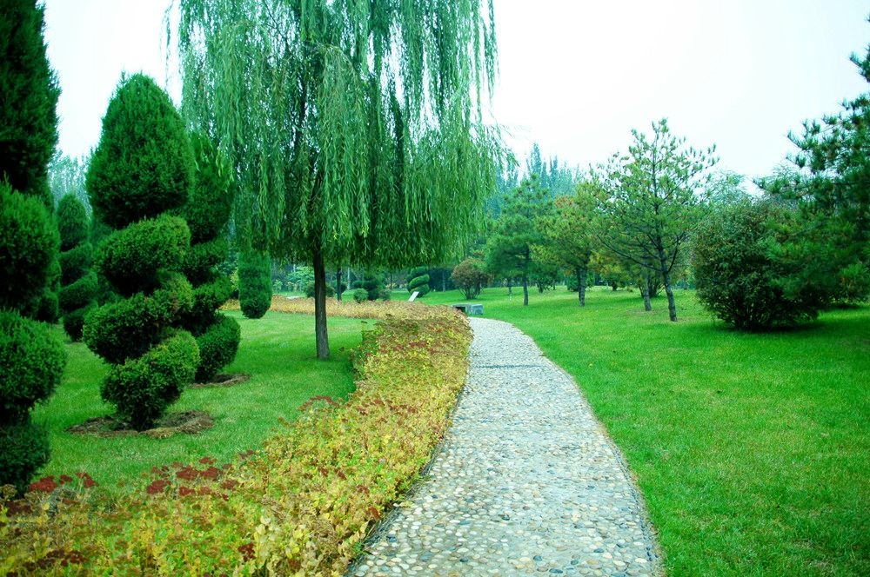
Lead in
What can you see?
I can see a forest/mountain/nature park.

Slide 4

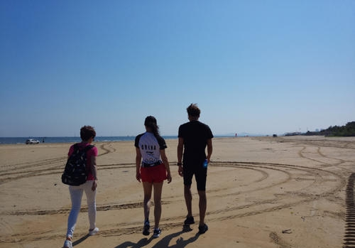
Where am I?
I’m on the beach.
Which season is it?
It’s summer.
What am I doing?
I’m walking.

Slide 5
Write a short passage.
I am on the beach. It is summer. I am walking. My friends are here, too. They are walking, too. I will take some pictures.

Slide 6
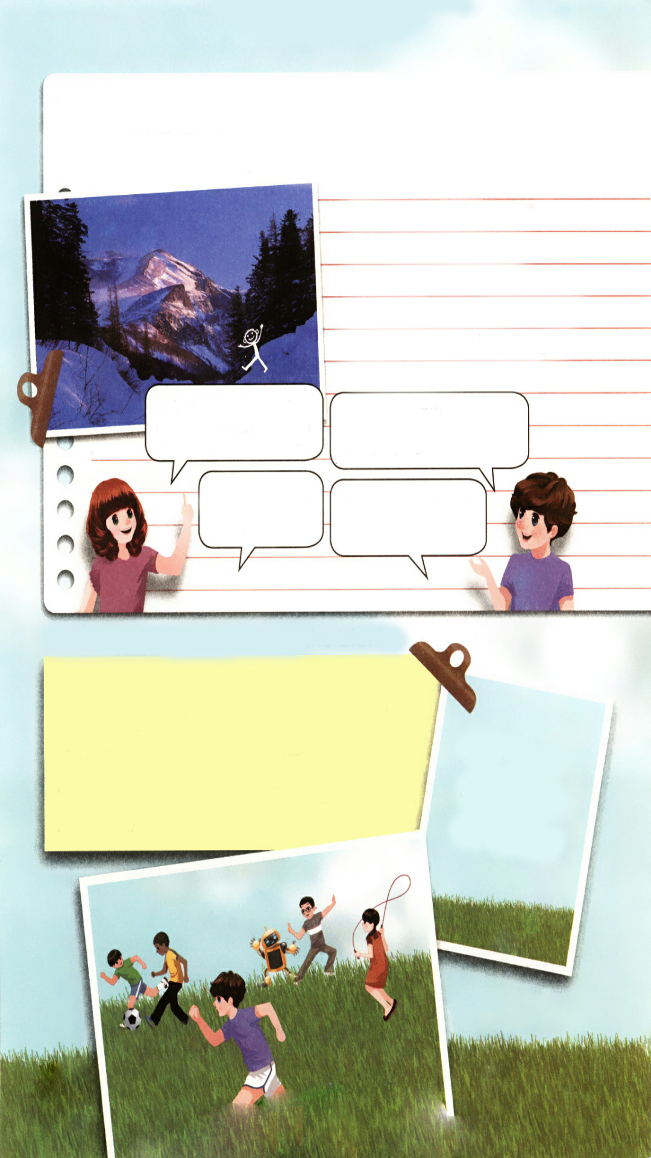
Presentation
If you are in picture. Can you answer the questions?
Where are you?
What are you doing?
Which season is it?
Are there any people there?
If so, what are they doing?
What will you do next?

Slide 7
Ask and answer.
Where are you ?
What are you doing?
I’m in Jilin now.
I’m playing in the snow.
Which season is it?
Winter. It is my favourite season.

Slide 8
Read and answer.
Look. This is Mike’s photo. What do you see?
Mike is running.
Zhang Peng and John are
playing football.
Chen Jie is jumping rope.
Wu Binbin and Robin are
doing kung fu.

Slide 9
Fill in the blanks.
August 1st A Sports Day
Zhang Peng and John are football.
Chen Jie is rope. I am .
We are having lots of fun. Where are Wu Binbin and Robin?
playing
jumping
running
drink eat
jump play
run sleep

Slide 10
Now suppose you’re in the summer camp. Zoom and Zip are going to visit you. What do you want them to bring to you?
I want them to bring me…

Slide 11
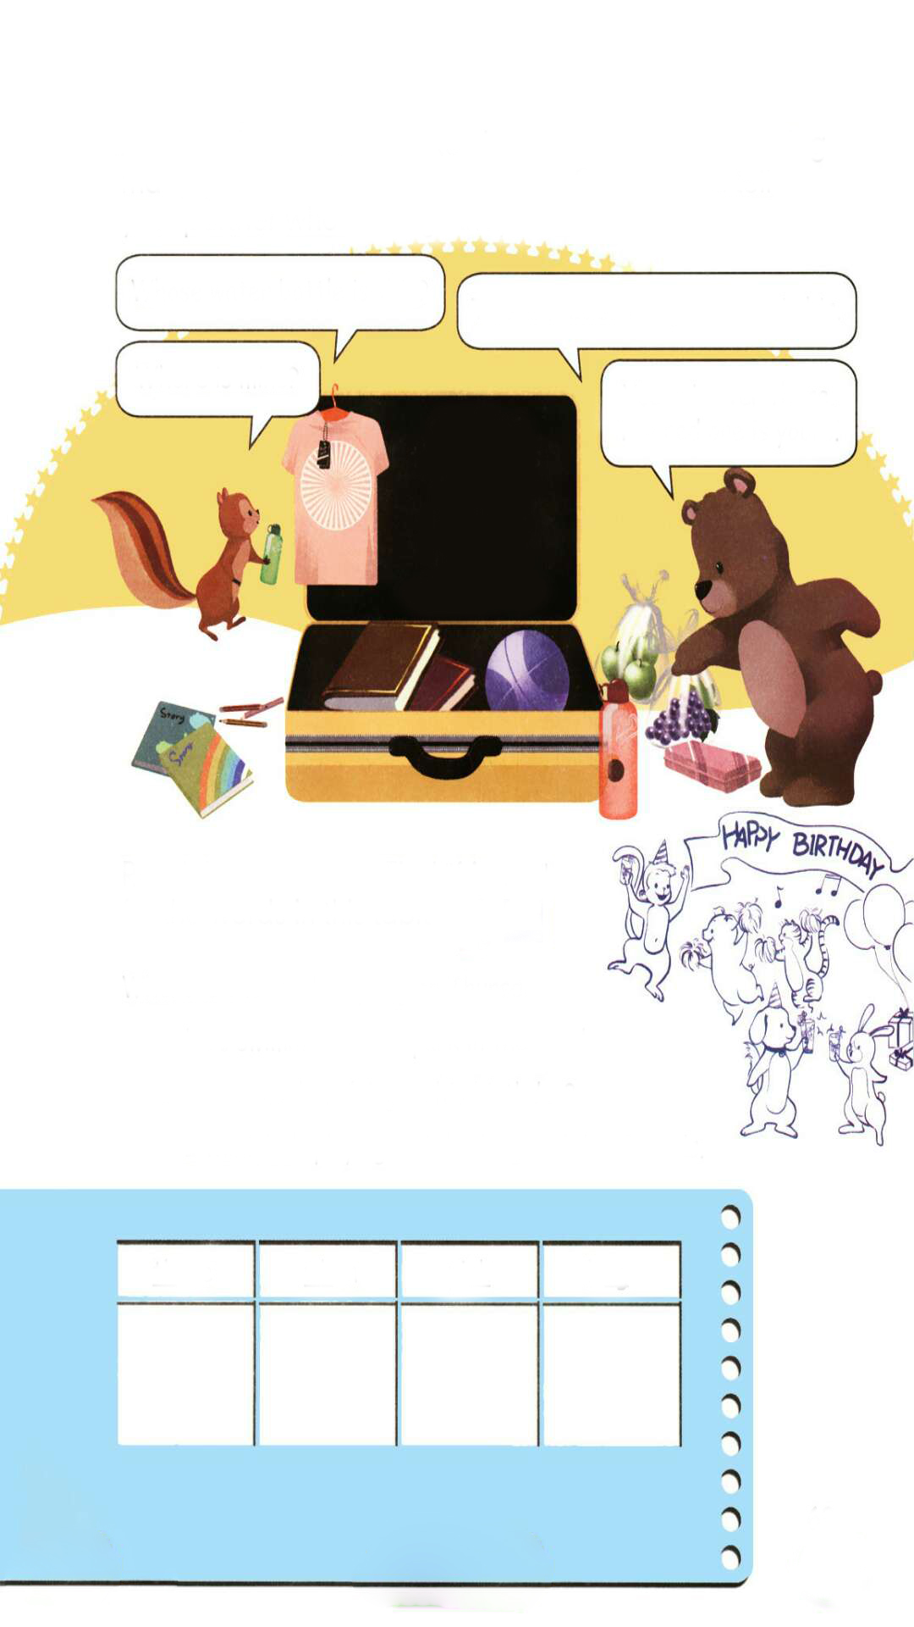
Let’s look at the things they bring to you.
点击画面 播放视频
Whose water bottle is this?
This is Fido’s. The green one is his.
Where is mine?
Yours is over there. The red one is yours.
our/ours
their/theirs
his/his
her/hers
my/mine
your/yours

Slide 12
Talk about the other gifts.
点击画面 播放视频
Whose … is this?
This is …s.
Where is …?
… is over there. … is yours.
our/ours
their/theirs
his/his
her/hers
my/mine
your/yours

Slide 13

Now please read the sentences, Find “friends” for the words in this table.
点击画面 播放视频
Where is the monkey going on Thursday?
He’s swimming in the park in the south.
What is the monkey doing on his birthday?
I think he’s playing and drinking with his friends.

Slide 14
Find “friends” for the words in this table.
three
when
pink
long
going
swimming
doing
playing
drinking
Thursday
south
birthday
think
where
what
think
drinking

Slide 15
Language points
We are having lots of fun.
【详解】该句为现在进行时。lots of意思是“许多的”, fun指“乐趣”，have fun 意思是“玩儿得开心”。
【辨析】lots of和a lot of
1. lots of和a lot of都可以作定语,即当作 many或 much那样来使用。因此,谓 语动词的形式不是依据lot和lots来决定,而是依据of所引导的名词的数来决定,如: A lot of time has been wasted.有许多时间给浪费掉了。(a lot of= much)

Slide 16
A lot of people have been present.已有许多人到了。(a lot of= many) There is lots of time to spare.时间绰绰有余。(lots of= much)
2. a lot of=lots of表示“许多的”，可以修饰可数名词复数和不可数名词。
3. a lot是表示程度的短语,意思是“很；非常”。如:thanks a lot(多谢); know a lot about China(对中国了解很多)。
4. 书面语用a lot of较多,口语用lots of较多。

Slide 17
Practice
Read as fast as you can.
1. My brother gets three maths books for his tenth birthday. Oh, too many!
2. What a sweet little white whale! Whose is it?
3. Sing a song, you young girl, on this beautiful morning.
4. Let me think about why the elephants can drink water using their trunks.

Slide 18





Exercises
一、找规律，补全单词，并连线。
1. three thanks ma__ __s A.
2. think pink i__ __ B.
3. when what __ __ere C.
4. young long si__ __ D.
t h
n k
w h
n g

Slide 19
二、单项选择。
( )1. —_______ bottle is this?
—It’s Amy’s.
A. What B. Whose C. Who’s
( )2. Mike is _______ in the park.
A. running B. run C. runing
( )3. There are two pens on the desk. The red one is_______. The black one is_______.
A. mine, yours B. mine, your C. yours, her
B
A
A

Slide 20
三、按要求完成句子。
1. John is playing football. Tom is playing football.（合成一句话。）
John and Tom ________ ________ football.
2. I’m listening to music.（就划线部分提问。）
______ ________ ________ ________?
3. This is his shirt.（改为同义句。）
This shirt is________.
are playing
What are you doing
his

Slide 21


Summary
1.复习巩固了第四单元至第六单元的核心语言。
2.复习巩固了字母组合：th, wh, nk, ng的发音规则。
七彩课堂
伴你成长

Slide 22

Homework
ONE
TWO
Act the dialogue out with your friends.
Write a poem using the sentences we have learnt.
七彩课堂
伴你成长
Collect the words with th, wh, nk, ng.

Slide 23








