Slide 1


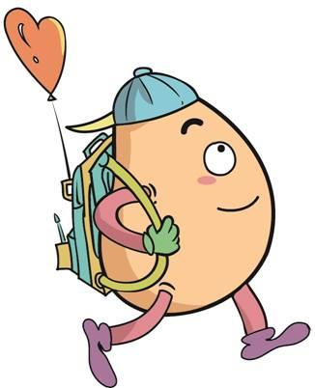






人 教 PEP 版 英 语 五年 级 下 册
Recycle 2
Mike’s summer camp
第一课时

Slide 2

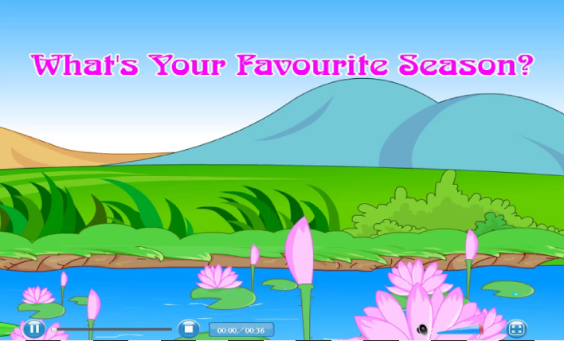
Warm up

Slide 3
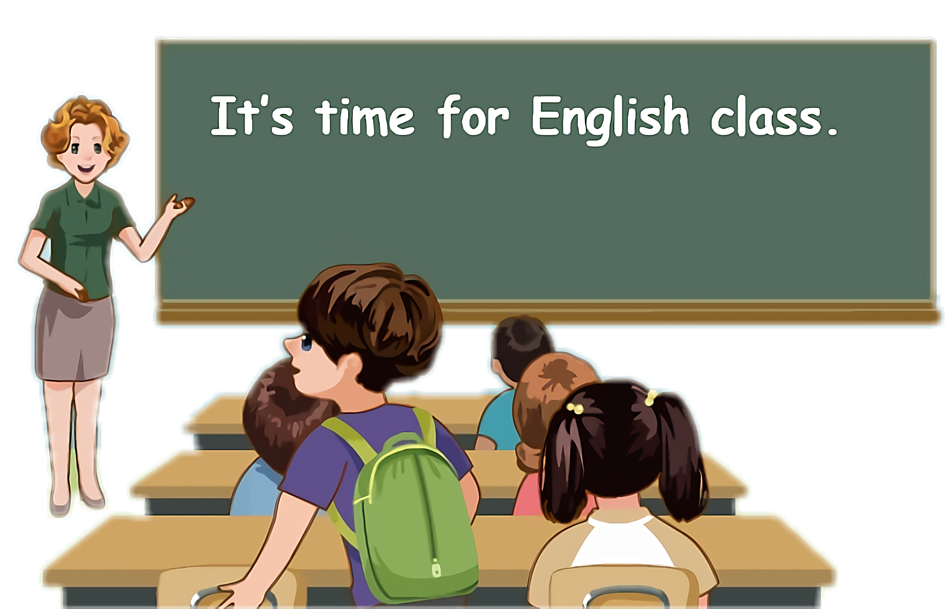
Lead in
Children, let’s go to the summer camp. OK?
OK!

Slide 4
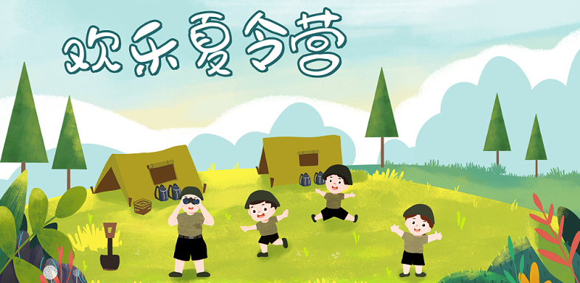
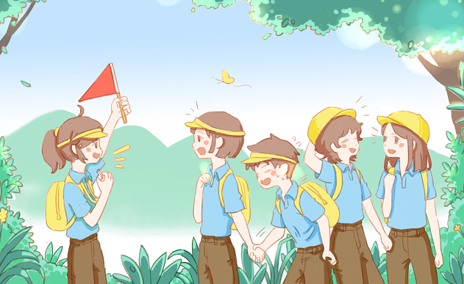
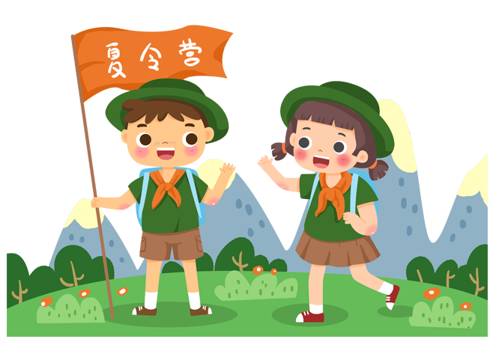
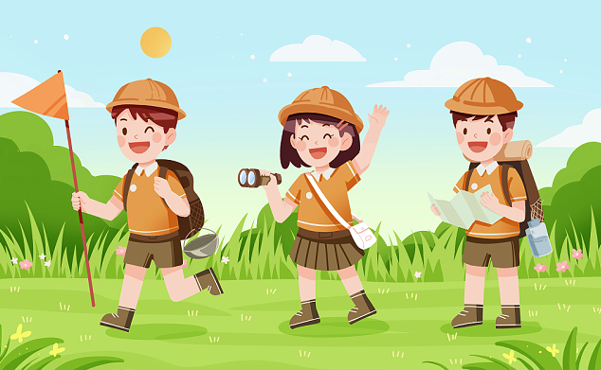

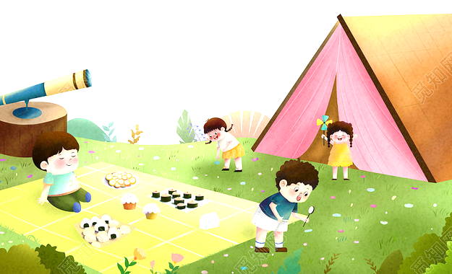
Lead in
The summer camp

Slide 5
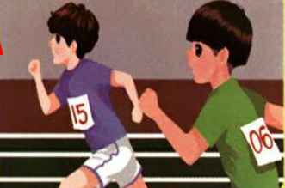
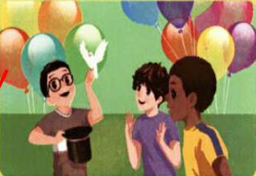
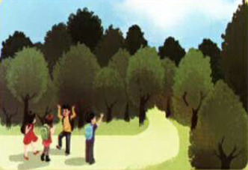
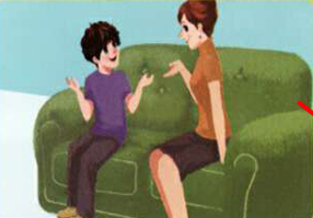
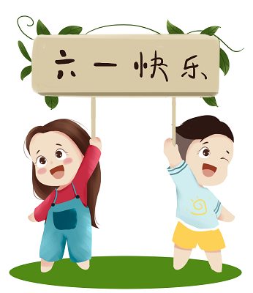
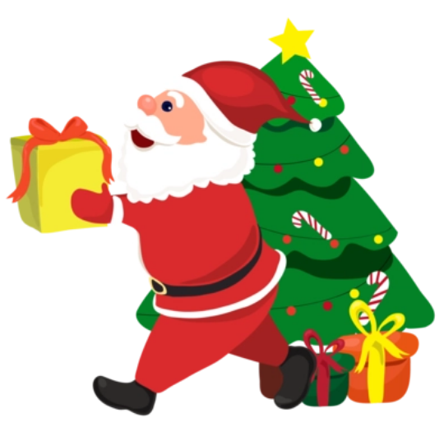
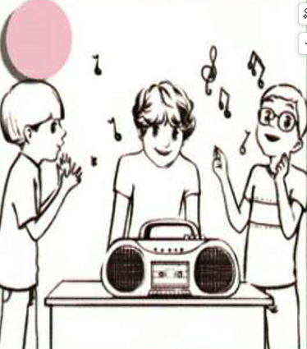
Let’s introduce the activities.

Slide 6
Preaentation
Talk about the activities
Talk about Mike’s summer camp.
Talk about how many days there are per month.
Talk about when the holiday is.

Slide 7
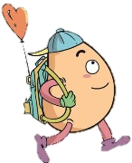


Mike’s summer camp
Listen and match.
Mike is at summer camp. What will he do? Listen and match.

Slide 8
听力材料.
1.Mike: Hi, Mum.
Mum: Hi. How is your summer camp?
Mike: Fine. Today, we had an art class.
Mum: Good.
Mike: On August 1st we'll have a sports day.
2.Mum: What are you doing now?
Mike: We're listening to music. We'll have lunch.
Mum: I see. What's for lunch?
Mike: Potatoes and rice.

Slide 9
听力材料.
3.Mum: What else will you do at camp?
Mike: On the 6th we'll have a trip to the forest.
Mum: That sounds fun.
Mike: And on the 11th, we'll have a party.
Mum: Great!
4.Mum: OK. Mike. Be a good boy! Keep your room clean.
Mike: I will.
Mum: See you at home on August 12th.
Mike: OK. Bye-bye. I love you, Mum.
Mum: Love you, too.

Slide 10
Listen and fill in the blanks.
1. On August 1st we’ll ____________ day.
2. We are _________ to music now.
3. on the 6th we’ll have a trip to the _______ .
4. On the 11th we’ll have a _______.
have a sports
listening
forest
party

Slide 11
Listen to dialogue 2 and tick the right picture.
What are the children doing?
√

Slide 12
Listen to dialogue 1 and dialogue 4. Choose the right answers.
1. When is the sports day? It is in _____ .
A. June B. July C. August
2. Mike’s mum: Be a good boy. ______ .
A. Work quietly B. Keep your room clean C. Talk quietly.
C
B

Slide 13
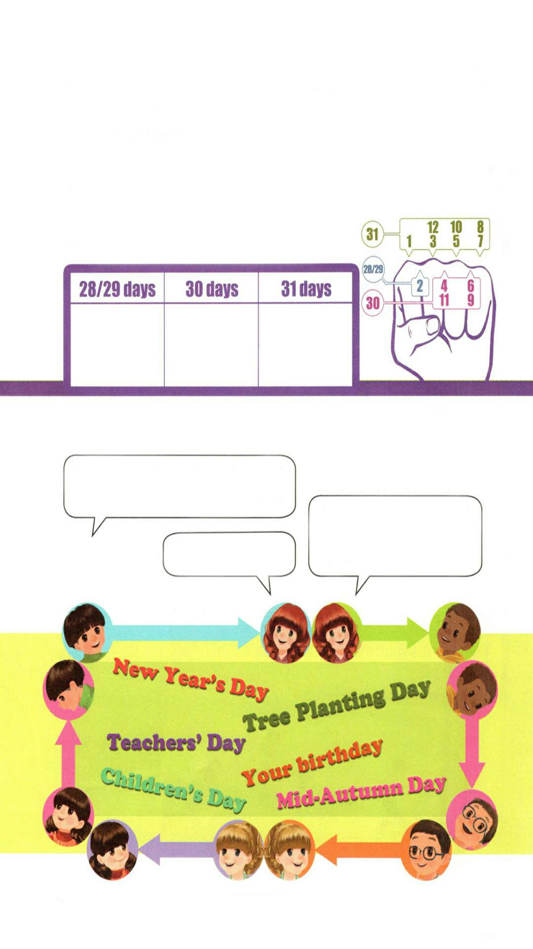
Read the chant and write the months in the correct column.
Thirty days has September, April, June and November; February has twenty-eight alone.
All the rest have thirty-one
Except in leap year. That's the time
When February's days are twenty-nine.
单独，独自
其他的
闰年
Jan. Mar. May. July. Aug. Oct. Dec.
Apr. June Sept. Nov.
Feb.

Slide 14
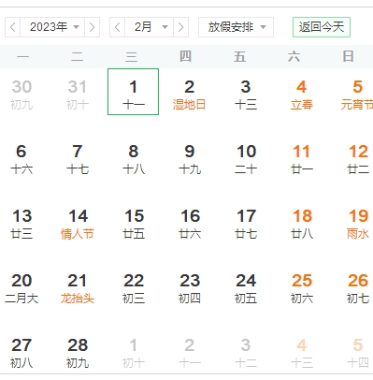
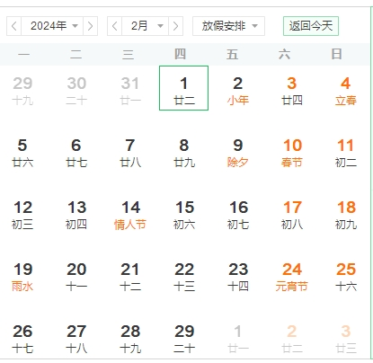
Does every February have 28 days?
闰年
Except in leap year. During a leap year, February has 29 days.

Slide 15
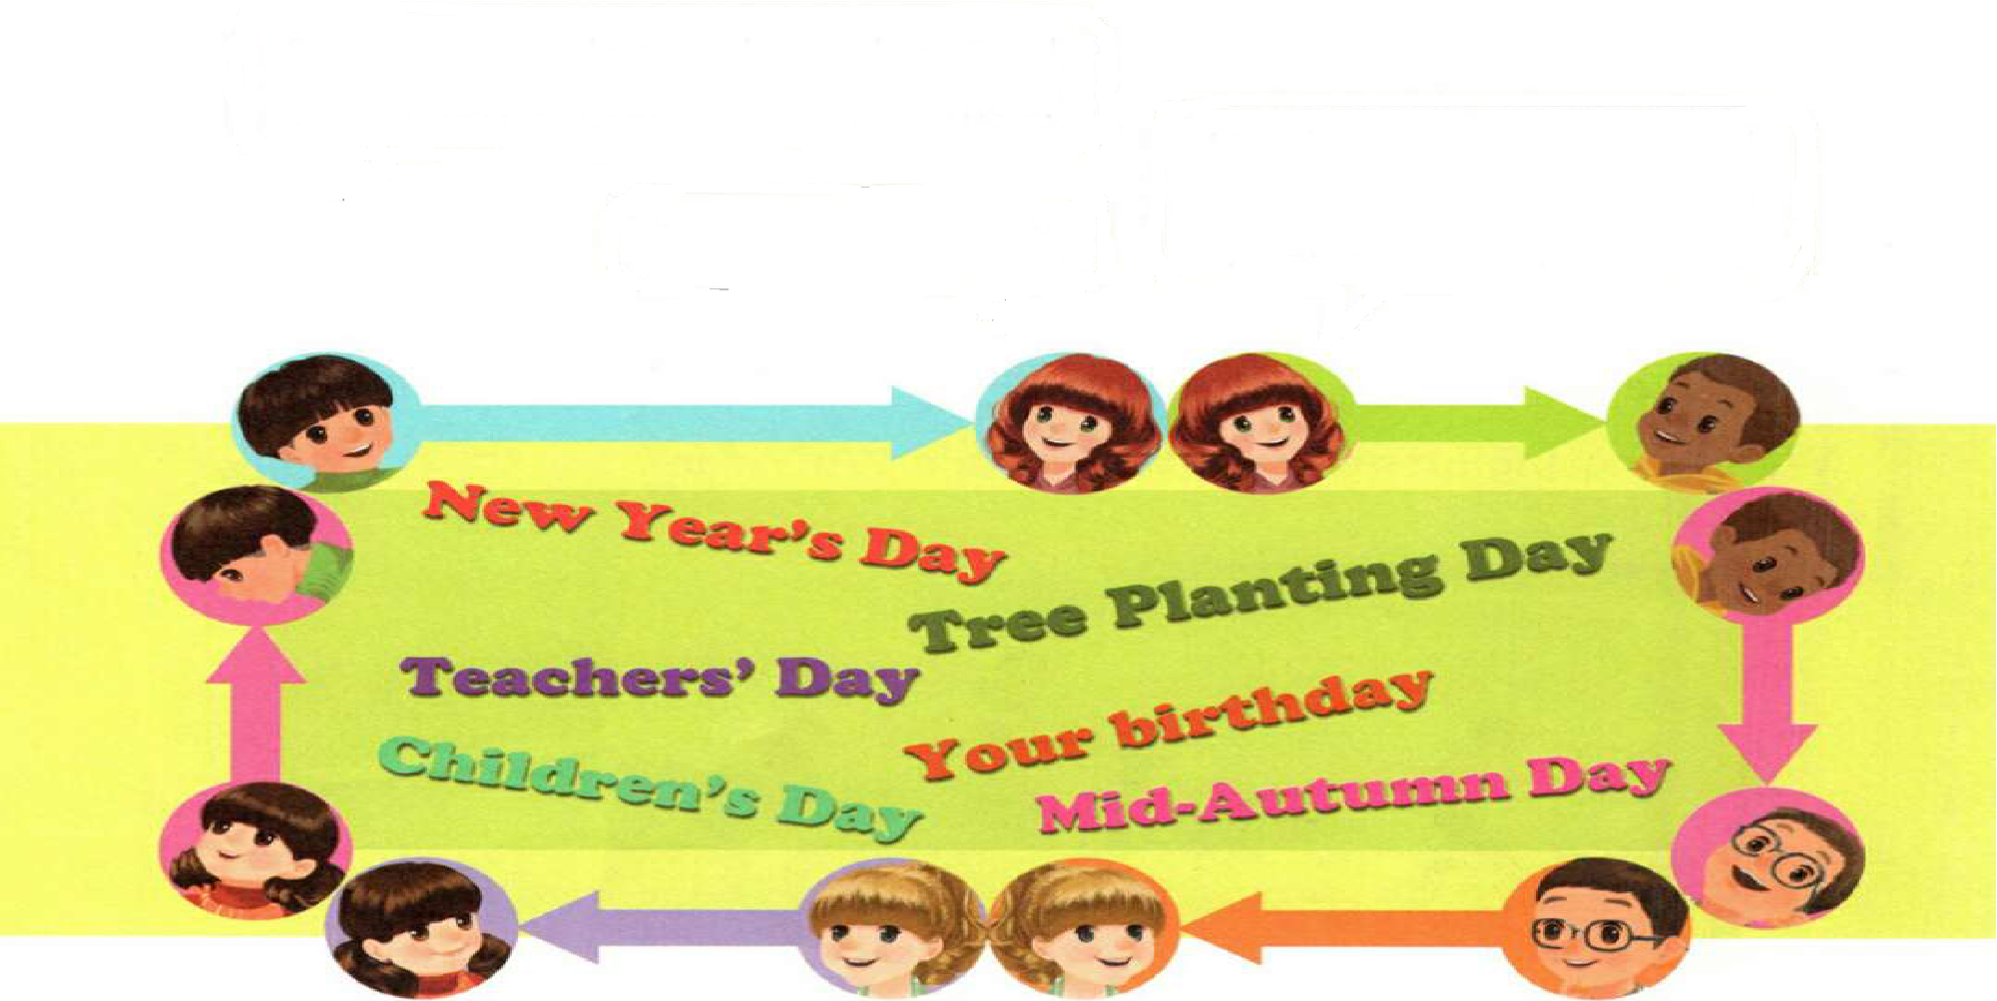
A game: Animals and dates.
Pandas, pandas and pandas. Tell me when Children’s Day comes.
Monkeys, monkeys and monkeys. Tell me when your birthday comes.
It’s on June 1st.

Slide 16
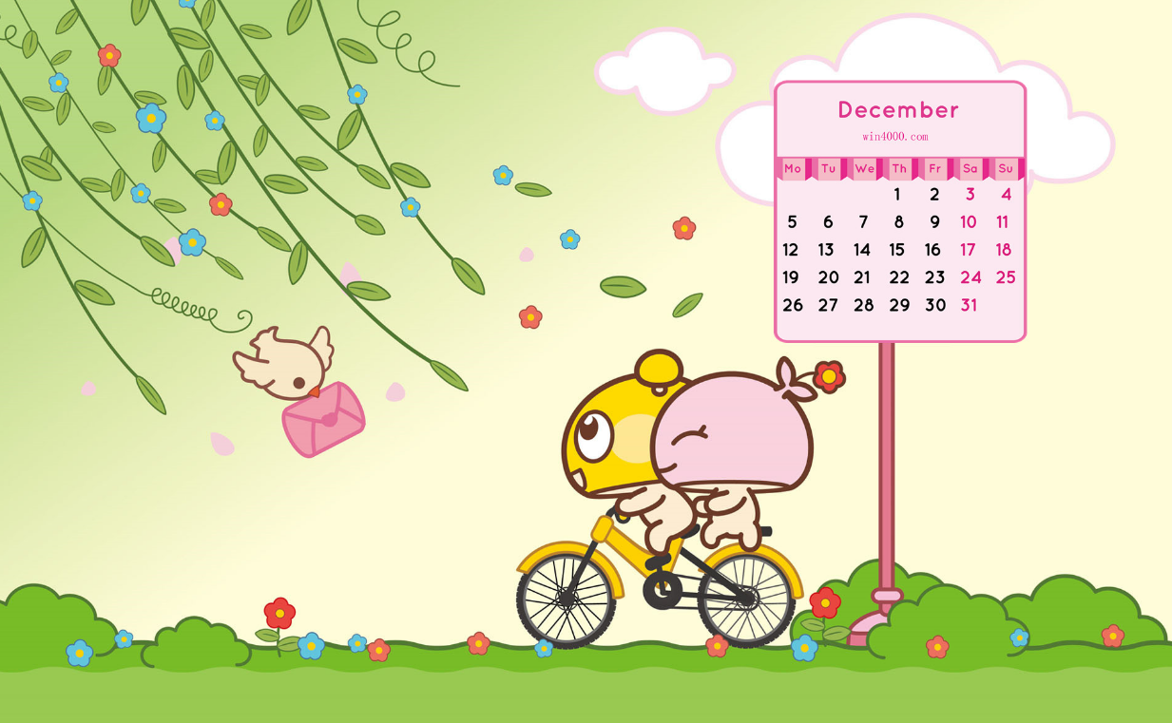
Good to know
月份歌
一三五七八十腊，
三十一天永不差。
四六九冬三十天，
只有二月二十八。
每逢四年闰一日，
一定要在二月加。

Slide 17



Exercises
一、看图写词组。
Christmas Day
Children’s Day
Teachers’ Day
Mid-Autumn Day
New Year’s Day

Slide 18
二、将节日与对应的日期连线。
1.
2.
3.
4.
New Year’s Day
A.
B.
C.
D.
April 1st
Teachers’ Day
June 1st
April Fool’s Day
September 10th
Children’s Day
January 1st

Slide 19
三、单项选择。
( )1. ________ is Mike doing?
A. What B. Where C. Who
( )2. There are ________ days in February in 2015.
A. 28 B. 29 C. 30
( )3. Tom and his friends ________ to music.
A. listening B. are listening C. listen
( )4.—When is Christmas?
—It’s________.
A. December 25th B. June 1st C. August 1st
A
A
B
A

Slide 20

Summary
这节课我们通过一些活动,复习和巩固了关于日期、节日、行为规范、人物正在做的事情的句型。

Slide 21
Homework
ONE
TWO
Act the chant out with your friends.
Make a short dialogue using the sentences we have learnt.
Play games in pairs like “Animals and dates”.

Slide 22







