Slide 1









人 教 PEP 版 英 语 五 年 级 下 册
Recycle 2
Mike’s summer camp
Part one

Slide 2


Warm up
Let’s sing.

Slide 3

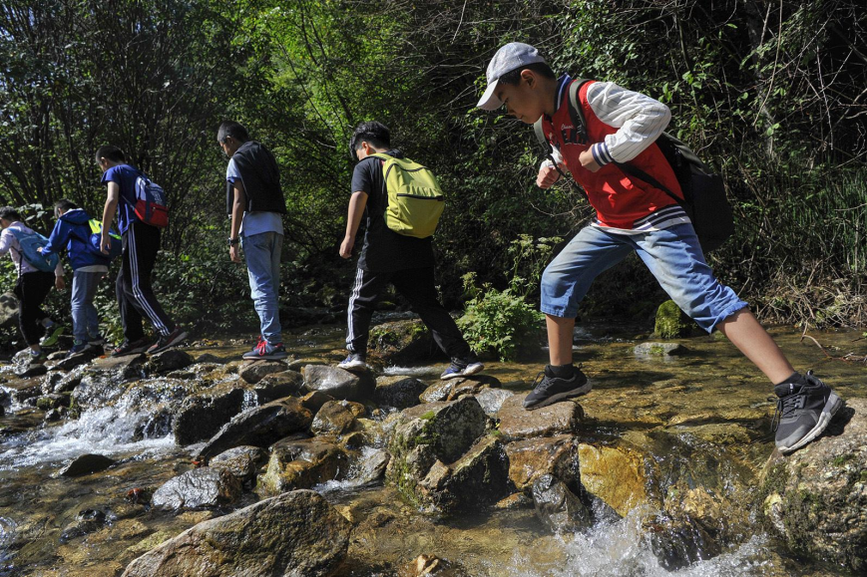
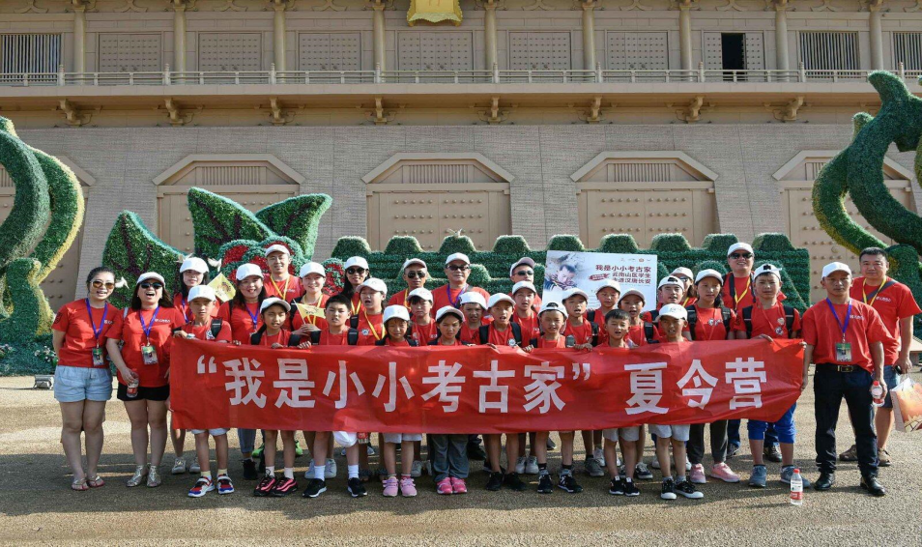
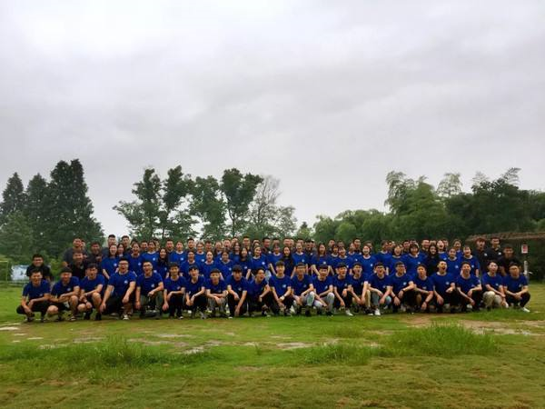
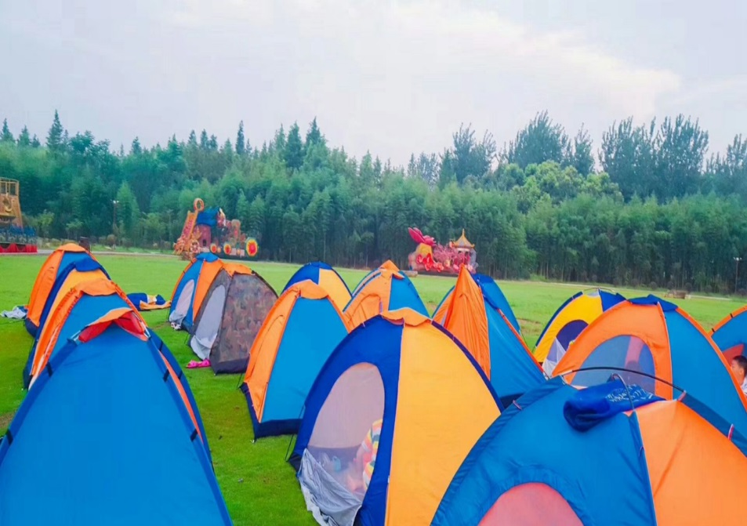
Lead in
What are these photos about?
Summer camp.

Slide 4

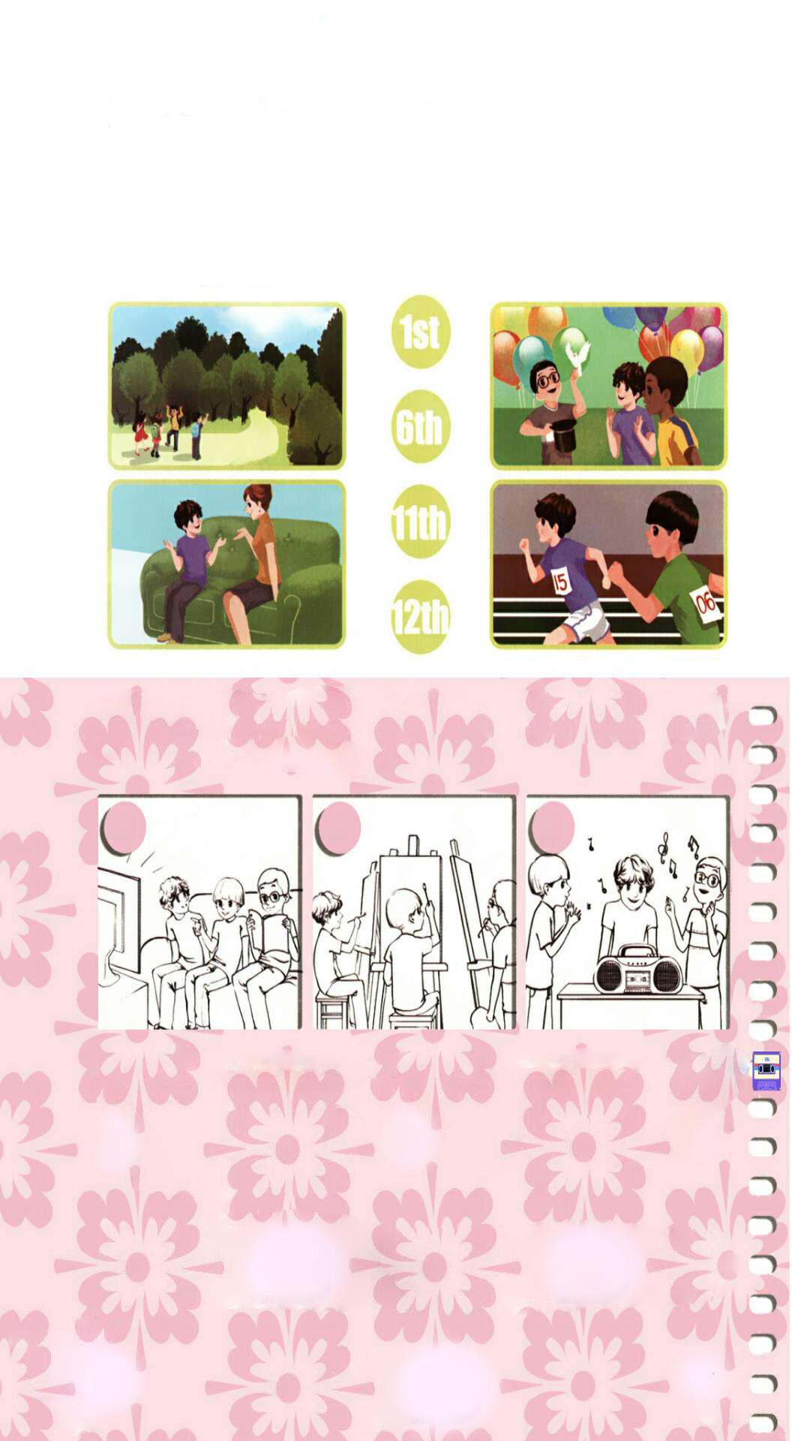
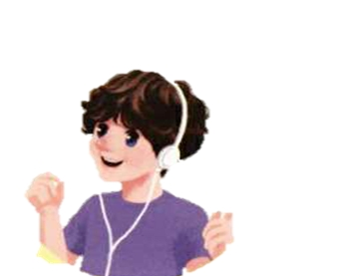
Who is at the summer camp, too?
Mike.

Slide 5

Presentation
Mike’s summer camp
Mike is at summer camp. What will he do? Let’s listen and match.

Slide 6
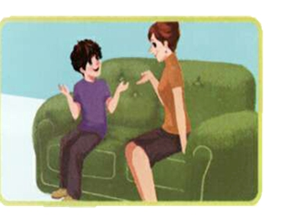
Who is calling Mike?
His Mum.
Yes, Mum knows Mike’s summer camp schedule. But she wants to know what Mike is doing.
Let’s listen.

Slide 7
Listen to dialogue 2 and tick the right picture.
√

Slide 8
Listen to dialogue 1 and dialogue 4. Choose the right answers.
When is the sports day? It is in _____ .
A. June B. July C. August
2. Mike’s mum: Be a good boy. ______ .
A. Work quietly B. Keep your room clean C. Talk quietly.
C
B

Slide 9
听力材料：
1.Mike: Hi, Mum .
Mum: Hi. How is your summer camp?
Mike: Fine. Today, we had an art class.
Mum: Good.
Mike: On August 1st we'll have a sports day.
2.Mum: What are you doing now?
Mike: We're listening to music. We'll have lunch.
Mum: I see. What's for lunch?
Mike: Potatoes and rice.

Slide 10
听力材料：
3.Mum: What else will you do at camp?
Mike: On the 6th we'll have a trip to the forest.
Mum: That sounds fun.
Mike: And on the 11th, we'll have a party.
Mum: Great!
4.Mum: OK. Mike. Be a good boy! Keep your room clean.
Mike: I will.
Mum: See you at home on August 12th.
Mike: OK. Bye-bye. I love you, Mum.
Mum: Love you, too.

Slide 11
Pair work.
1.Do you like the summer camp?
2.If you are at the summer camp, what are you doing there?

Slide 12
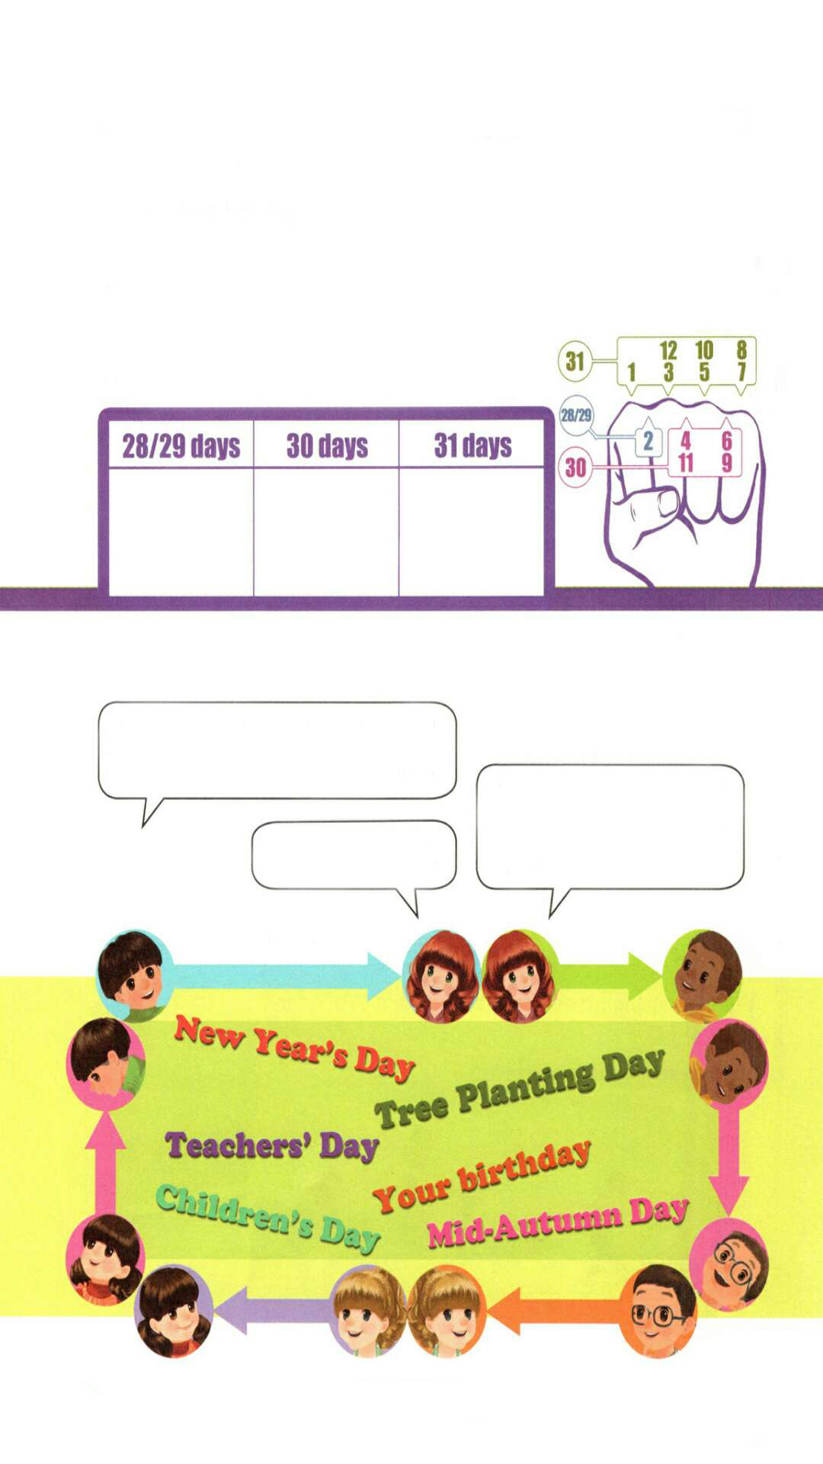
Read the chant and write the months in the correct column.
点击画面 播放视频
Thirty days has September, April, June and November; February has twenty-eight alone.
All the rest have thirty-one
Except in leap year. That's the time
When February's days are twenty-nine.
Jan. Mar. May July Aug. Oct. Dec.
Apr. June Sept. Nov.
Feb.

Slide 13
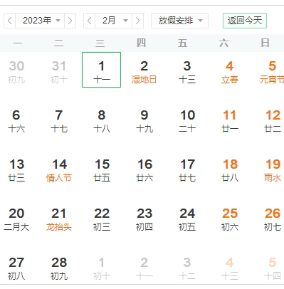
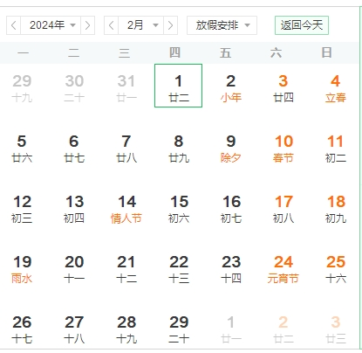
Does every February have 28 days?
点击画面 播放视频
Except in leap year. During a leap year, February has 29 days.
闰年

Slide 14
Practice
Discuss in groups.
点击画面 播放视频
I like March. My birthday is in March, and Women’s Day is in March, too. What about you? What festival comes in your favourite month?

Slide 15
A game: Animals and dates.
Pandas, pandas and pandas. Tell me when Children’s Day comes.
Monkeys, monkeys and monkeys. Tell me when your birthday comes.
It’s on June 1st.

Slide 16

Exercises
一、将节日与对应的日期连线。
1.
2.
3.
4.
New Year’s Day
A.
B.
C.
D.
April 1st
Teachers’ Day
June 1st
April Fool’s Day
September 10th
Children’s Day
January 1st

Slide 17
二、单项选择。
( )1. ________ is Mike doing?
A. What B. Where C. Who
( )2. There are ________ days in February in 2015.
A. 28 B. 29 C. 30
( )3. Tom and his friends ________ to music.
A. listening B. are listening C. listen
( )4.—When is Christmas?
—It’s________.
A. December 25th B. June 1st C. August 1st
A
A
B
A

Slide 18
三、情景交际。
1.在图书馆的时候，我们应该：________
2.在学习的时候，我们应该：________
3.当看到你的朋友房间很乱时，应说：_________
C
B
A
A. Keep your room clean.
B. Work quietly.
C. Talk quietly.

Slide 19
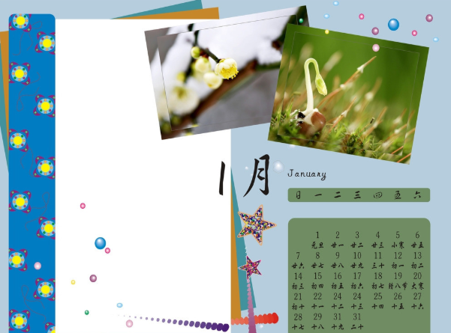
I want to know
月份歌：
一三五七八十腊，
三十一天永不差。
四六九冬三十天，
只有二月二十八。
每逢四年闰一日，
一定要在二月加。

Slide 20


Summary
这节课我们通过一些活动，复习和巩固了关于日期、节日、行为规范、人物正在做的事情的句型。
七彩课堂
伴你成长

Slide 21

Homework
ONE
TWO
Act the chant out with your friends.
Make a short dialogue using the sentences we have learnt.
七彩课堂
伴你成长
Play games in pairs like “Animals and dates”.

Slide 22








