Slide 1


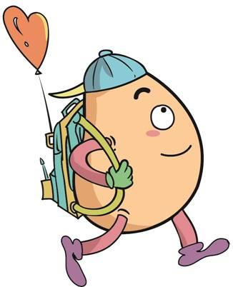






人 教 PEP 版 英 语 五年 级 下 册
Recycle 1
Sarah’s weekend
第二课时

Slide 2

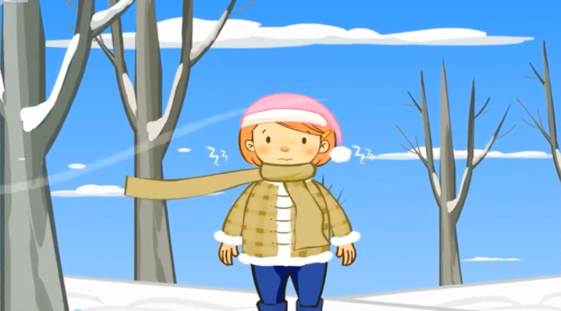
Warm up

Slide 3
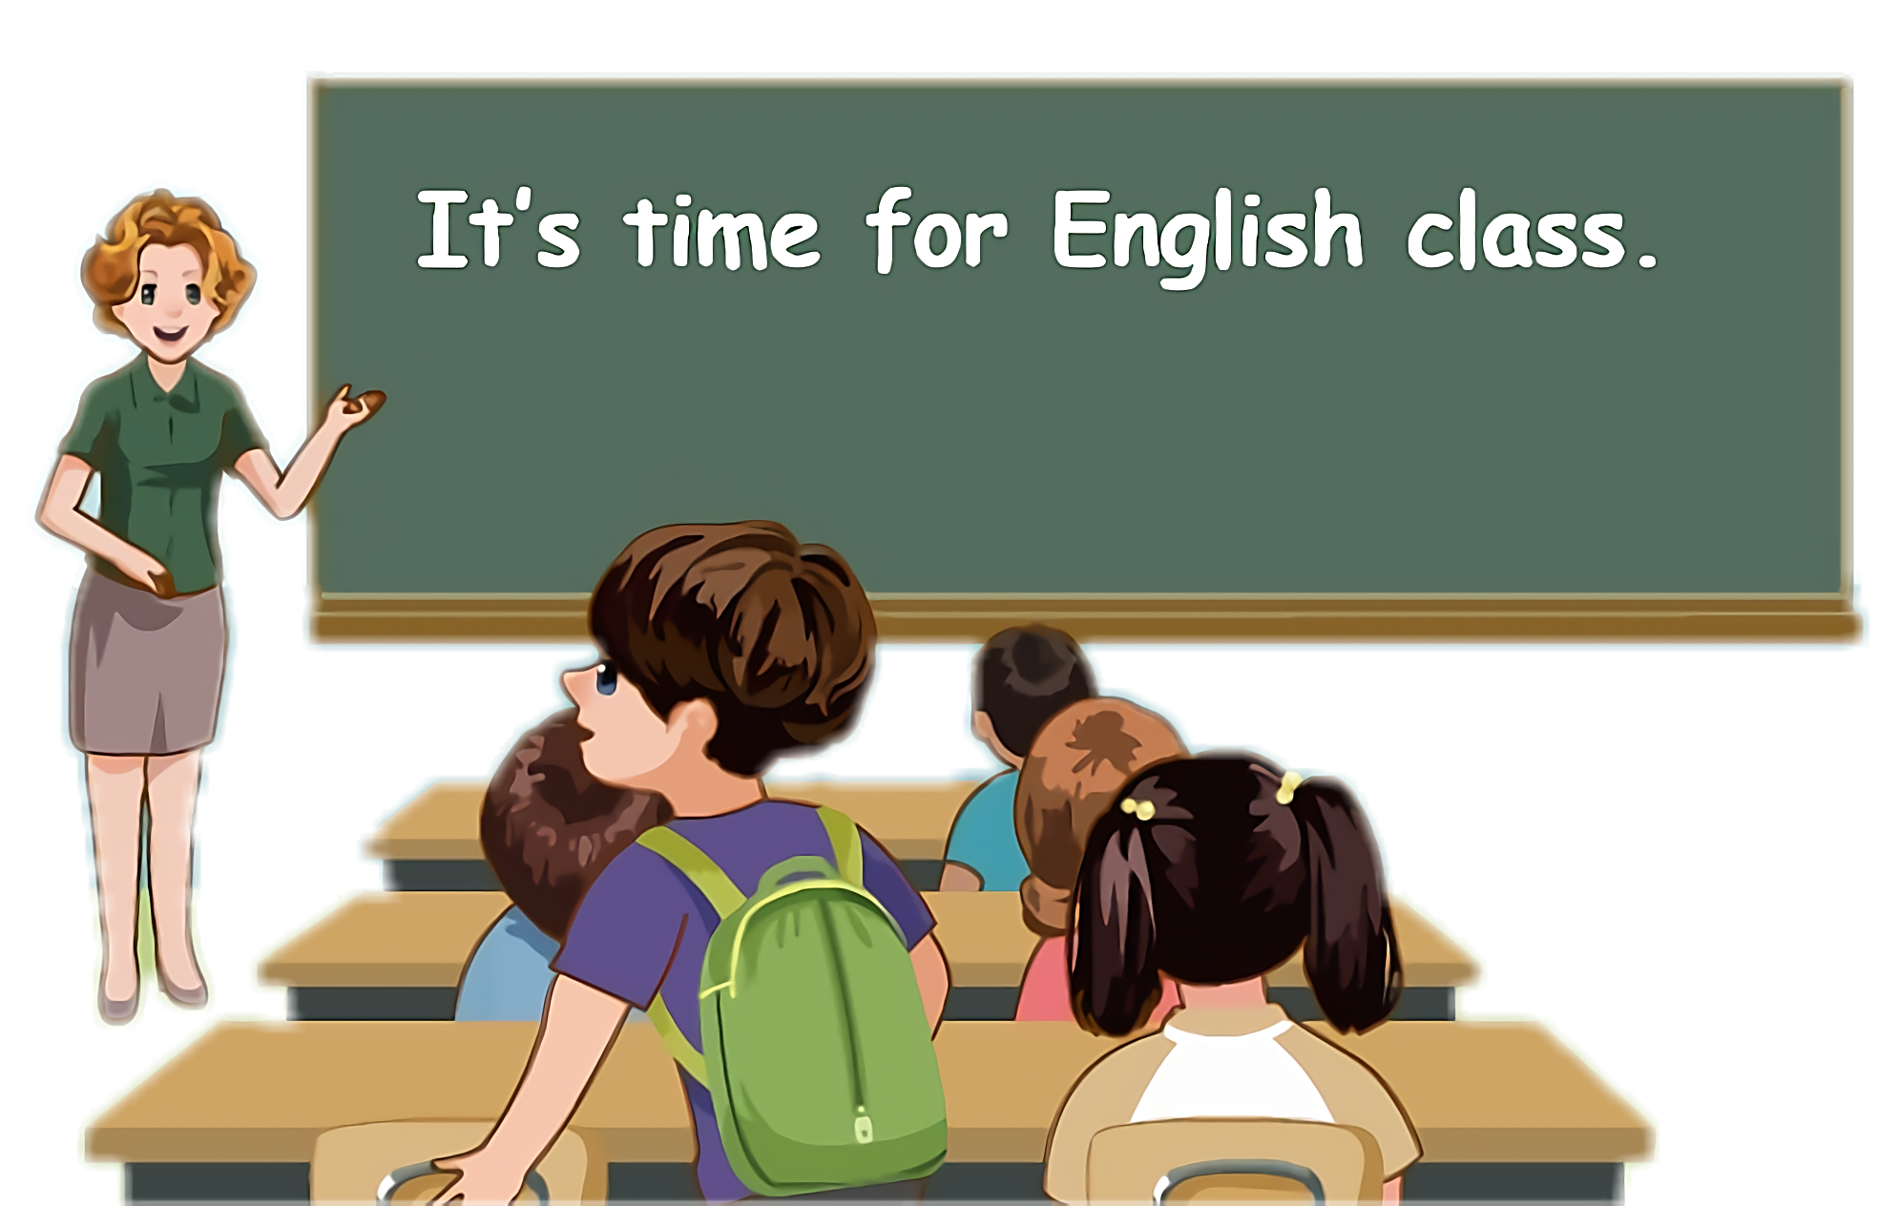
Lead in
Children, what’s the weather like today?
It’s...

Slide 4
What’s the weather like in Sydney? What season is it?

Slide 5
Sarah will visit Sydney in April. Her friend in Sydney is telling her something about Sydney.

Slide 6

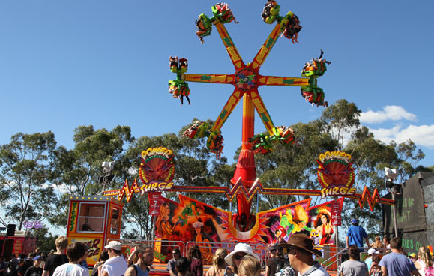
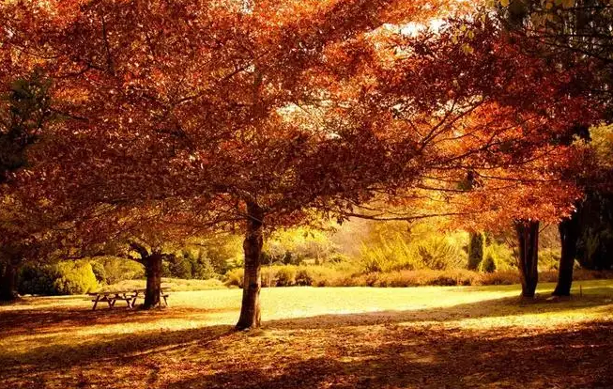
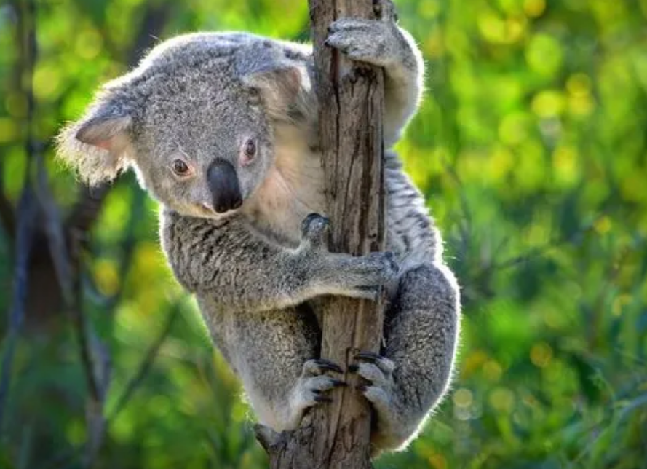
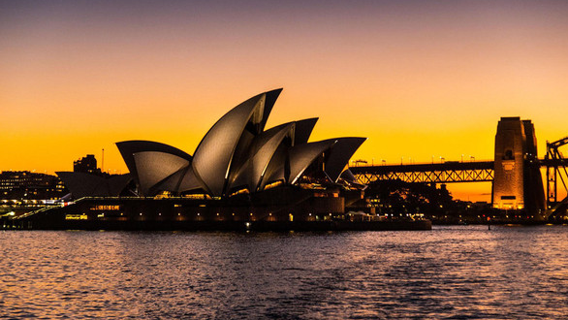
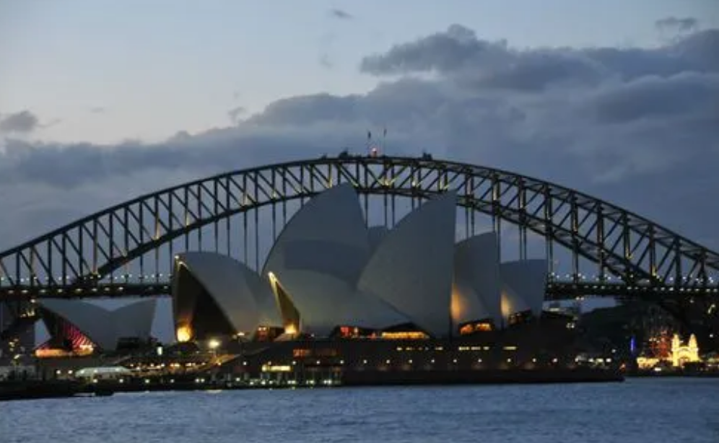
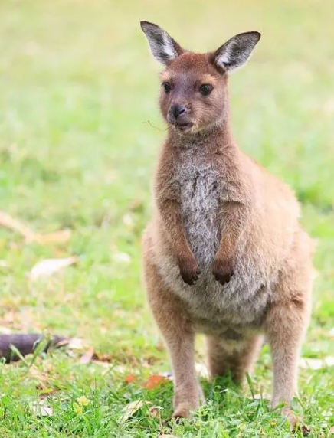
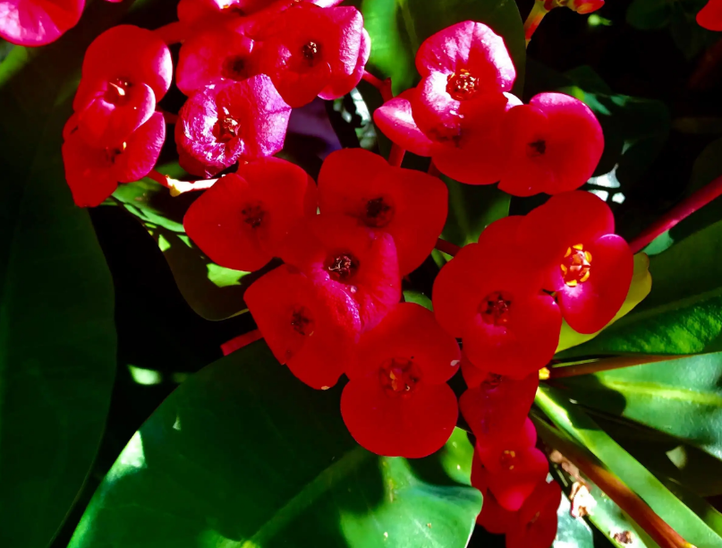
Let’s introduce Sydney.

Slide 7
Presentation
Talk about the weather.
Talk about Sydney’s weather.
Talk about China’s weather.
Talk about the pronunciation of cl, pl, gr, ch, sh.

Slide 8


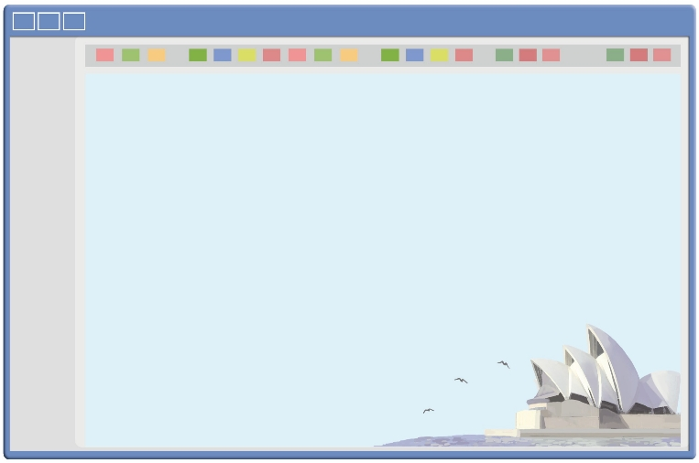
Listen and read.
Sarah will visit Sydney in April. She asks Stella,a friend there, about the weather. Here is Stella’s reply.
Hi, Sarah!
It is autumn in April here in Sydney. Autumn is my favourite season! It is warm in the day and cool at night. Many people visit us in autumn because they like the weather.
When you come, you can visit the Sydney Opera House. It is the most famous buliding in Australia.
What is the weather like April in your city?
What do you often do?
All the best,
Stella

Slide 9
Listen and repeat.
Hi, Sarah!
It is autumn in April here in Sydney. Autumn is my favourite season! It is warm in the day and cool at night. Many people visit us in autumn because they like the weather.
When you come, you can visit the Sydney Opera House. It is the most famous buliding in Australia.
What is the weather like April in your city?
What do you often do?
All the best,
Stella
表达某人最喜欢的季节
白天温暖，晚上凉爽
悉尼歌剧院
最著名的
在你的城市四月的天气怎么样？

Slide 10

Read and act.
1.Read it together.
2.Each student
reads a sentence.
Tip: Choose one to read in two. 选择一种两人练习。
3. Read in roles.
自己分配角色。

Slide 11
Read and answer.
1. Is it spring in Sydney in April?
2. What’s the weather like in April in Sydney?
No, it isn’t. In Sydney, it is autumn in April.
It is warm in the day and cool at night.

Slide 12
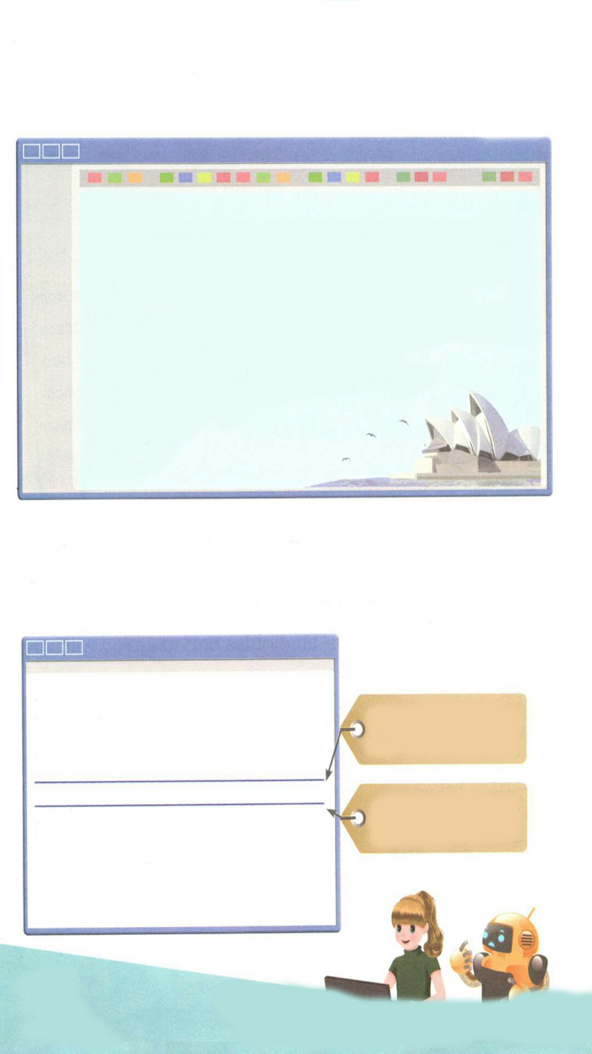
Now can you answer the email for Sarah, please?
Hi, Stella!
Thanks for your email. It is spring here in China.
What’s the weather like in spring?
It is spring in Beijing. The weather is warm and rainy. The flowers are beautiful and the grass is green. I usually go on a picnic in the park.
What do you usually do then?
Please visit me someday and I am sure you will have a good time!
Best wishes,
Sarah
玩得愉快，玩得高兴
=have fun
=have a nice time
=enjoy oneself

Slide 13

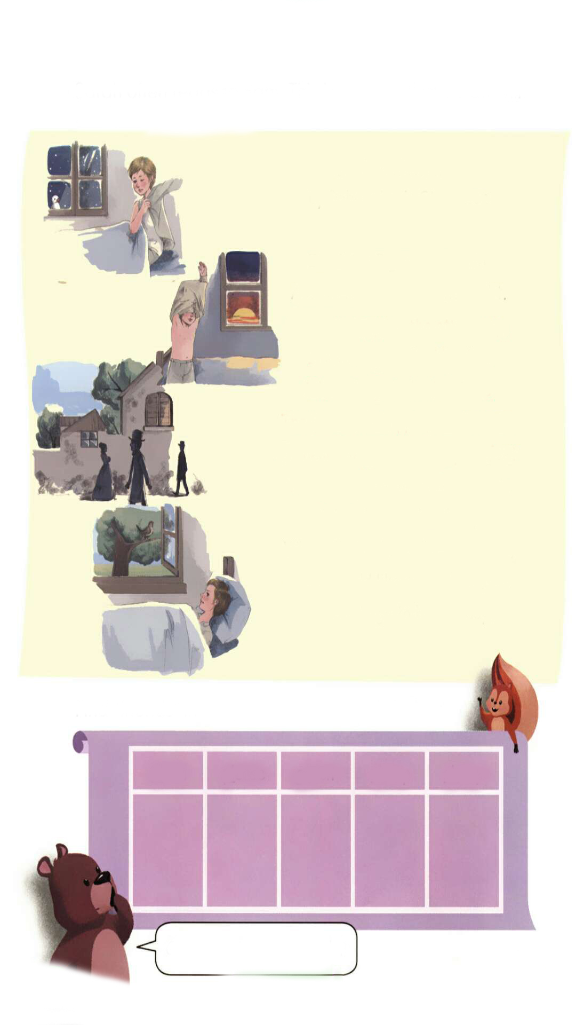
Listen to the tape.
Bed in Summer
by Robert Louis Stevenson
In winter I get up at night
And dress by yellow candlelight.
In summer, quite the other way,
I have to go to bed by day.
I have to go to bed and see
The birds still hopping on the tree,
Or hear the grown-up people’s feet
Still going past me in the street.
And does it not seem hard to you,
When all the sky is clear and blue,
And I should like so much to play,
To have to go to bed by day?

Slide 14
Read again and understand.
Bed in Summer夏日之床
by Robert Louis Stevenson
In winter I get up at night冬日我大清早起床
And dress by yellow candlelight.借着黄色的烛光穿裳
In summer, quite the other way,夏日完全相反
I have to go to bed by day.我必须在日间上床
I have to go to bed and see我必上床且看
The birds still hopping on the tree, 鸟儿还在树梢跃荡
Or hear the grown-up people’s feet抑或聆听成年人的脚声
Still going past me in the street.仍旧在街道走过我的身旁
And does it not seem hard to you,它对你来说难道不为难吗
When all the sky is clear and blue,在明亮而蔚蓝的天空当前
And I should like so much to play,而我如此喜欢玩耍
To have to go to bed by day?却必须在白天就上床

Slide 15

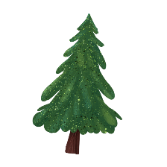


Language point.
It is warm in the day and cool at night.
用来描述天气情况
句型结构：
It's + 表示天气的形容词.
eg. It’s cold today.

Slide 16
Language point.
Autumn is my favourite season.
用来表达某人最喜欢的季节
句型结构：
季节 + is + sb’s favourite season
=Sb's + favourite season + be+季节.
= Sb + like/likes + 季节 + best.
eg: Spring is Bob's favourite season.
= Bob's favourite season is spring.
= Bob likes spring best.

Slide 17
Act the poem out.
Bed in Summer
by Robert Louis Stevenson
In winter ...
And dress...
In summer...
I have to ...
I have to ...
The birds ...
Or hear ...
Still going ...
And does it ...
When all the sky is ...
And I should like ...
To have to ...

Slide 18

流利地朗读
流利地表演
有感情地表演

Slide 19
Find “friends” in the poem for the words below.
clean please green cheap sheep
clear
play
grown
much
should
Can you write more words?

Slide 20
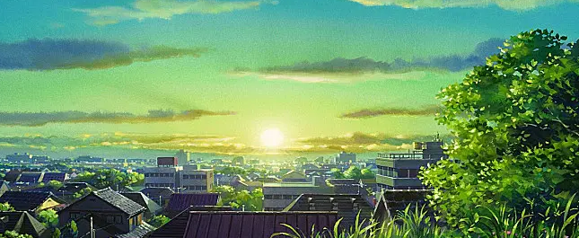
Good to know
Beauty is everywhere. For us, it is not lack of beauty, but a lack of discovery.
美是到处都有的，对于我们，不是缺少美，而是缺少发现。

Slide 21
Exercises
一、根据规律写出它们的朋友。(每道题至少写出三个来）
1. cheap ________________________________
2. shop ________________________________
3. green ________________________________
4. class ________________________________
5. play ________________________________
chicken chair China
ship sheep fish
great grass grow
clean clock clear
plan plate please

Slide 22
二、对画线部分提问。
1.My favourite season is winter.
______________________________________
2. I usually go swimming on Sundays.
________________________________________
3. Many people visit us in autumn because they like the weather.
___________________________________________
What is your favourite season?
What do you usually do on Sundays?
Why do many people visit you in autumn?

Slide 23
三、阅读短文，判断正(T)误(F).
Today is Sunday. It is fine today. The sun is shinning. The sky is blue. Mr. Smith and his family are walking in the park. There are four people in his family. Mr. Smith and Mrs. Smith are looking at the boats in the lake. Tom is looking at the birds in the sky. Mary is not looking at the boats in the lake. She is looking at a big ship. They have a good time.
( ) 1. Today is Saturday.
( ) 2. Today is a fine day.
( )3. There are three people in Mr. Smith’s family.
( )4. Mary is looking at the boats in the lake.
( )5. Mr. Smith and Mrs. Smith are in the boat.
F
T
F
F
F

Slide 24

Summary
1.复习了关于活动、季节、节日等单词和短语。
2.复习了下列句型：
—What’s the weather like in ...? —It’s...
—What do you often do? —I often...
2.复习了字母组合：cl, pl, gr, ch, sh的发音规则。

Slide 25
Homework
ONE
TWO
Act the poem out with your friends.
Make a short dialogue using the sentences we have learnt.
Collect the words with cl, pl, gr, ch, sh.

Slide 26







