Slide 1









人 教 PEP 版 英 语 五 年 级 下 册
Recycle 1
Sarah’s weekend
Part two

Slide 2

Warm up
Free talk.
T: What’s the weather like today?
…
T: What season is it now?
…

Slide 3

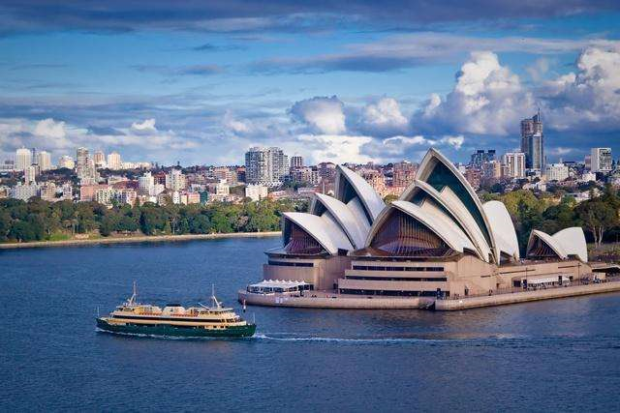
Lead in
What’s the weather like in Australia?
What season is it?

Slide 4
Presentation
Sarah will visit Sydney in April. Her friend in Sydney is telling her something about Sydney.
What season is it in April?
Let’s listen.
It’s Autumn in Sydney in April.

Slide 5


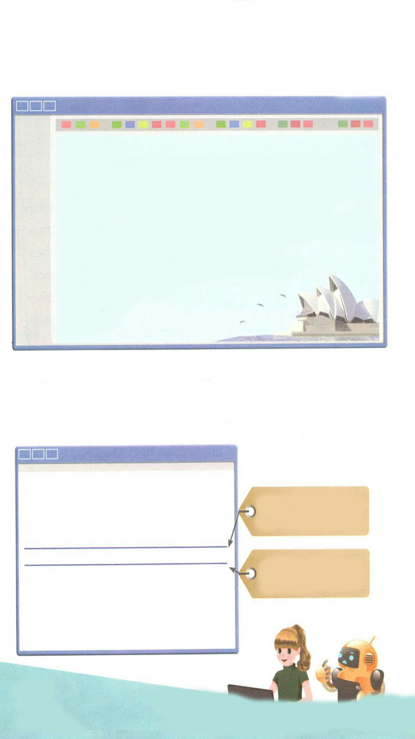
Listen and read.
Hi, Sarah!
It is autumn in April here in Sydney. Autumn is my favourite season! It is warm in the day and cool at night. Many people visit us in autumn because they like the weather.
When you come, you can visit the Sydney Opera House. It is the most famous building in Australia.
What is the weather like in April in your city?
What do you often do?
All the best,
Stella

Slide 6
Read and answer.
1. Is it spring in Sydney in April?
2. What’s the weather like in April in Sydney?
No, it isn’t. In Sydney, it is autumn in April.
It is warm in the day and cool at night.

Slide 7
Listen again and underline the sentences about autumn.
Hi, Sarah!
It is autumn in April here in Sydney. Autumn is my favourite season! It is warm in the day and cool at night. Many people visit us in autumn because they like the weather.
When you come, you can visit the Sydney Opera House. It is the most famous building in Australia.
What is the weather like in April in your city?
What do you often do?
All the best,
Stella

Slide 8
Now can you answer the email for Sarah, please?
点击画面 播放视频
Hi, Stella!
Thanks for your email. It is spring here in China.
What’s the weather like in spring?
It is spring in Beijing. The weather is warm and rainy. The flowers are beautiful and the grass is green. I usually go on a picnic in the park.
What do you usually do then?
Please visit me someday and I am sure you will have a good time!
Best wishes,
Sarah

Slide 9
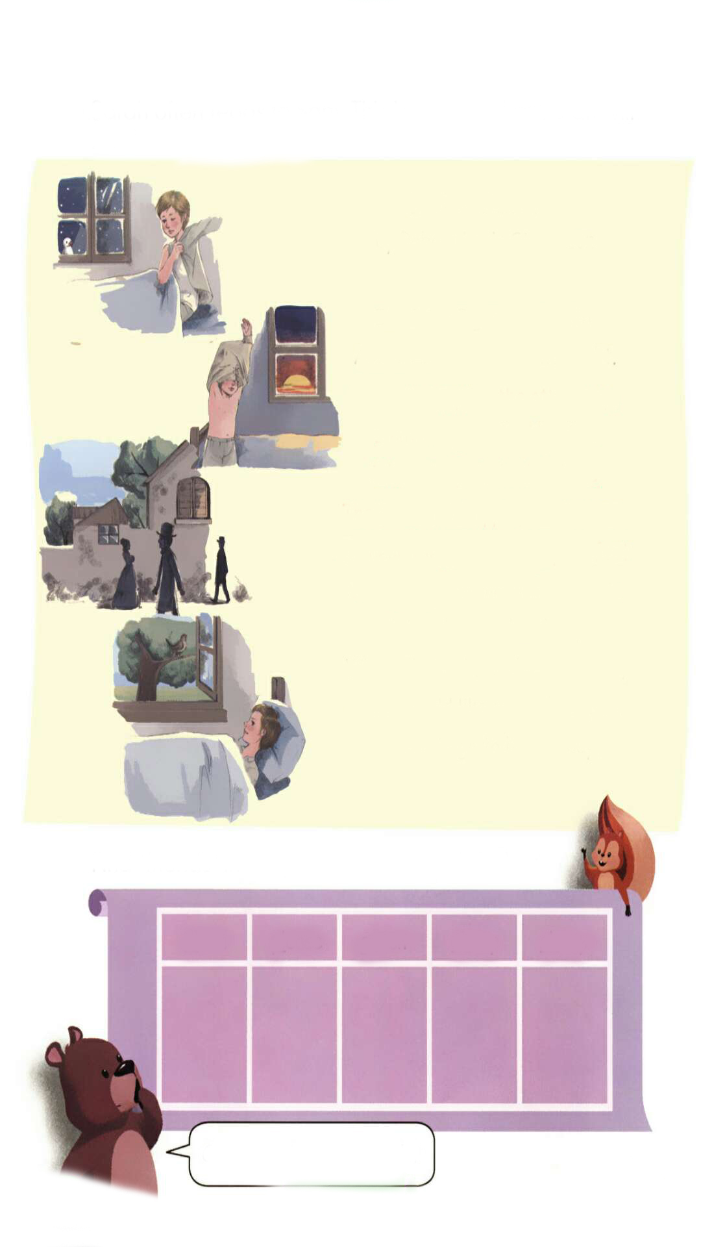
Listen to the tape.
Bed in Summer
by Robert Louis Stevenson
In winter I get up at night
And dress by yellow candlelight.
In summer, quite the other way,
I have to go to bed by day.
I have to go to bed and see
The birds still hopping on the tree,
Or hear the grown-up people’s feet
Still going past me in the street.
And does it not seem hard to you,
When all the sky is clear and blue,
And I should like so much to play,
To have to go to bed by day?

Slide 10
Read after the tape.
Bed in Summer
by Robert Louis Stevenson
In winter I get up at night
And dress by yellow candlelight.
In summer, quite the other way,
I have to go to bed by day.
I have to go to bed and see
The birds still hopping on the tree,
Or hear the grown-up people's feet
Still going past me in the street.
And does it not seem hard to you,
When all the sky is clear and blue,
And I should like so much to play,
To have to go to bed by day?

Slide 11
Act the poem out.
Bed in Summer
by Robert Louis Stevenson
In winter ….
And dress by …..
In summer, …,
I have to ….
I have to …
The birds still …,
Or hear …
Still going ….
And does it …,
When all the sky is …,
And I should like …,
To have to …?

Slide 12
Find “friends” in the poem for the words below.
clean please green cheap sheep
clear
play
grown
much
should
Can you write more words?

Slide 13
Language points
1. It is warm in the day and cool at night.
【详解】这个句子用来描述天气情况。
句型结构:It's+ 表示天气的形容词.
e.g. It's hot today.

Slide 14
2. Autumn is my favourite season!
【详解】这个句子用来表达某人最喜欢的季节。favourite前必须用形容词性物主代词或名词所有格。
【拓展】表达某人最喜欢的季节。 Sb's + favourite season + be+季节. = Sb + like/likes + 季节 + best.
如: Spring is Bob's favourite season.
= Bob's favourite season is spring.
= Bob likes spring best.

Slide 15

Practice
Write a poem.
游戏方案：学生每四人一组，在课前准备的纸上边画季节，边讨论书写描写季节的句子，并写出四季小诗。然后老师择优在全班面前进行分享，展示。

Slide 16

Exercises
一、根据规律写出它们的朋友。(每道题至少写出三个来）
1. cheap ________________________________
2. shop ________________________________
3. green ________________________________
4. class ________________________________
5. play ________________________________
chicken chair China
ship sheep fish
great grass grow
clean clock clear
plan plate please

Slide 17
二、问答连连看。
( )
What do you do on the weekend?
Which season do you like best?
Why?
Where is your bag?
When is Tree planting Day?
C
( )
D
( )
A
( )
E
( )
B
Because I like go swimming.
B. It’s in March.
C. I usually watch TV on the weekend.
D. I like summer best.
E. It’s in my bedroom.

Slide 18
三、连词成句。
1. have, I, to, go , to, bed, (.)
_________________________________
2. weather, in, like, is, what, the, spring (?)
_________________________________
3. is, my, season, Autumn, favourite (.)
_________________________________
I have to go to bed.
What is the weather like in spring?
Autumn is my favourite season.

Slide 19


Summary
复习巩固了第一单元至第三单元的核心语言同时复习巩固了字母组合：cl, pl, gr, ch , sh的发音规则。
七彩课堂
伴你成长

Slide 20

Homework
ONE
TWO
Act the poem out with your friends.
Write a poem using the sentences we have learnt.
七彩课堂
伴你成长
Collect the words with cl, pl, gr, ch, sh.

Slide 21








