Slide 1


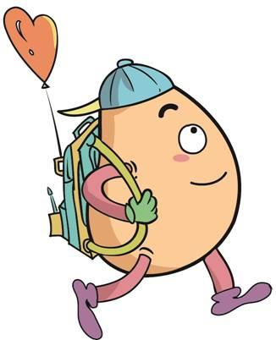






人 教 PEP 版 英 语 五年 级 下 册
Recycle 1
Sarah’s weekend
第一课时

Slide 2

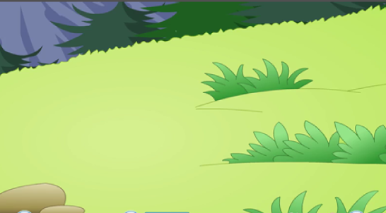
Warm up

Slide 3
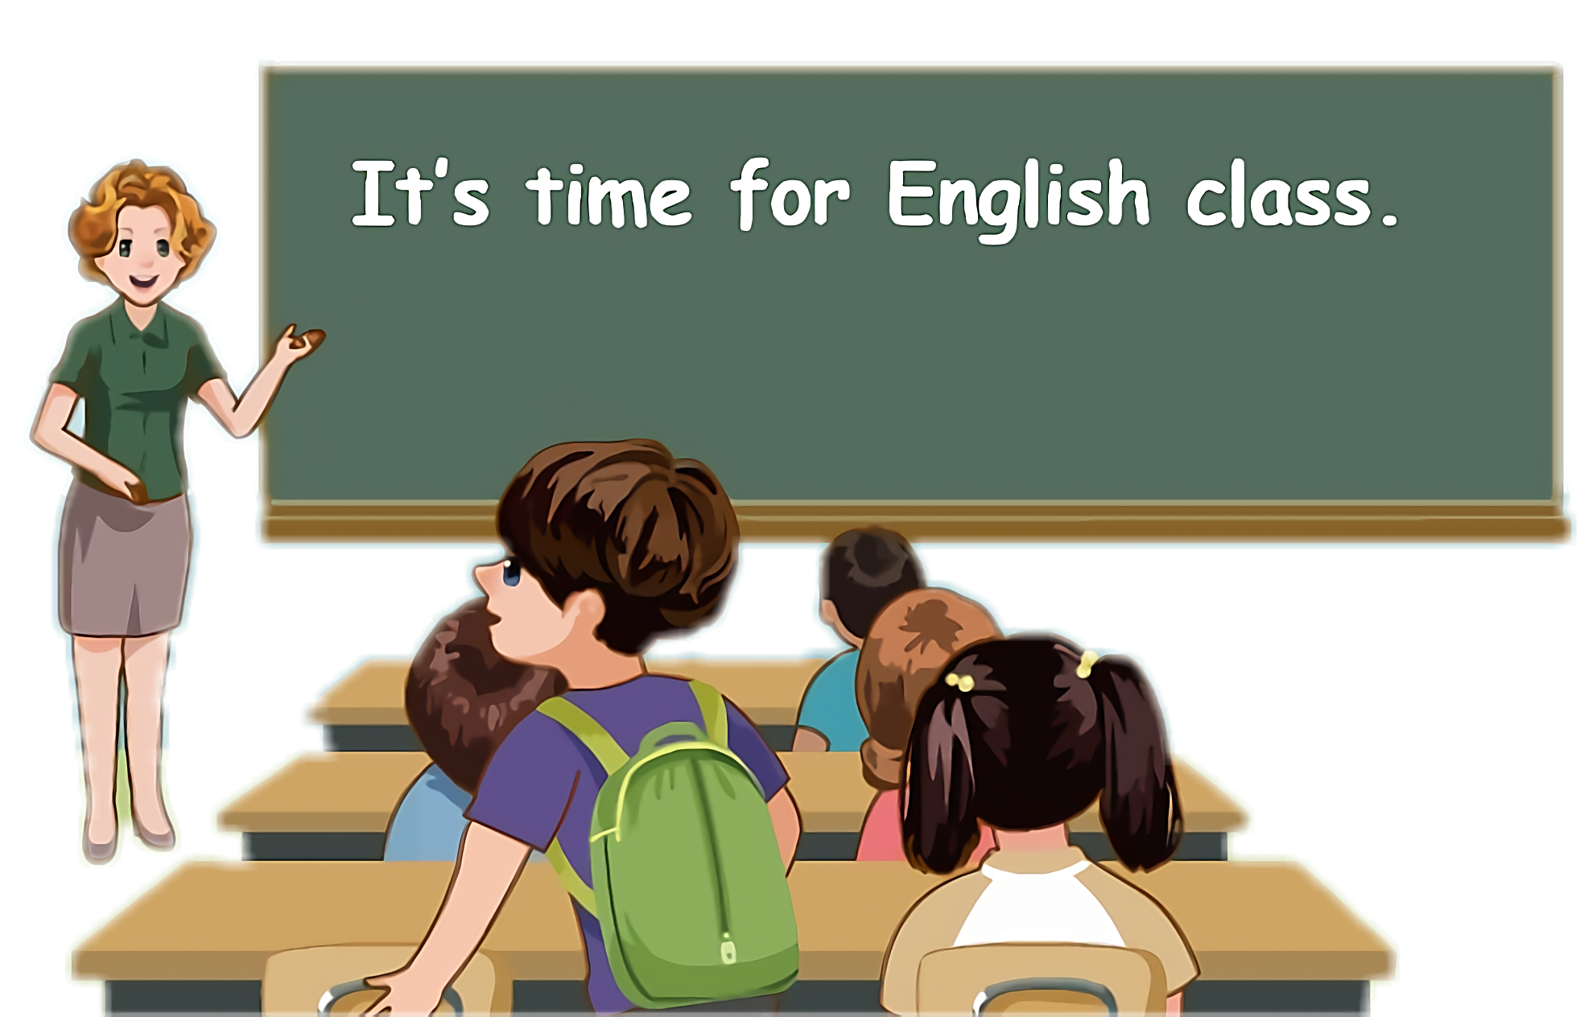
Lead in
Children, what will you do this weekend?
I will...

Slide 4

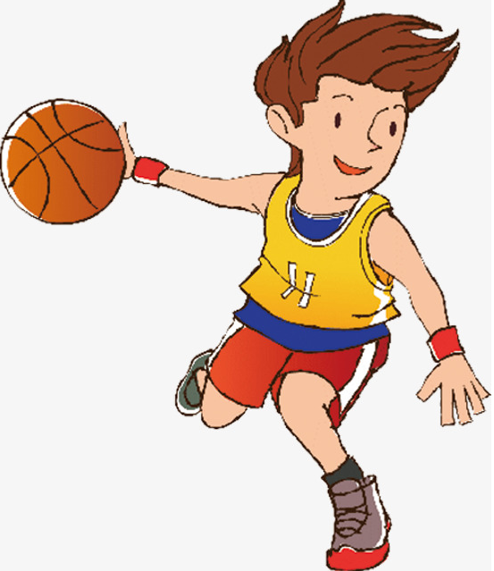
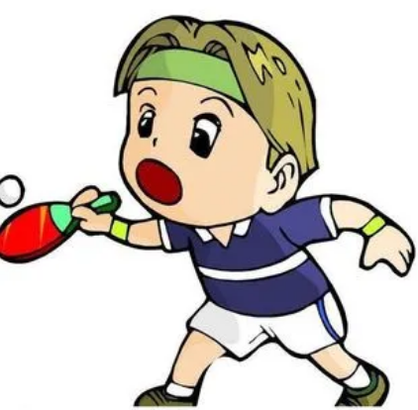
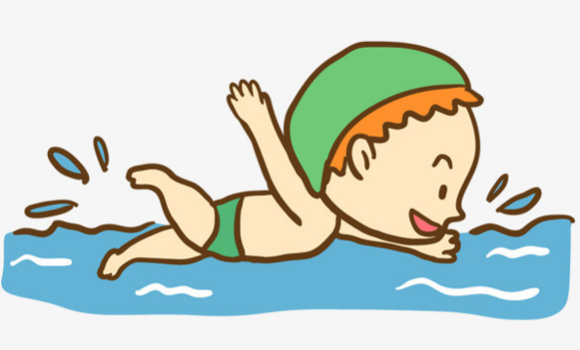
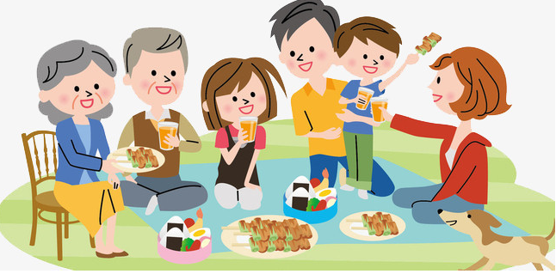
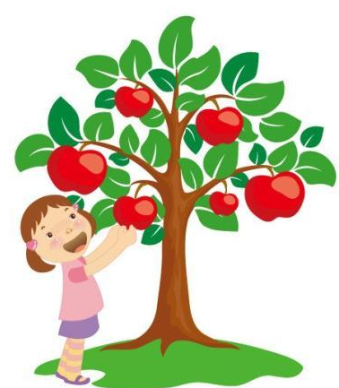
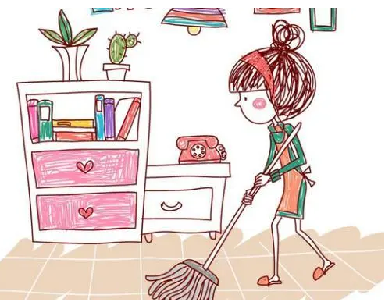
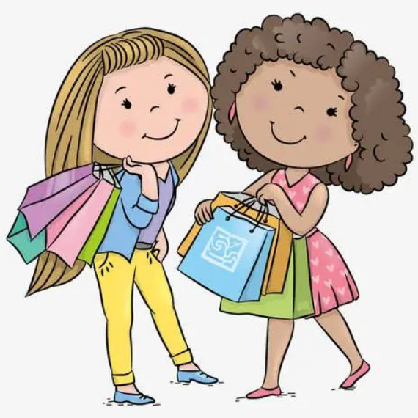
Let’s introduce my weekend.

Slide 5
Presentation
Talk about the weekend.
Talk about Sarah’s weekend.
Talk about Sarah’s father’s timetable.
Talk about Sarah’s mother’s timetable.

Slide 6

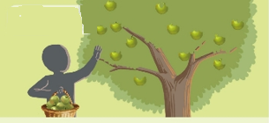

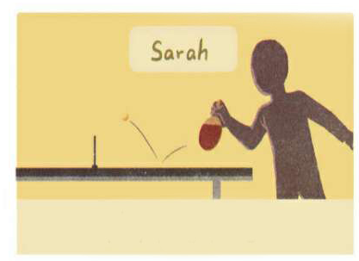
Sarah’s weekend
Look and guess!
What will Sarah do this weekend? Guess!
It’s Saturday morning. Sarah is calling her friends.

Slide 7

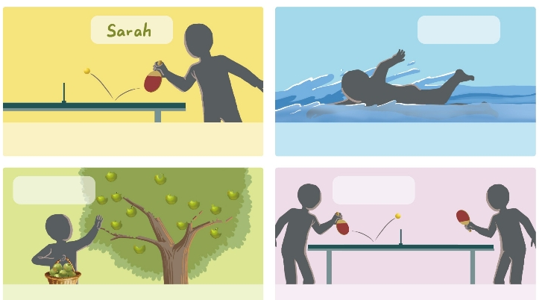
Listen and write the names.
Wu Binbin
play ping-pong
go swimming
Mike
Amy
pick apples
play ping-pong with Sarah

Slide 8
听力材料
1. Mike: Hello.
Sarah: Hi, Mike. This is Sarah.
Mike: Hi, Sarah.
Sarah: I will play ping-pong tomorrow morning. Would
you like to come?
Mike: Sorry. I will pick apples with my grandpa.
Sarah: No problem.

Slide 9
听力材料
2. Sarah: Hi, Wu Binbin ! This is Sarah.
Wu Binbin: Hi!
Sarah: I will play ping-pong tomorrow. Will you come?
Wu Binbin: Sorry. I will go swimming.
Sarah: That’s OK. See you Monday.
Wu Binbin: See you.
3.Amy: Hello!
Sarah: Hi! Amy. This is Sarah. I will play ping-pong tomorrow
morning. Can you come?
Amy: Sure. I am free.
Sarah: Cool！

Slide 10
Fill in the blanks.
1. Mike will ____________ with my grandpa.
2. Wu Binbin will ____________.
3. ______ will play ping-pong with Sarah.
pick apples
go swimming
Amy

Slide 11




Language point.
This is Wu Binbin.
打电话时的自我介绍
句型结构：
This is + 人名(+speaking).
【拓展】电话常用语
(1) 问对方是谁: 汉语里我们习惯说“你是谁?”“你找哪位?”，但是在英文里绝对不能说“Who are you? Who are you looking for?” 而要说“Who is speaking?” 。

Slide 12
Language point.
This is Wu Binbin.
打电话时的自我介绍
(2)介绍自己的时候: 说“我是……”的时候，不能说“I am …” 而要说“This is … speaking.”或“This is …”。
(3)找人的时候: 不能说: “I want to talk to …”，首先要问“Is this … speaking?”要跟别人确认对方是不是你要找的人。
(4)让对方等一等: 打电话时，我们让对方等待一下，不要说“Wait a minute.”，而要说 “Hold on please. ” 或“Don't hang up.” 。

Slide 13
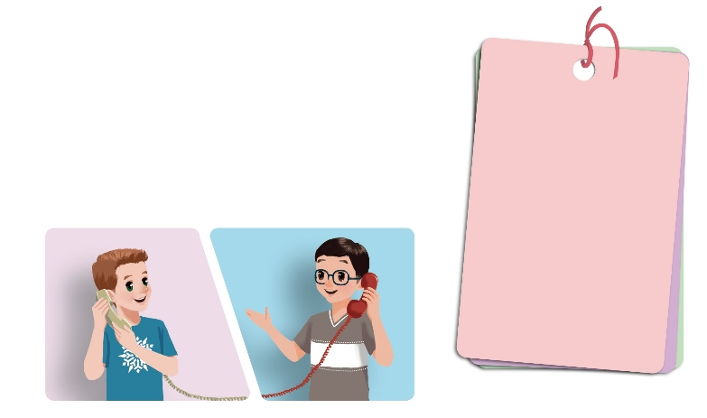
Call your friends and plan your weekend.
Hi, Oliver. This is Wu Binbin. Are you free this ...?
Hello.
go shopping
play basketball
go swimming
go on a picnic
pick apples
...
...

Slide 14
Hi, Oliver. This is Wu Binbin. Are you free this weekend? I want to play basketball. Would you like to come?
Hello.
go shopping
play basketball
go swimming
go on a picnic
pick apples
Sure. I’m free.
Cool!

Slide 15
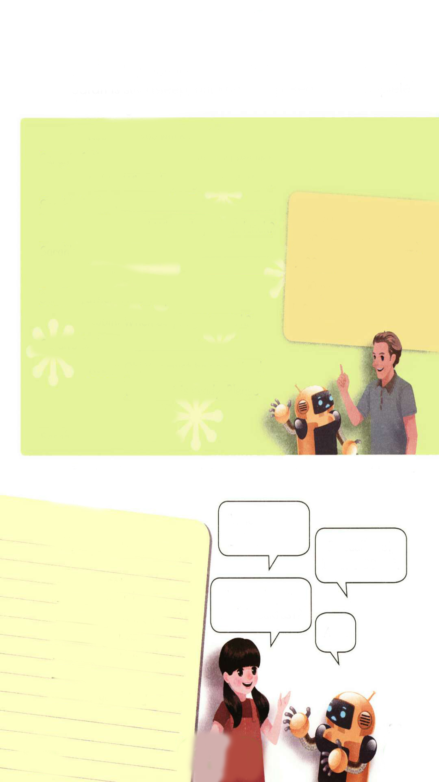
Look and answer.
It’s Sunday morning. Sarah’s father is home after work. Sarah is still asleep, but Robin is up.
6:00 p.m. go to work
8:00 a.m. eat breakfast
9:00 a.m. go to bed
2:00 p.m. eat lunch
5:00 p.m. eat dinner
Who are they?
They are Sarah’s father and Robin.

Slide 16
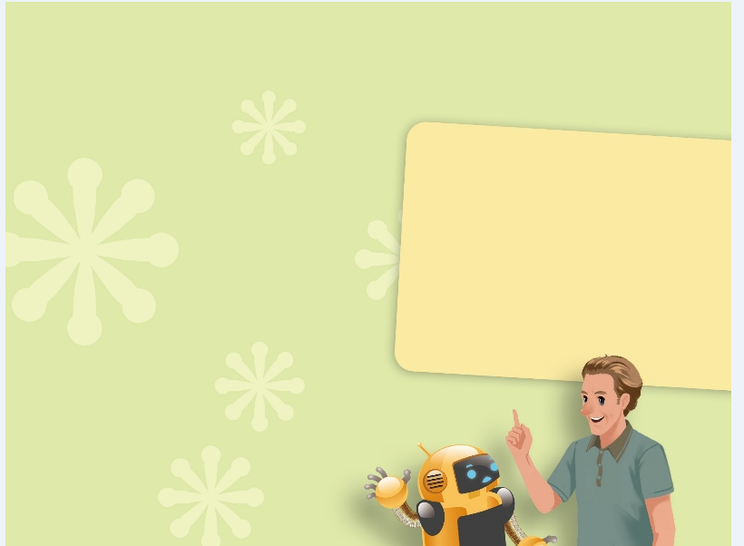
Read and complete the dialogue.
Robin: Do you work at night?
Sarah’s father: Yes, I’m a doctor. I often work at night.
Robin: When do you go to bed then?
Sarah’s father: _______________________.
Robin: Wow! When do you eat lunch?
Sarah’s father: _______________________.
Robin: _______________________.
Sarah’s father: At 5:00 p.m.
Robin: When do you go to work?
Sarah’s father:_______________________.
Robin: Oh! You must be very tired. Breakfast is
ready. Please enjoy it!
Sarah’s father: Thanks.
I go to bed at 9:00 a.m.
6:00 p.m. go to work
8:00 a.m. eat breakfast
9:00 a.m. go to bed
2:00 p.m. eat lunch
5:00 p.m. eat dinner
I eat lunch at 2:00 a.m.
When do you eat dinner?
I go to work at 6:00 p.m.

Slide 17
Read again and understand.
It is Sunday morning. Sarah’s father is home after work. Sarah is still asleep, but Robin is up. Read and complete the dialogue.
星期日早上，萨拉的父亲下班后在家，萨拉还在睡觉，但是罗宾起床了，读并完成对话。
Robin: Do you work at night?你在晚上工作吗？
Sarah’s father: Yes, I’m a doctor. I often work at night.是的，我是一名医生，我经常在晚上工作。
Robin: When do you go to bed then?那么你什么时候上床睡觉？
Sarah’s father: I go to bed at 9:00 a.m. 我在上午九点上床睡觉。
Robin: Wow! When do you eat lunch?哇！你什么时候吃午饭？
Sarah’s father: I eat lunch at 2:00 p.m.我在下午两点吃午饭。
Robin: When do you eat dinner? 你什么时候吃晚饭？
Sarah’s father: At 5:00 p.m.在下午五点。
Robin: When do you go to work?你什么时候去上班？
Sarah’s father:I go to work at 6:00 p.m. 我在下午六点去上班。
Robin: Oh! You must be very tired. Breakfast is ready. Please enjoy it!
哦！你一起很累。早餐做好了，请享用吧！
Sarah’s father: Thanks.谢谢。
6:00 p.m. go to work
8:00 a.m. eat breakfast
9:00 a.m. go to bed
2:00 p.m. eat lunch
5:00 p.m. eat dinner

Slide 18
Read carefully.
在家
It is Sunday morning. Sarah’s father is home after work. Sarah is still asleep, but Robin is up. Read and complete the dialogue.
睡着的adj
在晚上
Robin: Do you work at night?
Sarah’s father: Yes, I’m a doctor. I often work at night.
Robin: When do you go to bed then?
Sarah’s father: I go to bed at 9:00 a.m.
Robin: Wow! When do you eat lunch?
Sarah’s father: I eat lunch at 2:00 p.m.
Robin: When do you eat dinner?
Sarah’s father: At 5:00 p.m.
Robin: When do you go to work?
Sarah’s father:I go to work at 6:00 p.m.
Robin: Oh! You must be very tired. Breakfast is ready. Please enjoy it!
Sarah’s father: Thanks.
询问什么时间在做什么事情
6:00 p.m. go to work
8:00 a.m. eat breakfast
9:00 a.m. go to bed
2:00 p.m. eat lunch
5:00 p.m. eat dinner
准备好了
请享用吧

Slide 19

Read and act.
1.Read it together.
2.Each student
reads a sentence.
Tip: Choose one to read in two. 选择一种两人练习。
3. Read in roles.
自己分配角色。

Slide 20
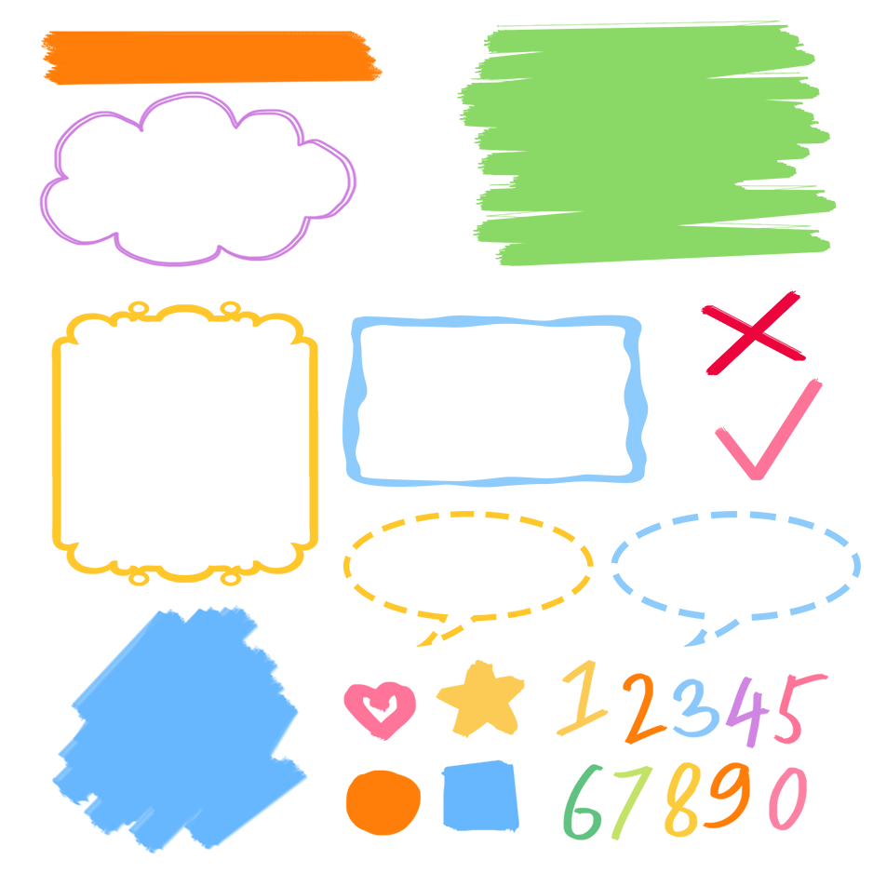
流利地朗读
流利地表演
有感情地表演

Slide 21

Find out your parents’ timetables and role-play with your partner.
When do you get up, Mum?
My ‘s timetable
get up
cook breakfast
go to work
go home
cook dinner
.
go to bed
I usually get up at 6:00 a.m.
When do you cook breakfast?
At …

Slide 22
When do you get up, Mum?
mum
My ‘s timetable
get up
cook breakfast
go to work
go home
cook dinner
.
go to bed
I usually get up at 6:00 a.m.
6:00 a.m.
6:30 a.m.
When do you cook breakfast?
7:30 a.m.
5:00 p.m.
At …
5:30 p.m.
6:00 p.m.
eat dinner
9:00 p.m.

Slide 23

Good to know
A bird in the hand is worth two the bush.
一鸟在手胜似二鸟在林。

Slide 24
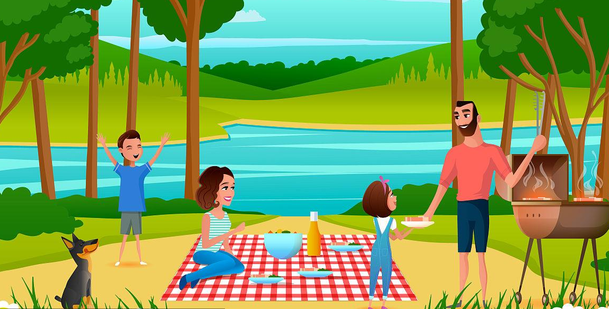
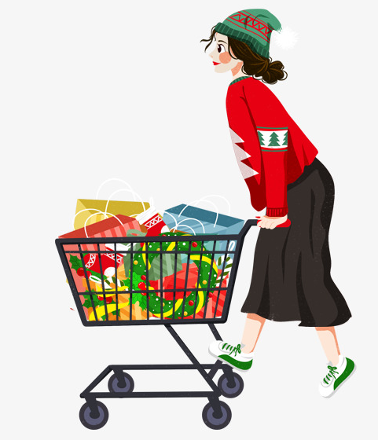
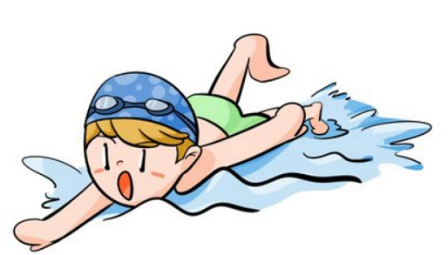
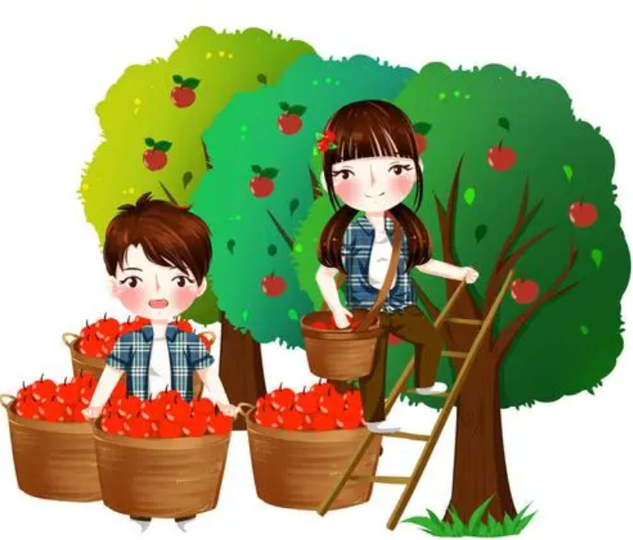
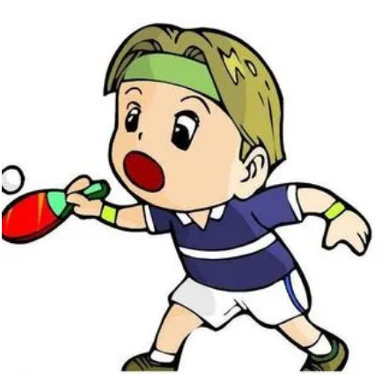
Exercises
一、看图写词组
go on a picnic
go shopping
go swimming
pick apples
play ping-pong

Slide 25
二、为下列句子选择相应的答句。
( )1.Why do you like winter best?
( )2. When do you go to school?
( )3.What’s the weather like in autumn?
( )4. What do you do on the weekend?
( )5. Which season do you like best?
E
C
D
A
B
A.I often go shopping.
B. Summer.
C. I go to school at 8 o’clock.
D. It’s windy and cool.
E. Because I can make a snowman.

Slide 26
三、按照要求完成句子。
1.I often go to school at 7:30 in the morning.(对划线部分提问)
____________________________________
2.weekend, go, this, will, shopping, I (.)(连词成句)
___________________________________
3.I have lunch at school. (对划线部分提问)
_____________________________
When do you often go to school in the morning?
I will go shopping this weekend.
Where do you have lunch?

Slide 27

Summary
1.复习了关于活动、季节、节日等单词和短语。
2.复习了下列句型：
—When do you …?
— I usually...

Slide 28
Homework
ONE
TWO
Act the dialogue out with your friends.
Make a short dialogue using the sentences we have learnt.
Play games in pairs like “Role-play”.

Slide 29







