Slide 1









人 教 PEP 版 英 语 五 年 级 下 册
Recycle 1
Sarah’s weekend
Part one

Slide 2


Warm up
Let’s chant.

Slide 3

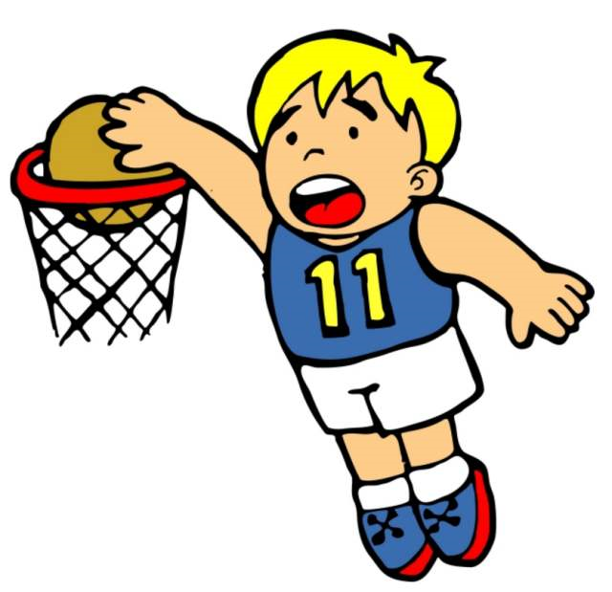
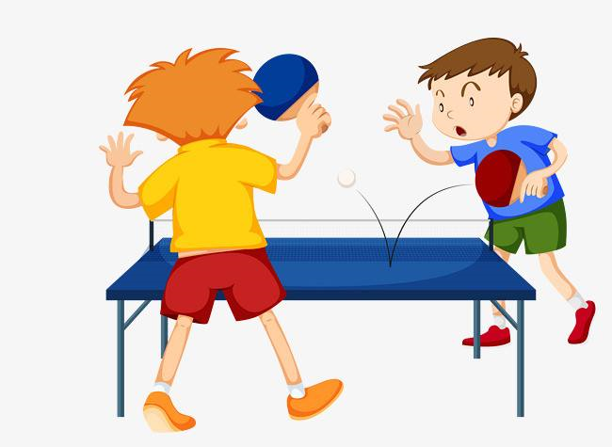


Lead in
What will you do this weekend?
I will ___________.

Slide 4
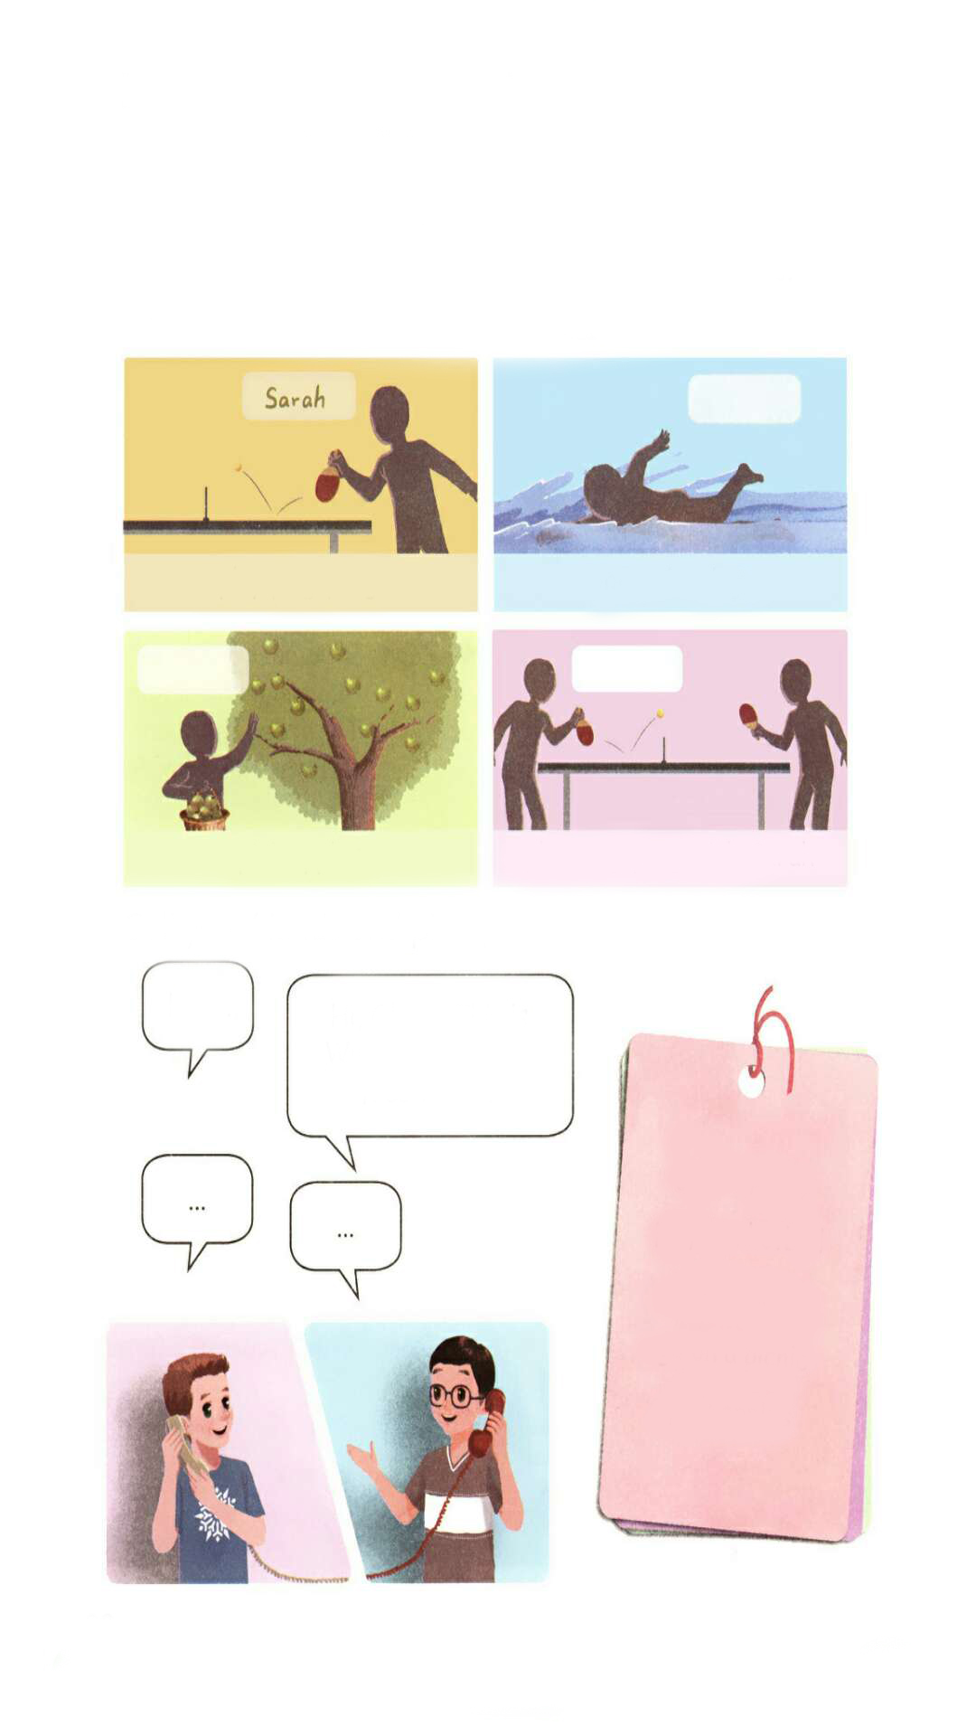
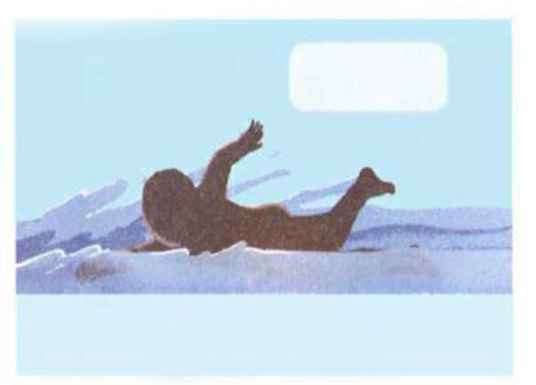
Presentation
Sarah’s weekend
What will Sarah do this weekend? Guess!
It’s Saturday morning. Sarah will play ping-pong. She is calling her friends. But some of them can’t play with her.

Slide 5


Listen and answer the questions.
Who are these friends?
Wu Binbin, Mike and Amy.
In the end who will play ping-pong with Sarah?
Amy.

Slide 6
Listen again and write the names.
Wu Binbin
Mike
Amy

Slide 7
1.Mike:
Sarah:
Mike :
Sarah:
Mike :
Sarah:
Hello.
Hi, Mike. This is Sarah.
Hi, Sarah.
I will play ping-pong tomorrow morning. Would you like to come?
Sorry. I will pick apples with my grandpa.
No problem.

Slide 8
2. Sarah:
Wu Binbin :
Sarah:
Wu Binbin :
Sarah:
Wu Binbin :
3. Amy:
Sarah:
Amy:
Sarah:
Hi, Wu Binbin ! This is Sarah.
Hi!
I will play ping-pong tomorrow. Will you come?
Sorry. I will go swimming.
That’s OK. See you Monday.
See you.
Hello!
Hi! Amy. This is Sarah. I will play ping-pong tomorrow morning. Can you come?
Sure. I am free.
Cool！

Slide 9
Language points
This is Wu Binbin.
【详解】这是打电话时的自我介绍。
句型结构:This is + 人名(+speaking).
【拓展】电话常用语
(1) 问对方是谁: 汉语里我们习惯说“你是谁?”“你找哪位?”，但是在英文里绝对不能说”Who are you? Who are you looking for?”,而要说”Who is speaking?”。

Slide 10
(2)介绍自己的时候: 说“我是……”的时候,不能说”I am …”,而要说“This is … speaking.”或“This is …”。
(3)找人的时候: 不能说: “I want to talk to …”,首先要问“Is this … speaking?”,要跟别人确认对方是不是你要找的人。
(4)让对方等一等: 打电话时,我们让对方等待一下,不要说“Wait a minute.”,而要说 “Hold on please.” 或“Don't hang up.”。

Slide 11
Role-play

Slide 12
Call your friends and plan your weekend.
Hello.
Hi, Oliver. This is Wu Binbin. Are you free this...?
go shopping
play basketball
go swimming
go on a picnic
pick apples

Slide 13
What do you usually do at…?
点击画面 播放视频
6:00 p.m.
8:00 a.m.
9:00 a.m.
2:00 p.m.
5:00 p.m.

Slide 14
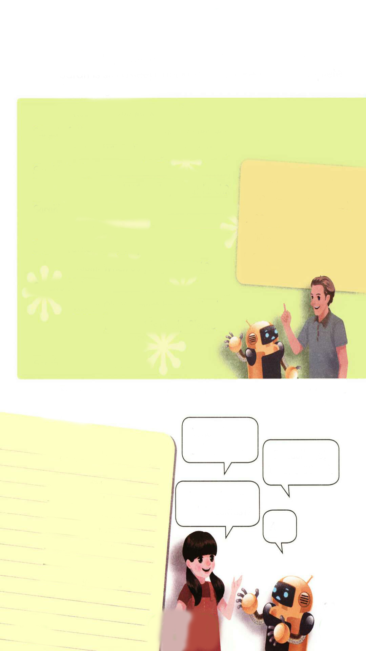
点击画面 播放视频
Who are they?
They are Sarah’s father and Robin.
6:00 p.m. go to work
8:00 a.m. eat breakfast
9:00 a.m. go to bed
2:00 p.m. eat lunch
5:00 p.m. eat dinner
It’s Sunday morning. Sarah’s father is home after work. Sarah is still asleep, but Robin is up.

Slide 15
Read and complete the dialogue.
点击画面 播放视频
Robin:
Sarah’s father:
Robin:
Sarah’s father:
Robin:
Sarah’s father:
Robin:
Sarah’s father:
Robin:
Sarah’s father:
Robin:
Sarah’s father:
Do you work at night?
Yes, I’m a doctor. I often work at night.
When do you go to bed, then?
.
Wow! When do you eat lunch?
.
?
At 5:00 p.m.
When do you go to work?
.
Oh! You must be very tired.
Breakfast is read. Please enjoy it!
Thanks.
I go to bed at 9:00 a.m.
6:00 p.m. go to work
8:00 a.m. eat breakfast
9:00 a.m. go to bed
2:00 p.m. eat lunch
5:00 p.m. eat dinner
I eat lunch at 2:00 p.m.
When do you eat dinner?
I go to work at 6:00 p.m.

Slide 16
Language points
Sarah is still asleep, but Robin is up.
【详解】在这个句子里but是连词,连接两个句子,表示转折。
句型结构: A is …, but B is….
e.g. Milk is good, but orange juice is my favourite.

Slide 17

Practice
Find out your parents’ timetables and role-play with your partner.
When do you get up, Mum?
My ‘s timetable
get up
cook breakfast
go to work
go home
cook dinner
.
go to bed
I usually get up at 6:00 a.m.
When do you cook breakfast?
At …

Slide 18

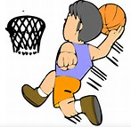



Exercises
一、看图写词组。
play basketball
go on a picnic
pick apples
go shopping
go swimming

Slide 19
二、时间活动对对碰。
1. 6:00 a.m. A. go home
2. 7:00 a.m. B. go to school
3. 9:00 a.m. C. do morning exercise
4. 1:30 p.m. D.eat breakfast
5. 5:00 p.m. E. have a class

Slide 20
三、连词成句。
1. school, go, do, when , to, you (?)
__________________________________________
2. 6:00 a.m. , usually, I, exercise, do, at, morning (.)
__________________________________________
3. ping-pong, play, Sarah, with, I (.)
___________________________________________
When do you go to school?
I usually do morning exercise at 6:00 a.m.
I play ping-pong with Sarah.

Slide 21
17:00 及以后2小时匈牙利、奥地利、瑞典、克罗地亚、捷克、德国、瑞士、荷兰、比利时、阿尔及利亚、尼日利亚、法国、西班牙
18:00 及以后2小时英国、爱尔兰、摩洛哥、葡萄牙、冰岛
21:00 及以后2小时巴西、乌拉圭、阿根廷等南美地区以及加拿大东部圣约翰斯地区。
22:00 及以后2小时巴拉圭、智利、委内瑞拉、多米尼加、玻利维亚、波多黎各等南美国家。
23:00 及以后2小时哥伦比亚、牙买加、秘鲁、古巴、加拿大的渥太华地区附近以及美国最东部地区，如波士顿、纽约。
0:00 及以后2小时尼加拉瓜、危地马拉、美国中部区、墨西哥、加拿大的温尼伯地区。

Slide 22


Summary
复习了下列短语：
play ping-pong go swimming pick apples go on a picnic play basketball等。
2.复习了下列句型：
—When do you …?
— I usually...
七彩课堂
伴你成长

Slide 23

Homework
ONE
TWO
Act the dialogue out with your friends.
Make a short dialogue using the sentences we have learnt.
七彩课堂
伴你成长
Play games in pairs like “Role-play”.

Slide 24








